Slide 1
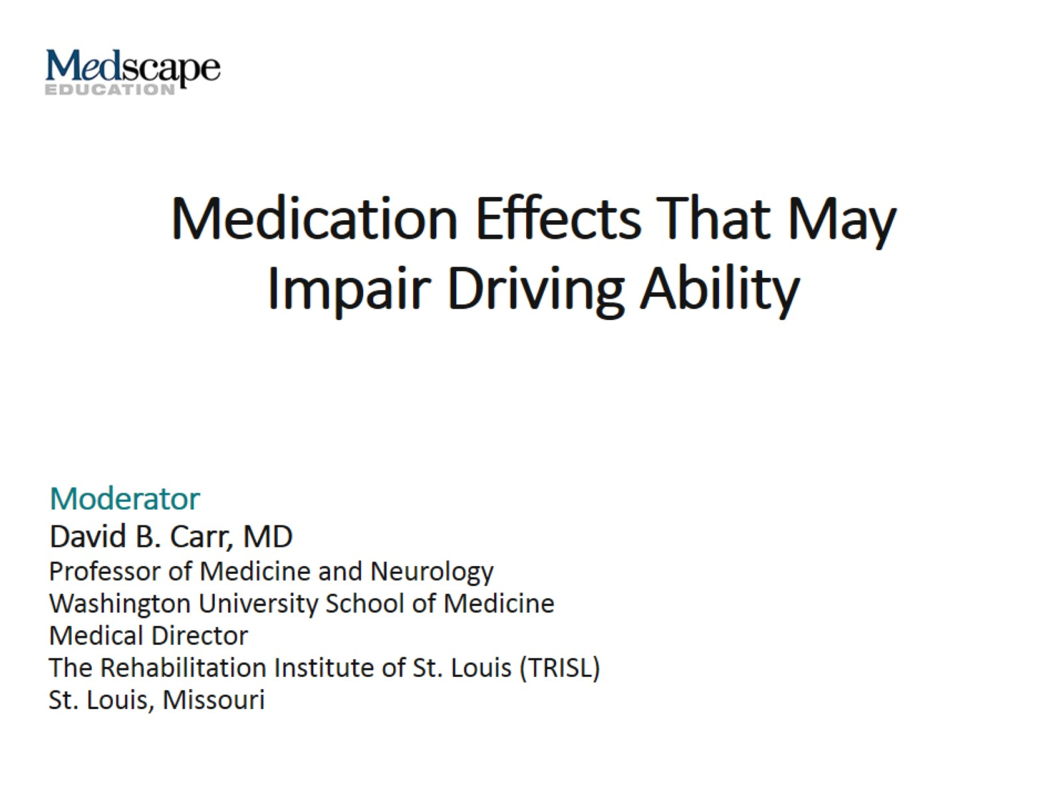
Medication Effects That May Impair Driving Ability

Slide 2
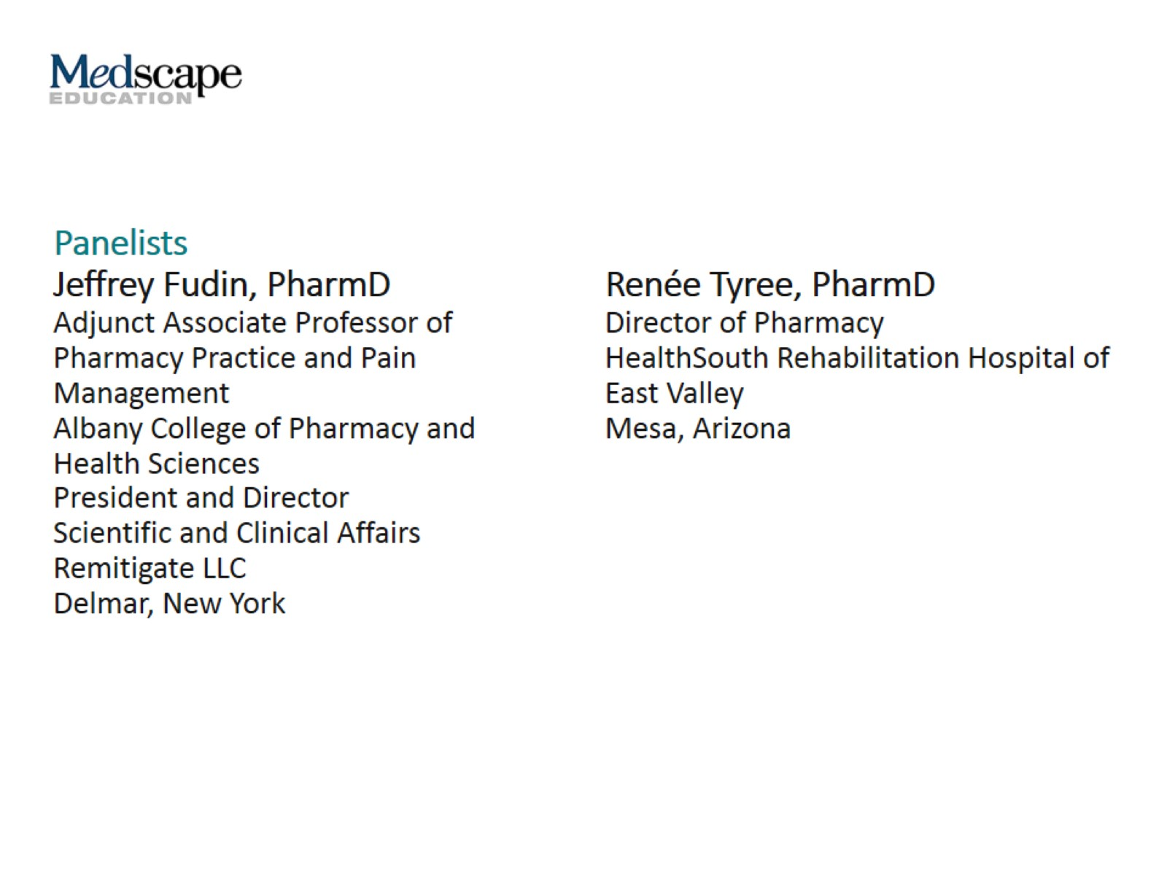

Slide 3
Introduction

Slide 4
Scope of the Problem

Slide 5
National Roadside Survey Results

Slide 6
PDI Medications

Slide 7
PDI Medications (cont)

Slide 8
Drug-Related AEs

Slide 9
Benzodiazepines and Hypnotics

Slide 10
Melatonin vs Zolpidem

Slide 11
NSAIDs

Slide 12
Teens/Young Adults and Prescription Drugs

Slide 13
Opioid Use in the Opioid-Naïve

Slide 14
Tramadol and Buprenorphine

Slide 15
Opioids for Acute Pain

Slide 16
Chronic Use: Opioid-Tolerant Patients

Slide 17
Precautions While Building Opioid Tolerance

Slide 18
AEs of OTC Antihistamines/Cough Medications

Slide 19
Other OTC Medication Concerns

Slide 20
Driving Effects and BAC Level

Slide 21
Alcohol-Medication Interactions

Slide 22
Cocaine and Other Drugs

Slide 23
Ecstasy and Amphetamines

Slide 24
Marijuana

Slide 25
DUI Among Young Drivers

Slide 26
Drug Combinations/Polypharmacy

Slide 27
Patient Counseling and Education

Slide 28
Pharmacist Counseling

Slide 29
Primary Care Provider Recommendations

Slide 30
Risk Reduction Strategies

Slide 31
Additional Resources

Slide 32
Conclusions

Slide 33
Conclusions (cont)

Slide 34
Abbreviations

