Slide 1
The Resurgence of Topical Treatments Across a Spectrum of Psoriasis

Slide 2
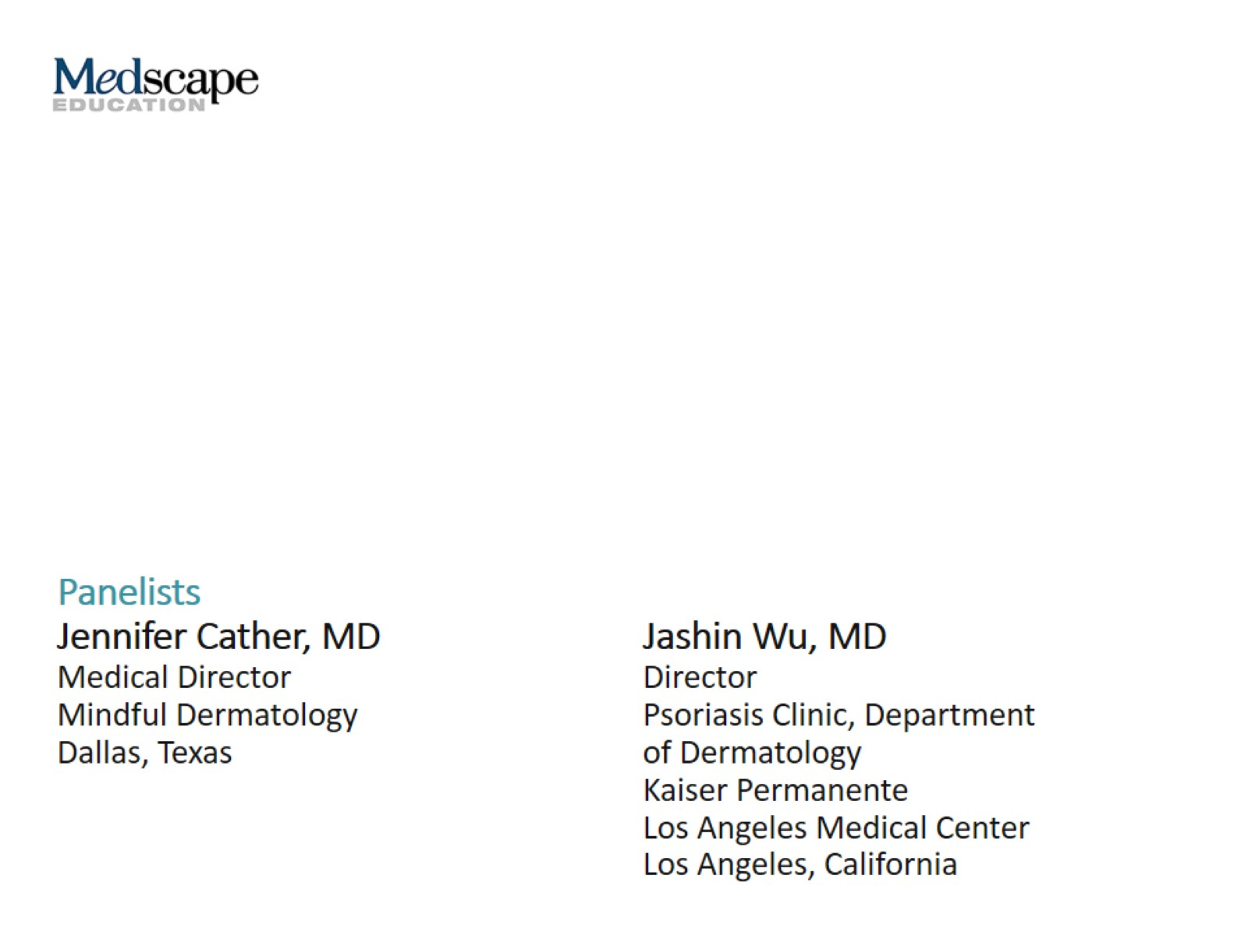

Slide 3
This program will include a discussion of off-label treatment and investigational agents not approved by the FDA for use in the United States and data that were presented in abstract form. These data should be considered preliminary until published in a peer-reviewed journal.

Slide 4
Topical Therapies for Treatment of Psoriasis

Slide 5
Case 1 Chris

Slide 6
How to Address Adherence Issues

Slide 7
Possible Topical Treatment Options

Slide 8
Choosing the Right TCS for the Right Patient

Slide 9
The Challenge of Potent TCS

Slide 10
The Challenge of Potent TCS (cont)

Slide 11
Vitamin D Analogues

Slide 12
Topical Retinoids

Slide 13
Combination Medication for Mild-to-Moderate Psoriasis

Slide 14
Calcipotriene + TCS Fixed-Combination Trial

Slide 15
Calcipotriene + TCS Combination

Slide 16
TAZ + TCS Combination

Slide 17
Case 2 Eduardo

Slide 18
Treatment Options for Genital Psoriasis

Slide 19
Case 3 Maria

Slide 20
What Patients Can Expect

Slide 21
Management Strategy for Facial Psoriasis

Slide 22
Concerns With Treatment During Pregnancy

Slide 23
Emerging Therapies HP + TAZ

Slide 24
Emerging Therapies HP + TAZ (cont)

Slide 25
Emerging Therapies Tapinarof

Slide 26
Concluding Remarks

Slide 27
Abbreviations

