Slide 1
Medical Factors Affecting Older Driver Safety

Slide 2
Introduction Topics to Be Covered

Slide 3
Age Is Not the Most Important Factor

Slide 4
Understand What Driving Means to Patients

Slide 5
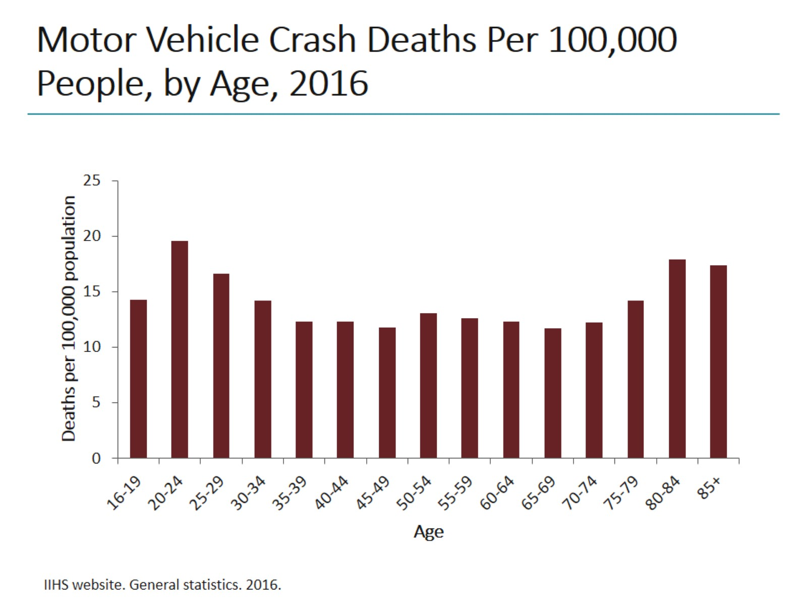
Motor Vehicle Crash Deaths Per 100,000 People, by Age, 2016

Slide 6
Balance Medical Conditions With Safe Driving

Slide 7
Polypharmacy Can Cause Iatrogenic Damage

Slide 8
Assessment of Driver Safety Must Be Ongoing

Slide 9
Case 1 Sheila

Slide 10
Psychiatric Disorders and Driver Safety

Slide 11
Neurologic Factors Can Influence Driver Safety

Slide 12
Cognitive and Neurologic Assessment of Driver Safety

Slide 13
Anxiety and Sleepiness Have Different Effects

Slide 14
Consider Potential Musculoskeletal Effects on Motor Function

Slide 15
Case 2 Bob

Slide 16
Cardiovascular Concerns and Driver Safety

Slide 17
Case 3 José

Slide 18
Metabolic Disorders and Diabetes Can Increase Driver Risk

Slide 19
Consider Vision and Hearing Loss Effects on Driver Safety

Slide 20
Consider Respiratory and Related Sleep Disorders

Slide 21
Other Conditions to Consider

Slide 22
Strategies to Mitigate Risk Planning Ahead

Slide 23
Strategies to Mitigate Risk Medical Treatment

Slide 24
Strategies to Mitigate Risk Compensation and Modification

Slide 25
Strategies for Recommending Driving Cessation

Slide 26
Additional Resources

Slide 27
Concluding Remarks

Slide 28
Abbreviations

