Slide 1
Statins and HIV:

Slide 2
Understanding the Changing CV Risk Burden in HIV Infection

Slide 3
Reasons for Increased ASCVD Risk in HIV Infection

Slide 4
Lipid Changes in HIV-Infected Individuals

Slide 5
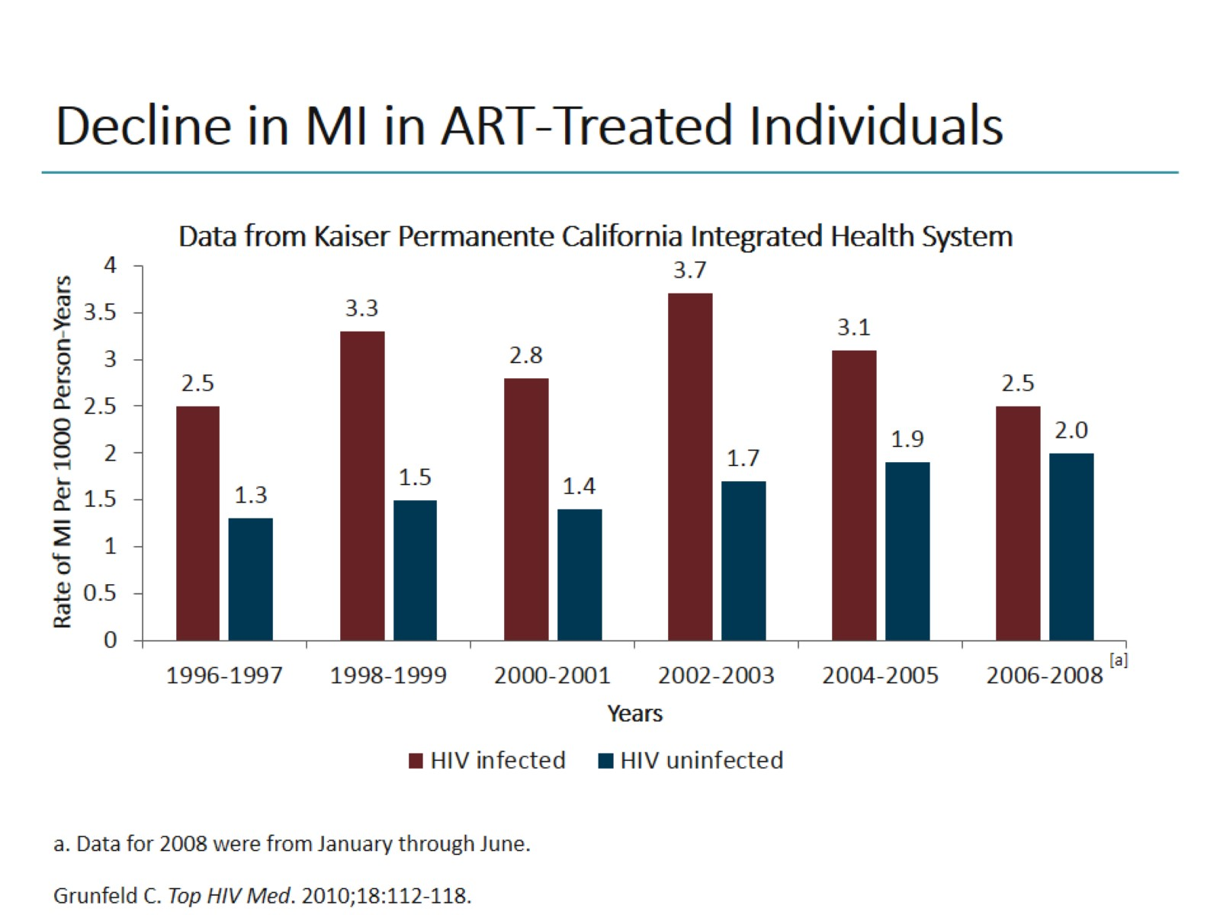
Decline in MI in ART-Treated Individuals

Slide 6
SMART: Episodic vs Continuous ART

Slide 7
Assessment of CV Risk for Primary Prevention in HIV-Infected Individuals

Slide 8
Match Lipid Treatment to Level of Risk: Per NLA, Count Risk Factors, Add HIV as Additional Factor

Slide 9
ACC/AHA Lifestyle as the Foundation for ASCVD Risk-Reduction Efforts

Slide 10
Drug-Drug Interactions: Use of Statins With PIs

Slide 11
JUPITER: CV Benefits and Diabetes Risk

Slide 12
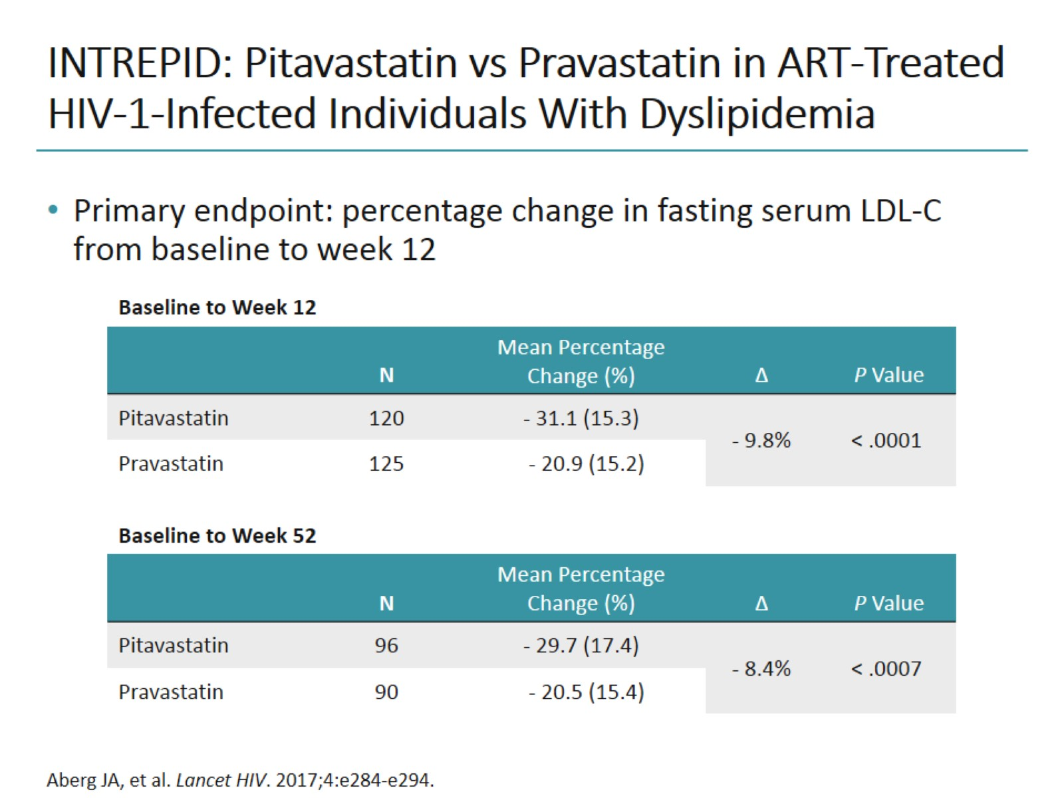
INTREPID: Pitavastatin vs Pravastatin in ART-Treated HIV-1-Infected Individuals With Dyslipidemia

Slide 13
INTREPID: Markers of Immune Activation and Arterial Inflammation

Slide 14
REPRIEVE: CV Outcomes Trial

Slide 15
Disparities in CV Care in the United States: HIV-Infected vs HIV-Uninfected Adults With CV Risk Factors

Slide 16
Challenges Associated With Statin Therapy in HIV-Infected Population

Slide 17
Other Anti-Inflammatory Strategies for HIV-Infected Individuals

Slide 18
Statin Therapy Considerations in HIV-Infected Individuals

Slide 19
Association Between LDL-C Lowering and CV Risk Reduction: Systematic Review and Meta-Analysis

Slide 20
Team-Based Care

Slide 21
Summary

Slide 22
Abbreviations

Slide 23
Abbreviations (cont)

