Slide 1
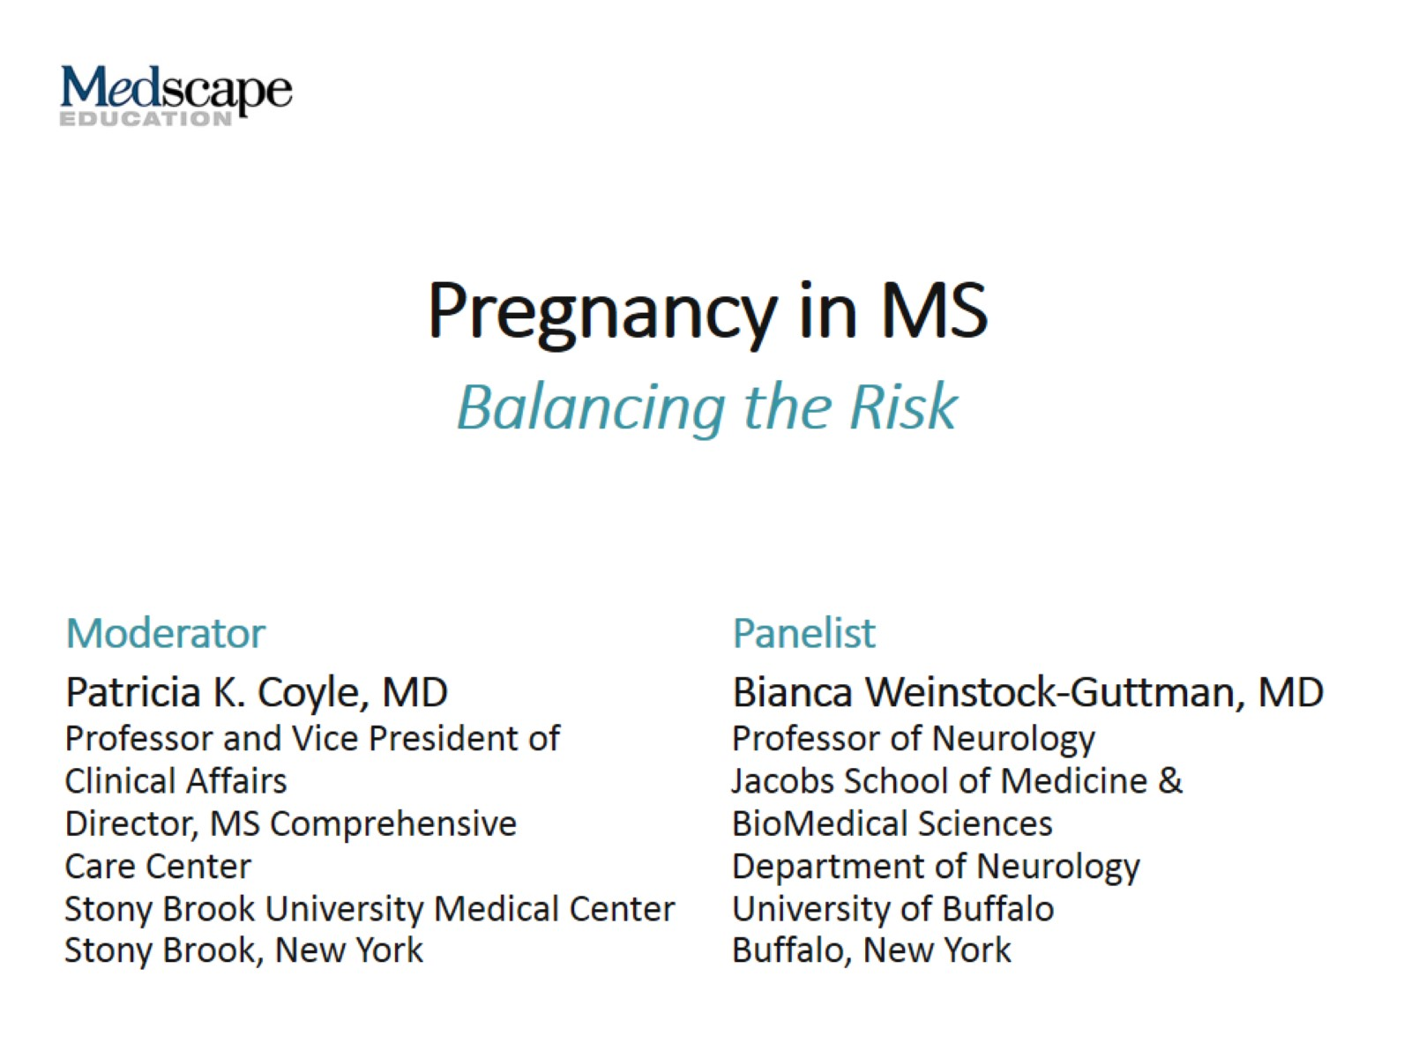
Pregnancy in MS

Slide 2
This program will include a discussion of off-label treatment and investigational agents not approved by the FDA for use in the US.

Slide 3
MS and Pregnancy: Pregnancy Is Not a Negative Prognostic Indicator

Slide 4
When Should DMTs Be Started in a Young Treatment-Naive Woman Who Wants to Become Pregnant?

Slide 5
Primary Progressive MS

Slide 6
MS ≠ High-Risk Pregnancy

Slide 7
Treating Relapse During Pregnancy

Slide 8
Is DMT Washout Necessary Before Considering Conception?

Slide 9
DMT Use During Pregnancy

Slide 10
Covering Medication Gaps: Bridging Strategies

Slide 11
Long-Lasting Induction Therapies: Pregnancy Planning

Slide 12
Abbreviations

