Slide 1
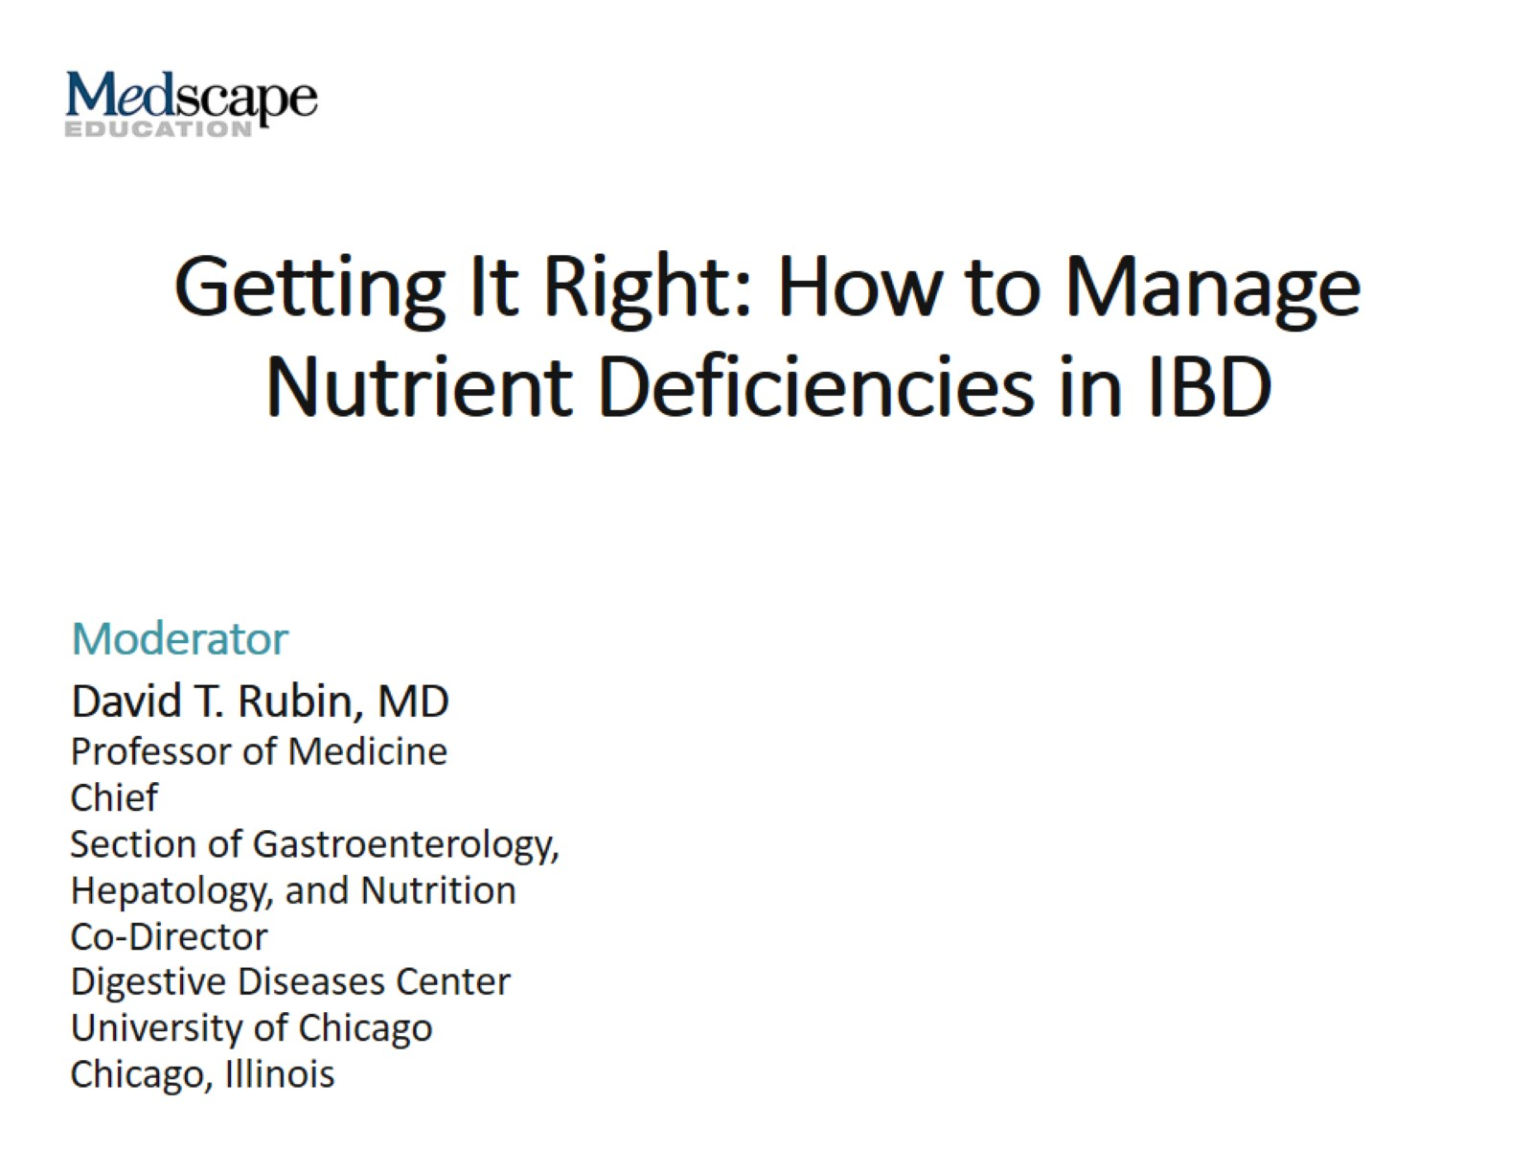
Getting It Right: How to Manage Nutrient Deficiencies in IBD

Slide 2
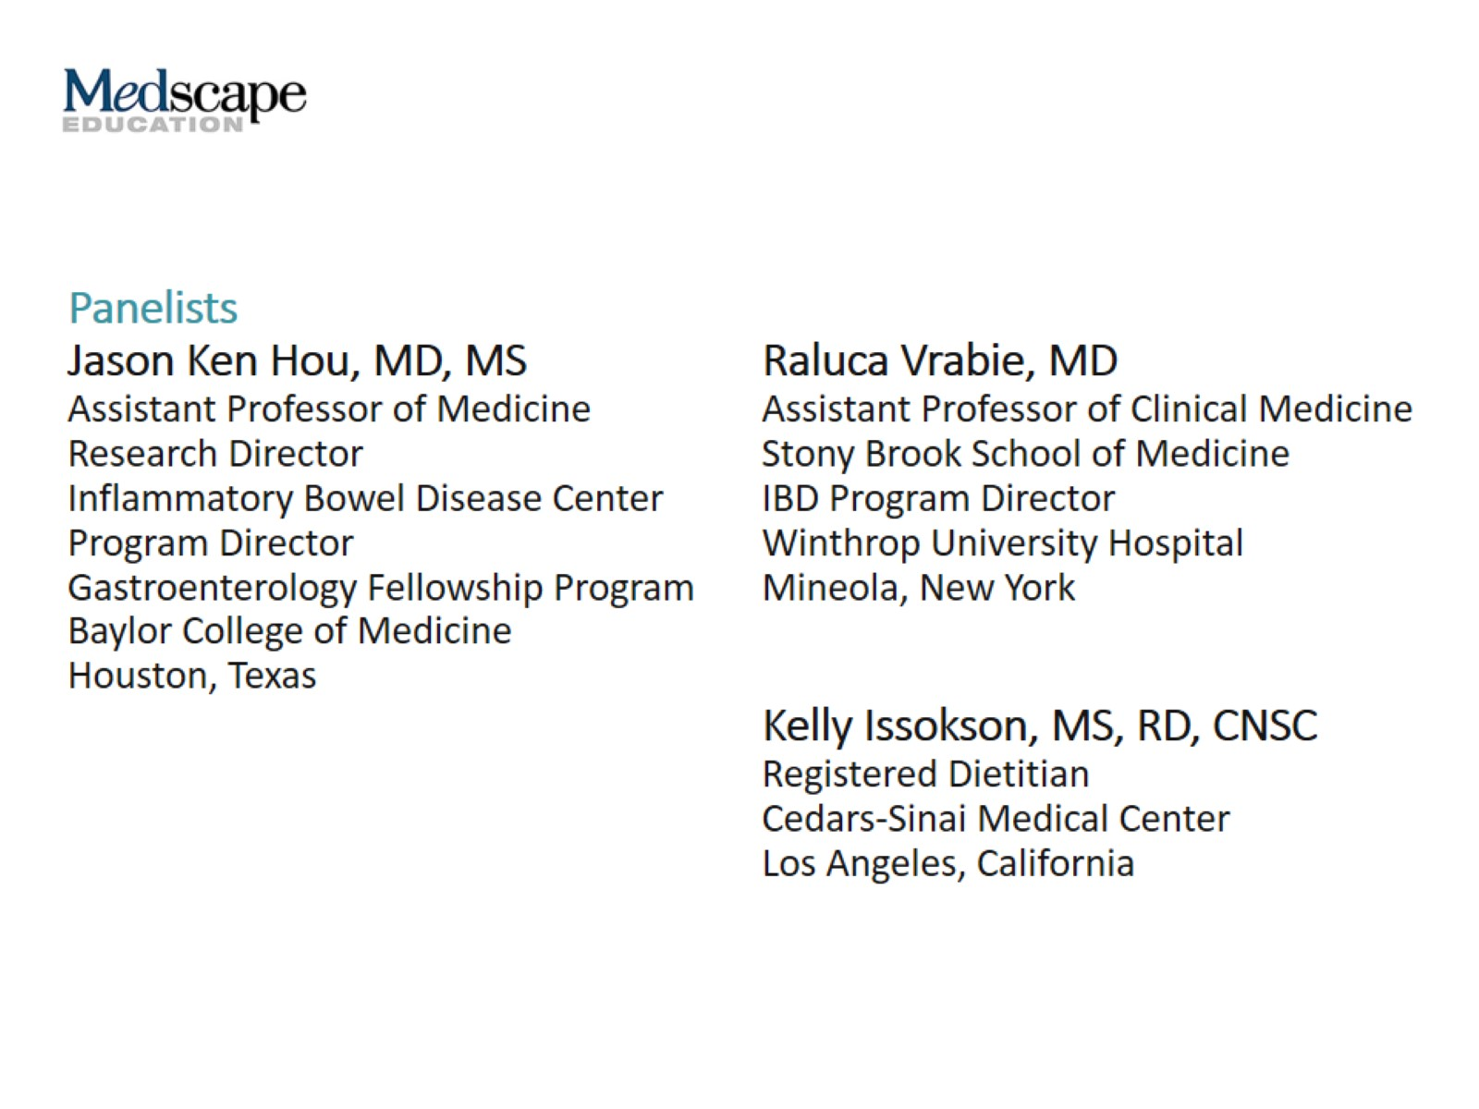

Slide 3
Micronutrient Deficiencies in IBD

Slide 4
Vitamin and Micronutrient Monitoring in IBD

Slide 5
Frequency of Monitoring

Slide 6
Burden of Micronutrient Deficiency

Slide 7
IDA

Slide 8
Case: 24-Year-Old Woman With CD

Slide 9
Case: 24-Year-Old Woman With CD Physical Examination

Slide 10
Case: 24-Year-Old Woman With CD Laboratory Results

Slide 11
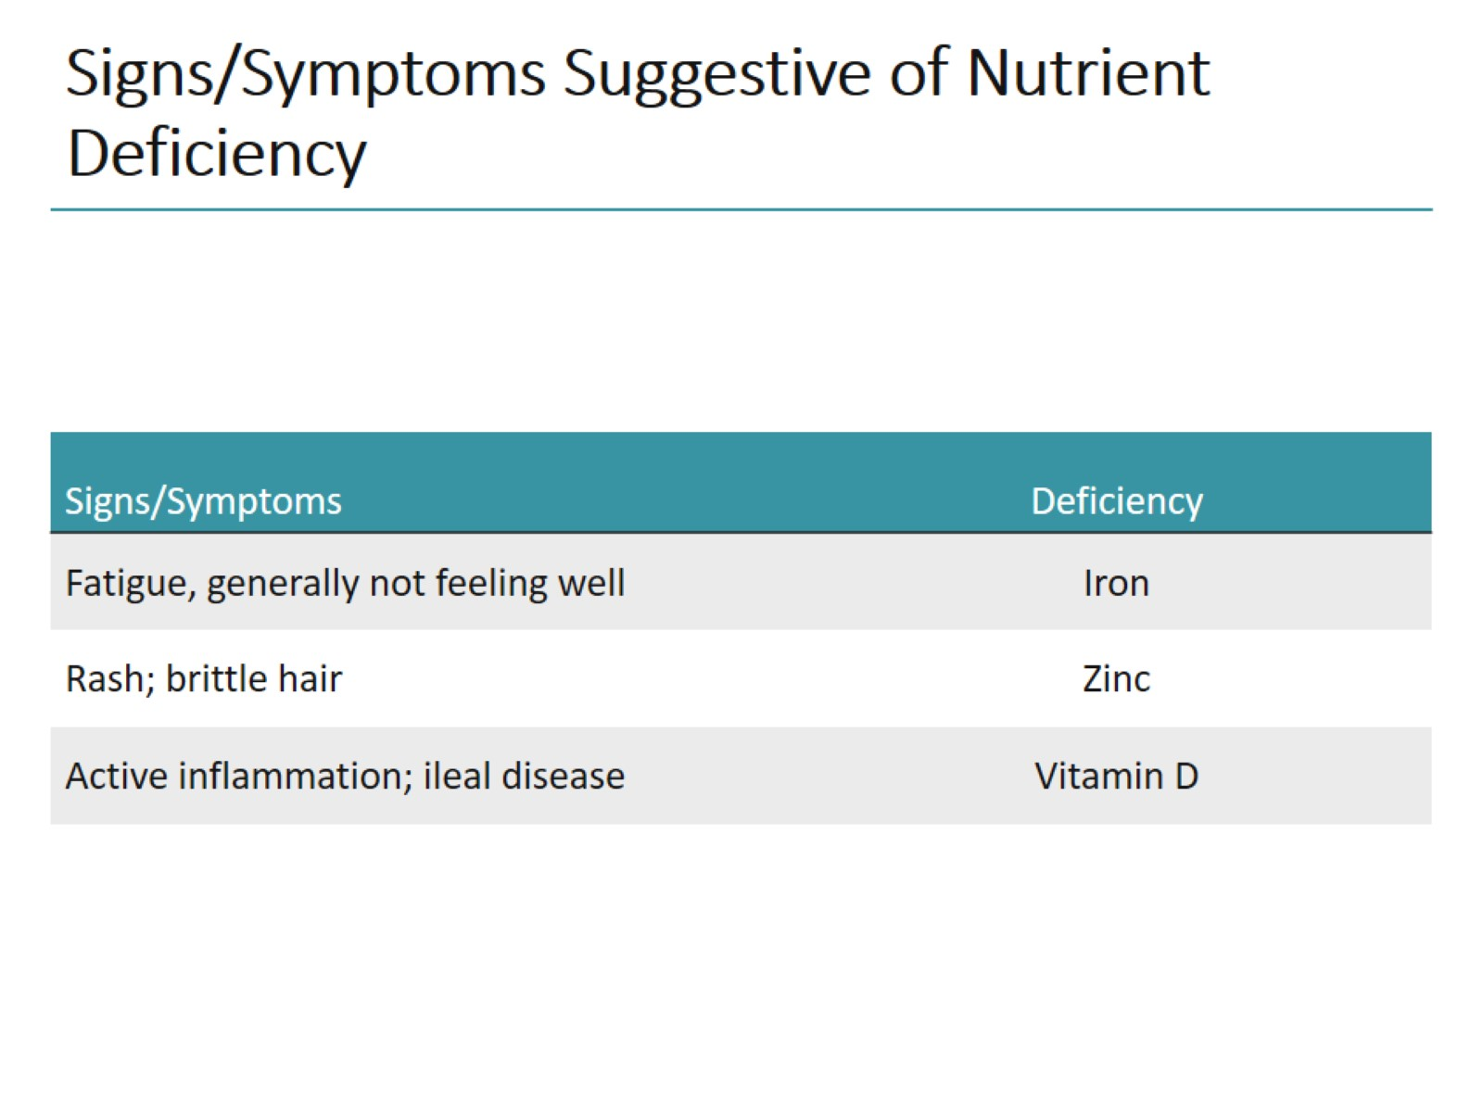
Signs/Symptoms Suggestive of Nutrient Deficiency

Slide 12
Typical Symptoms of IDA

Slide 13
Causes of Iron Deficiency in IBD

Slide 14
Screening for Iron Deficiency ECCO Guidelines

Slide 15
WHO Criteria for Anemia

Slide 16
Anemia Workup ECCO Guidelines

Slide 17
Diagnostic Criteria for Iron Deficiency ECCO Guidelines

Slide 18
Pathophysiology of Anemia in IBD

Slide 19
Dietary Sources of Iron

Slide 20
Treatment of IDA ECCO Guidelines

Slide 21
Oral Iron Supplements Pros/Cons

Slide 22
Treatment Response and Follow-Up Monitoring ECCO Guidelines

Slide 23
IV Iron Supplementation ECCO Guidelines

Slide 24
IV Iron Supplements Pros/Cons

Slide 25
IV Iron Formulations

Slide 26
Systematic Review and Bayesian Network Meta-Analysis

Slide 27
Provider-Reported Barriers to Anemia Treatment

Slide 28
Adverse Reactions After IV Iron Infusion US Commercial Claims Database Study

Slide 29
Hypophosphatemia

Slide 30
Gray Areas in the Management of Micronutrient Deficiency

Slide 31
Team-Based Care

Slide 32
Abbreviations

Slide 33
Abbreviations (cont)

