Slide 1
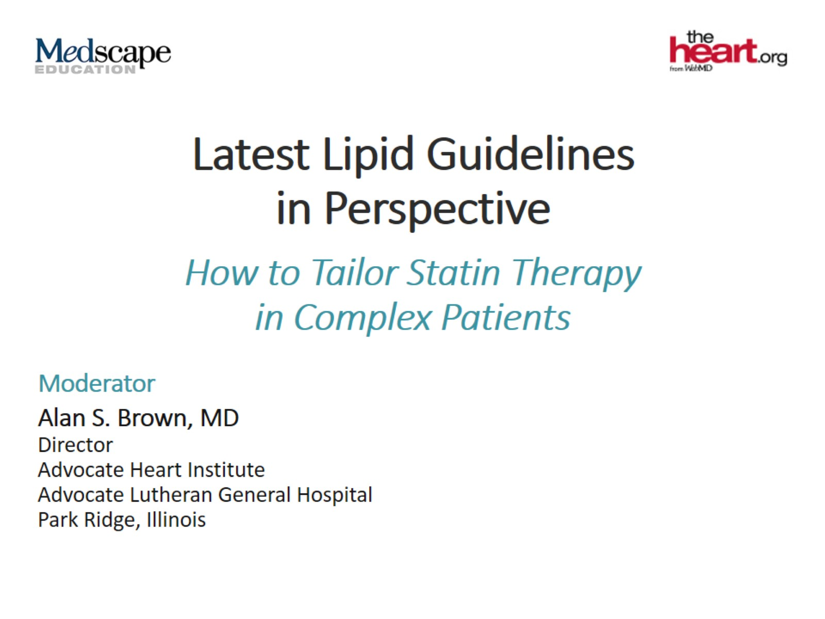
Latest Lipid Guidelines in Perspective

Slide 2


Slide 3
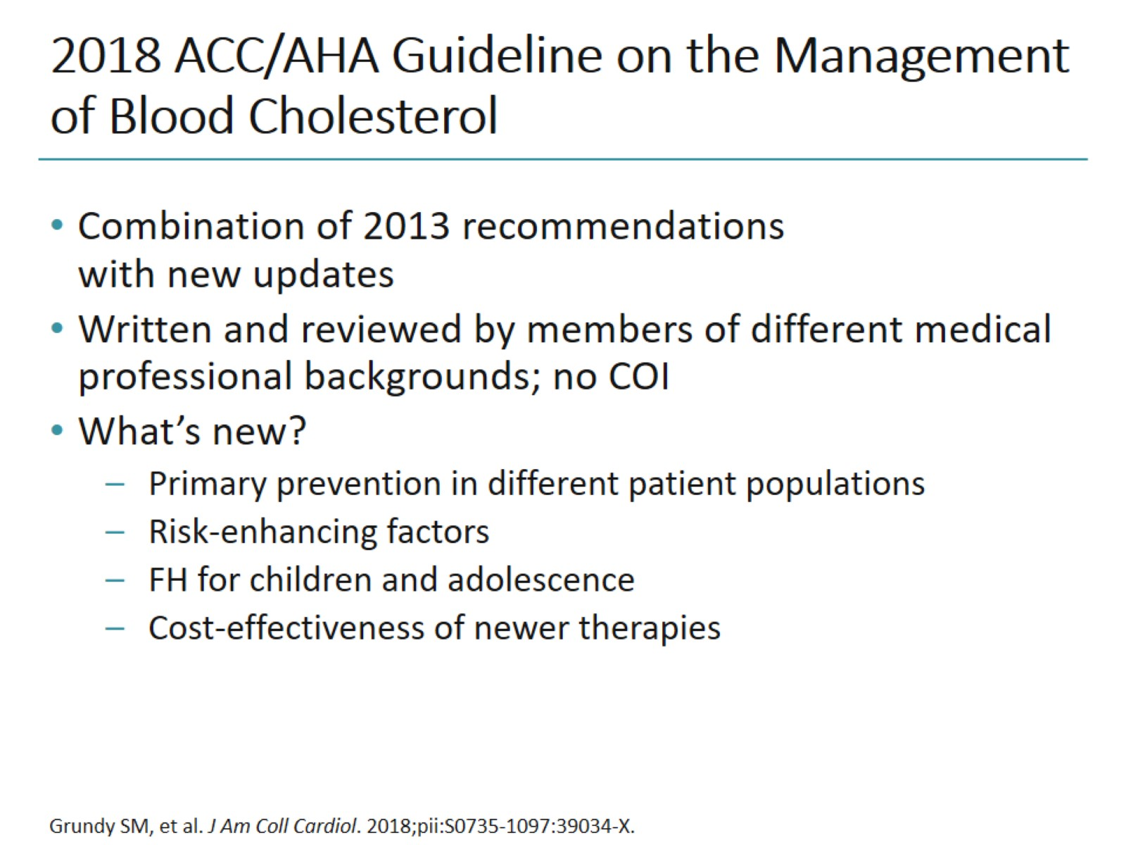
2018 ACC/AHA Guideline on the Management of Blood Cholesterol

Slide 4
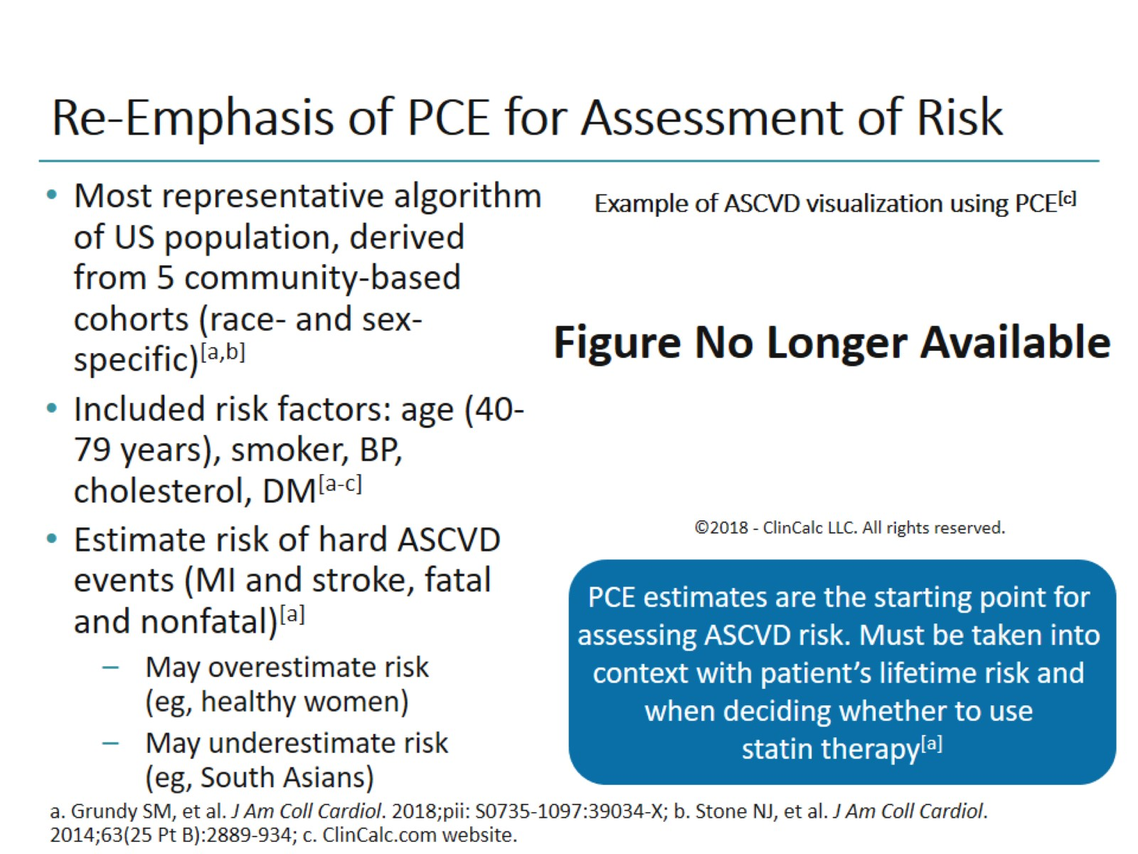
Re-Emphasis of PCE for Assessment of Risk

Slide 5
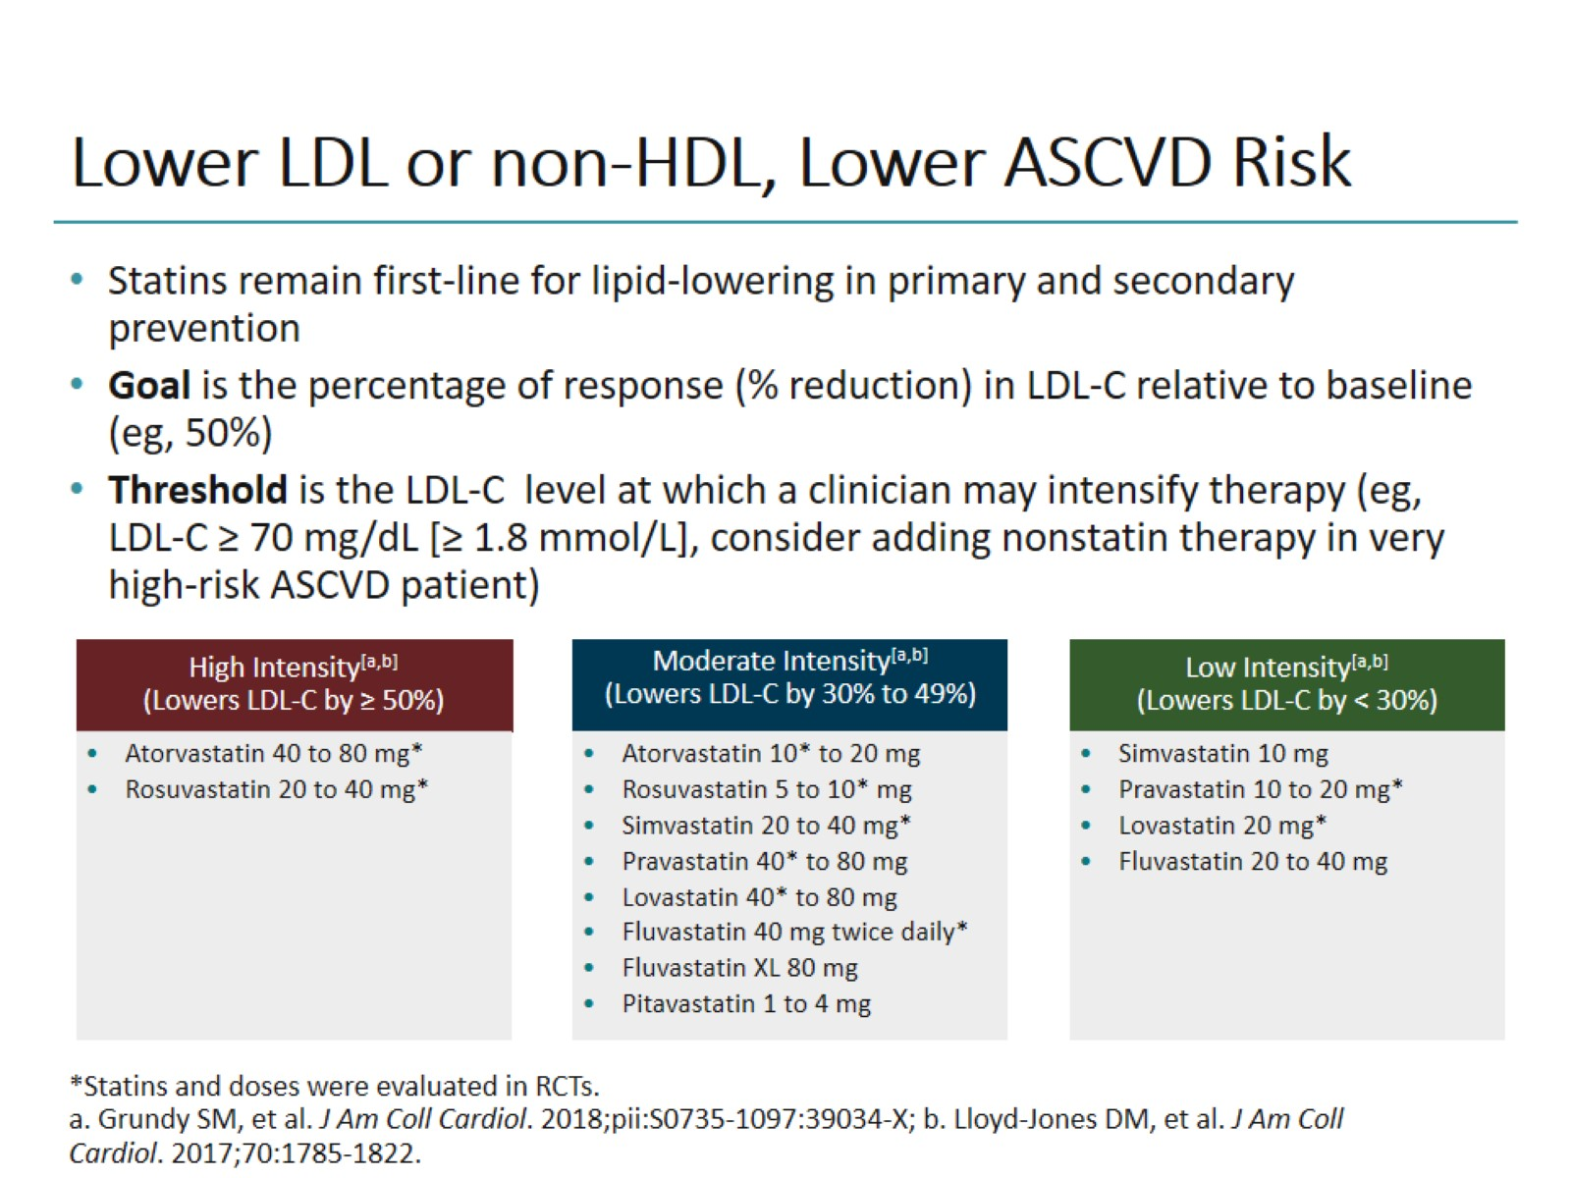
Lower LDL or non-HDL, Lower ASCVD Risk

Slide 6
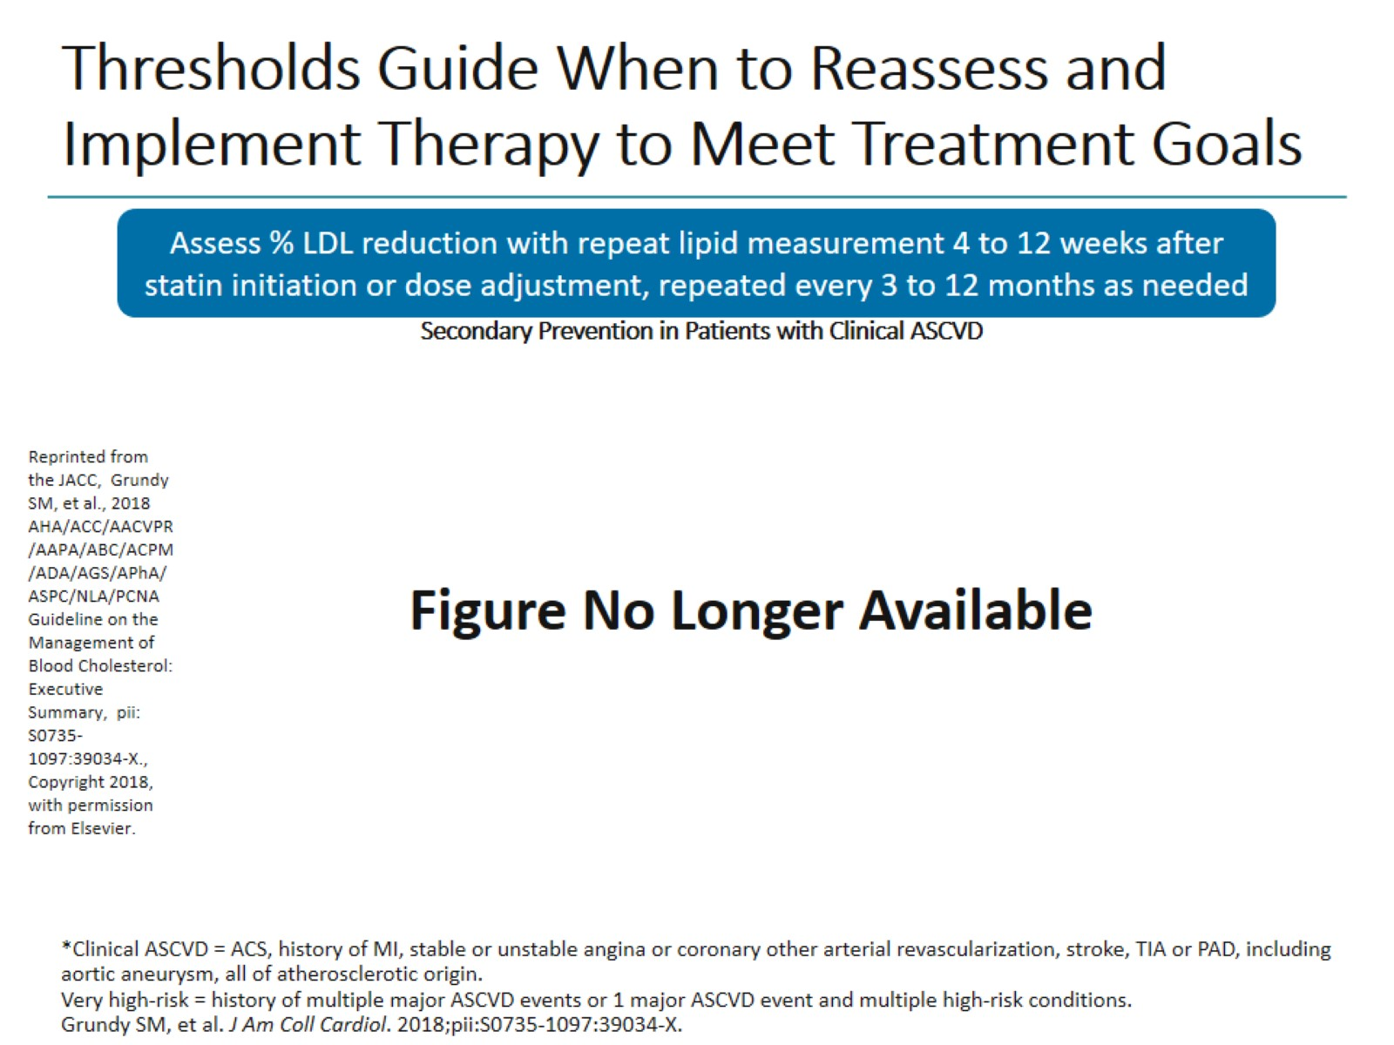
Thresholds Guide When to Reassess and Implement Therapy to Meet Treatment Goals

Slide 7
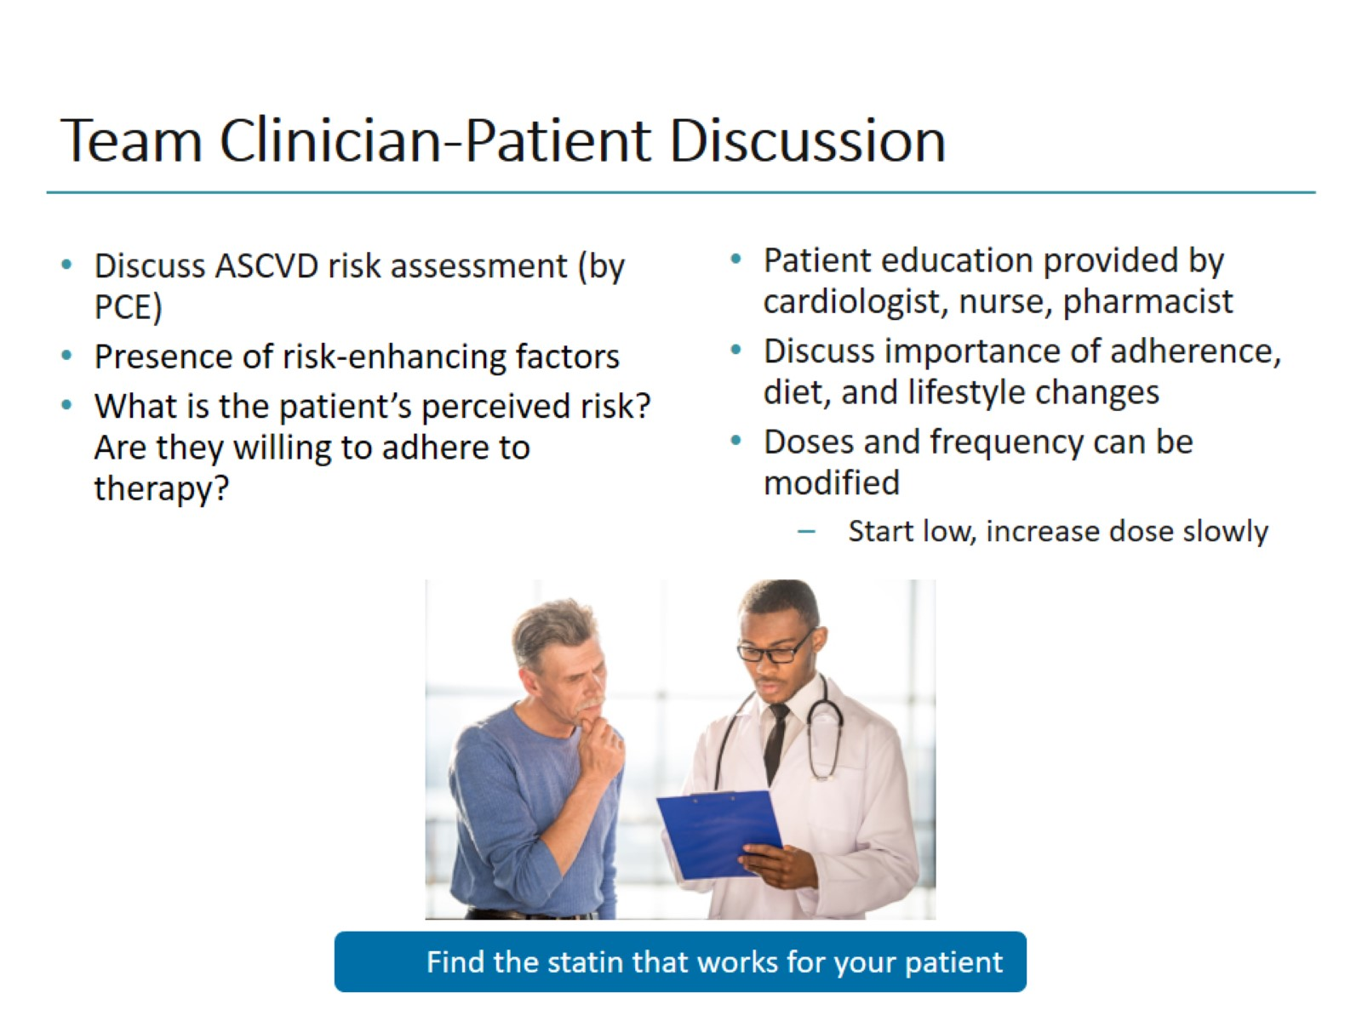
Team Clinician-Patient Discussion

Slide 8
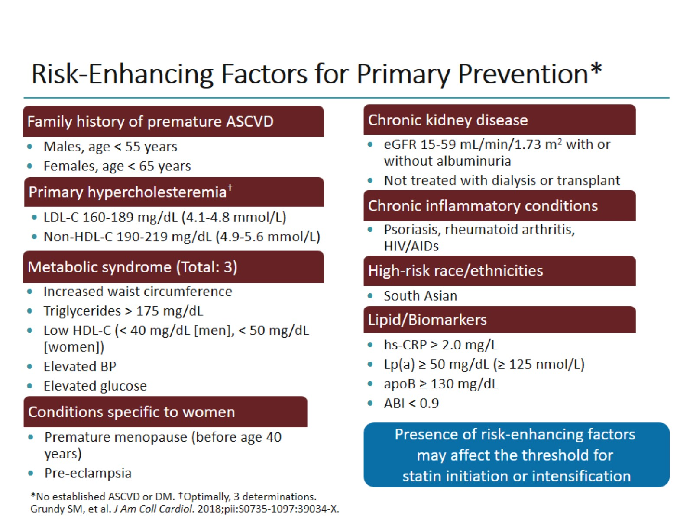
Risk-Enhancing Factors for Primary Prevention*

Slide 9
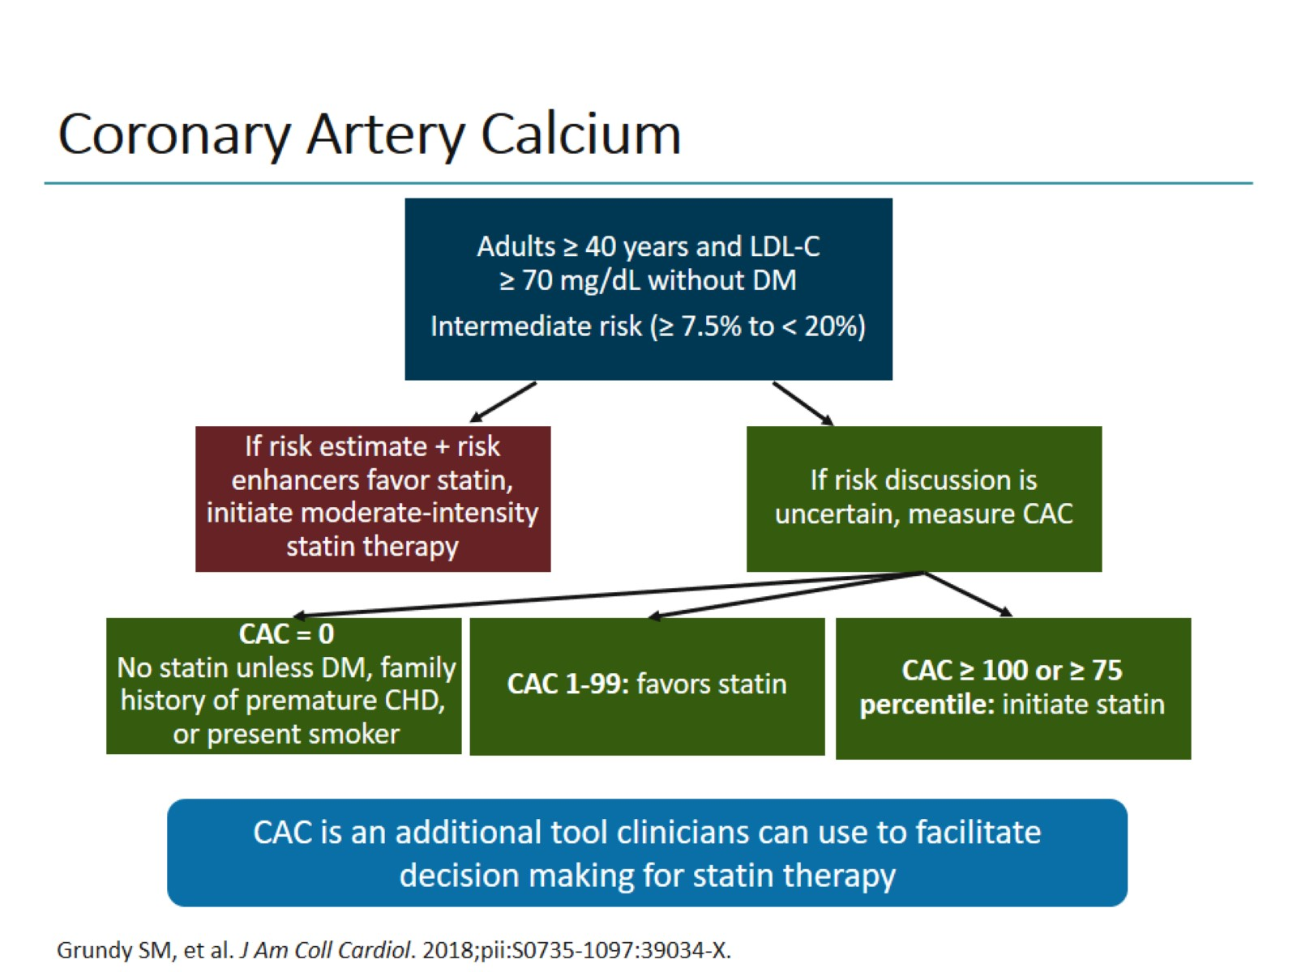
Coronary Artery Calcium

Slide 10
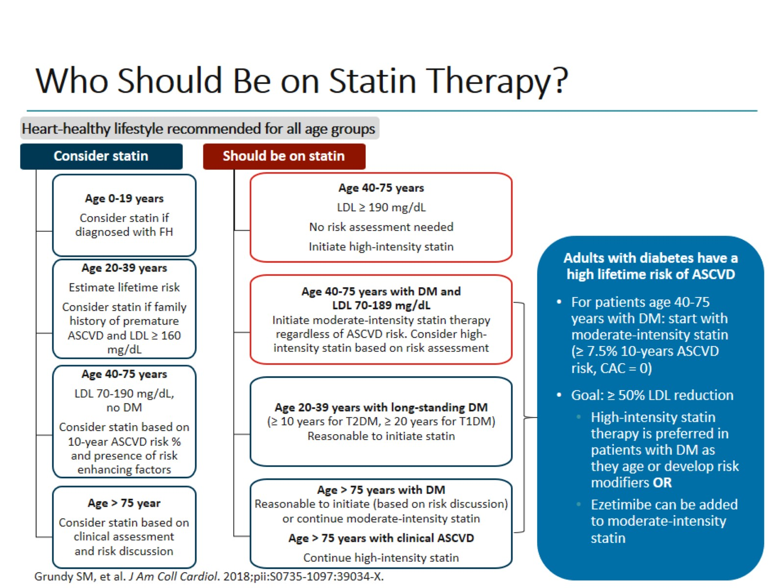
Who Should Be on Statin Therapy?

Slide 11
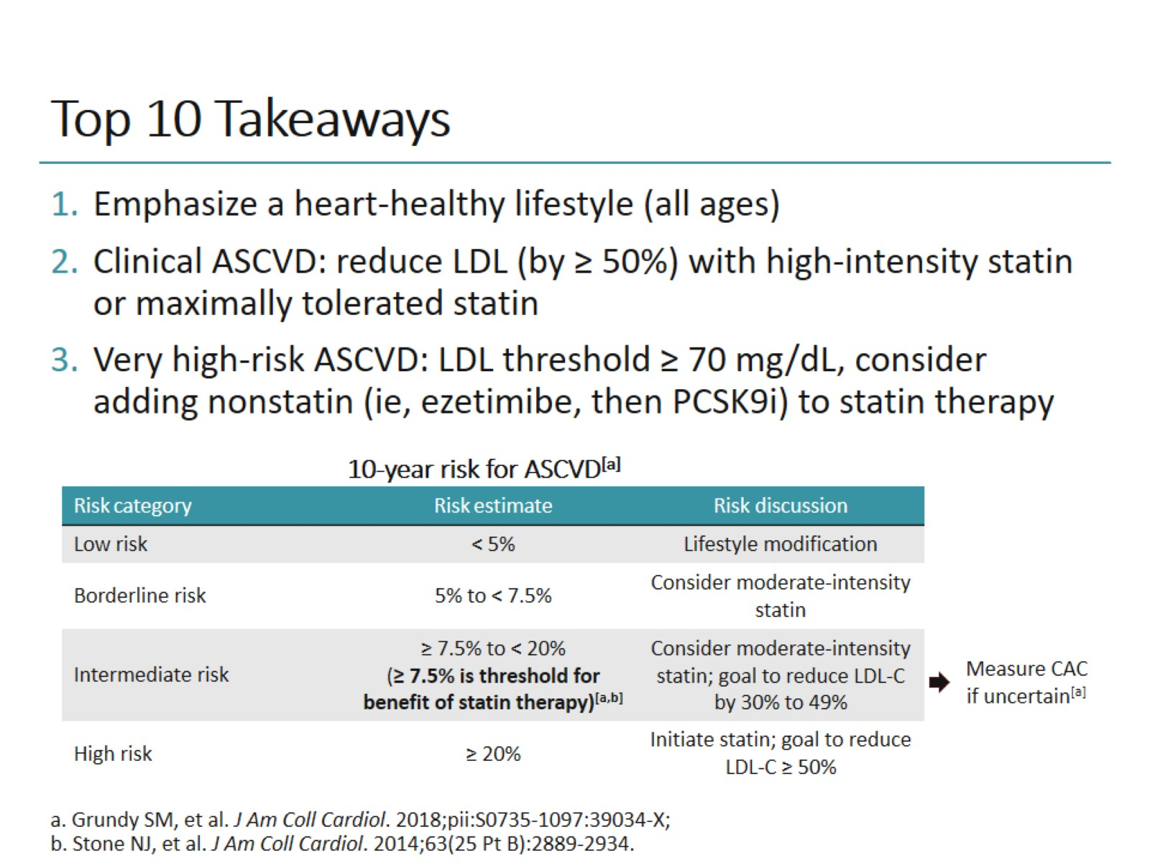
Top 10 Takeaways

Slide 12
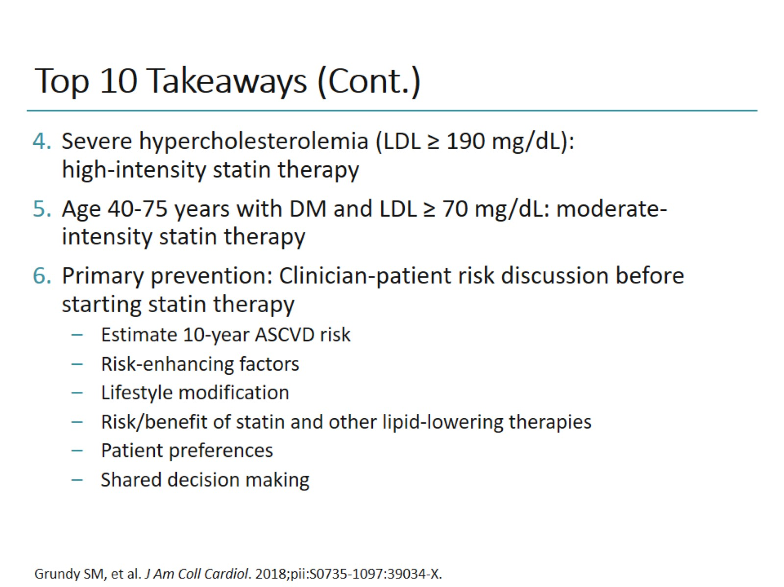
Top 10 Takeaways (Cont.)

Slide 13
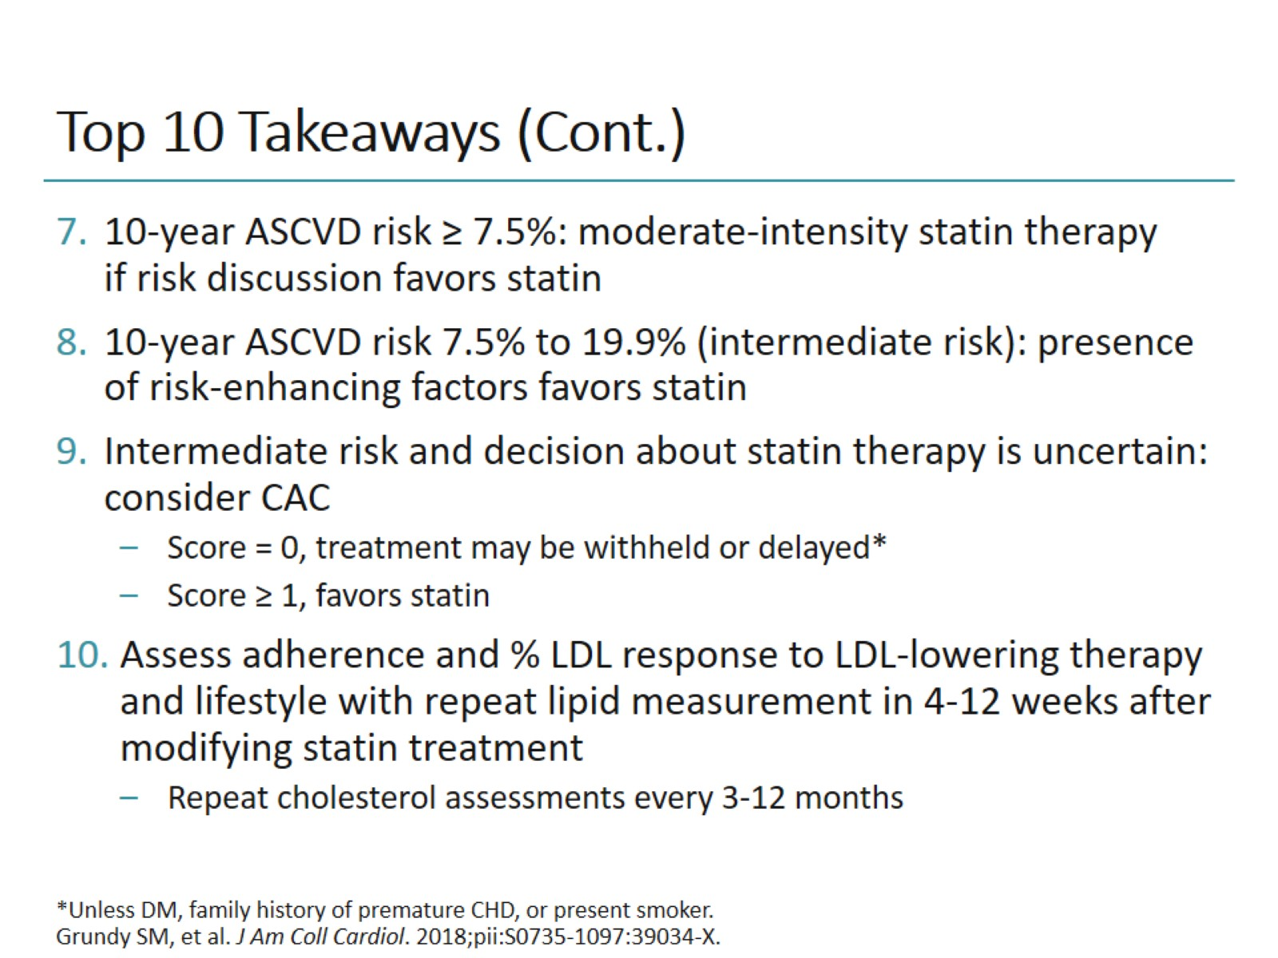
Top 10 Takeaways (Cont.)

Slide 14
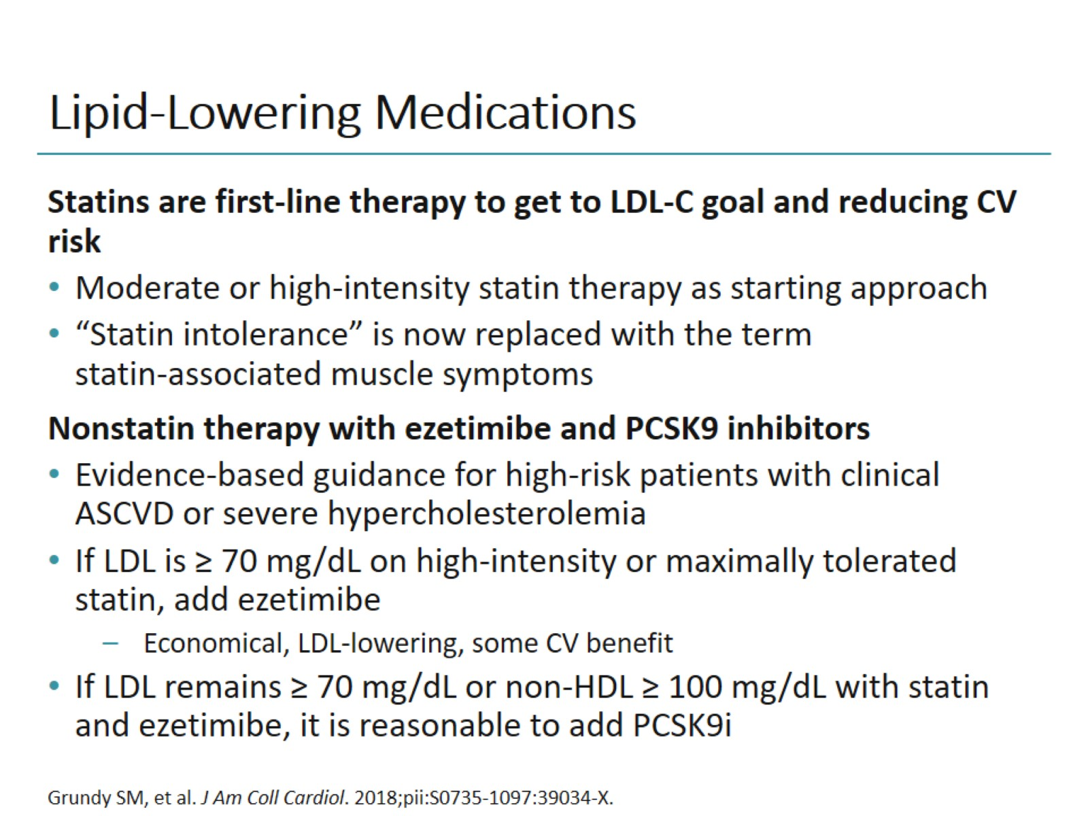
Lipid-Lowering Medications

Slide 15
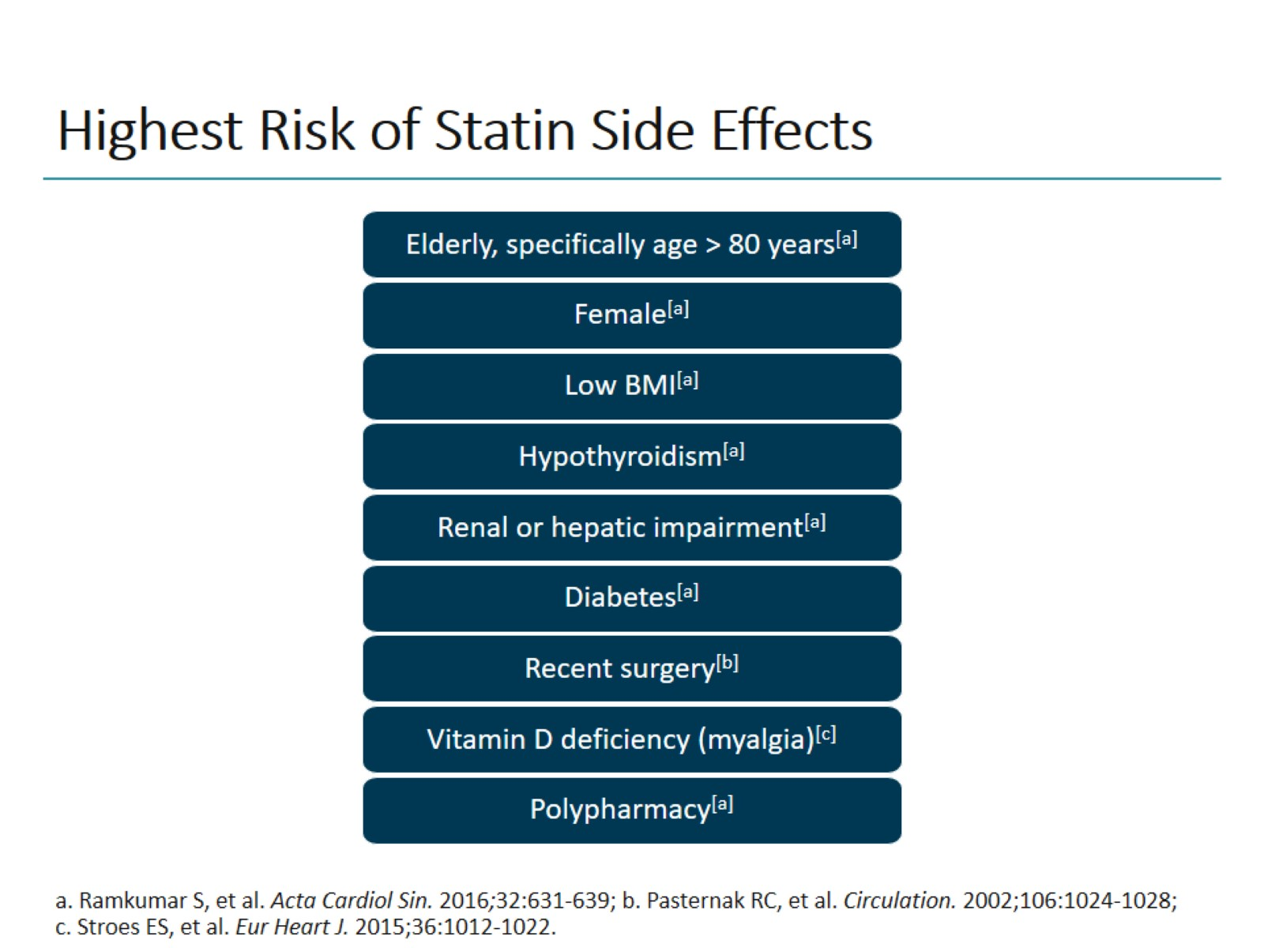
Highest Risk of Statin Side Effects

Slide 16
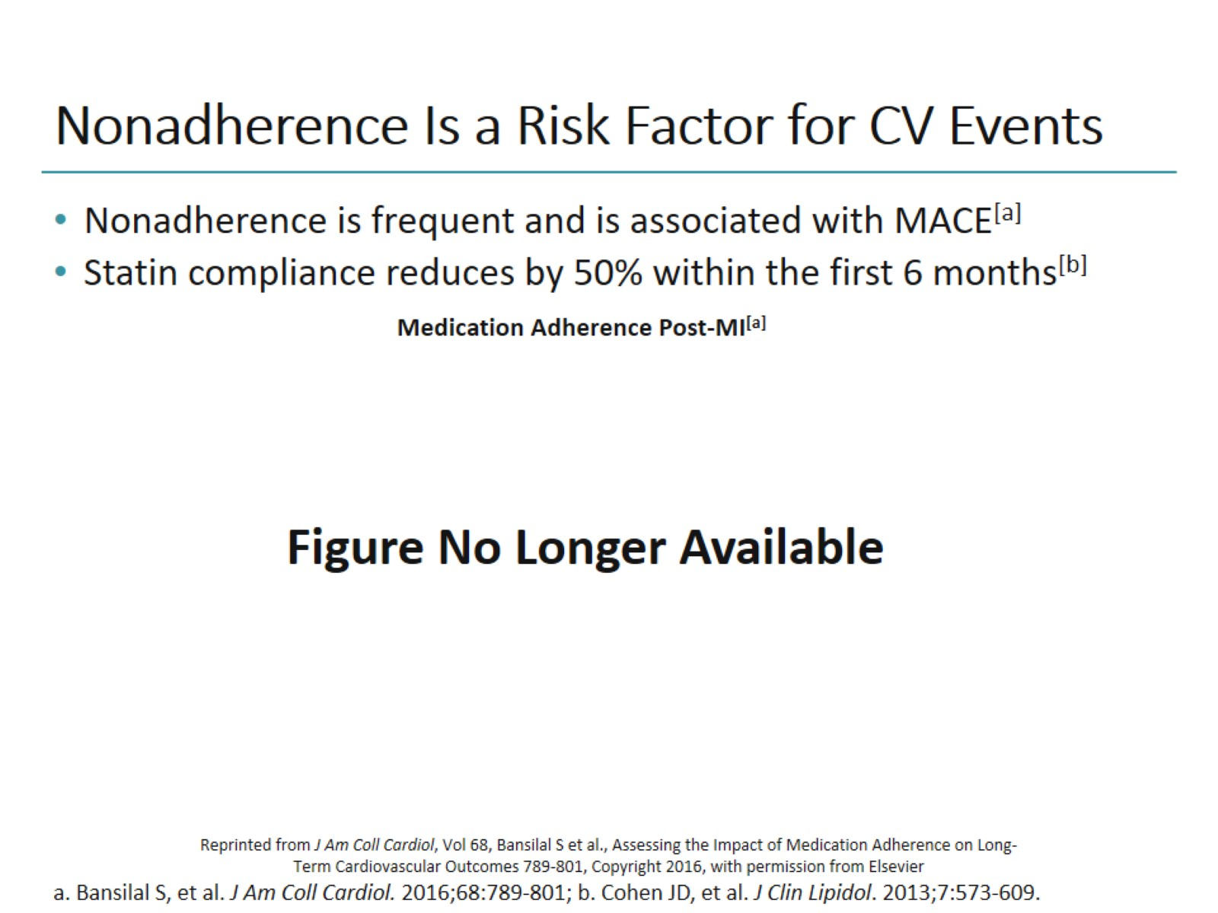
Nonadherence Is a Risk Factor for CV Events

Slide 17
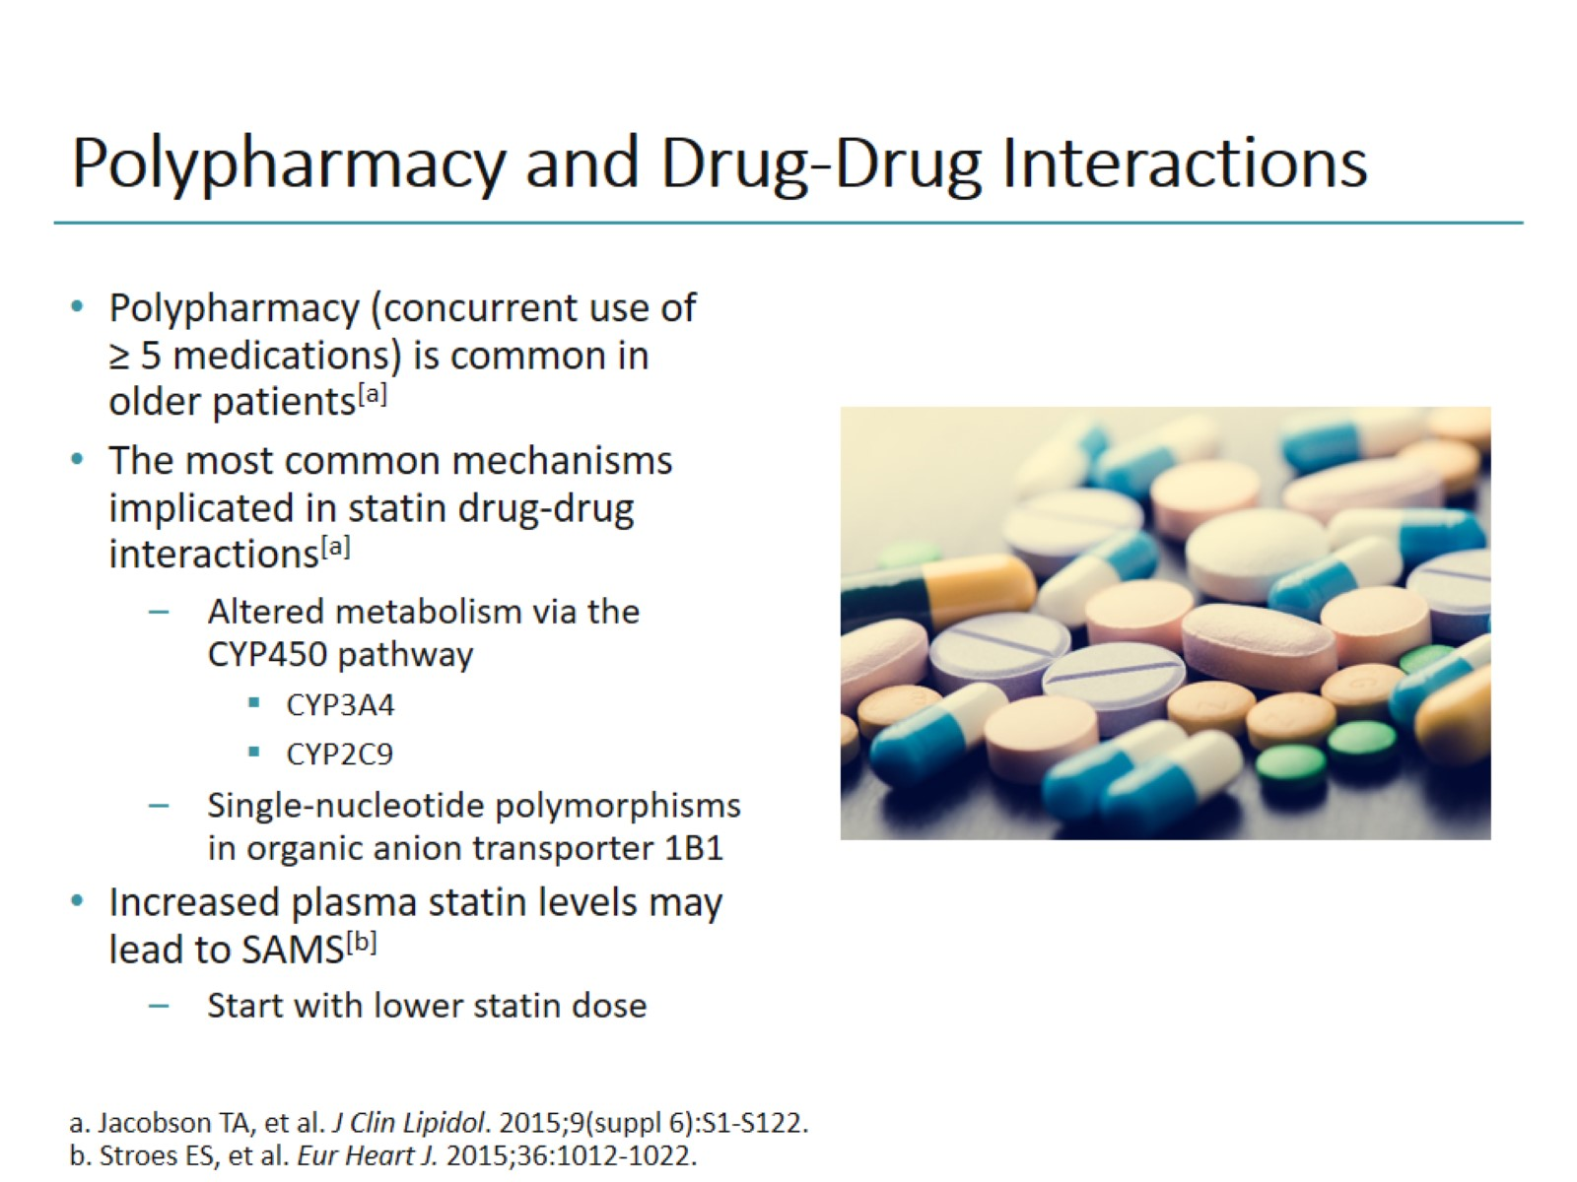
Polypharmacy and Drug-Drug Interactions

Slide 18
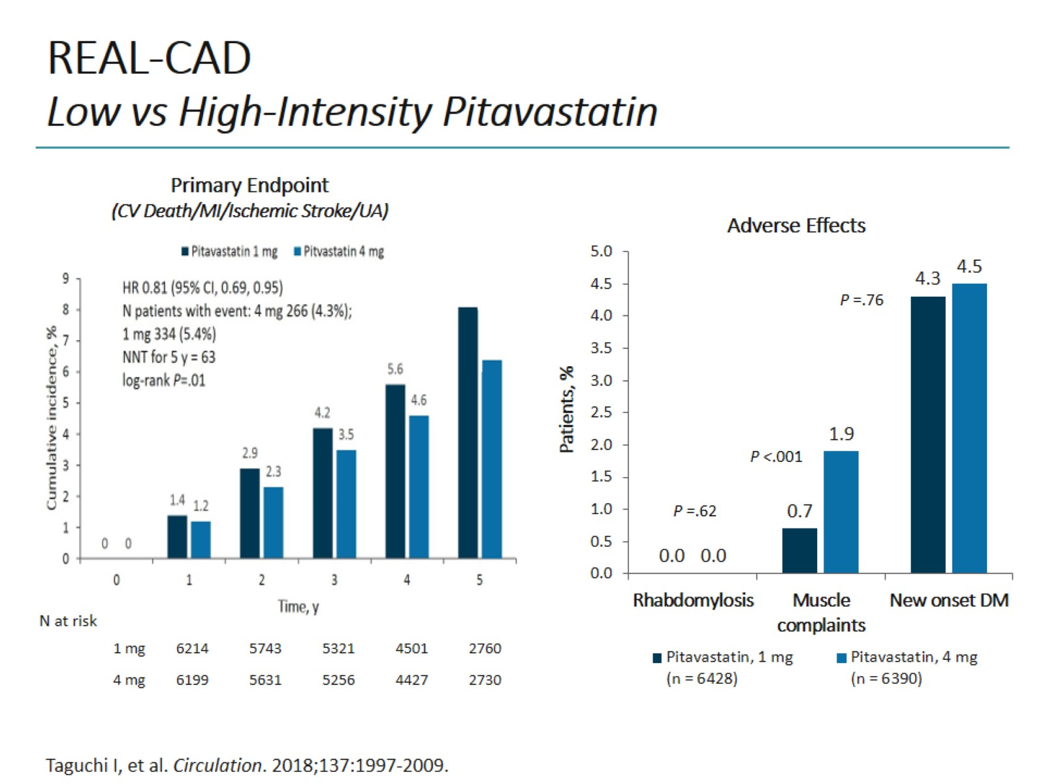
REAL-CAD
Low vs High-Intensity Pitavastatin

Slide 19
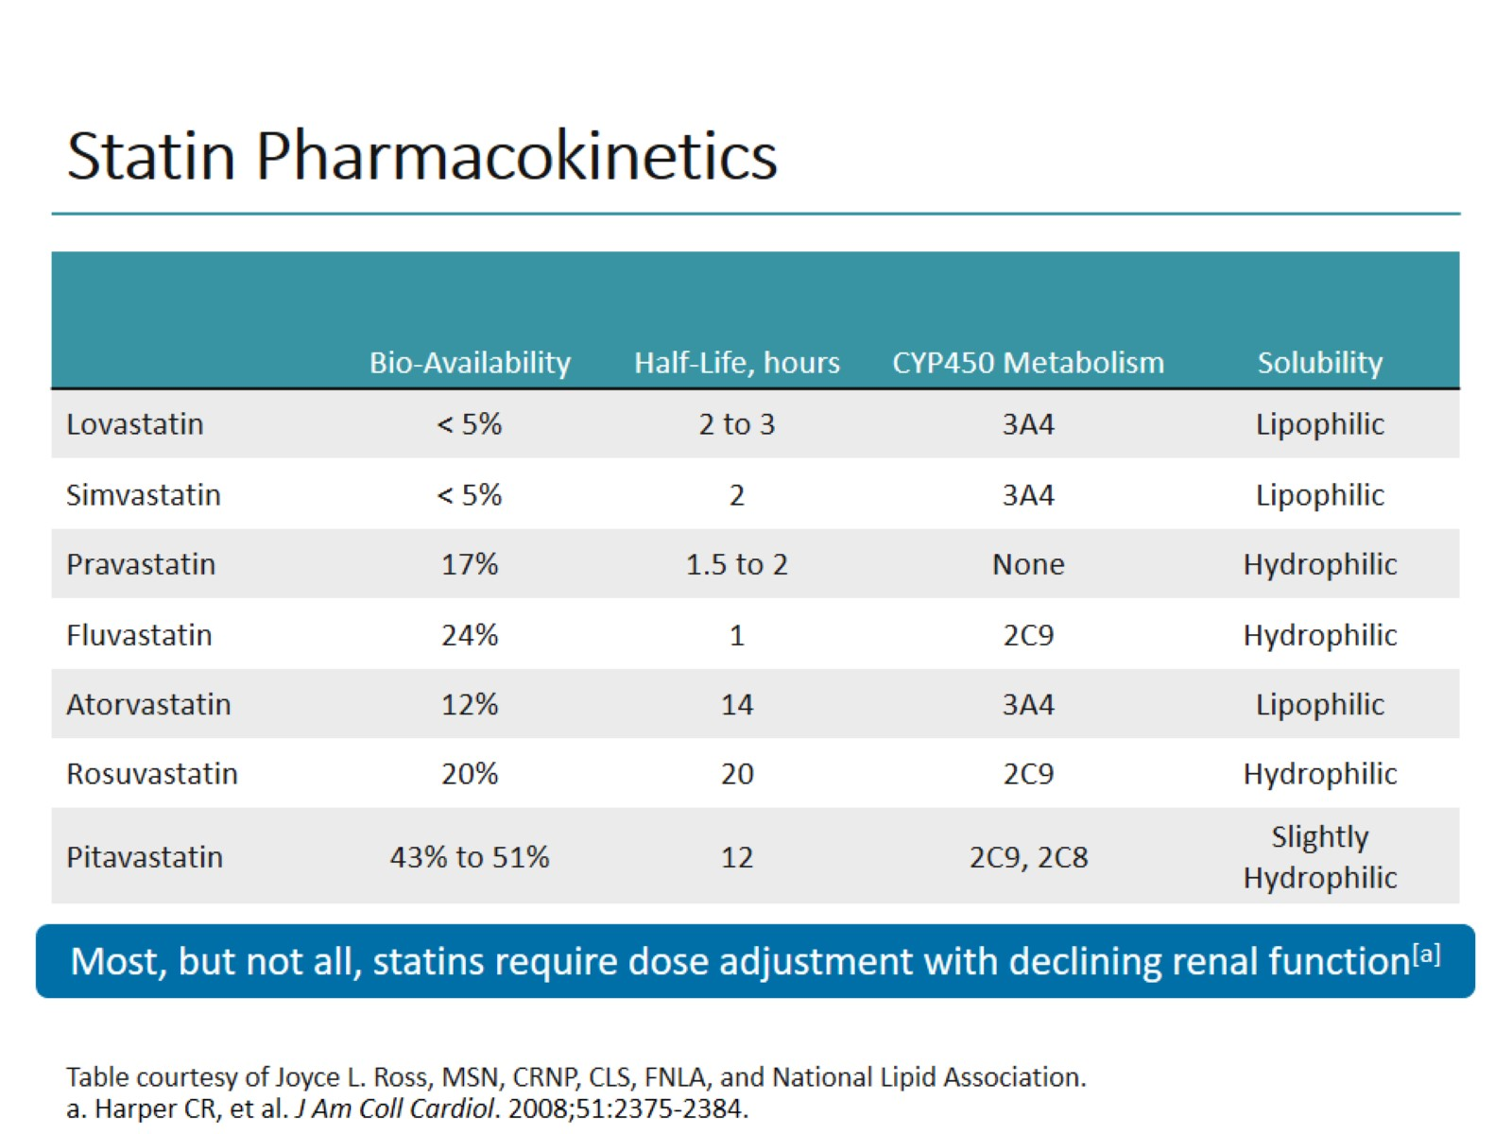
Statin Pharmacokinetics

Slide 20
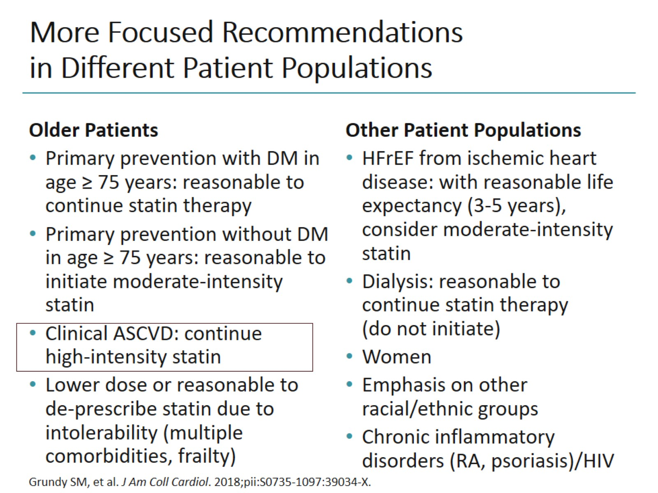
More Focused Recommendations in Different Patient Populations

Slide 21
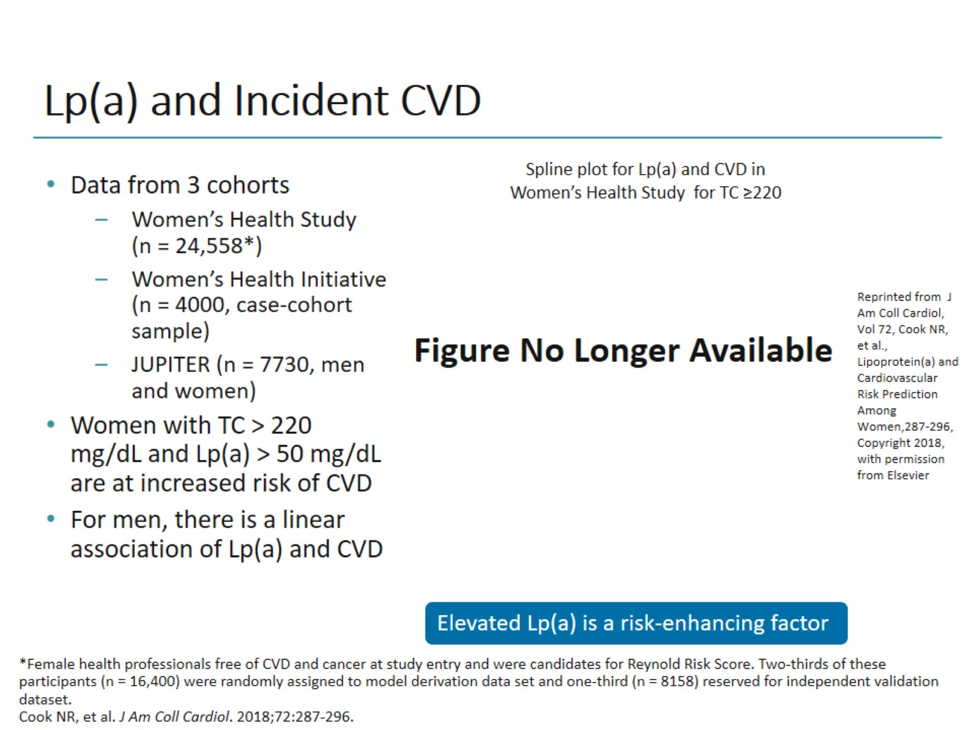
Lp(a) and Incident CVD

Slide 22
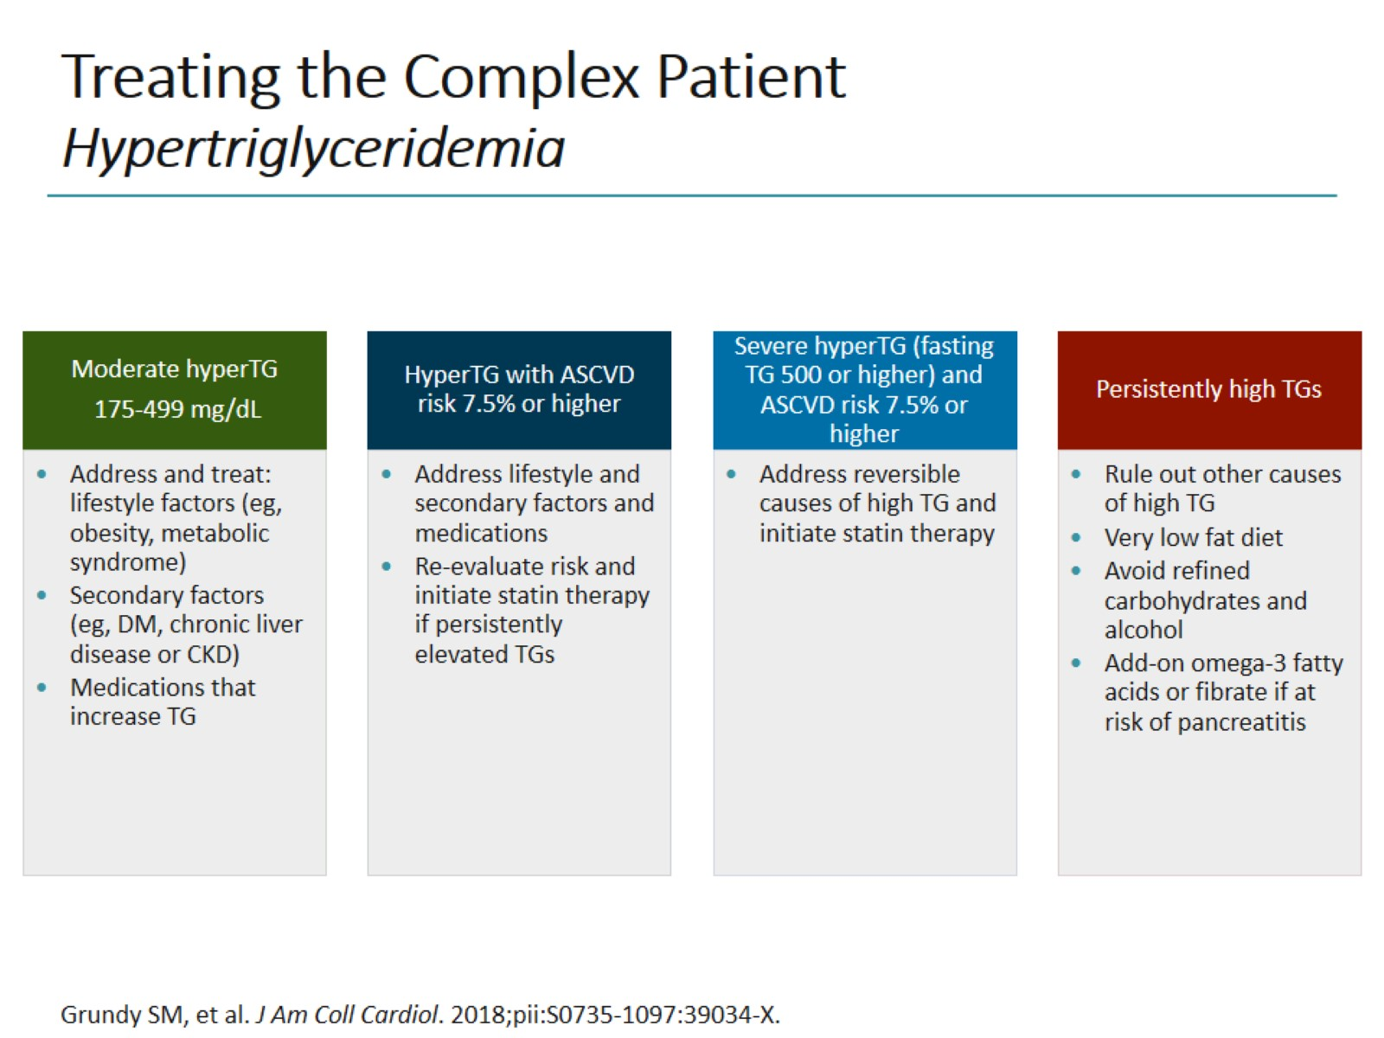
Treating the Complex Patient
Hypertriglyceridemia

Slide 23
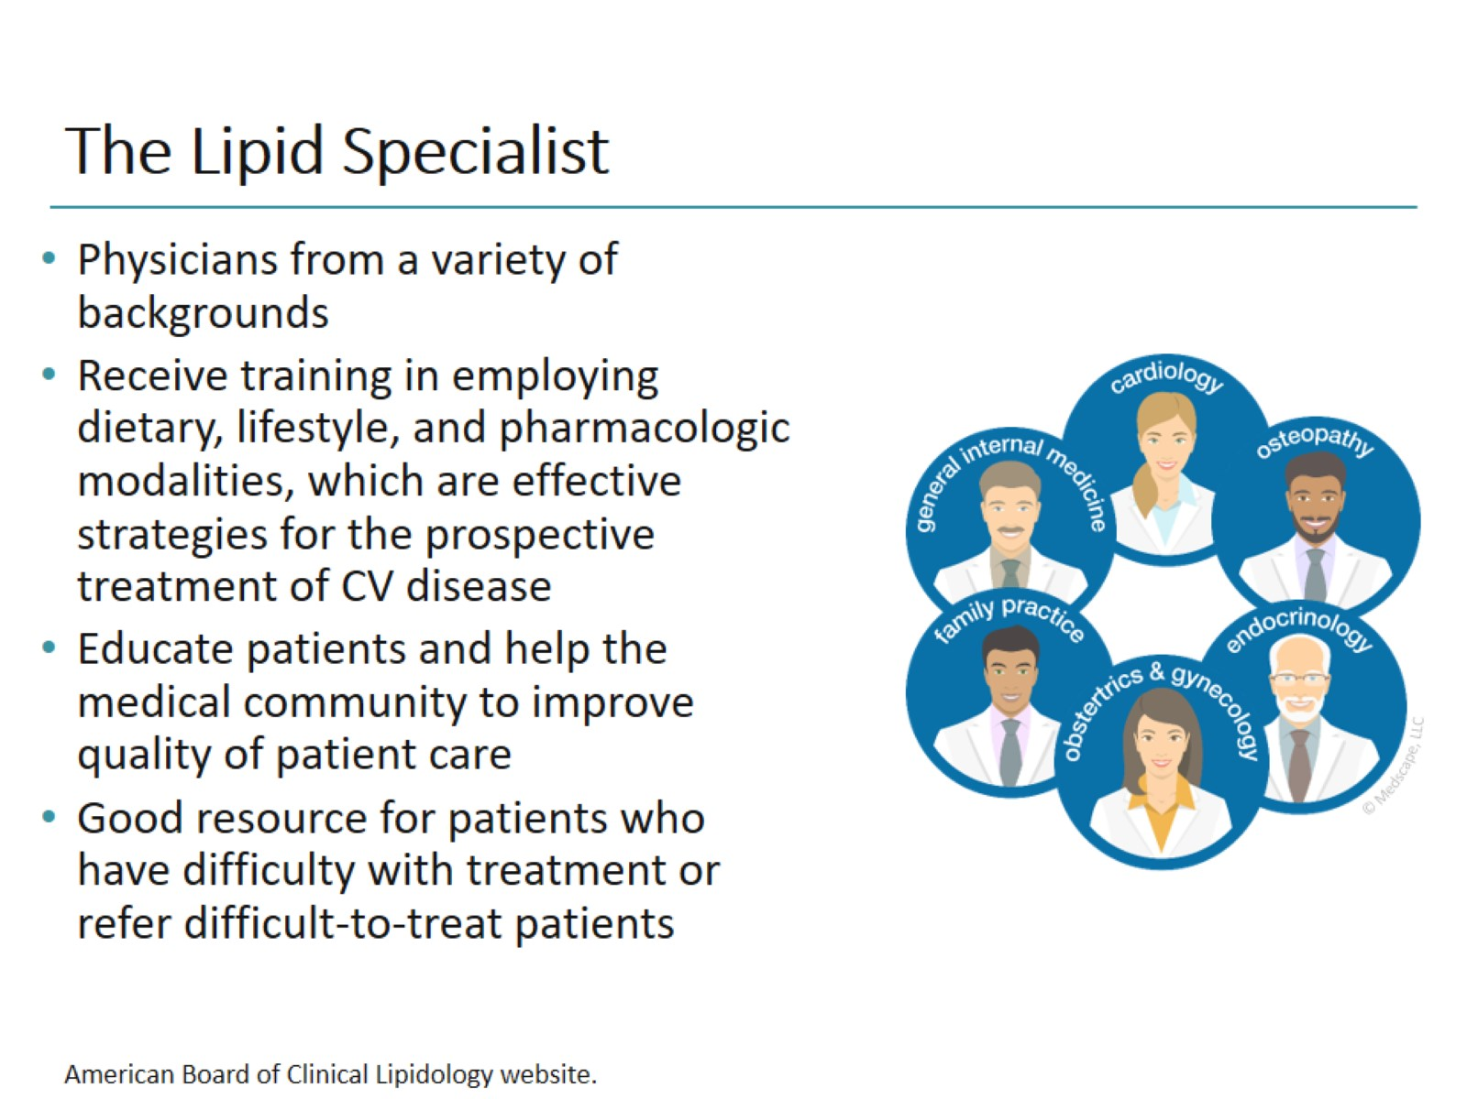
The Lipid Specialist

Slide 24
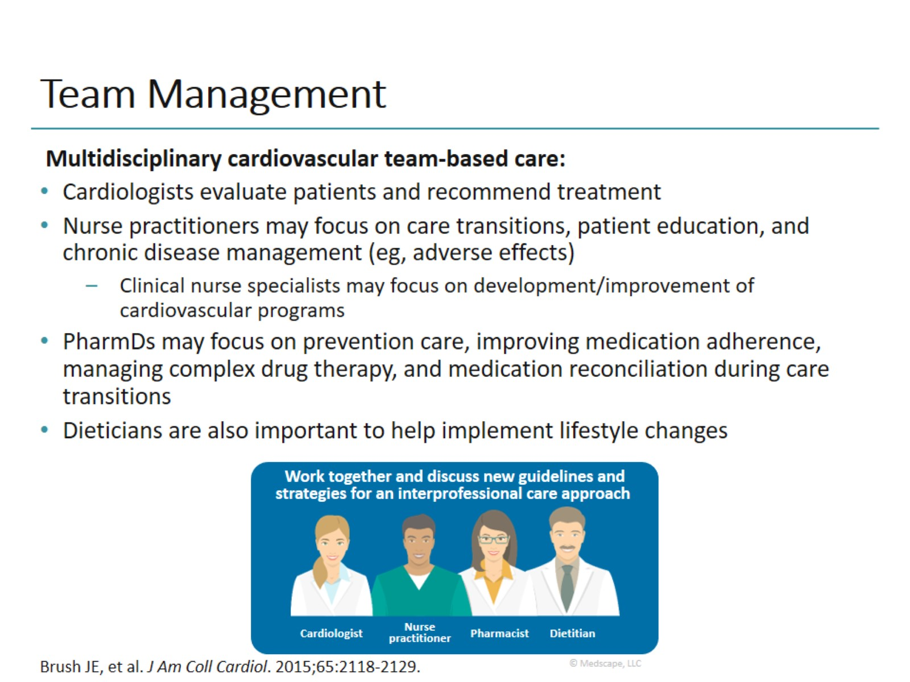
Team Management

Slide 25
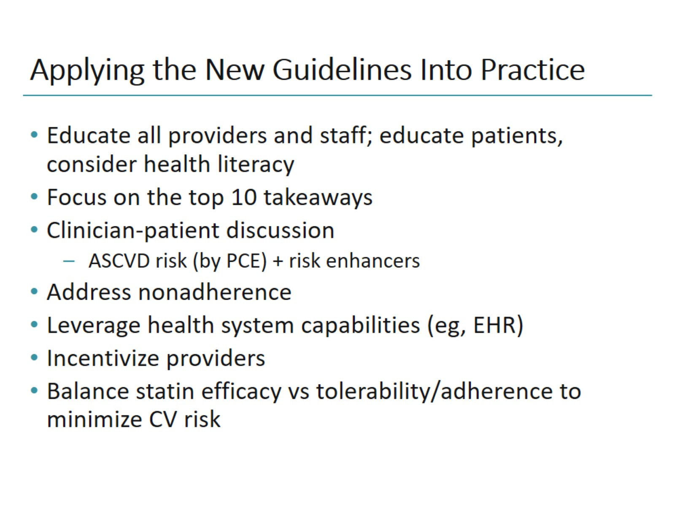
Applying the New Guidelines Into Practice

Slide 26
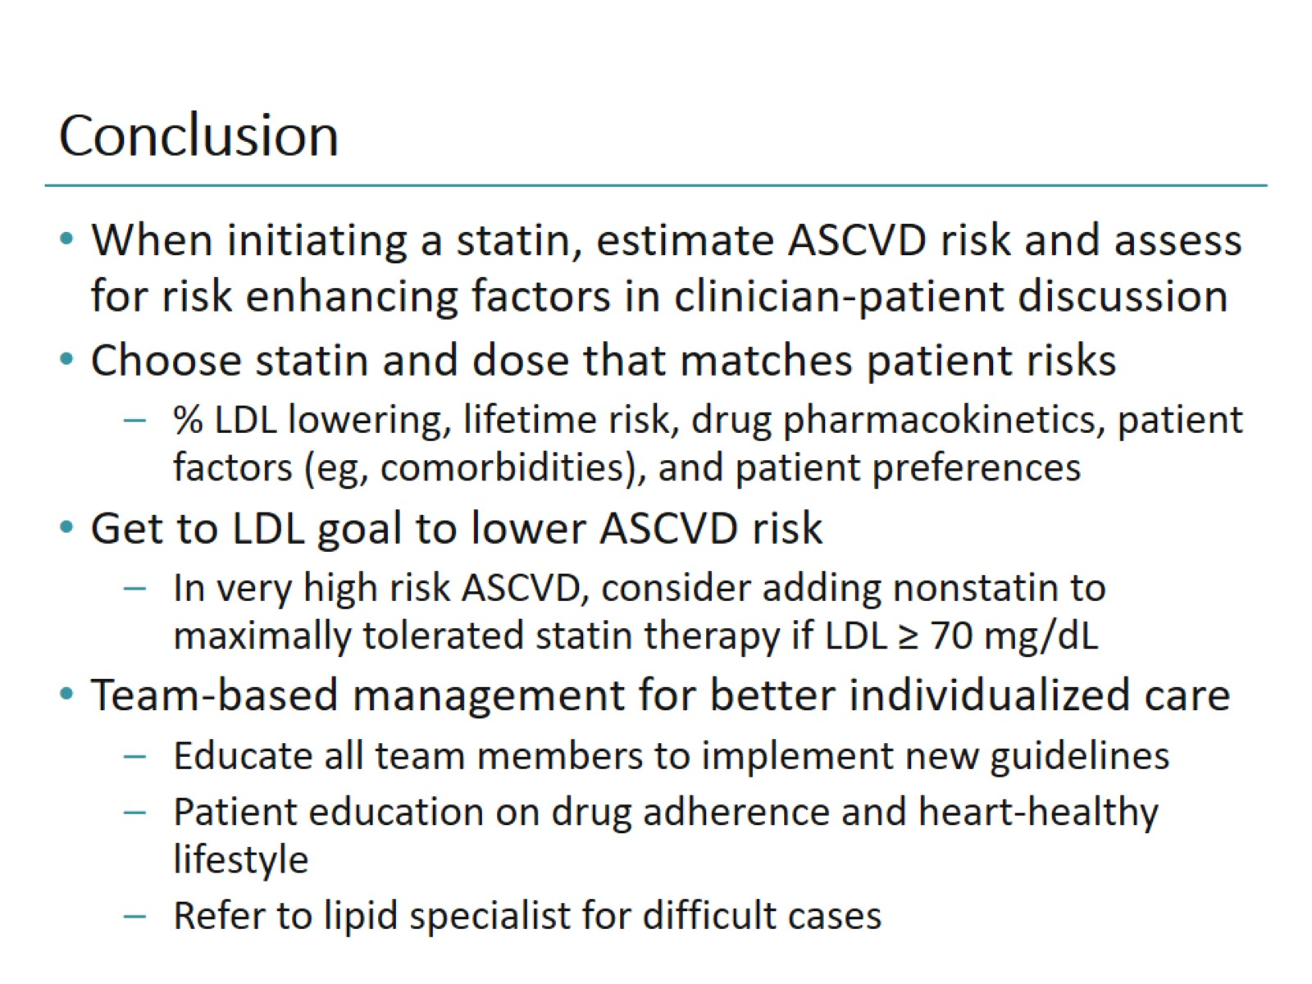
Conclusion

Slide 27
