Slide 1
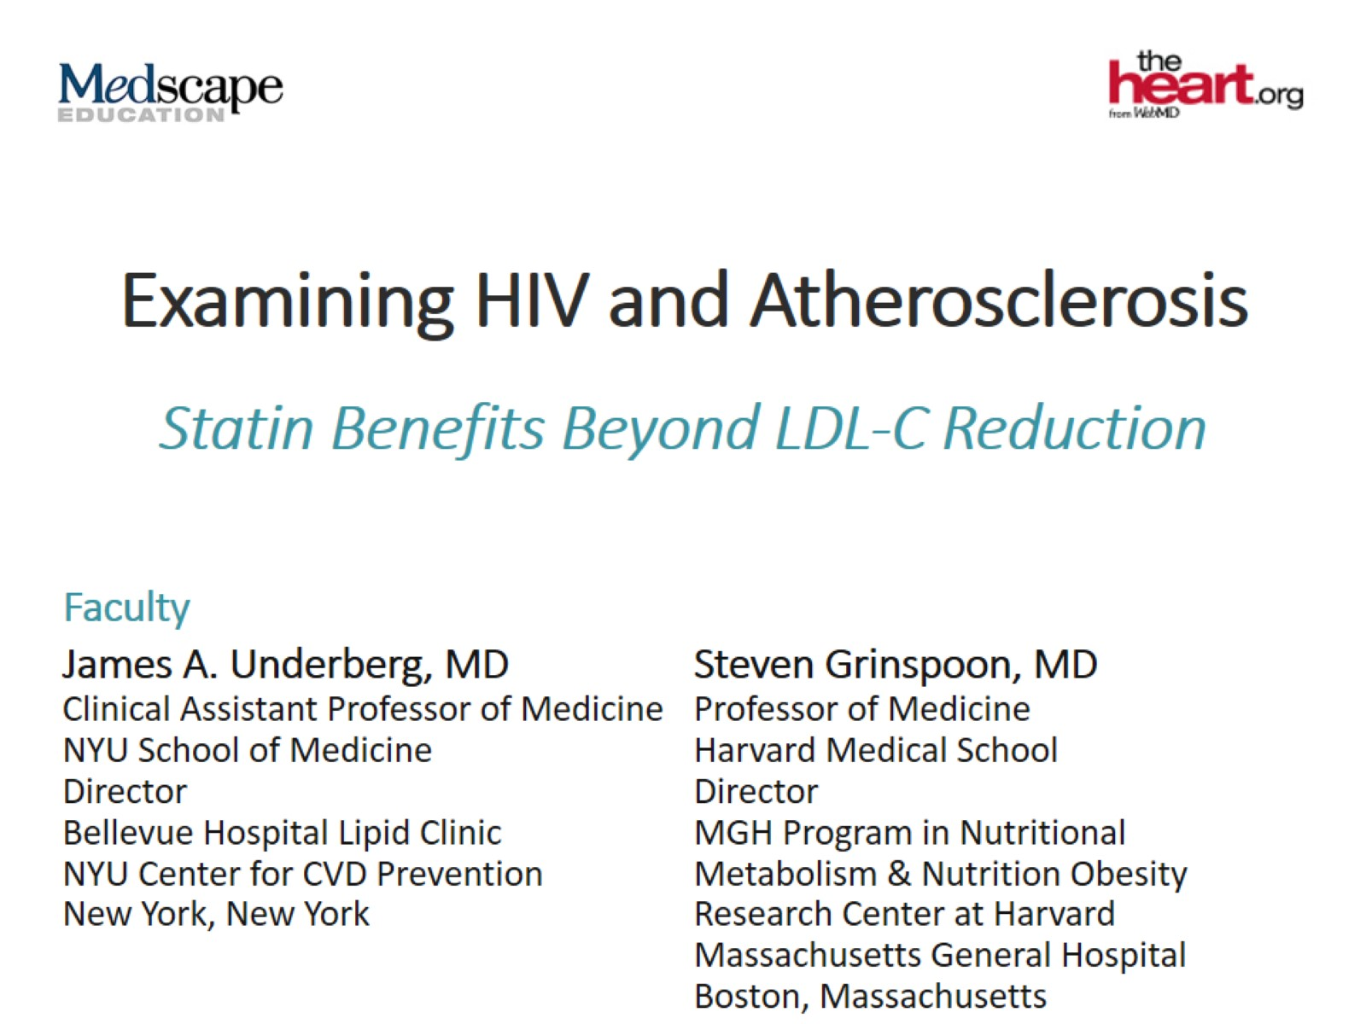
Examining HIV and Atherosclerosis

Slide 2
Epidemiology of Coronary Heart Disease in HIV Patients

Slide 3
Traditional Risks and Nontraditional Risks

Slide 4
CV Risk in the HIV-Infected Patient

Slide 5
CVD Risk and ART

Slide 6
ART Impact on Lipids

Slide 7
INTREPID Statins' Unique Properties to Lower Inflammation

Slide 8
Statins and Drug-Drug Interactions Consult Your Team

Slide 9
Use of Statins With Protease Inhibitors

Slide 10
INTREPID Pitavastatin vs Pravastatin in ART-Treated HIV-1-Infected Individuals With Dyslipidemia

Slide 11
INTREPID Pitavastatin vs Pravastatin in ART-Treated HIV-1-Infected Individuals With Dyslipidemia (cont)

Slide 12
HIV is a Cardiovascular Risk Factor

Slide 13
Assess Individual Risk and Treat Aggressively

Slide 14
REPRIEVE Trial Design

Slide 15
Why Pitavastatin

Slide 16
Statin Effects on Coronary Artery Plaque, LDL and Inflammation in HIV

Slide 17
Proposed Guideline Using 10-Year ASCVD Risk Estimate Plus CAC Scoring to Guide Statin Therapy

Slide 18
ACC Health Policy Statement Team Management

Slide 19
Concluding Remarks

