Slide 1
Treatment as Prevention

Slide 2
Probability of HIV Acquisition

Slide 3
Cofactors That Amplify Sexual Transmission

Slide 4
Azidothymidine

Slide 5
AZT Reduces Mother-to-Infant HIV Transmission

Slide 6
Growth of HIV Treatment Options

Slide 7
Viral Load and Heterosexual Transmission

Slide 8
Study of Transmission in Couples

Slide 9
HPTN 052: Immediate vs Delayed ART

Slide 10
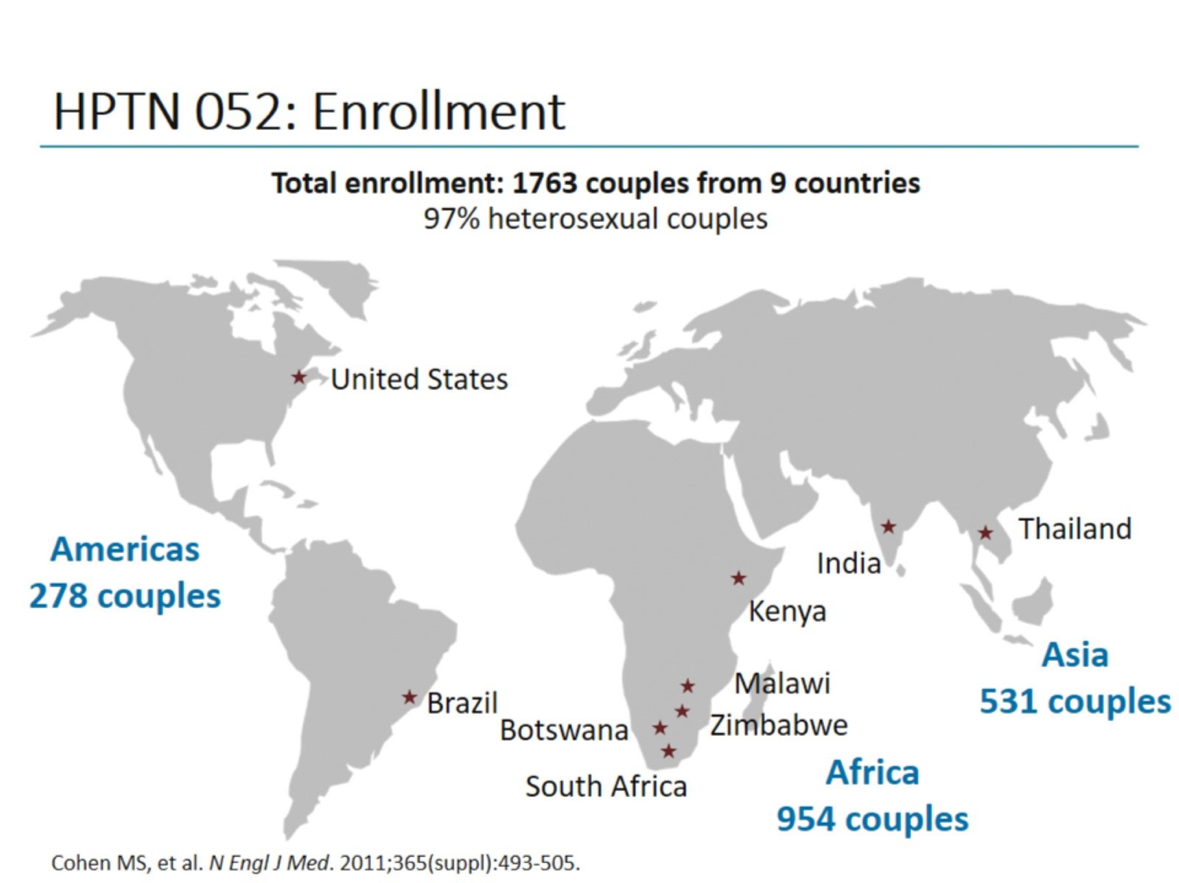
HPTN 052: Enrollment

Slide 11
HPTN 052: Transmission Results

Slide 12
HPTN 052: Immediate vs Delayed ART

Slide 13
TasP: 2011 Breakthrough of the Year

Slide 14
Additional Studies Supporting Early ART

Slide 15
ART Treatment Allows People to LIVE With HIV

Slide 16
Treatment as Prevention Studies in MSM Couples

Slide 17
Ecological Data

Slide 18
Population-Based Studies

Slide 19
Milestones in HIV Treatment as Prevention

Slide 20
Treatment as Prevention

Slide 21
Treatment as Prevention

Slide 22
HIV Care Continuum

Slide 23
Achieving and Maintaining an Undetectable Viral Load

Slide 24
Care Across the Continuum

Slide 25
Health Disparities Within the HIV Epidemic

Slide 26
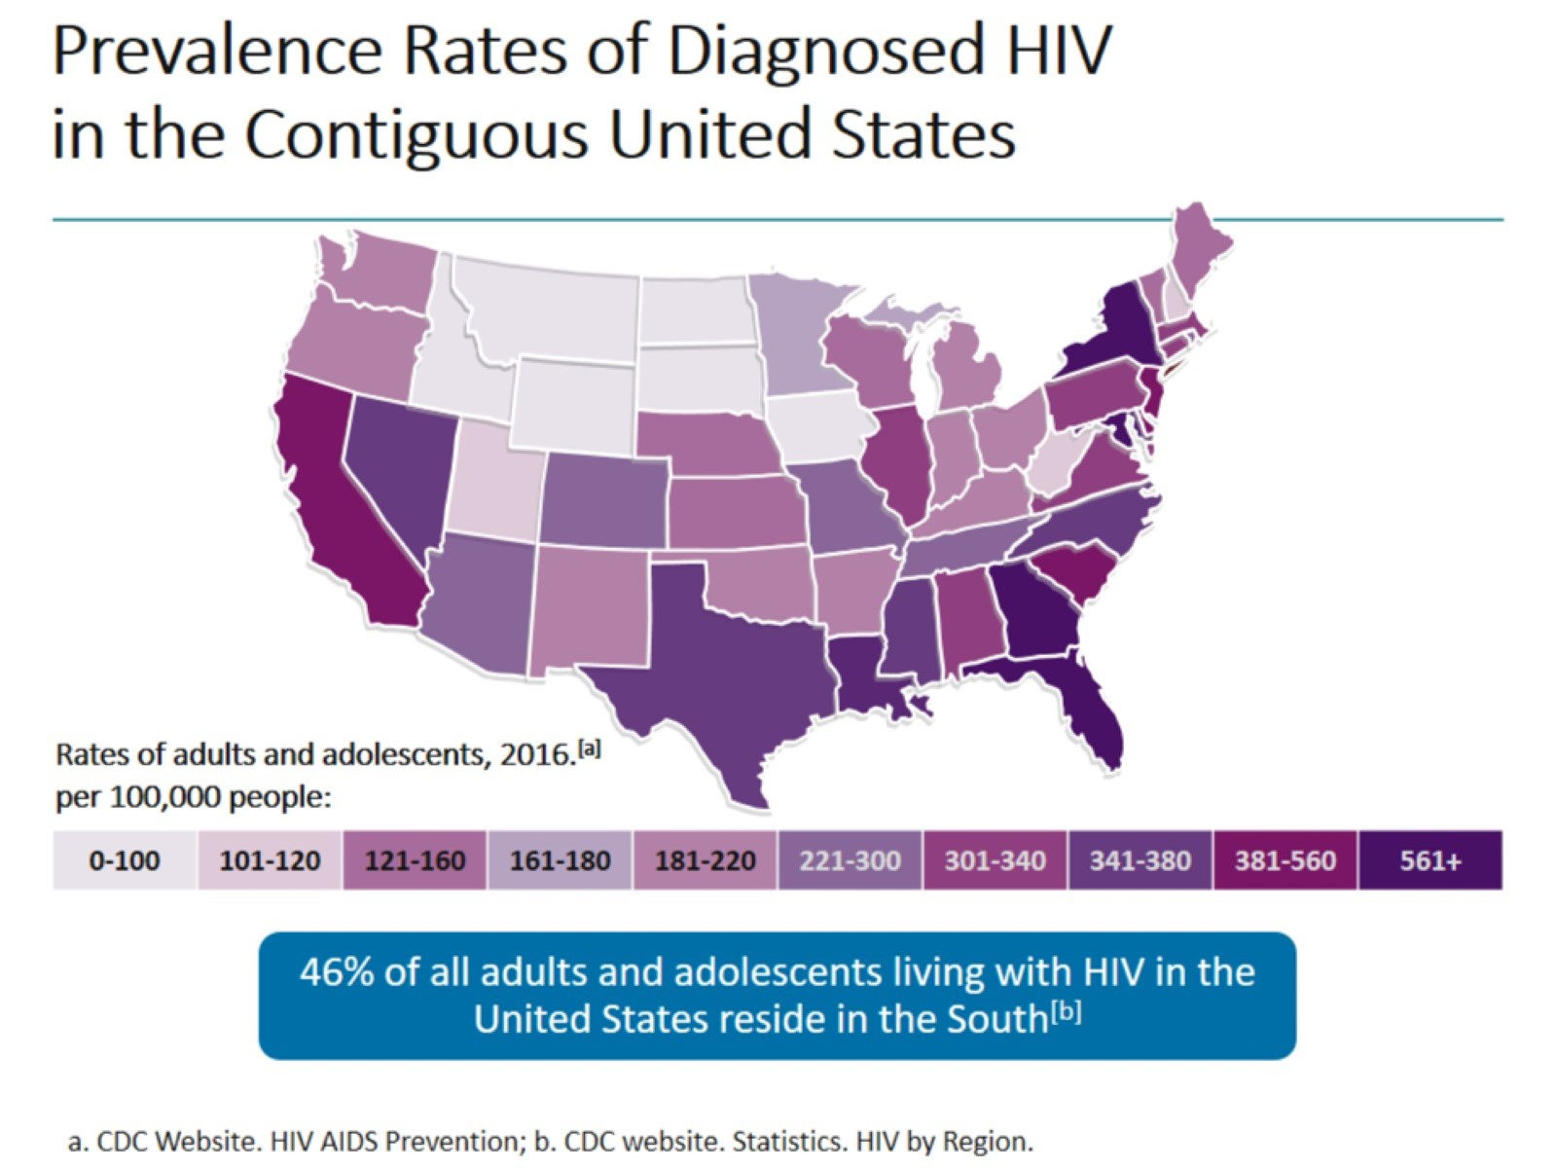
Prevalence Rates of Diagnosed HIV in the Contiguous United States

Slide 27
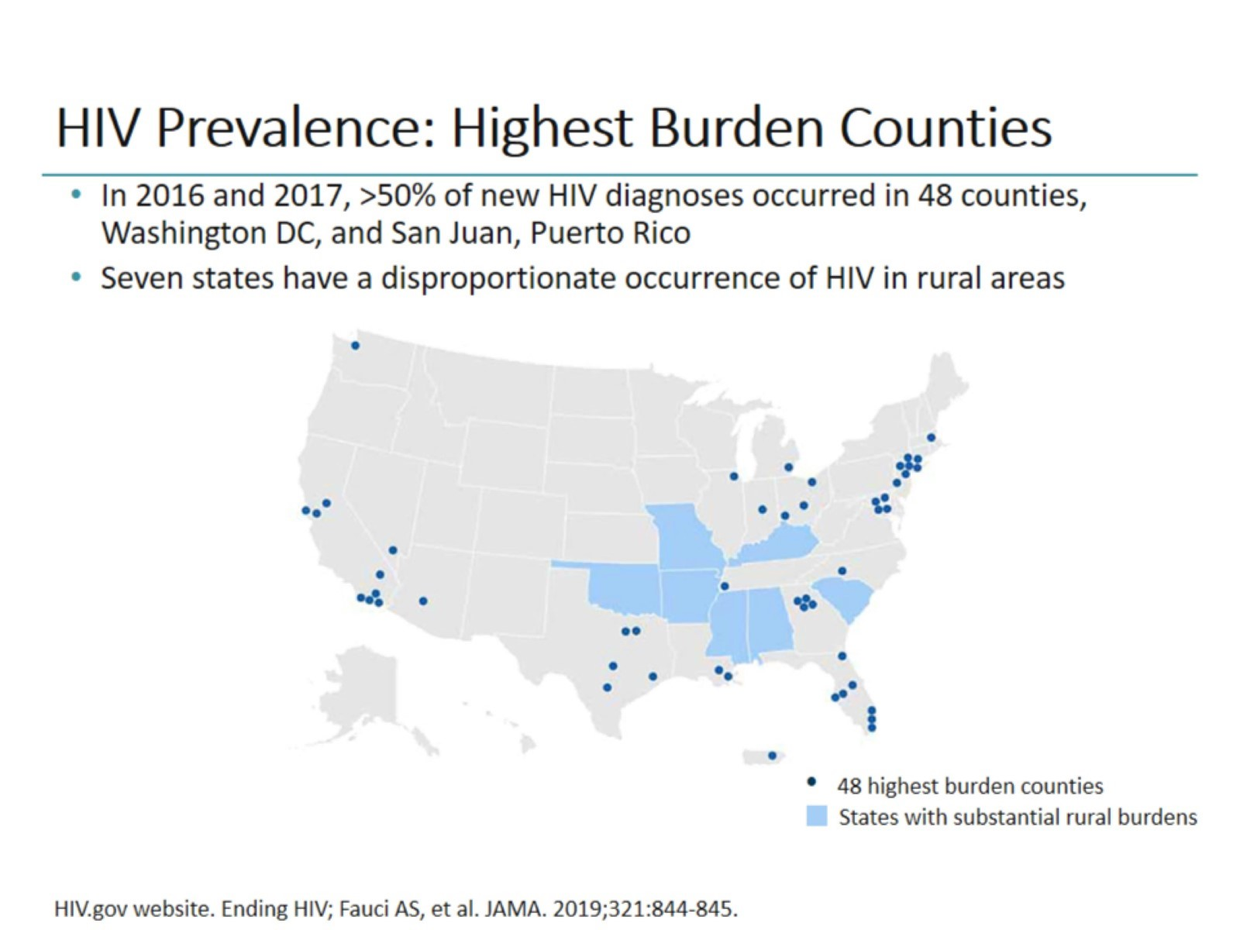
HIV Prevalence: Highest Burden Counties

Slide 28
New HIV Diagnoses Among the Most Affected Subpopulations, 2017

Slide 29
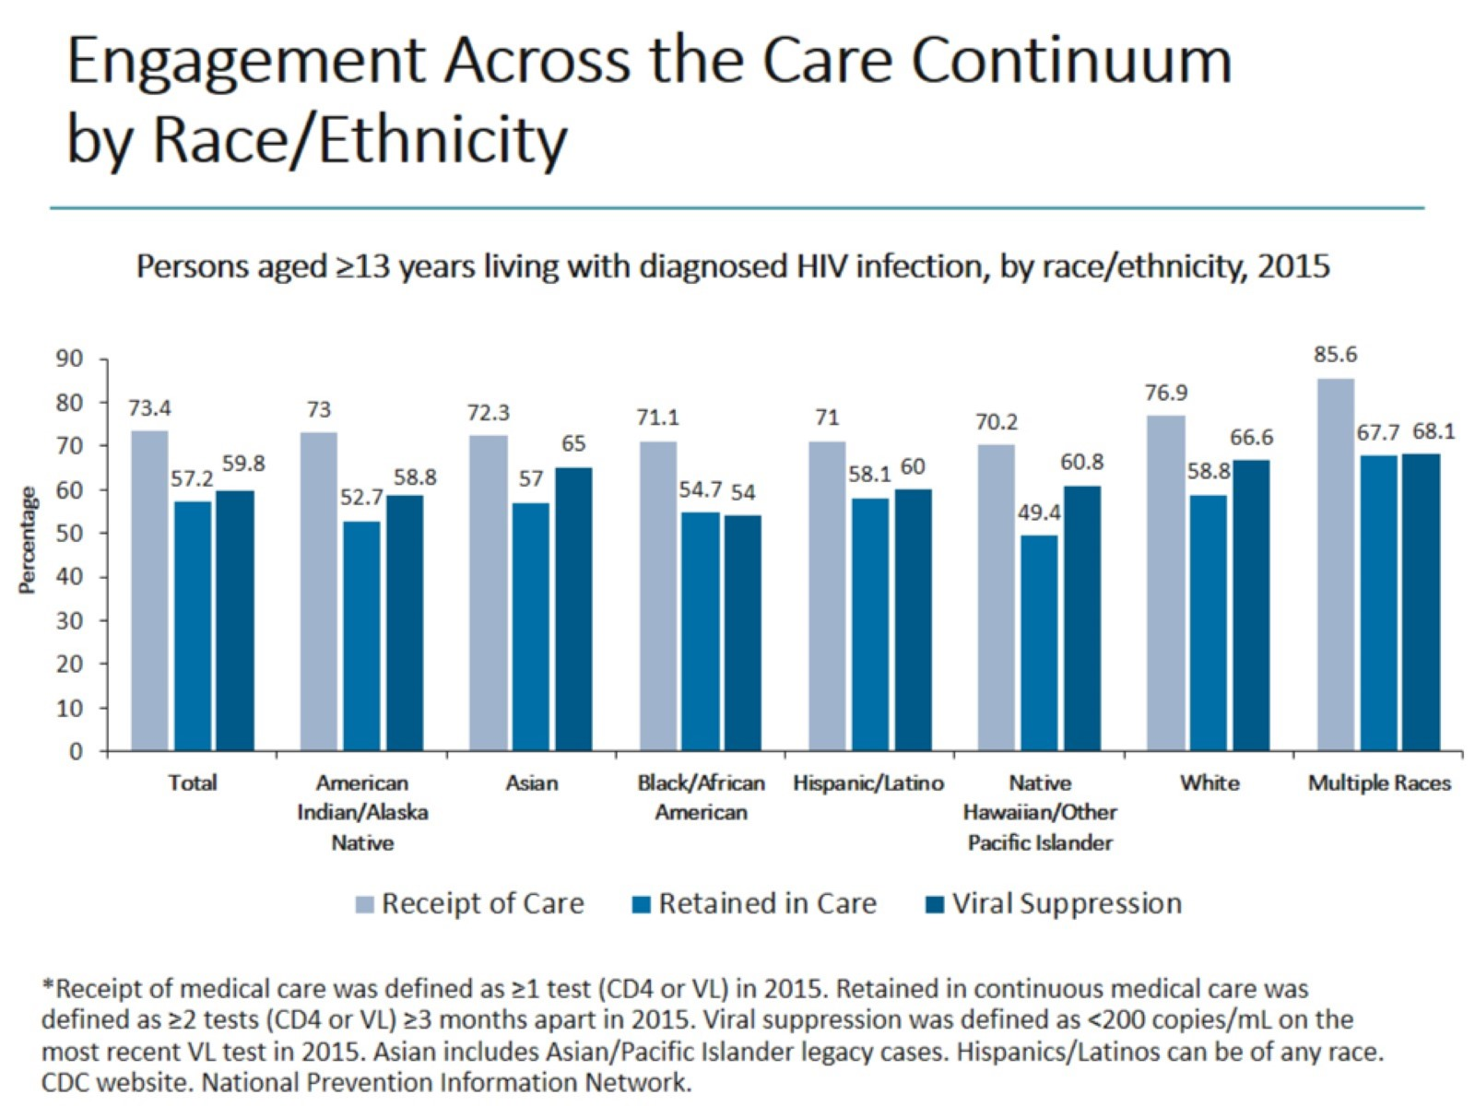
Engagement Across the Care Continuum by Race/Ethnicity

Slide 30
Social Determinants of Health

Slide 31
Disparities Across the Care Continuum

Slide 32
HIV Stigma

Slide 33
One Person May be Impacted by Many Different Factors

Slide 34
Intersectionality

Slide 35
Intersectionality: A Black Gay Man

Slide 36
Challenges to HIV Prevention and Care in the South

Slide 37
Reaching Viral Suppression

Slide 38
Strategies to Reduce HIV-Related Disparities

Slide 39
Summary

Slide 40
Treatment as Prevention

Slide 42
Clinical Scenario 1 Dr Palmore and Kevin Grant

Slide 43
Reflection on Clinical Scenario 1

Slide 44
Patient Perspective

Slide 45
Patient Perspective (cont)

Slide 46
Clinical Scenario: Summary of Feedback

Slide 47
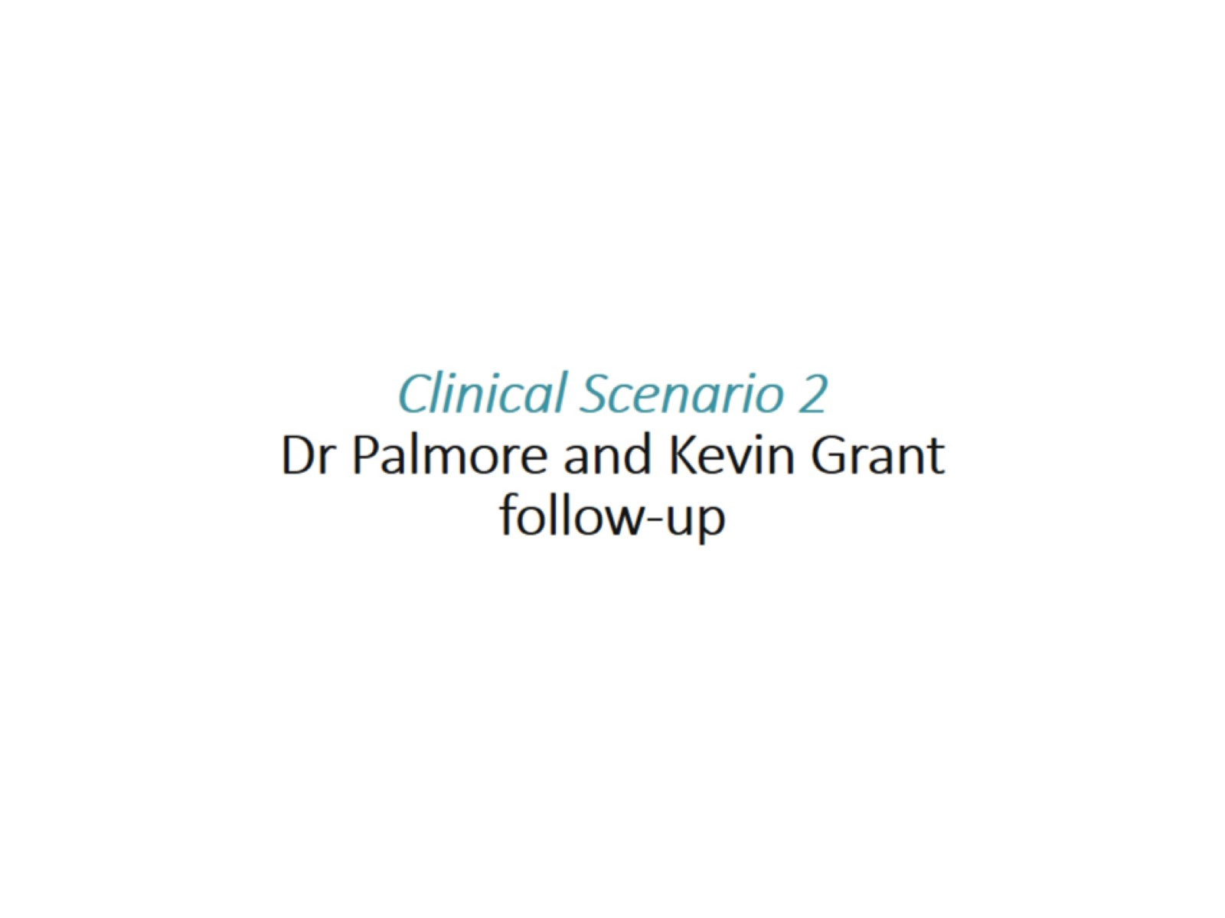
Clinical Scenario 2 Dr Palmore and Kevin Grant follow-up

Slide 48
Reflection on Clinical Scenario 2

Slide 49
Clinical Scenario 2 Expert Opinion/Patient Perspective

Slide 50
Adherence

Slide 51
Summary

Slide 52
Goals

Slide 53
Abbreviations

