Slide 1
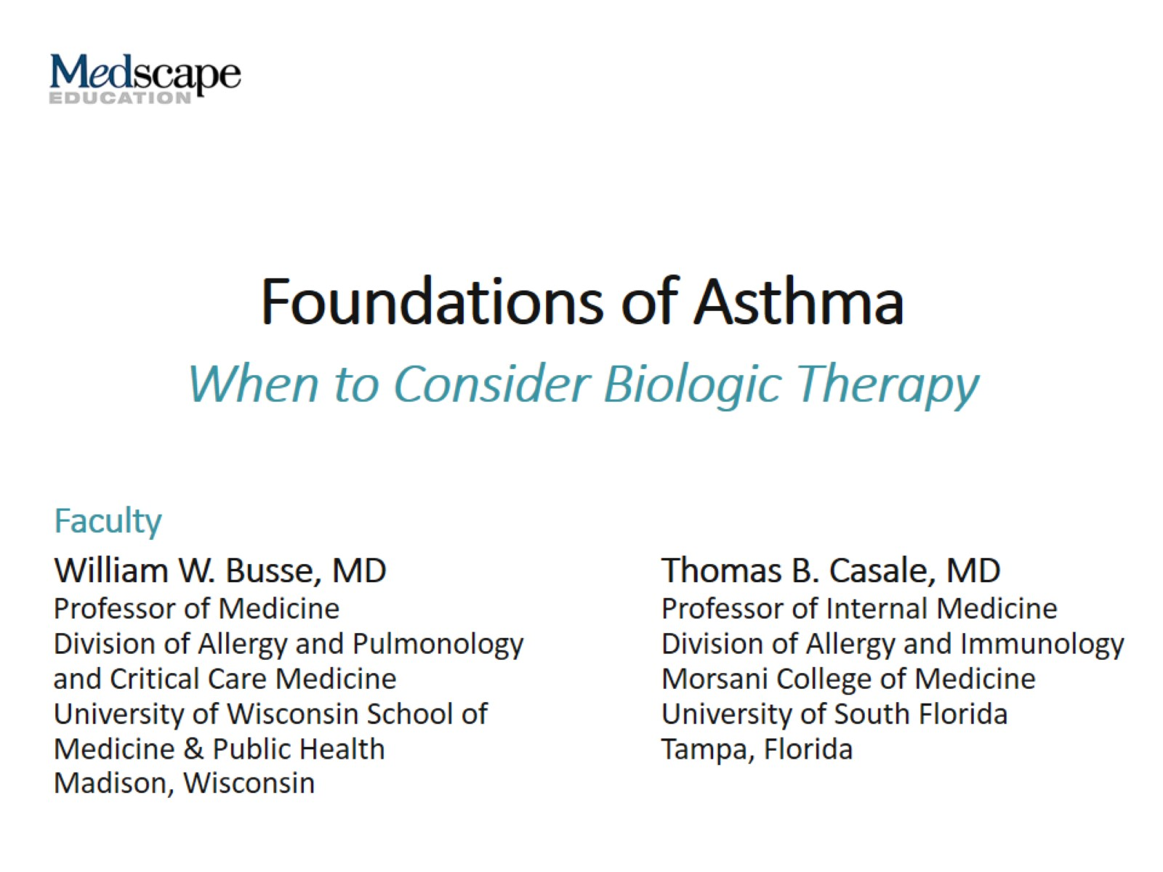
Foundations of Asthma

Slide 2
Asthma Overview

Slide 3
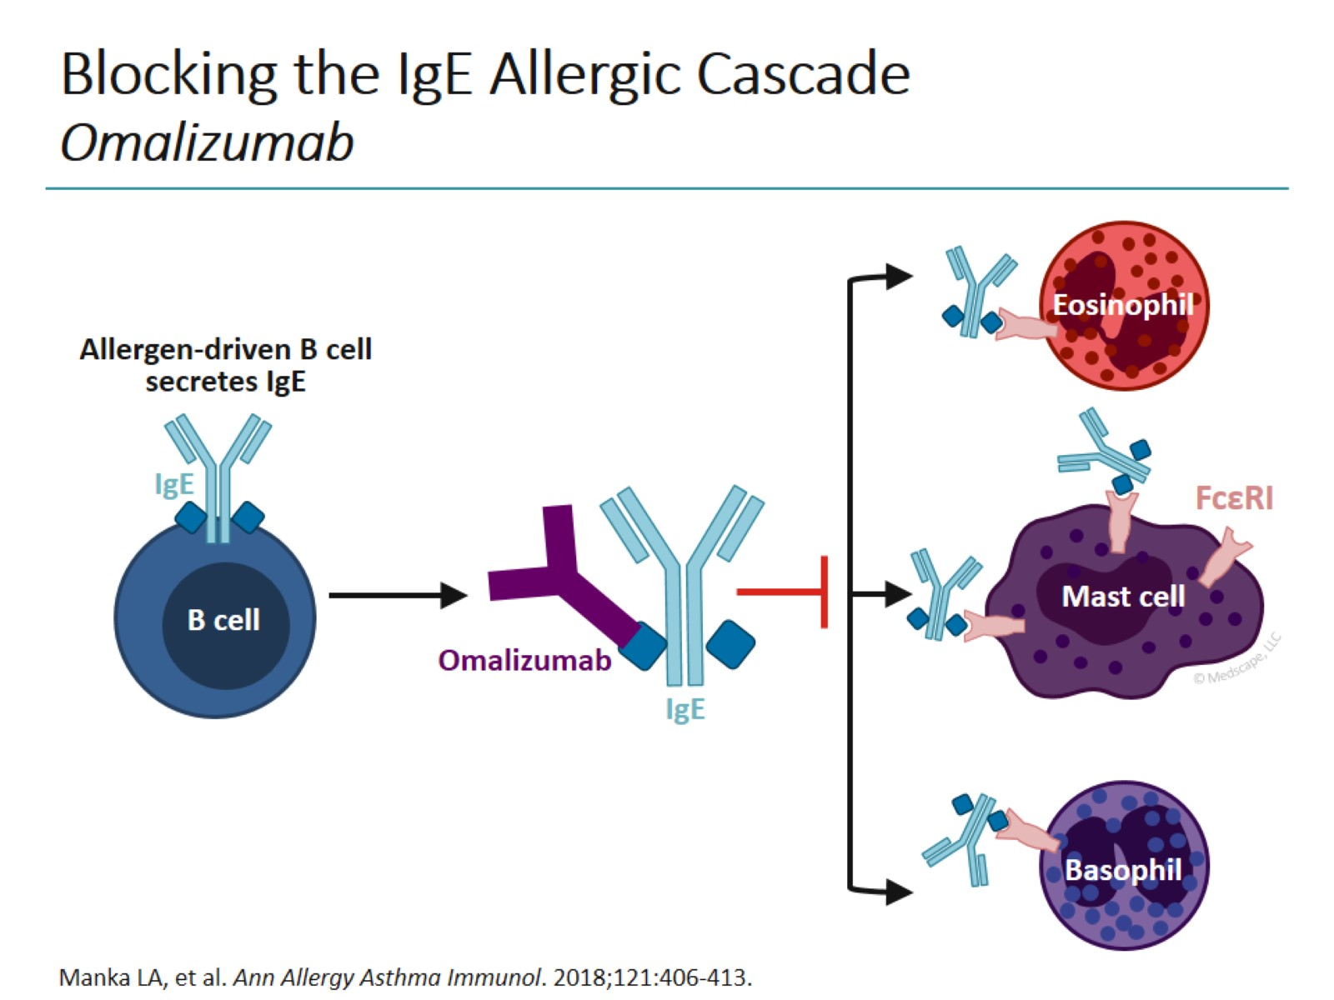
Blocking the IgE Allergic Cascade Omalizumab

Slide 4
Anti-IL-5 Therapy in Eosinophilic Asthma Mepolizumab, Reslizumab, Benralizumab

Slide 5
Anti-IL-4/IL-13 Therapy in Eosinophilic Asthma Dupilumab

Slide 6
Anti-IgE Monoclonal Antibody Omalizumab

Slide 7
Anti-IL-5 Biologics for Eosinophilic Asthma

Slide 8
Other Targeted Therapies for Eosinophilic Asthma

Slide 9
Biologics for Asthma: Warnings and Precautions

Slide 10
Efficacy of Biologics for Severe T2 Asthma

Slide 11
Does the Patient Need a Biologic?

Slide 12
Selecting the Right Biologic in Eosinophilic Asthma

Slide 13
How Long Should Biologic Therapy Be Used?

Slide 14
Concluding Remarks Biologics for Asthma

Slide 15
Abbreviations

