Slide 1
Mild Cognitive Impairment and Driving Safety

Slide 3
Introduction and Background

Slide 4
Older Adults and Driving

Slide 5
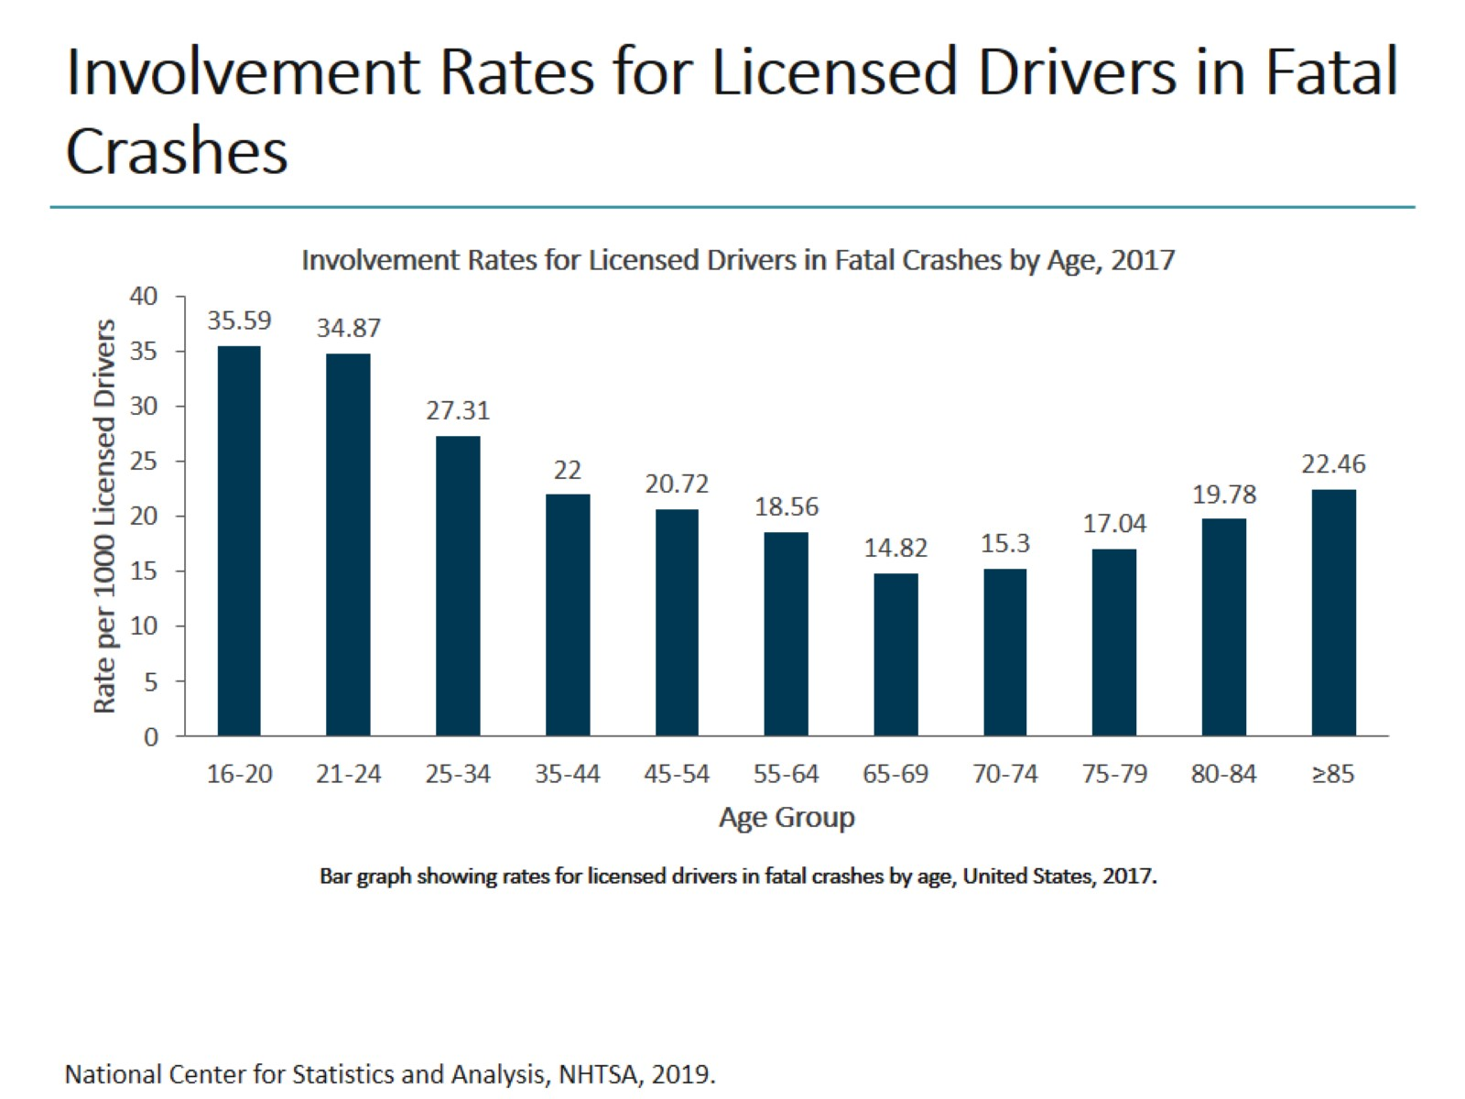
Involvement Rates for Licensed Drivers in Fatal Crashes

Slide 6
Cognitive Impairment

Slide 7
Patient Case MCI and Driving

Slide 8
Making the Diagnosis of MCI

Slide 9
Key Points in MCI

Slide 10
Patient Case Making the Diagnosis

Slide 11
Differential Diagnosis of MCI

Slide 12
Patient Case Evaluate for Reversible Causes and Comorbidities

Slide 13
MCI and Driving Literature

Slide 14
Red Flags Based on Medical Exam

Slide 15
Red Flags Reported by Patient/Caregiver

Slide 16
Clinician's Guide to Assessing and Counseling Older Drivers, 4th Edition

Slide 17
Clinician's Guide to Assessing and Counseling Older Drivers, 4th Edition (cont)

Slide 18
Collaboration With Driving Safety Professionals

Slide 19
Screening Recommendations

Slide 20
Screening Tools

Slide 21
Cognition Maze Test

Slide 22
Cognition MoCA

Slide 23
Cognition Trail Making B

Slide 24
Cognition Clock Drawing

Slide 25
Patient Case Office Based Driving Tests

Slide 26
Management of Outcomes

Slide 27
Management of MCI Screening

Slide 28
OT and DRS

Slide 29
Driver Rehabilitation Specialist

Slide 30
Prolong Safe Driving Treat Reversible Conditions

Slide 31
Assess Medications De-Prescribe or Use Lowest Dose of Least Offending Drug

Slide 32
Council on Health Lifestyle Behaviors to Delay or Prevent Cognitive Decline

Slide 33
Courses to Refresh Driving Knowledge

Slide 34
Patient Case One Year Later

Slide 35
Patient Case One Year Later (cont)

Slide 36
Driving Transition

Slide 37
Conversations With Patients and Families

Slide 38
Reporting Considerations

Slide 39
Where to Find Help?

Slide 40
Concluding Remarks

Slide 41
Abbreviations

Slide 42
Abbreviations (cont)

