Slide 1
Are We Ready to Define the Best Metric in Diabetes Management

Slide 2
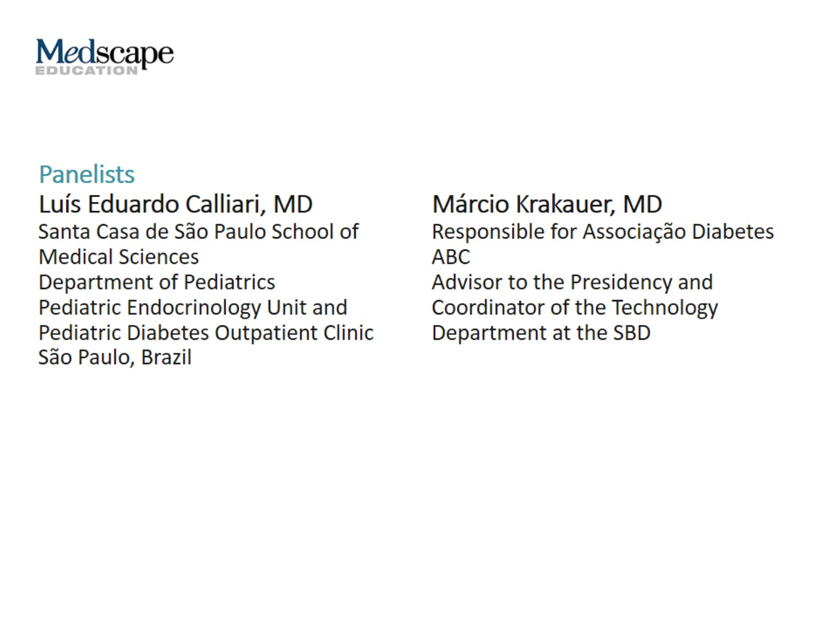

Slide 3
Outline

Slide 4
HbA_{1c} Key Milestones

Slide 5
Landmark DCCT/EDIC Study

Slide 6
HbA_{1c}

Slide 7
Correlation Between HbA_{1c} and Mean Glucose

Slide 8
HbA_{1c} and Glycemic Targets

Slide 9
History of Glycemic Monitoring

Slide 10
Using Ants to Diagnose Diabetes

Slide 11
Benedict’s Reagent to Test for Glucosuria

Slide 12
Glucose Meter and Logs

Slide 13
Real Patient’s Glycemic Graph 14 Days

Slide 14
Real Patient’s Glycemic Graph Daily CGM

Slide 15
HbA_{1c} Practical Limitations

Slide 16
What’s New in Glycemic Monitoring?

Slide 17
Consensus Reached on Use of CGM

Slide 18
Key Metrics for CGM Data Analysis and Reporting

Slide 19
Time In Target Range/Time In Range

Slide 20
Recommendations From the International Consensus on TIR, 2019

Slide 21
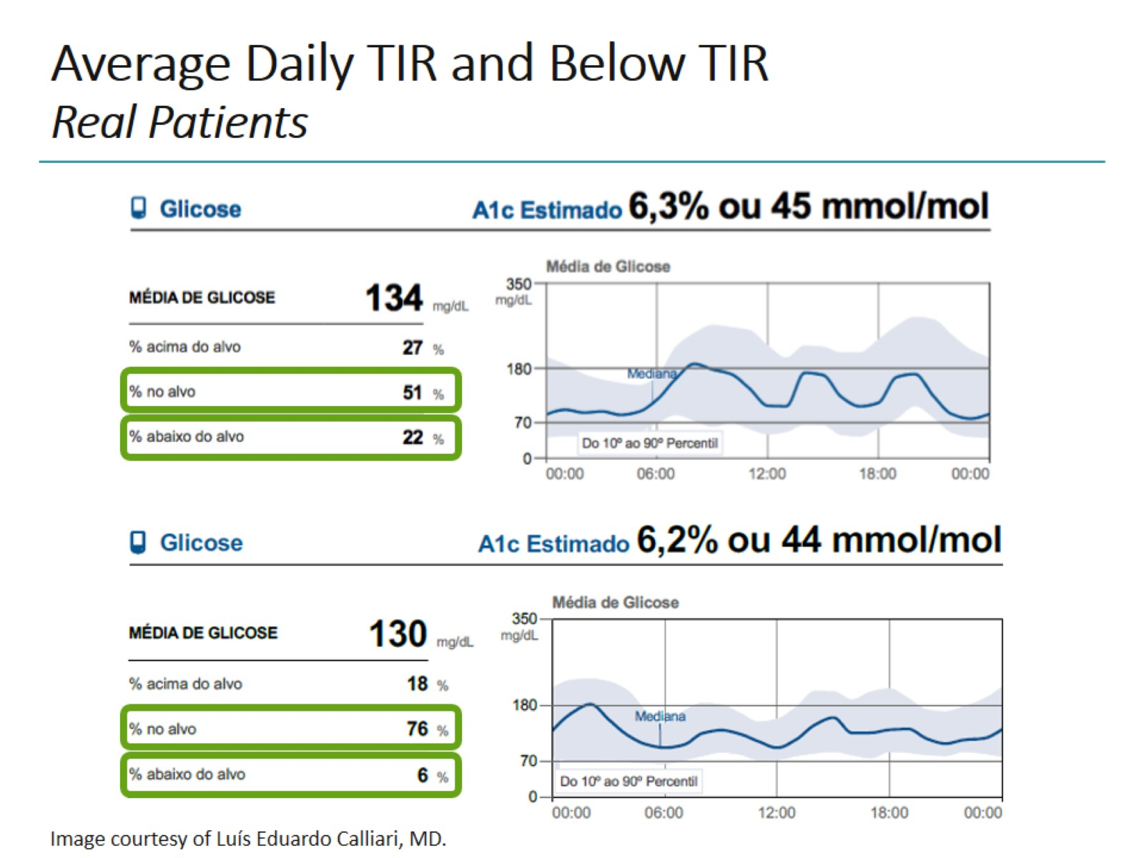
Average Daily TIR and Below TIR Real Patients

Slide 22
Average Daily TIR and Below TIR (cont) Real Patients

Slide 23
Relationship Between HbA_{1c} and TIR

Slide 24
TIR is Associated with Microvascular Complications

Slide 25
CGM Reporting The Ambulatory Glucose Profile (AGP)

Slide 26
AGP Report Time in Ranges

Slide 27
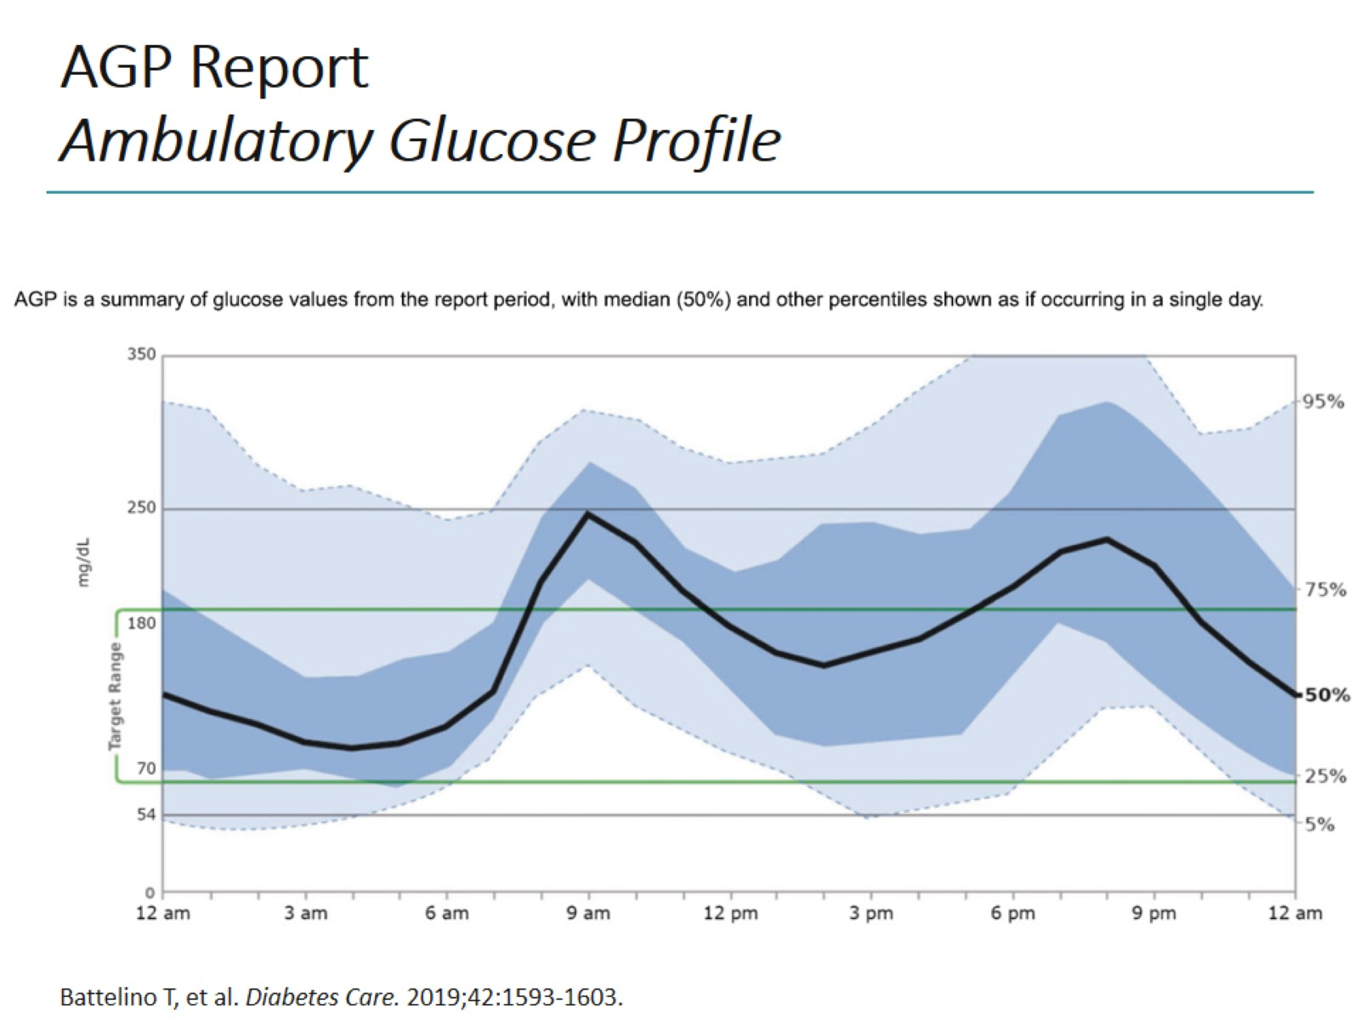
AGP Report Ambulatory Glucose Profile

Slide 28
AGP Report Daily Glucose Profiles

Slide 29
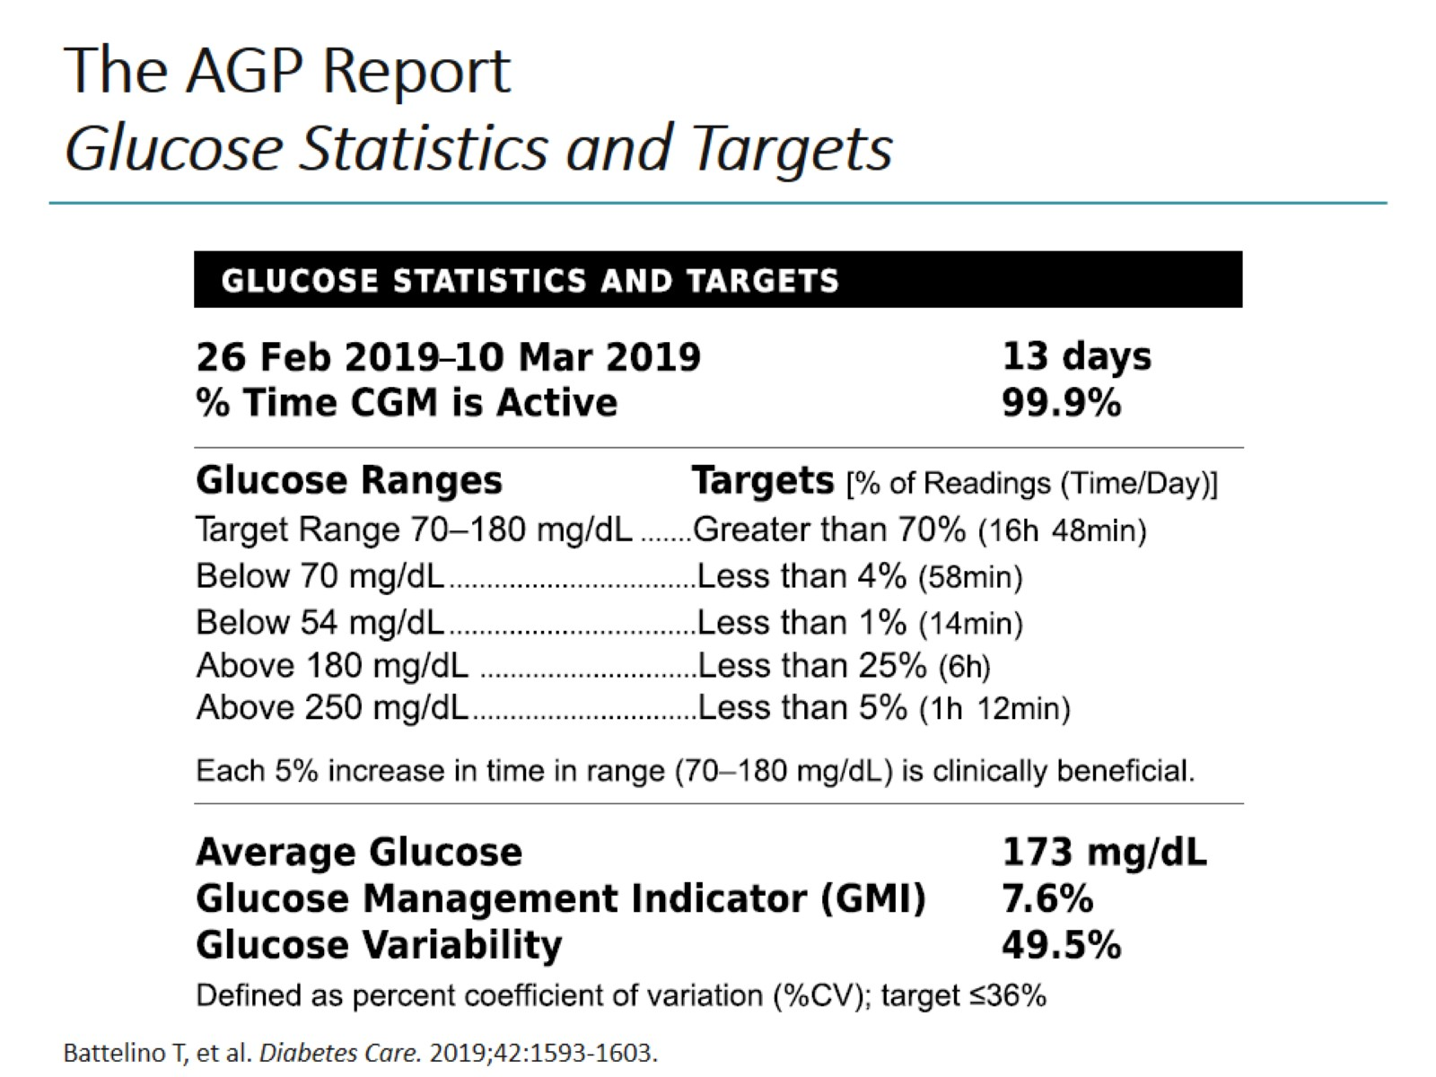
The AGP Report Glucose Statistics and Targets

Slide 30
CGM Reporting Valuable Information For Patients

Slide 31
CGM Reporting (cont) Value for Physicians and Patients

Slide 32
CGM Reporting (cont) Value for Physicians and Patients

Slide 33
CGM Reporting Glucose Variability

Slide 34
Glucose Variability CV and SD

Slide 35
Closing Remarks

Slide 36
Abbreviations

