Slide 1
Factor Xa Inhibitors in Coronary Artery Disease and Peripheral Artery Disease

Slide 3
Mechanism of Thrombus Formation

Slide 4
Mechanism of Thrombus Formation (cont) Process 1: Platelet Activation

Slide 5
Mechanism of Thrombus Formation (cont) Process 2: Thrombin Generation

Slide 6
Patients With PAD or CAD Remain At High Risk Despite Single or Dual Antiplatelet Therapy

Slide 7
Dual Pathway Inhibition Platelet Inhibition and Low-Dose Anticoagulation

Slide 8
COMPASS Trial Design

Slide 9
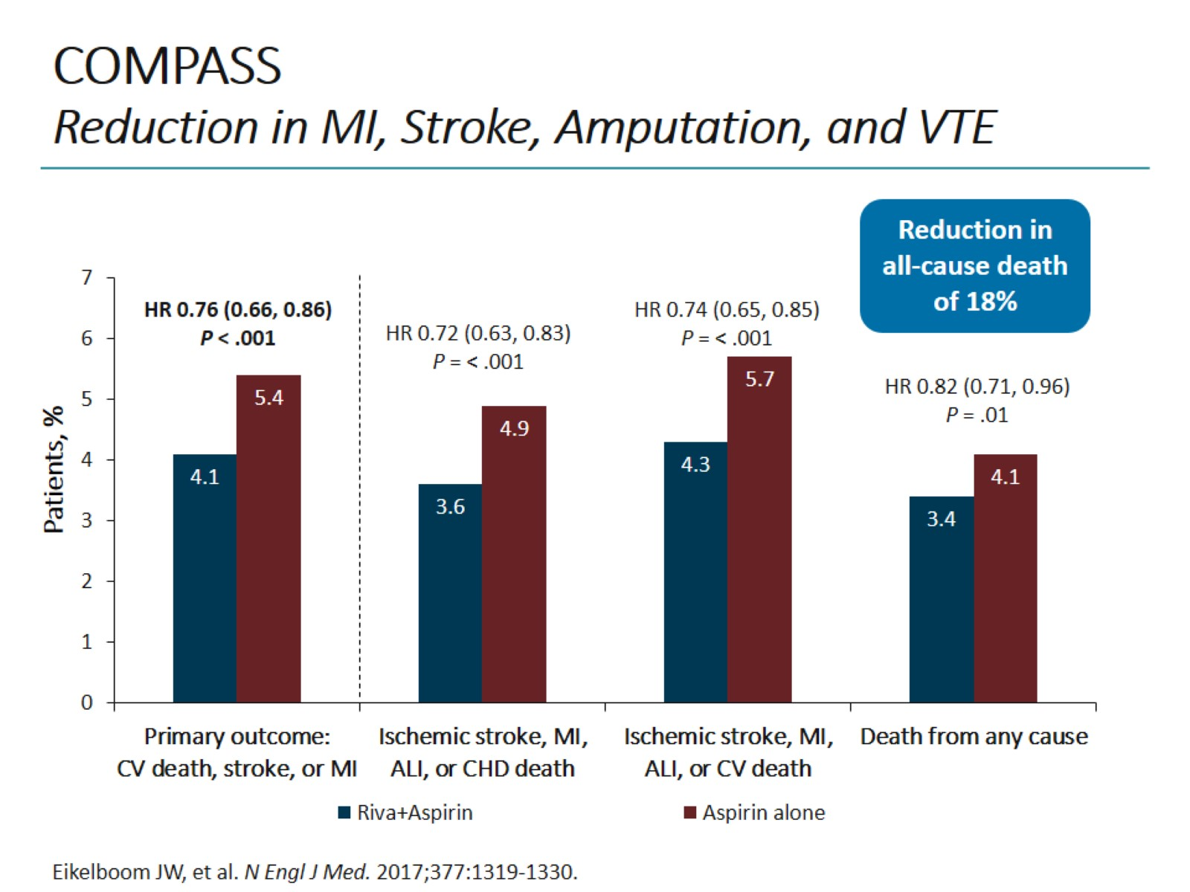
COMPASS Reduction in MI, Stroke, Amputation, and VTE

Slide 10
COMPASS Safety Results in Overall Population

Slide 11
COMPASS Primary Efficacy Endpoint

Slide 12
2019 ESC Guidelines for Diagnosis and Management of Chronic Coronary Syndromes: Dual Antithrombotic Therapy

Slide 13
Evolution of PAD Management

Slide 14
COMPASS: PAD Cohort

Slide 15
Guideline Recommendations for Antithrombotic Therapy in PAD Management

Slide 16
The Path to DPI

Slide 17
COMPASS PCI Subanalysis of COMPASS

Slide 18
COMPASS PCI Secondary Efficacy Endpoint (ITT)

Slide 19
VOYAGER PAD Study Design

Slide 20
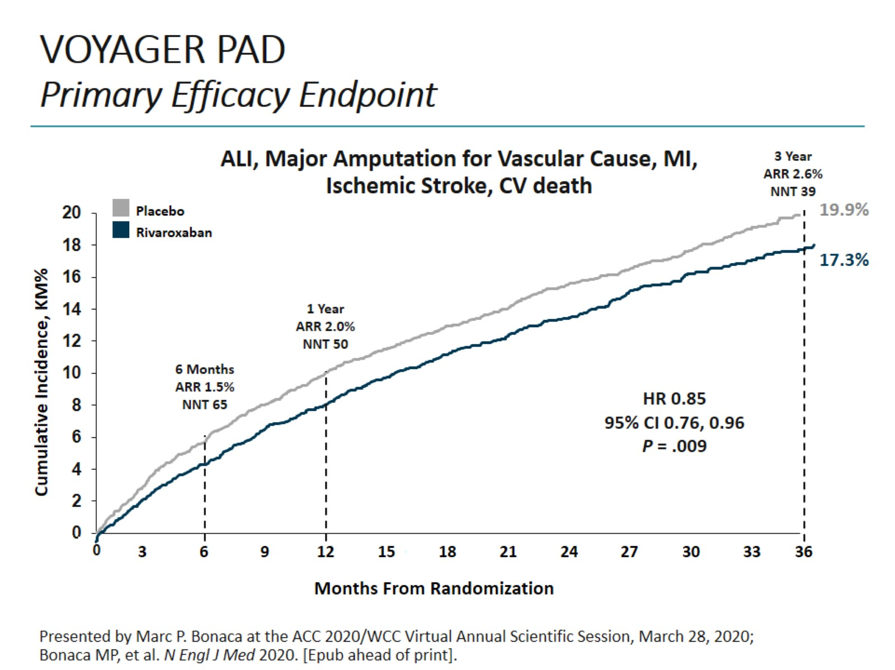
VOYAGER PAD Primary Efficacy Endpoint

Slide 21
VOYAGER PAD Safety Outcomes

Slide 22
Clinical Implications Antithrombotic Therapy in PAD

Slide 23
Patient Case

Slide 24
Antithrombotic Therapy Recommendations for PAD

Slide 25
Conclusions

Slide 26
Abbreviations

Slide 27
Abbreviations (cont)

Slide 28
Abbreviations (cont)

