Slide 1
The Aesthetic Game Show

Slide 2
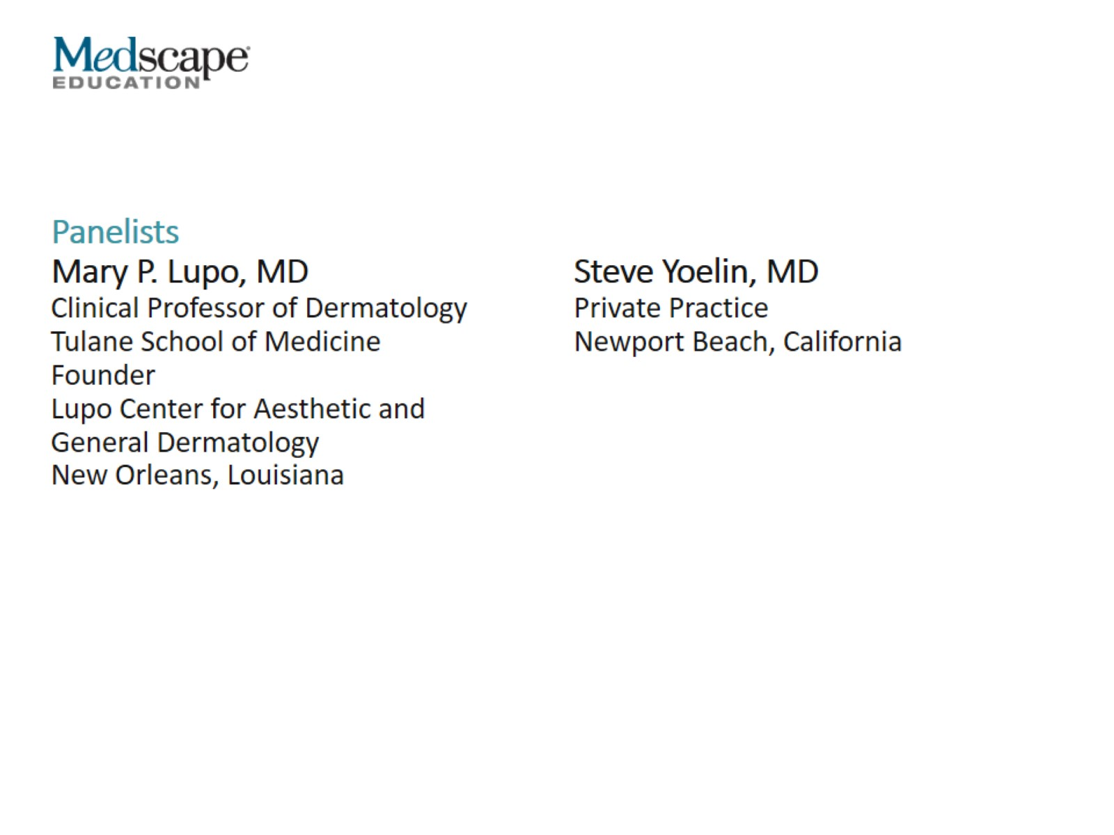

Slide 3
Patient 1: Woman With Fat Pad Dissent

Slide 4
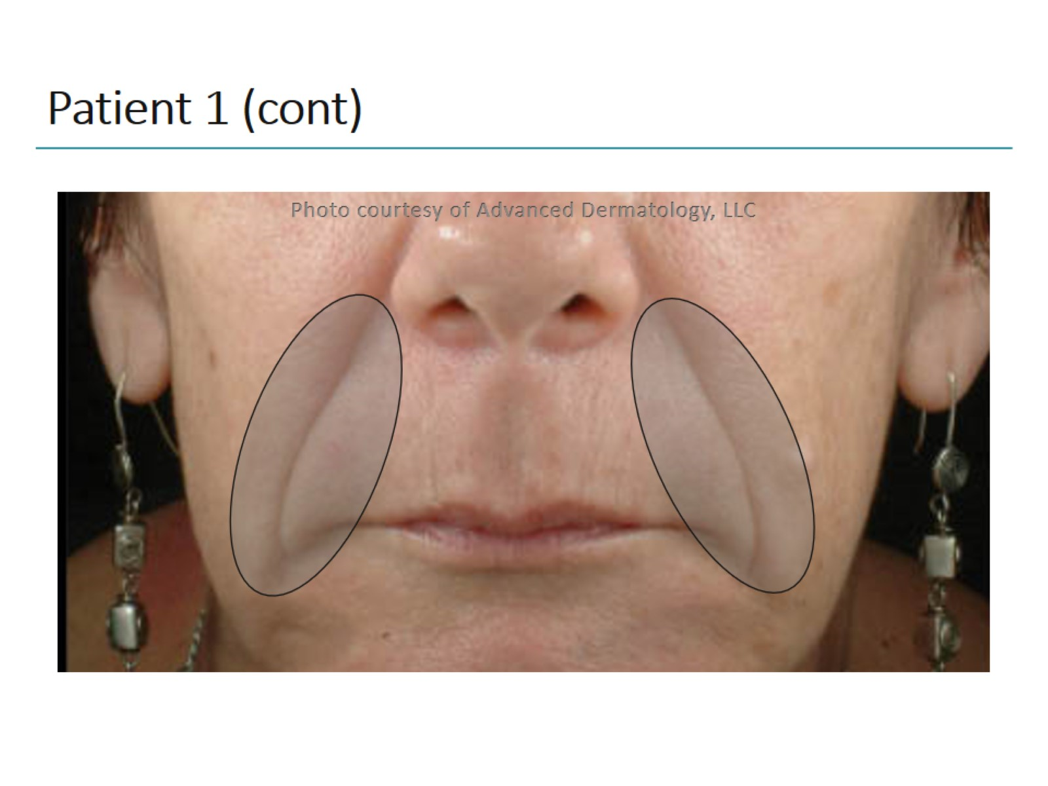
Patient 1 (cont)

Slide 5
Patient 1 (cont)

Slide 6
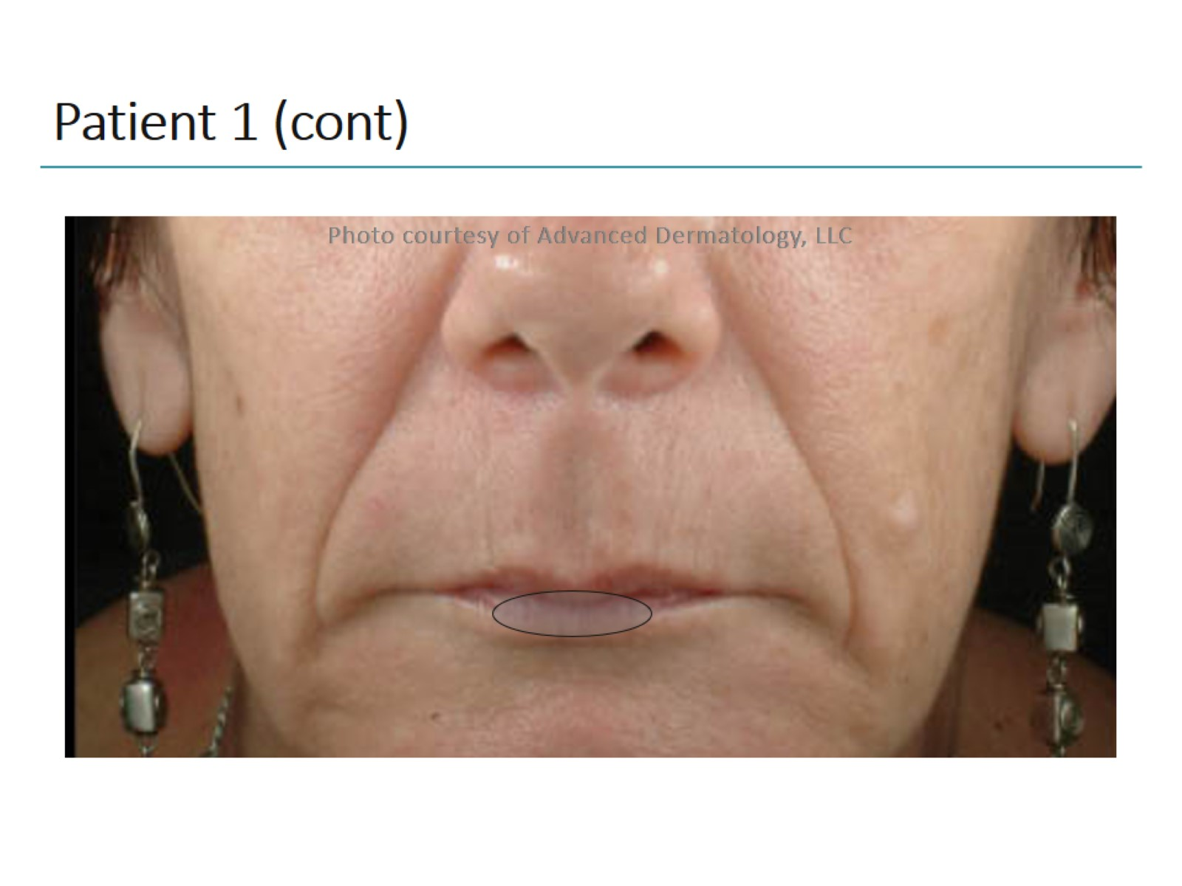
Patient 1 (cont)

Slide 7
Patient 1 (cont)

Slide 8
Patient 1 (cont)

Slide 9
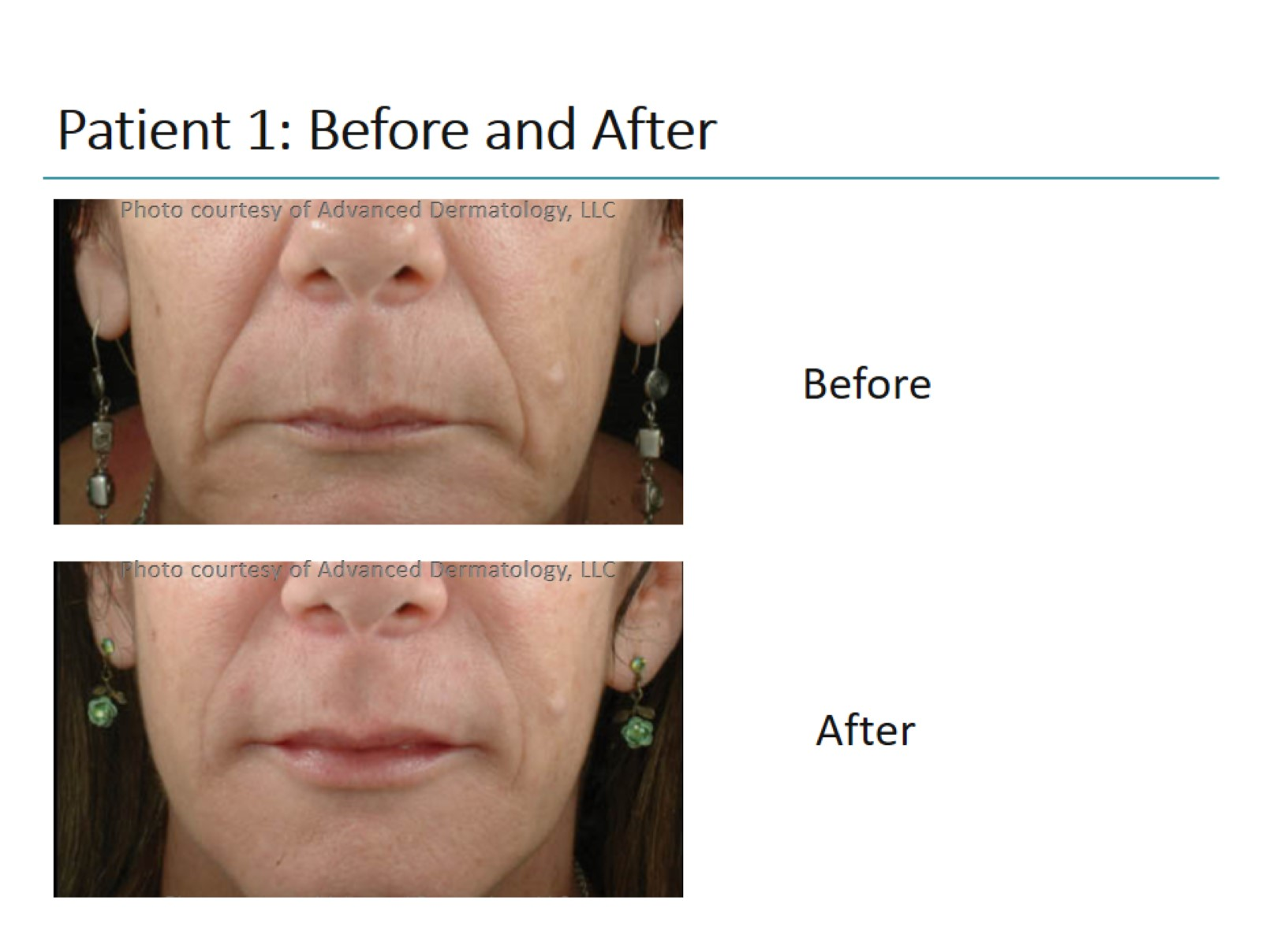
Patient 1: Before and After

Slide 10
How Was the Patient Treated?

Slide 11
Patient 2: Woman With Prominent Nasolabial Folds

Slide 12
Patient 2 (cont)

Slide 13
Patient 2 (cont)

Slide 14
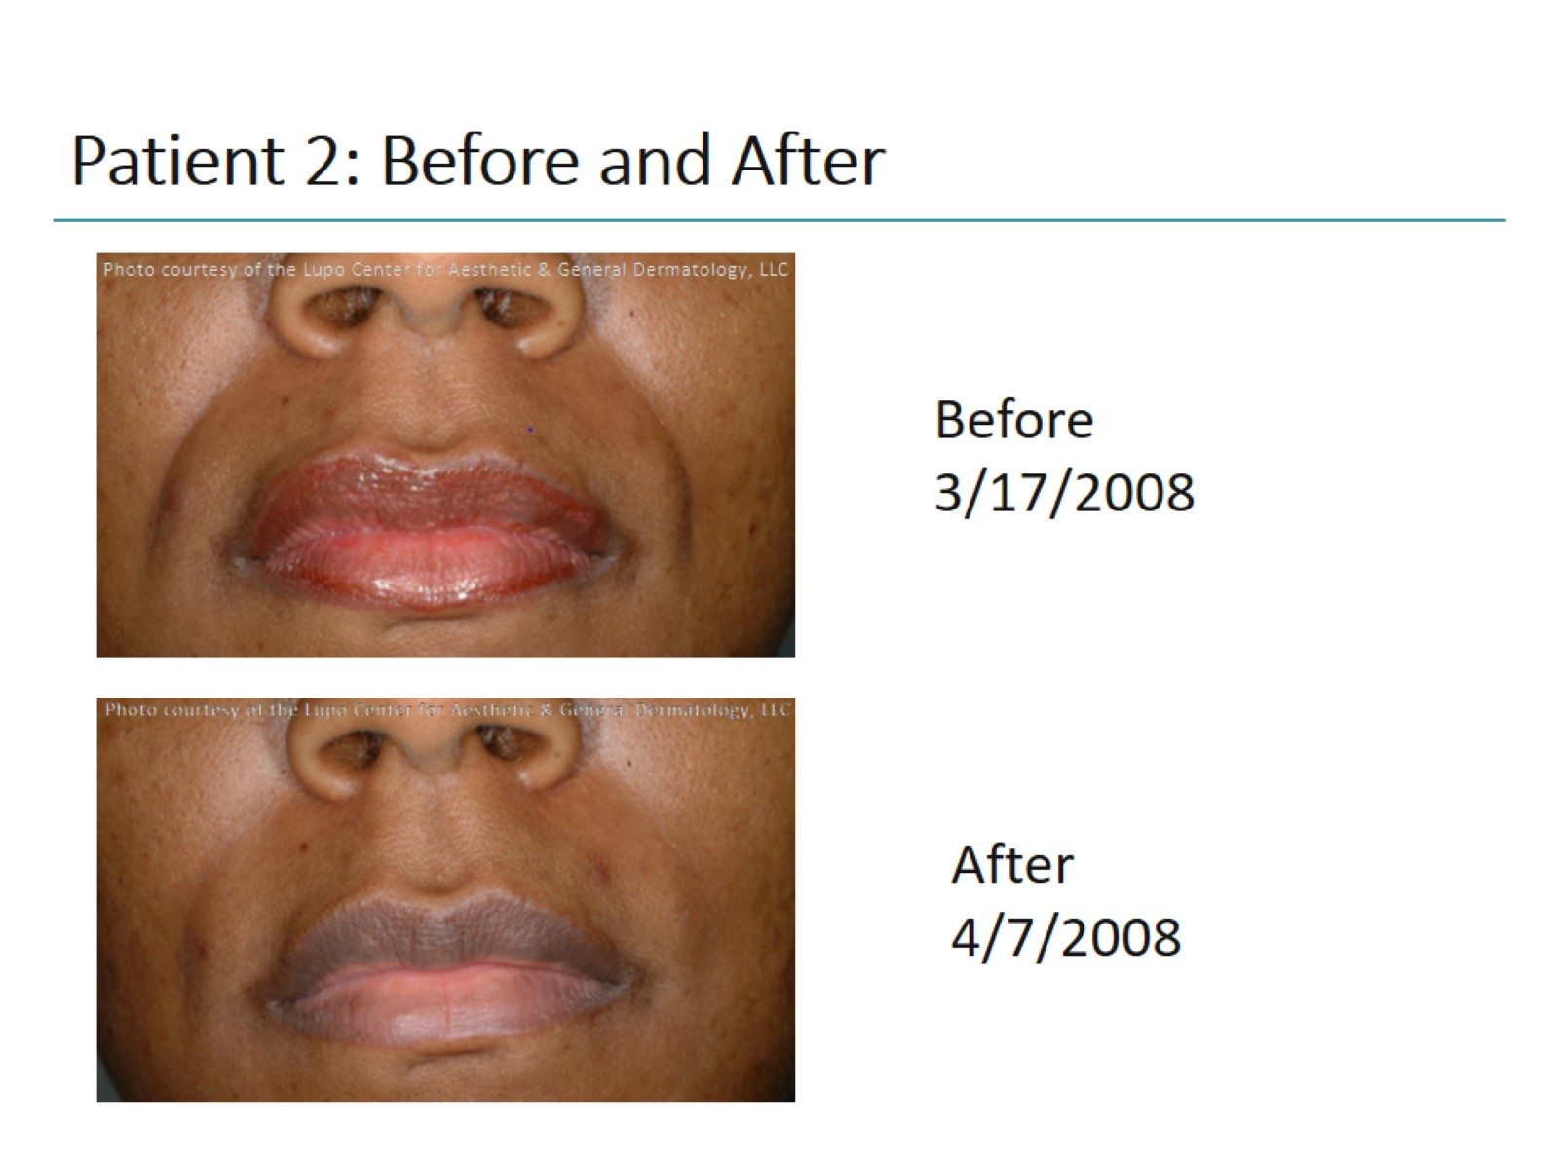
Patient 2: Before and After

Slide 15
How Was the Patient Treated?

Slide 16
Patient 3: Man With Static Forehead Lines

Slide 17
Patient 3 (cont)

Slide 18
Patient 3 (cont)

Slide 19
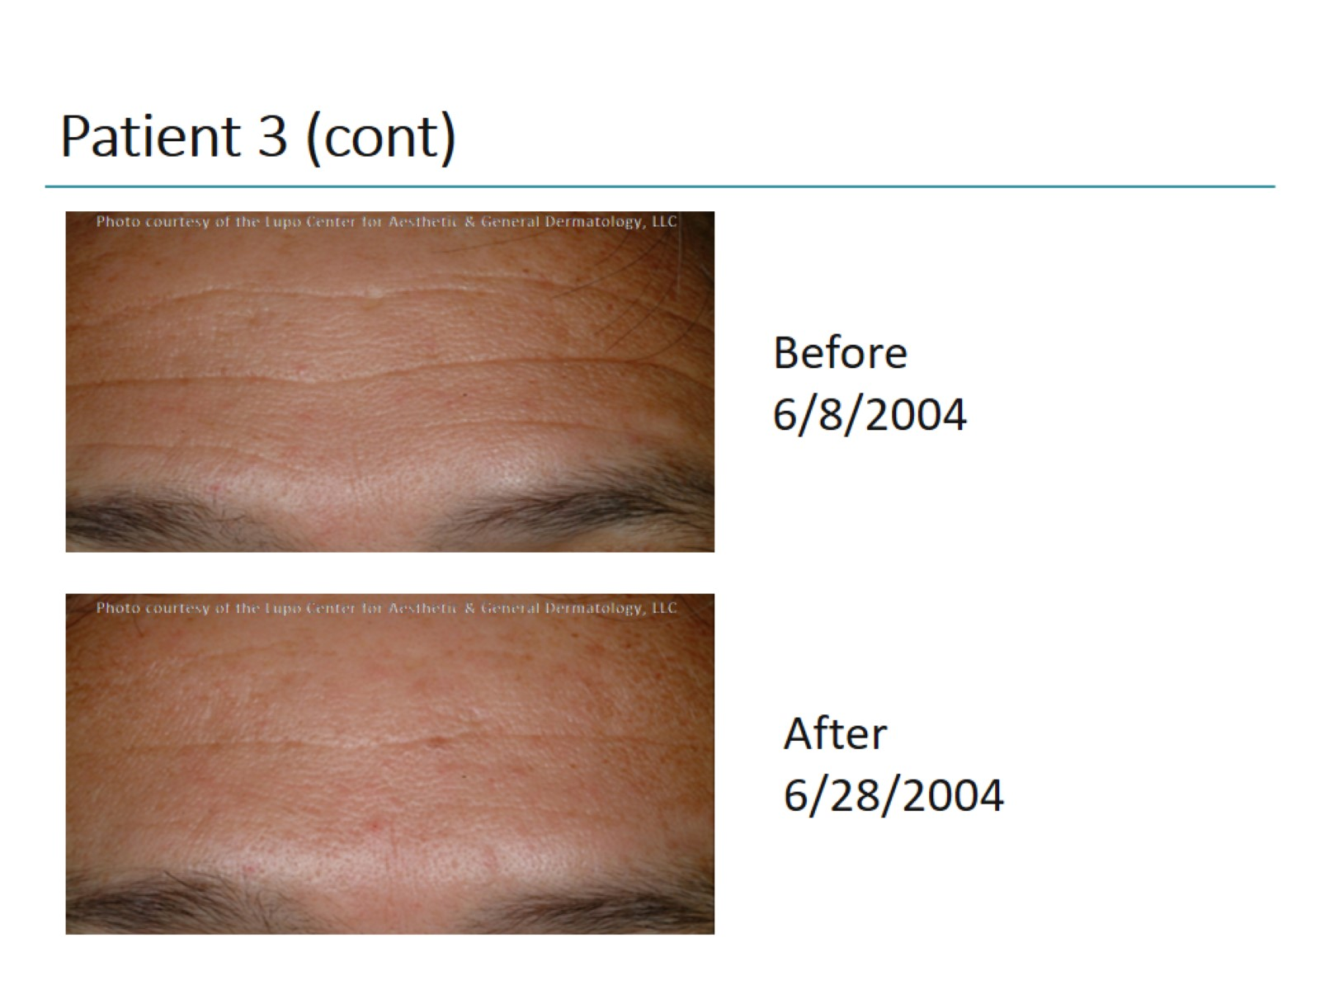
Patient 3 (cont)

Slide 20
How Was the Patient Treated?

Slide 21
Patient 4: Woman With Dynamic Crow's Feet

Slide 22
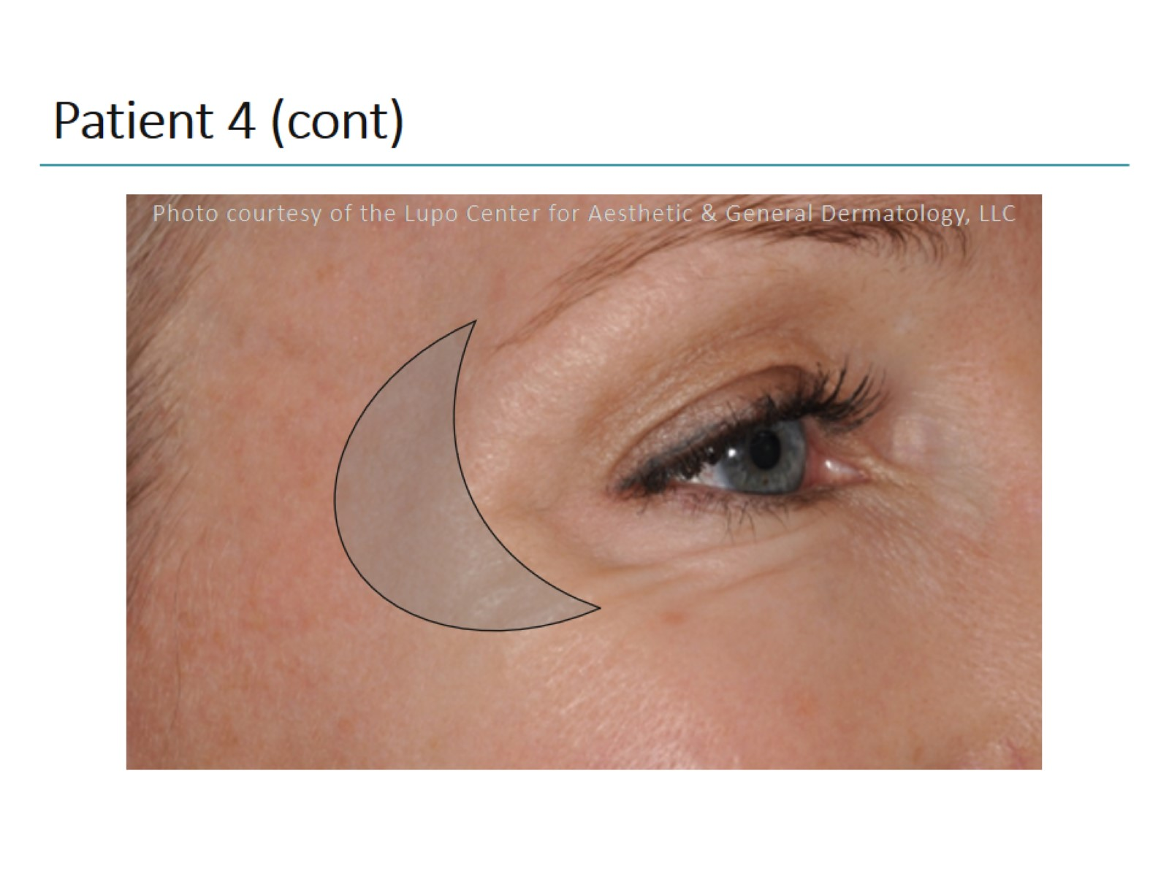
Patient 4 (cont)

Slide 23
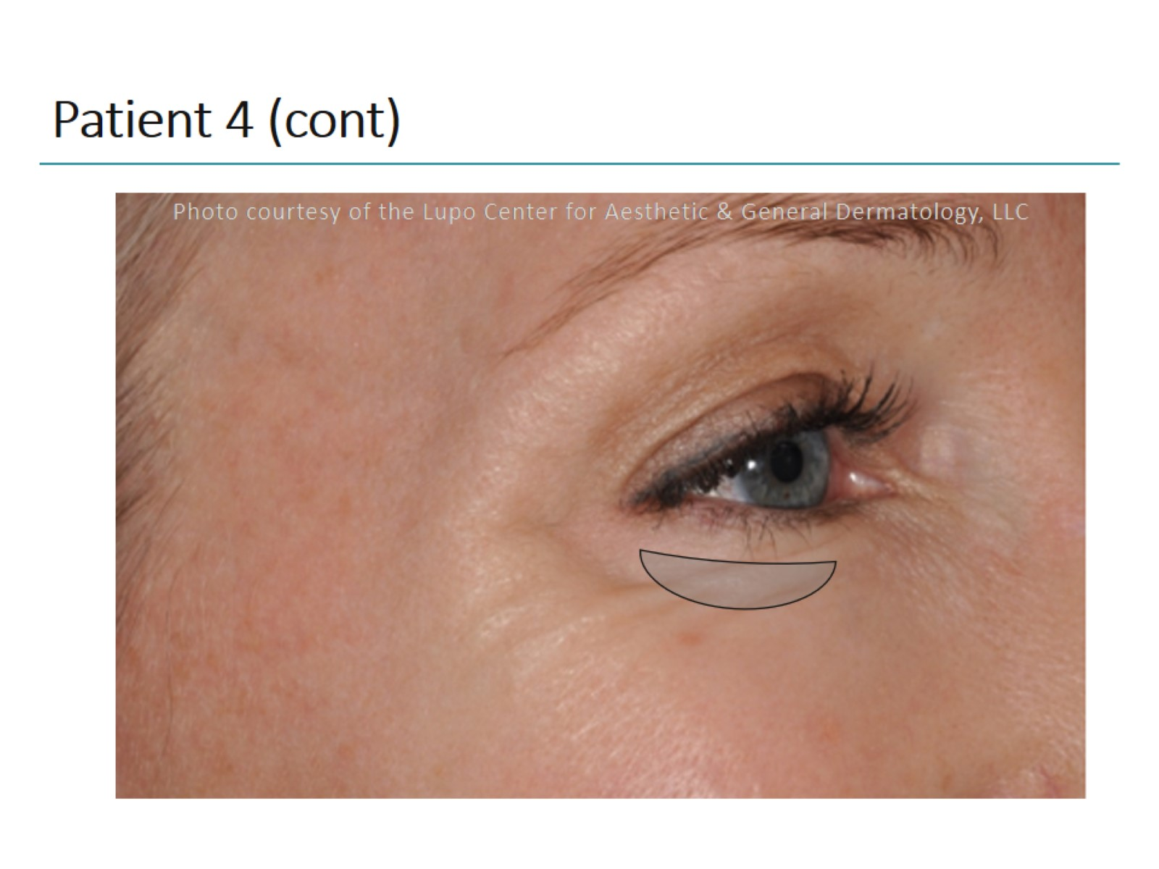
Patient 4 (cont)

Slide 24
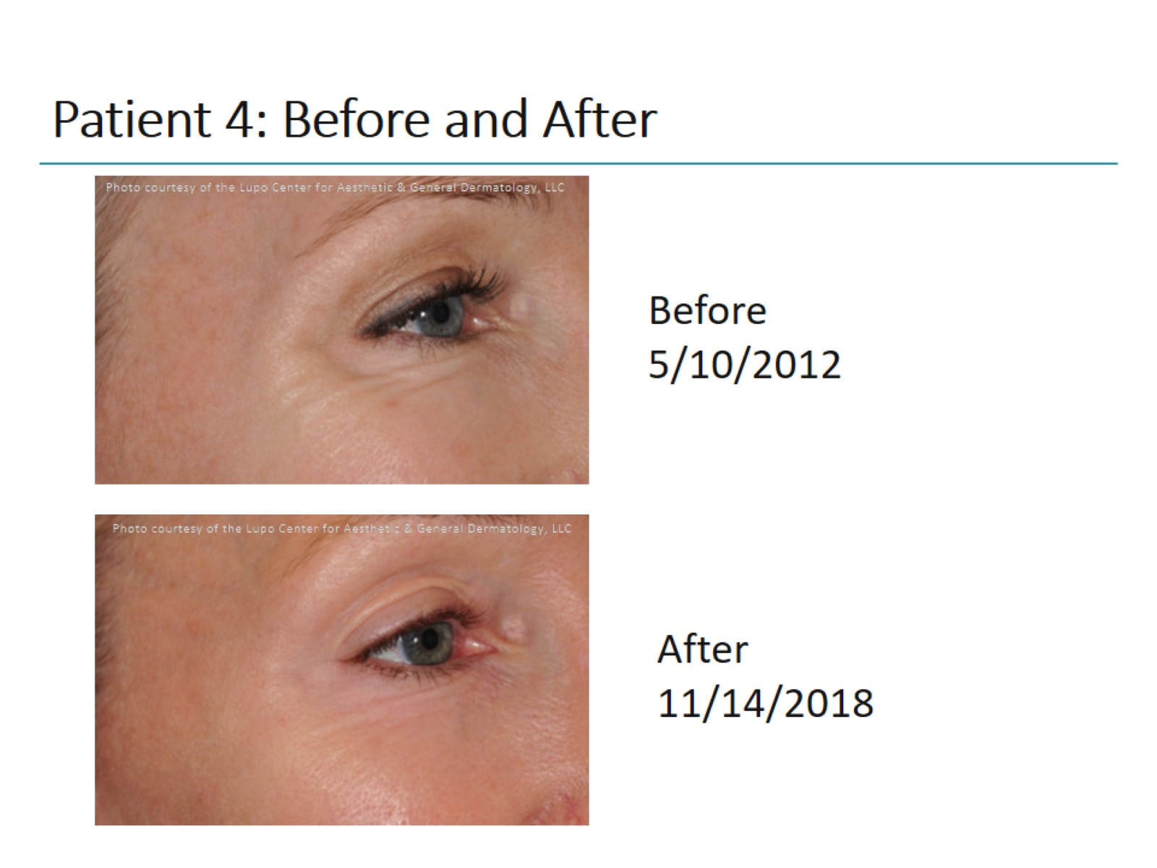
Patient 4: Before and After

Slide 25
How Was the Patient Treated?

Slide 26
Patient 5: Woman With Full Facial Rejuvenation 1

Slide 27
Patient 5 (cont)

Slide 28
Patient 5 (cont)

Slide 29
Patient 5 (cont)

Slide 30
Patient 5 (cont)

Slide 31
Patient 5 (cont)

Slide 32
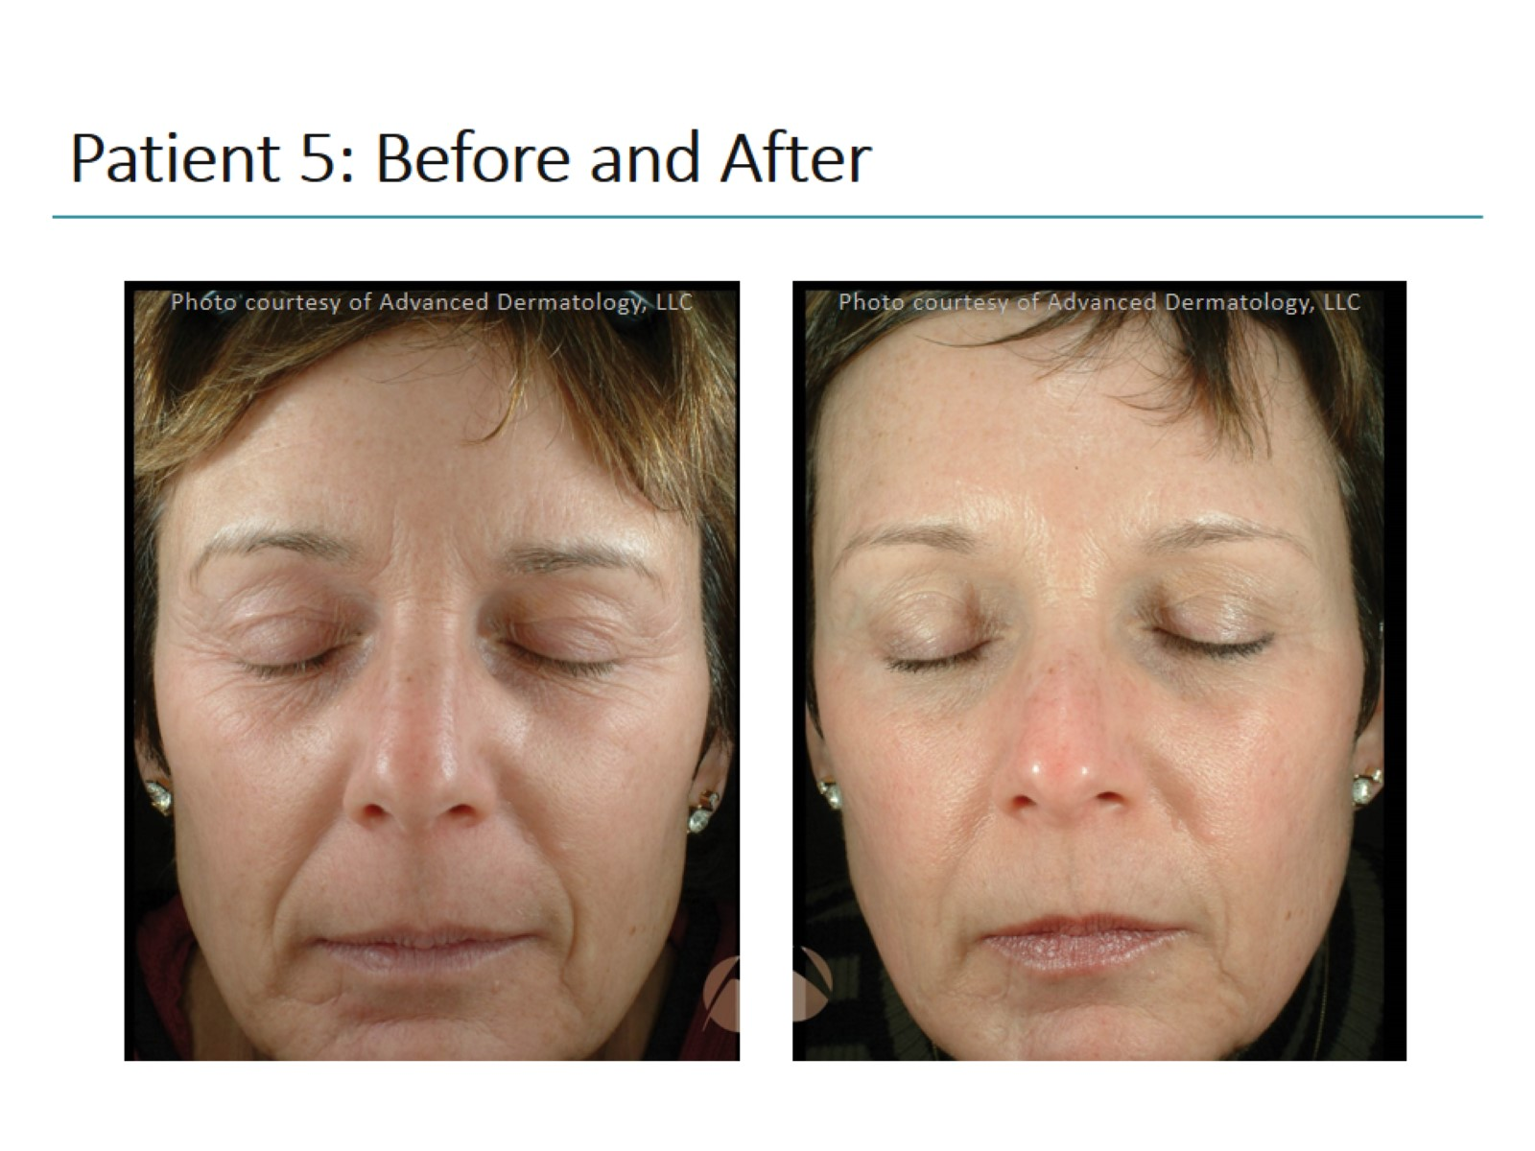
Patient 5: Before and After

Slide 33
How Was the Patient Treated?

Slide 34
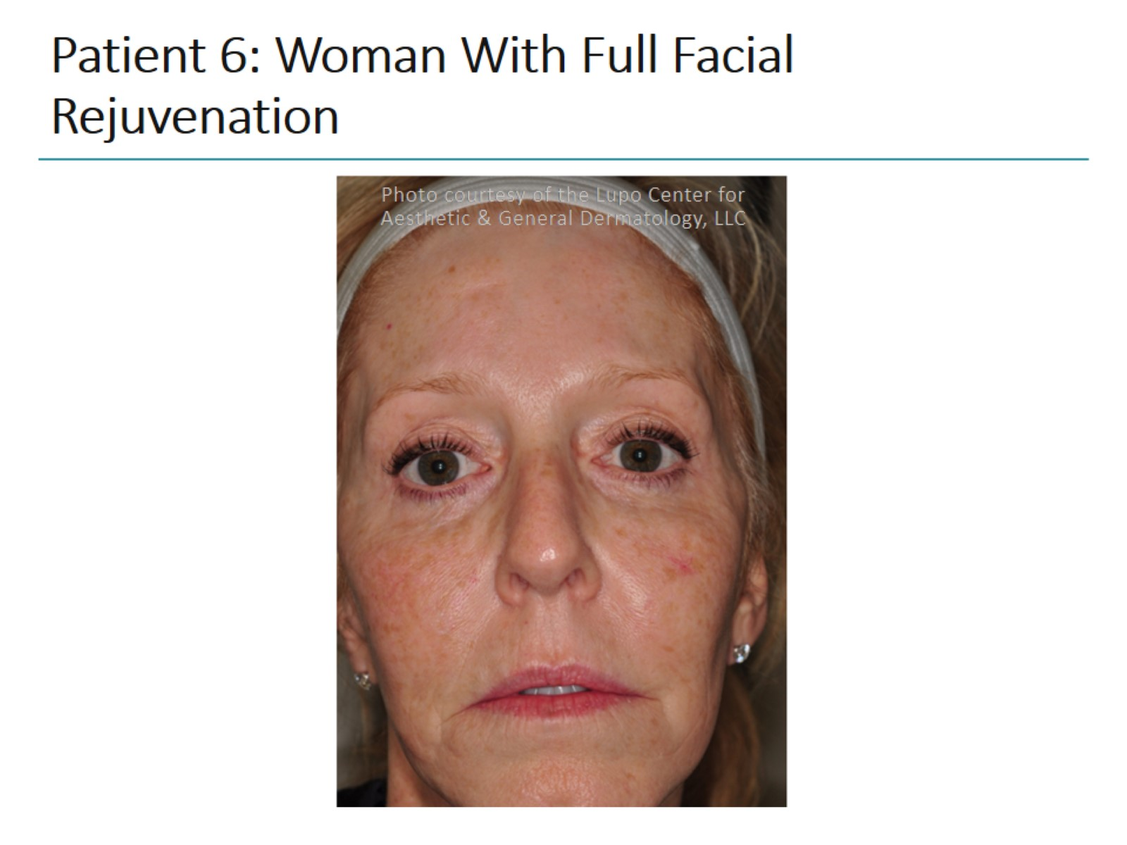
Patient 6: Woman With Full Facial Rejuvenation

Slide 35
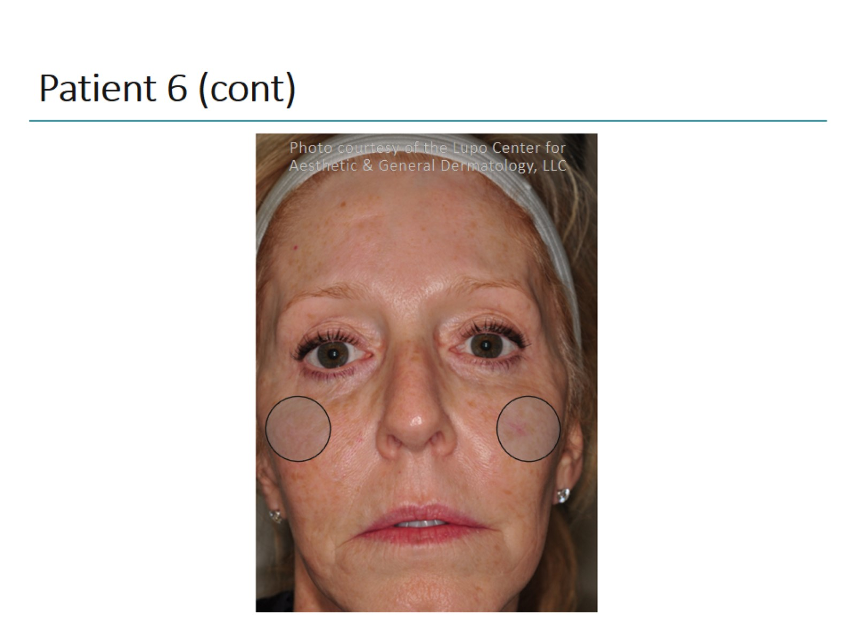
Patient 6 (cont)

Slide 36
Patient 6 (cont)

Slide 37
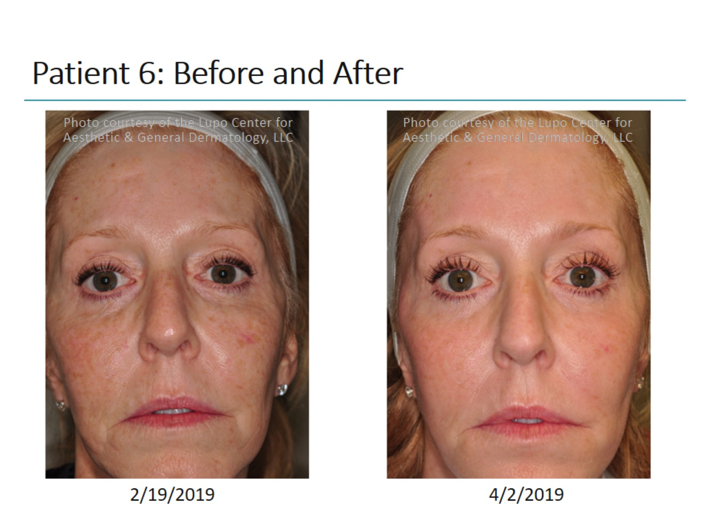
Patient 6: Before and After

Slide 38
How Was the Patient Treated?

Slide 39
Abbreviations

