Slide 1
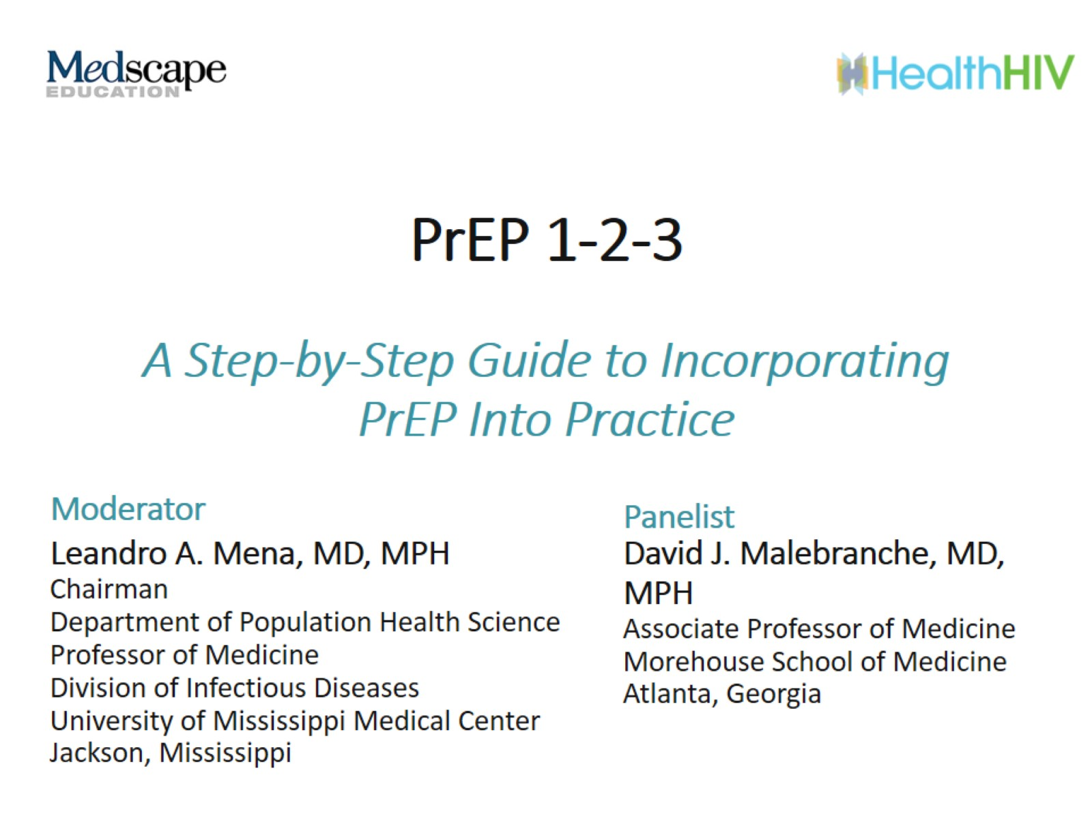
PrEP 1-2-3

Slide 2
PrEP: Pre-Exposure Prophylaxis Overview

Slide 3
PrEP Regimen #1 TDF 300 mg/FTC 200 mg

Slide 4
PrEP Regimen #2 TAF 25 mg/FTC 200 mg

Slide 5
PrEP Regimen #2 TAF 25 mg/FTC 200 mg (cont)

Slide 6
CDC Guidance for Implementing PrEP

Slide 7
Screening Who’s a Good Candidate for PrEP?

Slide 8
Screening Assess Risk

Slide 9
Obtaining a Detailed Sexual History

Slide 10
Obtaining a Detailed Sexual History (cont)

Slide 11
Obtaining a Drug Use History

Slide 12
Risk for Poor Adherence Adherence Impacts Efficacy

Slide 13
Monitoring Adherence to PrEP Direct and Indirect Methods

Slide 14
Risk of Adverse Outcomes

Slide 15
Initial Baseline Assessments Testing Prior to PrEP Initiation

Slide 16
Initial Baseline Assessments Testing Prior to PrEP Initiation (cont)

Slide 17
Initial Baseline Assessments Counseling and Education

Slide 18
Populations for Special Consideration Women During Periconception and Pregnancy

Slide 19
Populations for Special Consideration Transgender-Identifying People

Slide 20
Populations for Special Consideration Adolescents

Slide 21
Initiating PrEP Factors to Consider When Choosing a Regimen

Slide 22
Initiating PrEP Factors to Consider When Choosing a Regimen (cont)

Slide 23
Follow-up and Monitoring for PrEP

Slide 24
Follow-up and Monitoring for PrEP (cont)

Slide 25
Next Steps for Providers

Slide 26
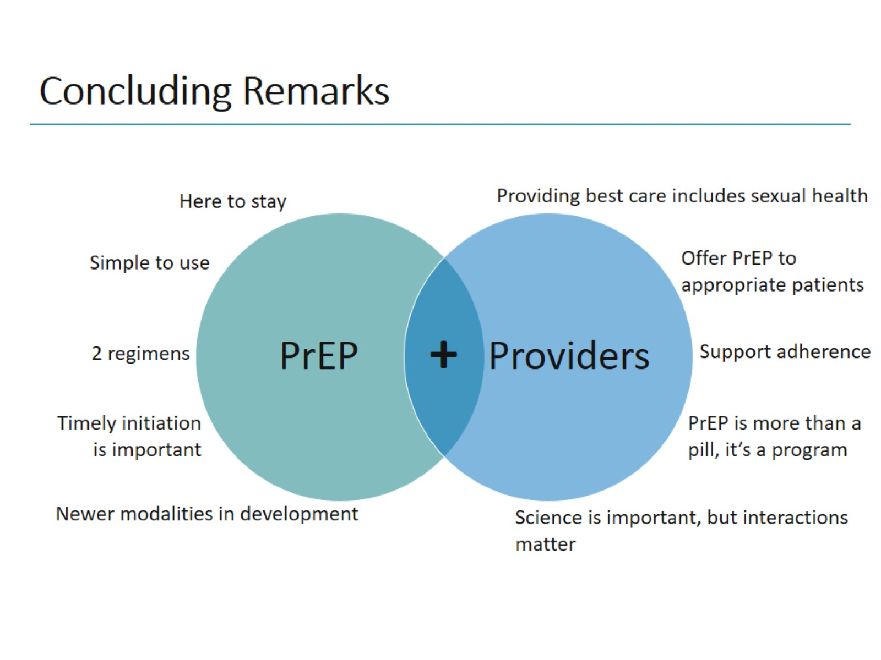
Concluding Remarks

Slide 27
Abbreviations

Slide 28
Abbreviations (cont)

