Slide 1
The COVID-19 Pandemic

Slide 2
Tracking the Pandemic

Slide 3
Classification of COVID-19 Severity

Slide 4
Disease Course

Slide 5
NIH Guidelines

Slide 6
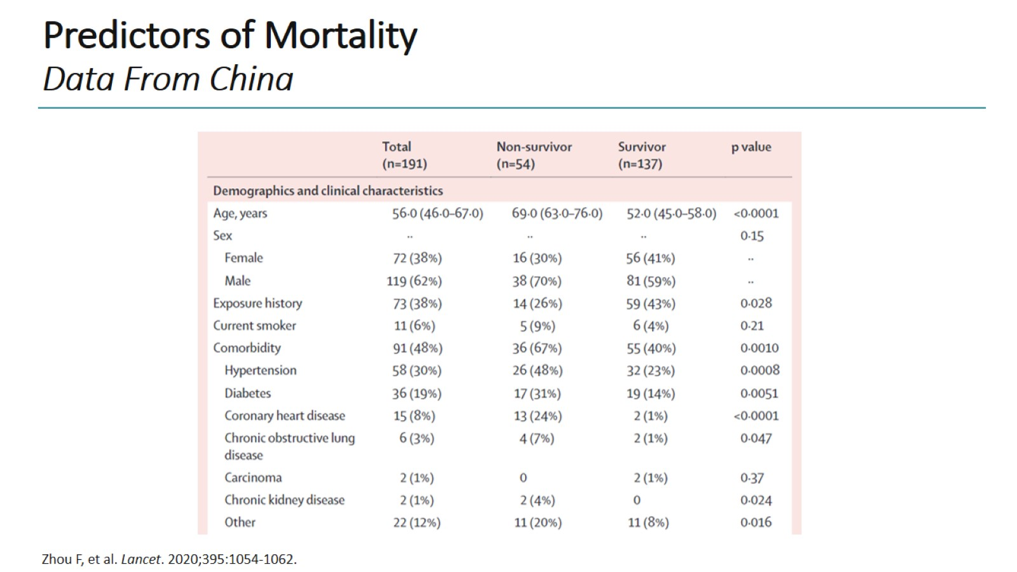
Predictors of Mortality Data From China

Slide 7
Predictors of Mortality Data From UK

Slide 8
Predictors of Mortality Ethnic Groups

Slide 9
SARS-CoV-2 ACE2 Receptor

Slide 10
Immune Response to COVID-19

Slide 11
Clinical Stages of Disease

Slide 12
Possible Treatments for COVID-19

Slide 13
Tocilizumab (IL-6 Blockade) for COVID-19 Hyperinflammation

Slide 14
Anakinra (IL-1 Blockade) for COVID-19 Hyperinflammation

Slide 15
Treatment Protocol in Dr Bassetti's Hospital

Slide 16
Treatment Protocol in Dr Bassetti's Hospital (cont)

Slide 17
Early Treatment with Tocilizumab and Steroids

Slide 18
Remdesivir (GS-5734)

Slide 19
Remdesivir in Adults With Severe COVID-19

Slide 20
Remdesivir for the Treatment of COVID-19 ACTT-1 Trial: Preliminary Report

Slide 21
Remdesivir for the Treatment of COVID-19 ACTT-1 Trial: Preliminary Report -- Results

Slide 22
Remdesivir Treatment Duration

Slide 23
Remdesivir Treatment Duration Study Results

Slide 24
Phase 3 Trial of Remdesivir in Patients With Moderate COVID-19 Results

Slide 25
Remdesivir Summary of Conclusions

Slide 26
SOLIDARITY Ongoing Trial

Slide 27
Case Study 1 Description

Slide 28
Case Study 1 Description (cont)

Slide 29
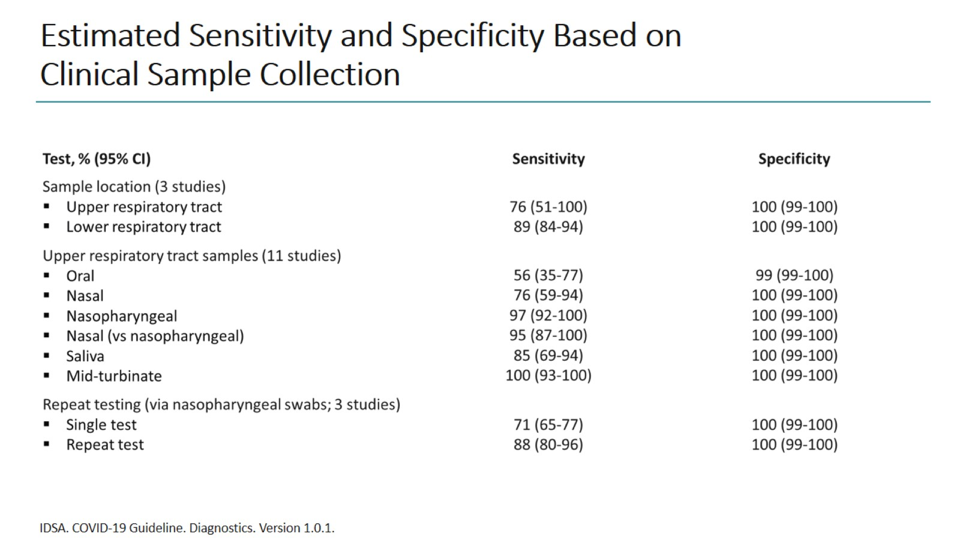
Estimated Sensitivity and Specificity Based on Clinical Sample Collection

Slide 30
Chest CT and Progressive Changes

Slide 31
Estimated Time Intervals and Rates of Viral Detection

Slide 32
Case Study 1 What Happened Next?

Slide 33
Case Study 1 Treatment Considerations

Slide 34
Case Study 1 Treatment

Slide 35
Case Study 2 Case Description

Slide 36
Case Study 2 Case Description (cont)

Slide 37
Risk Factors for Mortality

Slide 38
Case Study 2 Chest x-Ray, Results and Treatment

Slide 39
Case Study 2 Clinical Evolution

Slide 40
Case Study 2 Clinical Evolution: ICU

Slide 41
Respiratory Management Strategies in Severe COVID-19 Distinct Phenotypes

Slide 42
Case Study 2 Clinical Evolution: Echocardiography

Slide 43
Case Study 2 Clinical Evolution: Conclusion

Slide 44
Rapidly Evolving Pandemic Faculty Global Insights

Slide 45
Important Lessons Learned Expert Insights

Slide 46
Concluding Remarks

Slide 47
Abbreviations

Slide 48
Abbreviations (cont)

Slide 49
Abbreviations (cont)

