Slide 1
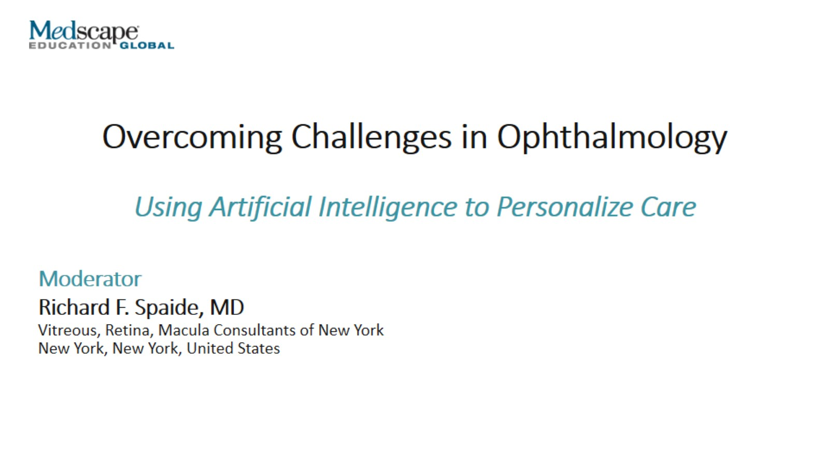
Overcoming Challenges in Ophthalmology

Slide 2
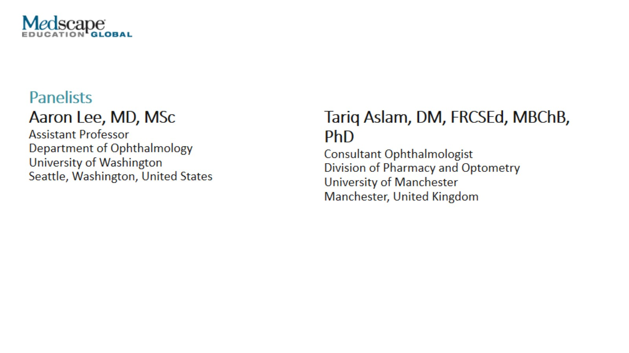

Slide 3
Introduction Learning Objectives

Slide 4
AI, Machine Learning, and Deep Learning

Slide 5
AI, Machine Learning, and Deep Learning (cont)

Slide 6
Imaging Enhancement

Slide 7
Automation of Testing

Slide 8
Automation of Testing

Slide 9
AI and Diagnosis Recent Literature

Slide 10
DL Algorithms in Detecting Eye Disease

Slide 11
DL and Function Neural Network to Model Impact of OCT Changes on VA

Slide 12
DL and Function AI-Based Impact of OCT Changes on VA

Slide 13
Clinical Implications of AI Faculty Perspectives

Slide 14
AI and Prognosis

Slide 15
Will AI Put Ophthalmologists Out of Business?

Slide 16
Human vs AI Approach to Diagnosis

Slide 17
Human vs AI Approach to Diagnosis (cont)

Slide 18
Remote Testing

Slide 19
Challenges in Remote Testing

Slide 20
Challenges in AI Validation

Slide 21
Challenges in AI Patient Adherence

Slide 22
Challenges in AI and Ethical Considerations

Slide 23
What Do You Hope to Gain With Personalized Medicine?

Slide 24
Concluding Remarks

Slide 25
Thank you for participating in this activity.

