Slide 1
Special Populations Tailored for Lipid Management

Slide 2
Changing Mortality in HIV

Slide 3
HAART Study: Increase in CHD Burden in HIV Cohorts

Slide 4
Epidemiology of CHD in HIV Patients

Slide 5
Mechanisms of CVD in HIV

Slide 6
Why Has CVD Mortality Increased Among HIV-Infected Persons?

Slide 7
Polypharmacy and Drug-Drug Interactions

Slide 8
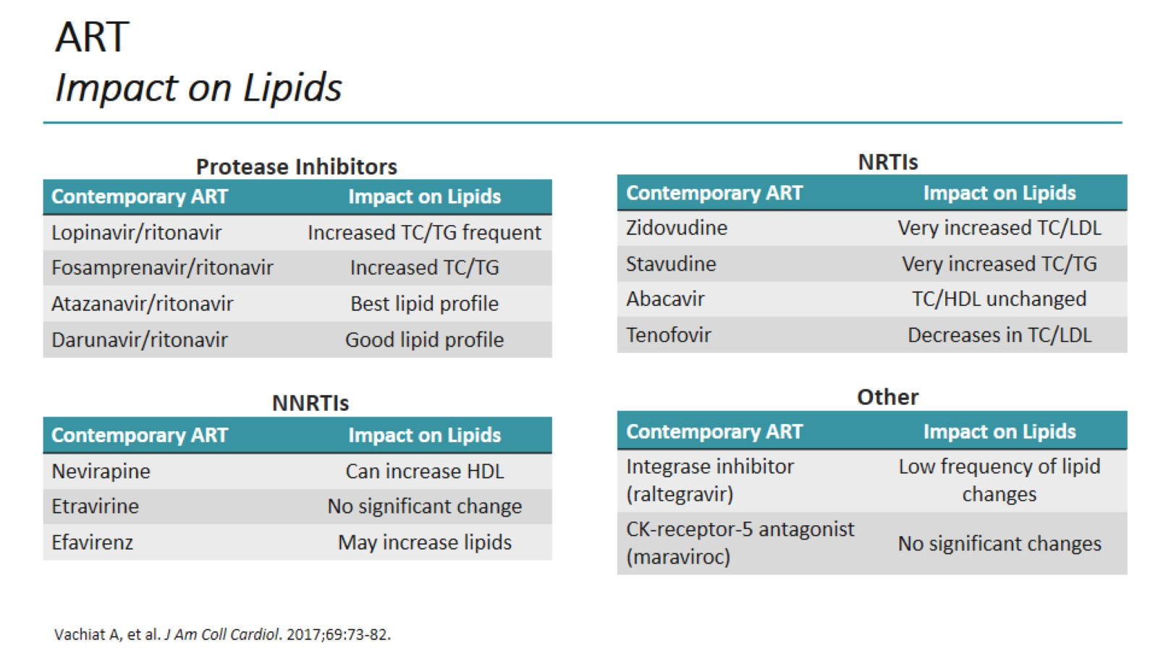
ART Impact on Lipids

Slide 9
CV Risk Assessment in the Patient Infected With HIV

Slide 10
Potential Drug Interactions Statins With Protease Inhibitors

Slide 11
INTREPID Statins’ Unique Properties to Lower Inflammation

Slide 12
REPRIEVE Trial Evaluating Primary Prevention of MACE With Pitavastatin

Slide 13
Clinical Practice Decisions Aging and Elderly

Slide 14
Primary and Secondary Prevention Considerations Older Patients

Slide 15
Tailoring Lipid-Lowering Therapy in Older Patients

Slide 16
CAC Scoring: The Tie Breaker

Slide 17
Statin Recommendations for Adults With HIV

Slide 18
Summary

Slide 19
Thank you for participating in this activity.

