Slide 1
What Have We Learned About Managing Patients With Inflammatory Diseases During the COVID-19 Pandemic?

Slide 3
Impact of COVID-19 on Patients With IBD

Slide 4
Alleviating Anxiety of Patients With IBD

Slide 5
Expert Guidance: International Organization for the Study of Inflammatory Bowel Diseases

Slide 6
Expert Guidance: British Society of Gastroenterology Acute Severe UC

Slide 7
Challenges of Outpatient Care and Infusion Clinics

Slide 8
Endoscopy Unit

Slide 9
Avoiding the Need for Endoscopy

Slide 10
Patients Participating in Clinical Trials With Mandated Endoscopies

Slide 11
Semi-Elective and Elective Surgery

Slide 12
Concluding Remarks

Slide 13
What Have We Learned About Managing Patients With Inflammatory Diseases During the COVID-19 Pandemic?

Slide 14
Questions to Consider

Slide 15
Biologics and Risks of SARS-CoV-2 in Patients With Psoriasis Milan Registry

Slide 16
Biologics and Risks of SARS-CoV-2 in Patients With Psoriasis Italian Registry

Slide 17
Global Psoriasis Registry Clinician-Reported Outcomes: PsoProtect

Slide 18
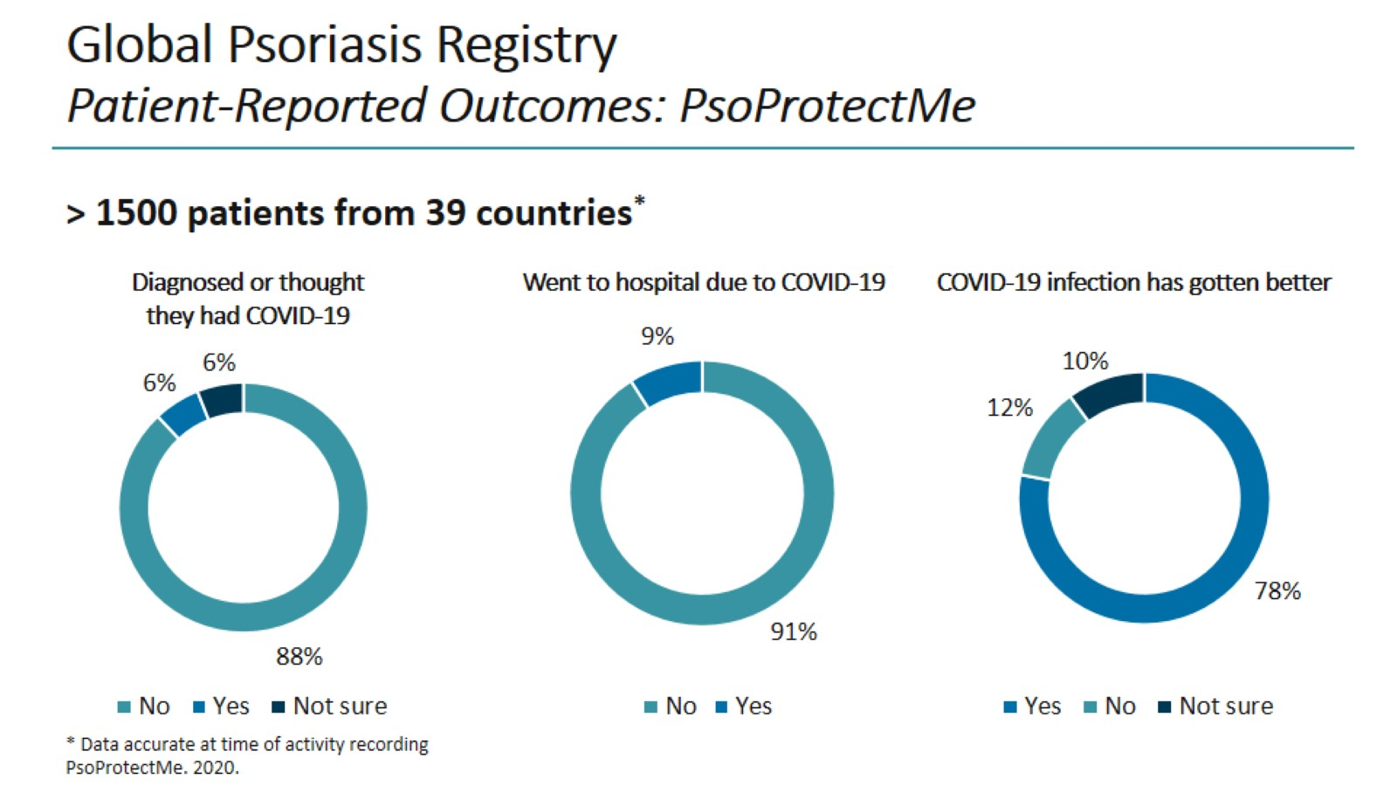
Global Psoriasis Registry Patient-Reported Outcomes: PsoProtectMe

Slide 19
Managing Dermatologic Patients on DMDs During COVID

Slide 20
Changes in Practice During the COVID Pandemic

Slide 21
Concluding Remarks

Slide 22
What Have We Learned About Managing Patients With Inflammatory Diseases During the COVID-19 Pandemic?

Slide 23
Cytokine Targets in RA Play Key Roles in COVID-19 Pathogenesis

Slide 24
Cytokine Inhibitor Therapy Does Not Increase Risk of Viral Infection

Slide 25
Risk of COVID-19 in Patients With Rheumatic Diseases

Slide 26
Cytokine Inhibitors Do Not Impact Course of COVID-19 in Patients With Rheumatic Diseases

Slide 27
COVID-19 Risk in Patients With Rheumatic Diseases Results From a Global Rheumatology Registry

Slide 28
Prevalence of SARS-CoV-2 Infection in Patients With Rheumatic Diseases

Slide 29
What Have We Learned Thus Far?

Slide 30
Managing Treatment of IMIDs in the Event of COVID-19 Infection

Slide 31
General Management of Patients With IMIDs During COVID

Slide 32
Abbreviations

Slide 33
Abbreviations (cont)

