Slide 1
Changing Paradigms in Management of Advanced GIST

Slide 2
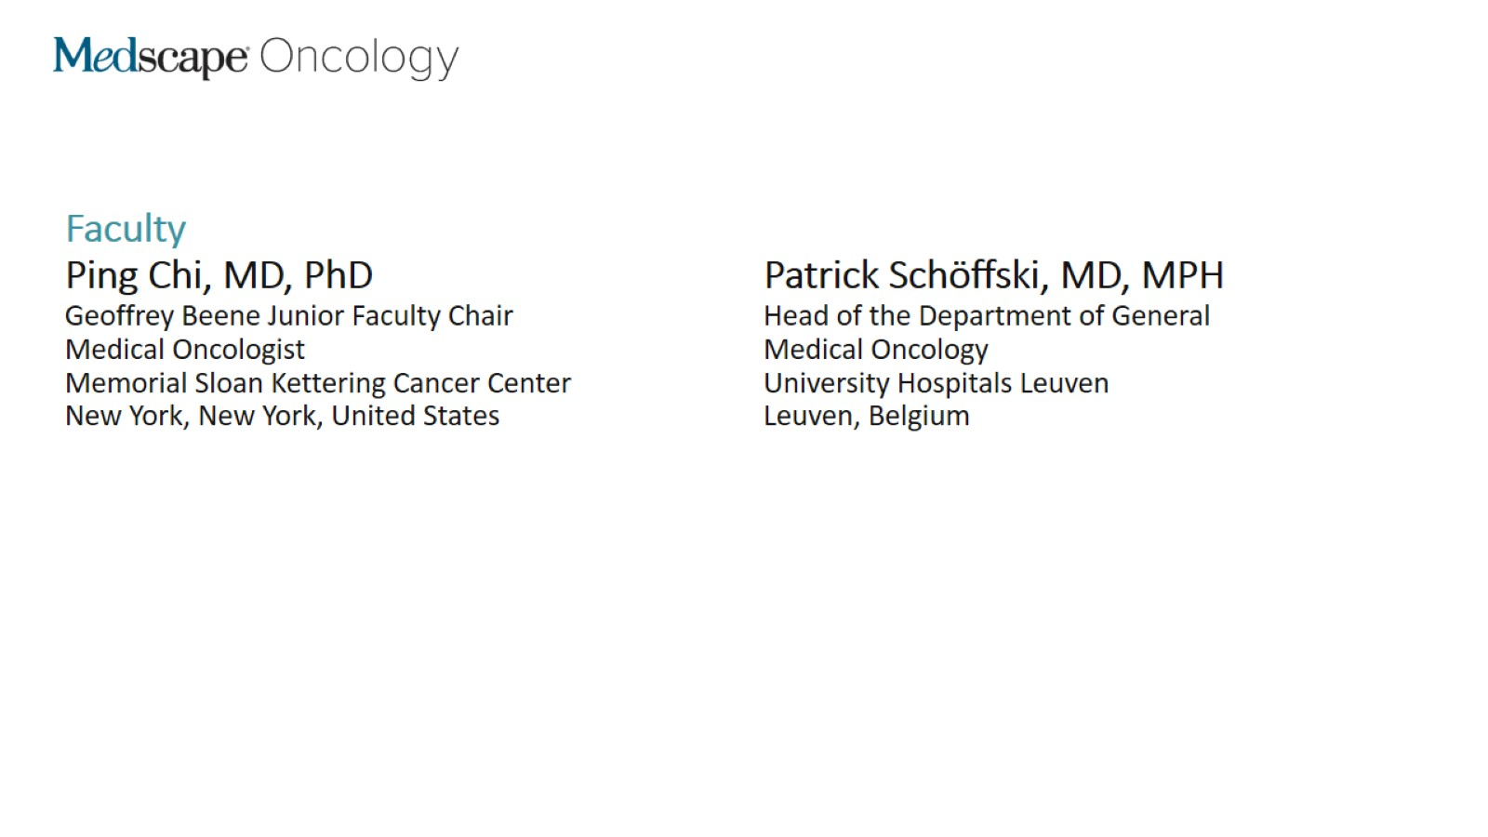

Slide 3
Program Overview

Slide 4
Introduction Key Drug Approvals in the United States

Slide 5
Introduction Key Drug Approvals in the European Union

Slide 6
Patient Case 1

Slide 7
Patient Case 1 Additional Workup & Treatment Options

Slide 8
Binimetinib + Imatinib Therapy Advanced GIST

Slide 9
Patient Case 1 Response to Therapy & Outcomes

Slide 10
Secondary Mutations in KIT Drug Sensitivities

Slide 11
Patient Case 1 Treatment Strategies for Resistance: Expert Considerations

Slide 12
Second-Line GIST Treatment Sunitinib Therapy

Slide 13
Patient Case 1 (cont)

Slide 14
Third-Line GIST Treatment Regorafenib Therapy

Slide 15
Patient Case 1 (con't)

Slide 16
Ripretinib Therapy

Slide 17
INVICTUS Trial Ripretinib vs Placebo

Slide 18
INVICTUS Trial: Ripretinib PFS and OS

Slide 19
INVICTUS Trial: Ripretinib Key Safety Signals

Slide 20
Ripretinib vs Sunitinib Advanced GIST After Imatinib: INTRIGUE Trial

Slide 21
Patient Case 2

Slide 22
Avapritinib Therapy

Slide 23
Concluding Remarks

Slide 24
Changing Paradigms in Management of Advanced GIST

Slide 25
Abbreviations

Slide 26
Abbreviations (cont)

Slide 27
Abbreviations (cont)

