Slide 1
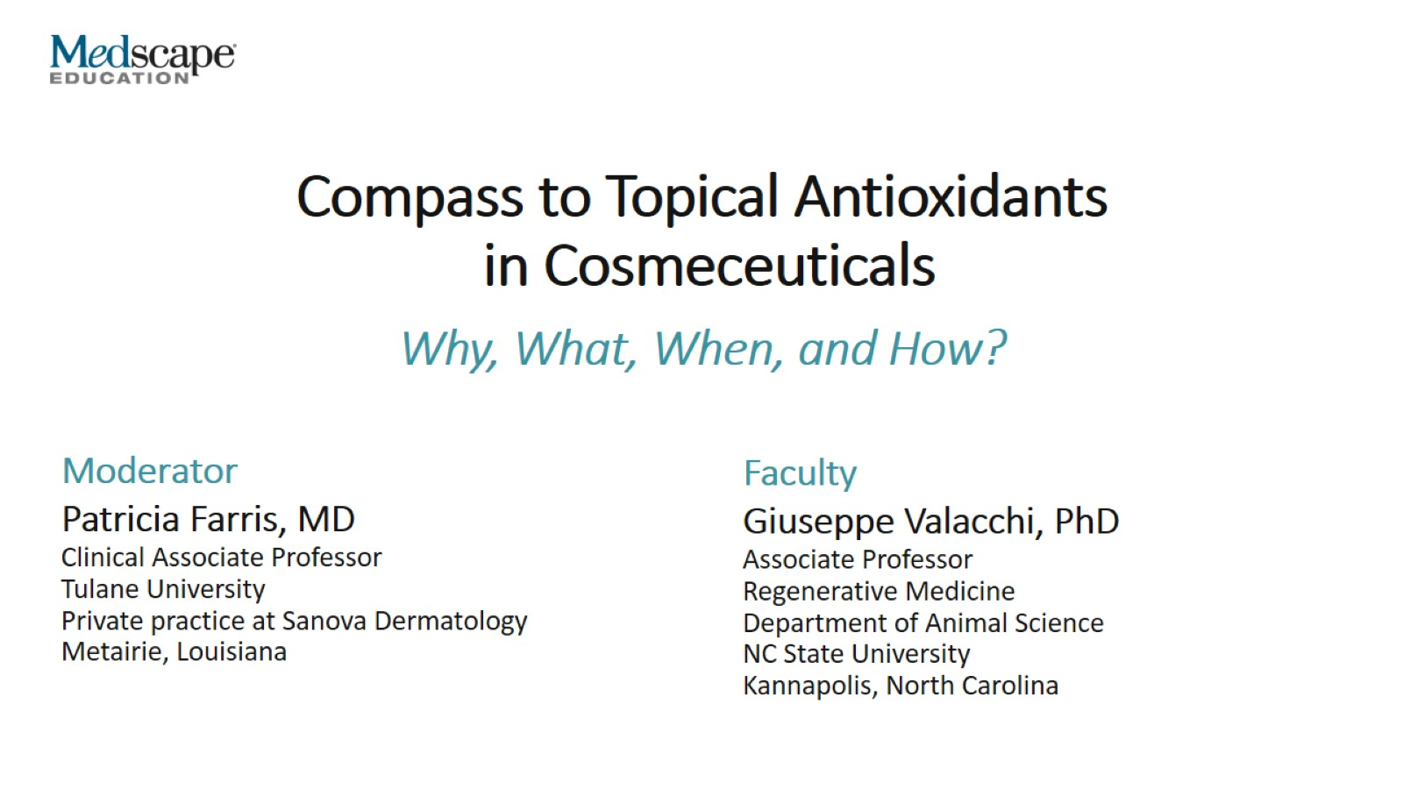
Compass to Topical Antioxidants in Cosmeceuticals

Slide 2
Agenda

Slide 3
Oxidative Stress

Slide 4
The Exposome

Slide 5
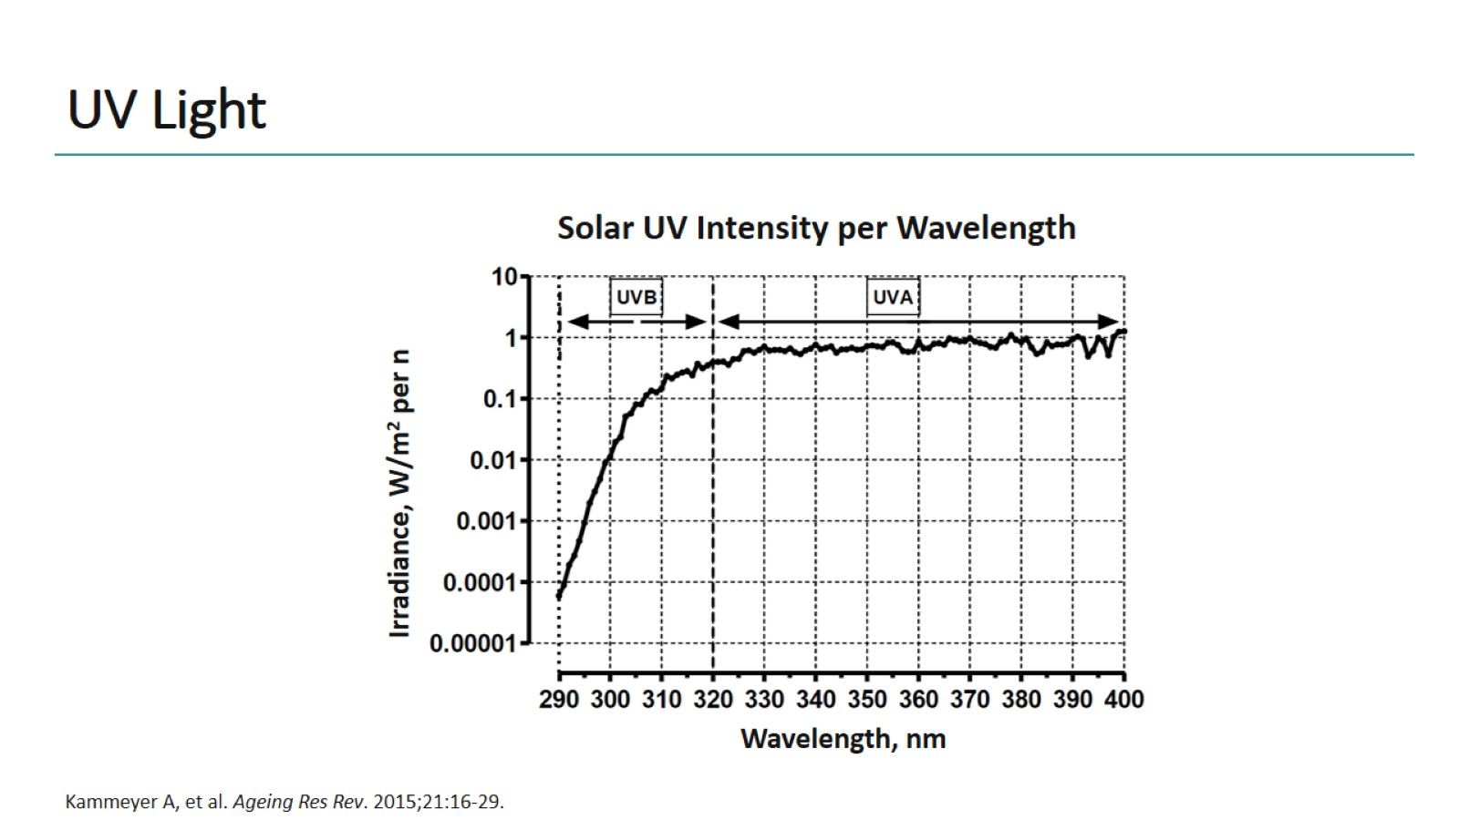
UV Light

Slide 6
Photoaging

Slide 7
Photodamage of the Skin

Slide 8
Photodamage of the Skin

Slide 9
Air Pollutants

Slide 10
Environmental Factors and the Skin

Slide 11
Skin Damage Effects of Cigarette Smoke

Slide 12
Particulate Matter and the Skin

Slide 13
Skin Damage Effects of Particulate Matter

Slide 14
Skin Damage Effects of Airborne Particle Exposure

Slide 15
Skin Damage Ozone

Slide 16
Ozone Induces ROS in a 3D Skin Model

Slide 17
Increased ROS Levels in Cutaneous Tissues After Ozone Exposure

Slide 18
Ozone Effects on Skin

Slide 19
Summary of Action of Pollutants on Skin

Slide 20
Antioxidant Defense System of the Skin

Slide 21
Oxidative Stress

Slide 22
Photoaging Clinical Evidence

Slide 23
Updated Approach to Environmental Protection Antioxidants

Slide 24
UV Light Protectors Expert Insights

Slide 25
Antioxidants

Slide 26
Clinical Studies Antioxidants

Slide 27
Vitamin C, Vitamin E, and Ferulic Acid Photoprotection

Slide 28
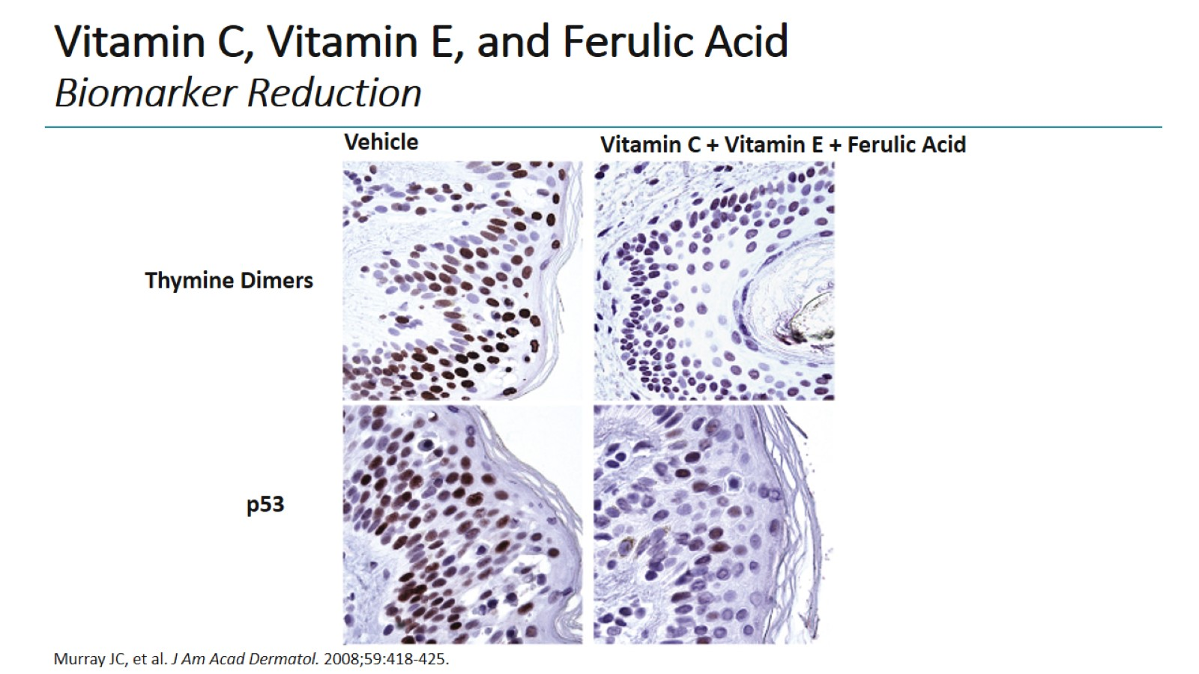
Vitamin C, Vitamin E, and Ferulic Acid Biomarker Reduction

Slide 29
First Human Study on Ozone Skin Biopsies

Slide 30
Ozone-Induced Aldehydes Are Reduced With Antioxidant Mixture

Slide 31
Markers of Ozone-Induced Oxidative Stress Reduced After Antioxidant Application

Slide 32
First Human Study on Ozone Skin Biopsies Ozone and Antioxidants

Slide 33
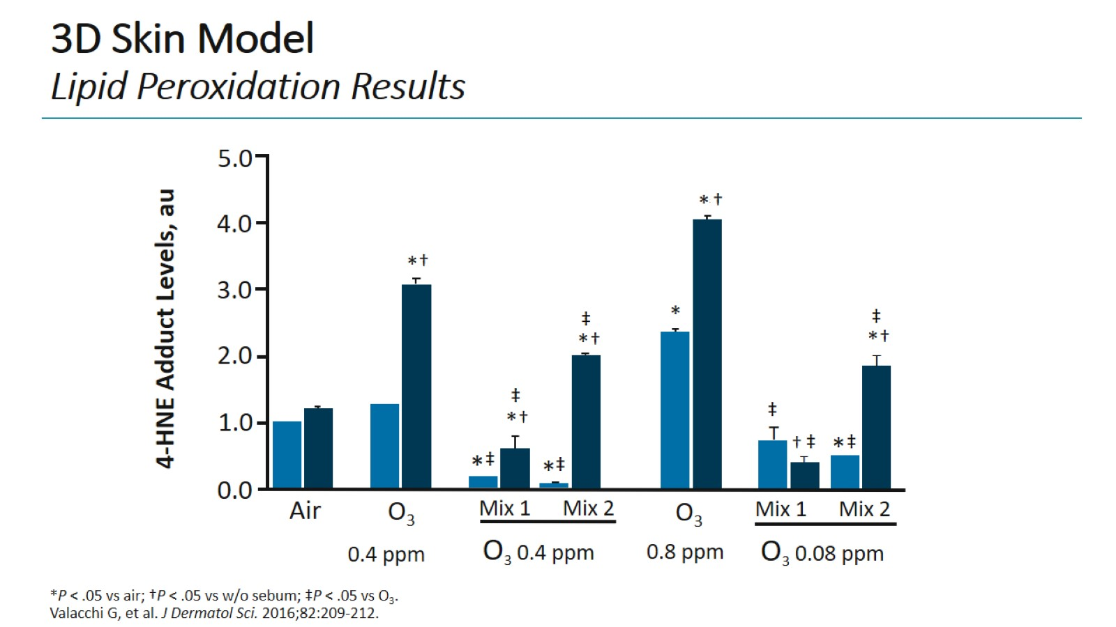
3D Skin Model Lipid Peroxidation Results

Slide 34
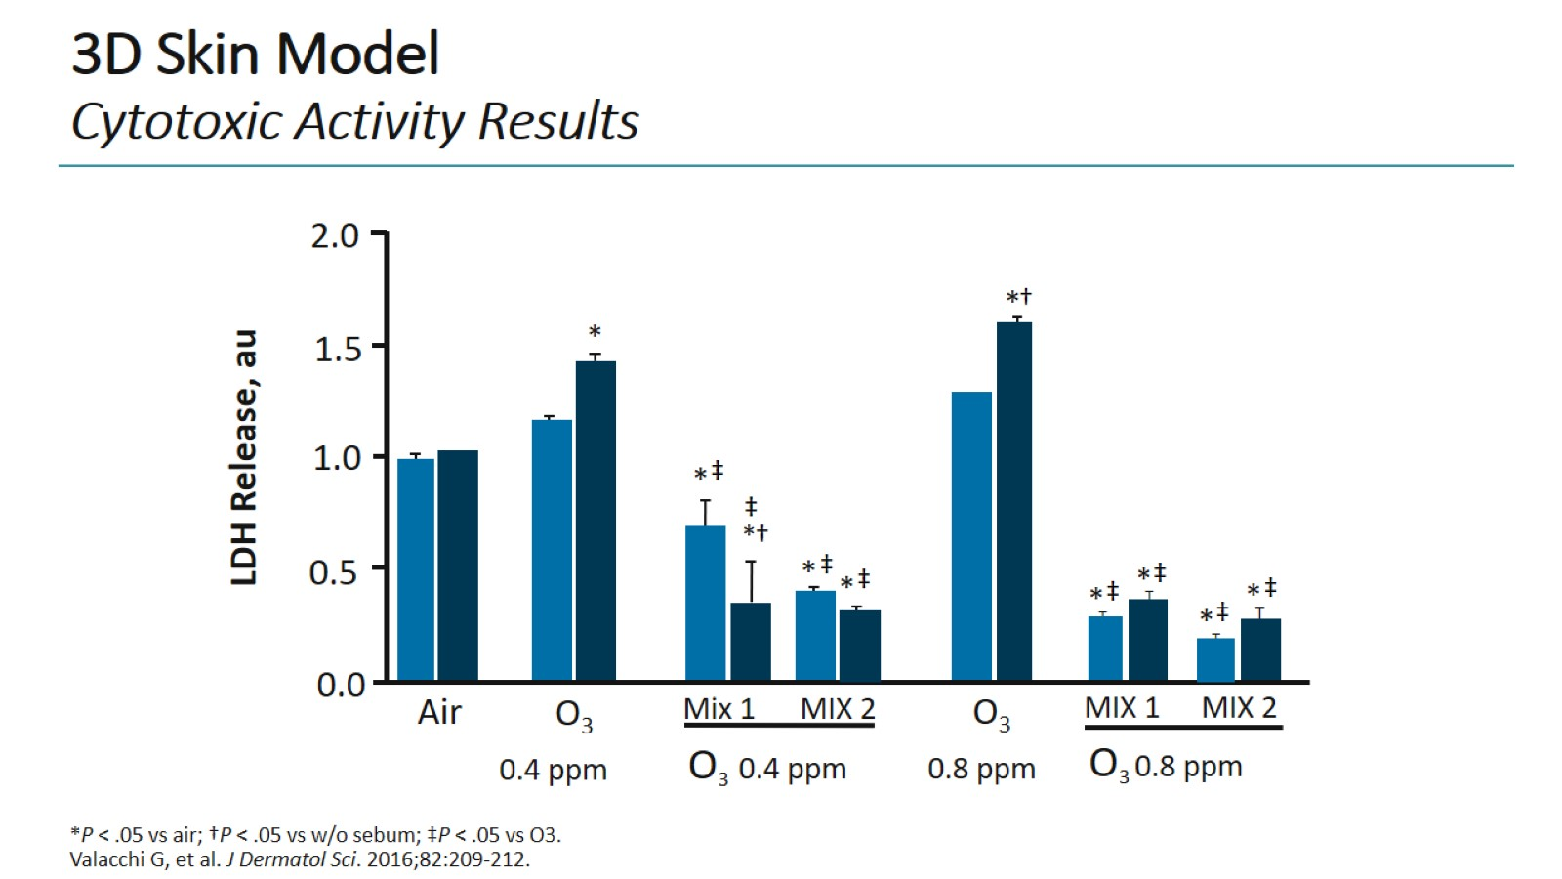
3D Skin Model Cytotoxic Activity Results

Slide 35
Deschampsia Antartica Extract + Ferulic Acid + Vitamin C Controlled Single-Blind, Prospective Study

Slide 36
Concluding Remarks

Slide 37
Thank you for participating in this activity.

Slide 38
ROS Production

Slide 39
ROS Production CREATED TO REPLACE FORMER SLIDE 21

