Slide 1
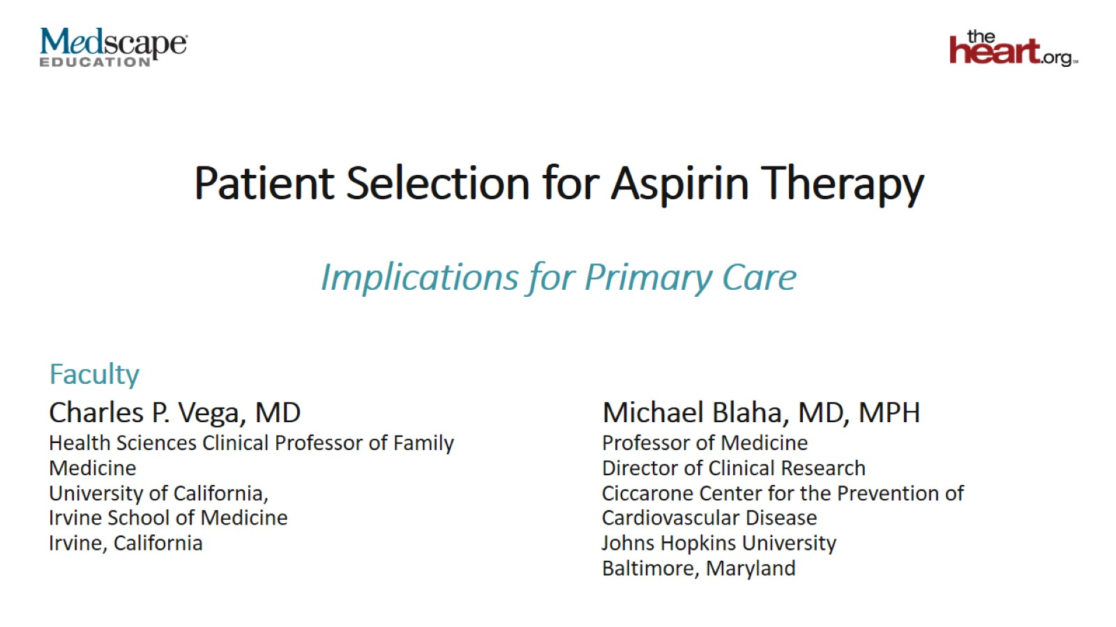
Patient Selection for Aspirin Therapy

Slide 2
The Role of Aspirin in Preventing CVD

Slide 3
ASCEND Trial

Slide 4
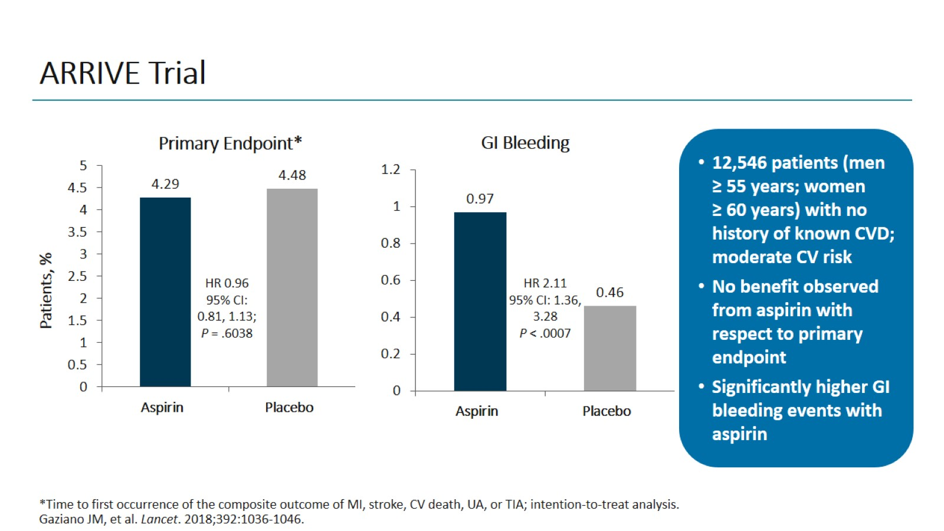
ARRIVE Trial

Slide 5
ASPREE Trial: Results

Slide 6
Meta-Analysis: Aspirin Benefits vs Risks

Slide 7
ACC/AHA Guideline 2019: Update on Aspirin

Slide 8
ACC/AHA Guideline 2019: ASCVD Risk Assessment

Slide 9
CAC Score as a Tool for Guiding Aspirin Therapy

Slide 10
MESA Study

Slide 11
Outcomes and Statistical Analysis

Slide 12
Patient Population

Slide 13
Interplay Between ASCVD Risk and CAC

Slide 14
NNT₅ and NNH₅ by ASCVD Risk and CAC

Slide 15
MESA Study Summary

Slide 16
Using CAC Score in Clinical Practice

Slide 17
Issues Affecting Patient Attitudes to CAC Score

Slide 18
Other Tools for Assessing CV Risk in Primary Prevention

Slide 19
Suggested Broad Clinical Application of CAC

Slide 20
Concluding Remarks

Slide 21
Abbreviations

Slide 22
Abbreviations (cont)

