Slide 1
The Nurse View

Slide 2
Introduction Biology of TNBC

Slide 3
Who Is at Risk for TNBC?

Slide 4
The Immune System and Breast Cancer

Slide 5
PD-L1 Expression in TNBC

Slide 6
Case Study 1 KW

Slide 7
Case Study 1 KW (cont)

Slide 8
Immune Checkpoint Inhibitors in TNBC

Slide 9
Immune Checkpoint Inhibitors in TNBC

Slide 10
IMpassion130: Atezolizumab + Nab-Paclitaxel for TNBC Study Design

Slide 11
IMpassion130: Atezolizumab for mTNBC PFS in PD-L1+ and SP142+ Populations

Slide 12
KEYNOTE-355: Pembrolizumab + Chemotherapy for mTNBC Study Design

Slide 13
KEYNOTE-355: Pembrolizumab + Chemotherapy PFS in PD-L1 CPS ≥ 10 Population

Slide 14
Case Study 1 KW (cont)

Slide 15
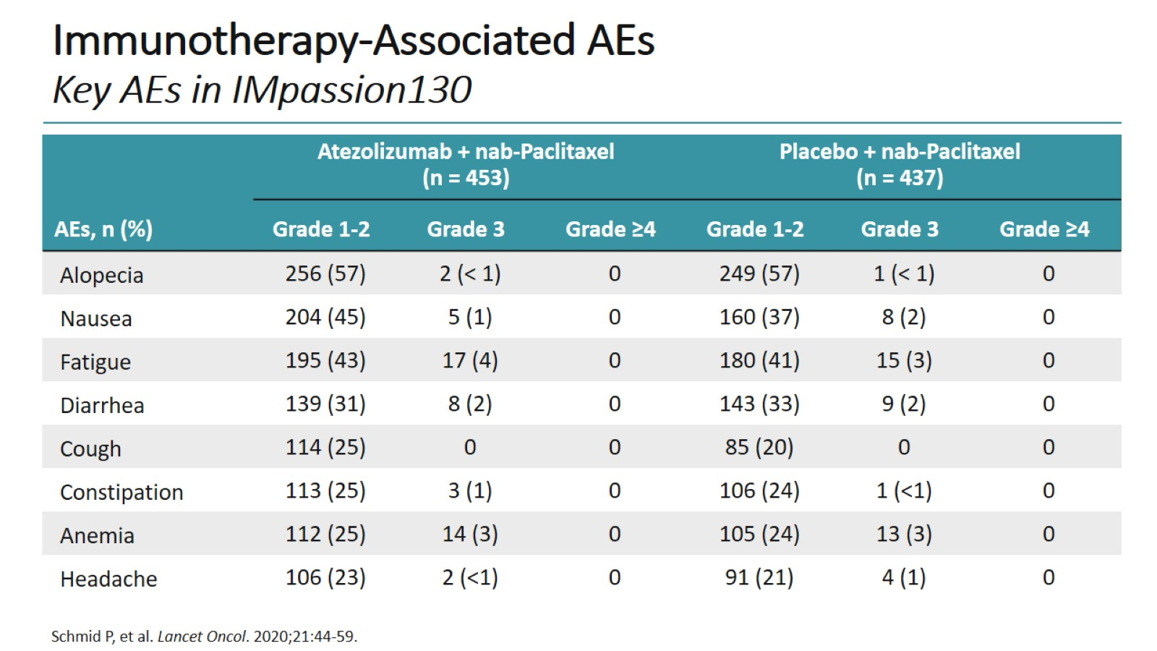
Immunotherapy-Associated AEs Key AEs in IMpassion130

Slide 16
Immunotherapy-Associated AEs TRAEs With Incidence ≥ 20% in KEYNOTE-355

Slide 17
Case Study 1 Side Effects From Atezolizumab + Nab-Paclitaxel

Slide 18
Common IrAEs Associated With Immunotherapy

Slide 19
Expert Opinions Side Effects of Combination Immunotherapy + Chemotherapy

Slide 20
Expert Opinions Patient Education and Side Effects

Slide 21
PARP Inhibitors

Slide 22
Case Study 2 MC

Slide 23
Case Study 2 MC (cont)

Slide 24
PARP Inhibitors in TNBC

Slide 25
OlympiAD: Olaparib for mBC With a gBRCA Mutation

Slide 26
EMBRACA: Talazoparib for Advanced Breast Cancer and a gBRCA-Mutation

Slide 27
BROCADE3: Veliparib + Carboplatin and Paclitaxel in BRCA-Mutated Advanced Breast Cancer

Slide 28
Case Study 2 MC (cont)

Slide 29
Expert Opinions Managing Side Effects of PARP Inhibitors

Slide 30
Expert Opinions Managing Side Effects of PARP Inhibitors (cont)

Slide 31
Future Directions in Targeted Therapies in TNBC Checkpoint Inhibitors in mTNBC

Slide 32
Future Directions in Targeted Therapies in TNBC Checkpoint Inhibitors in the [Neo]Adjuvant Setting

Slide 33
OlympiAD: Olaparib for mBC With a gBRCA Mutation

Slide 34
Concluding Remarks

Slide 35
Abbreviations

Slide 36
Abbreviations (cont)

