Slide 1
Nosocomial Pneumonia Definitions

Slide 2
Pathogen Isolates From Patients With Pneumonia Hospitalized in US ICUs, 2015-2017

Slide 3
Cefiderocol for Treatment of Nosocomial Pneumonia APEKS-NP Trial

Slide 4
APEKS-NP Trial Clinical Cure Rates by Pathogen

Slide 5
CREDIBLE-CR: Randomized, Open-Label, Phase 3 Trial of Cefiderocol for Serious Gram-Negative Infections

Slide 6
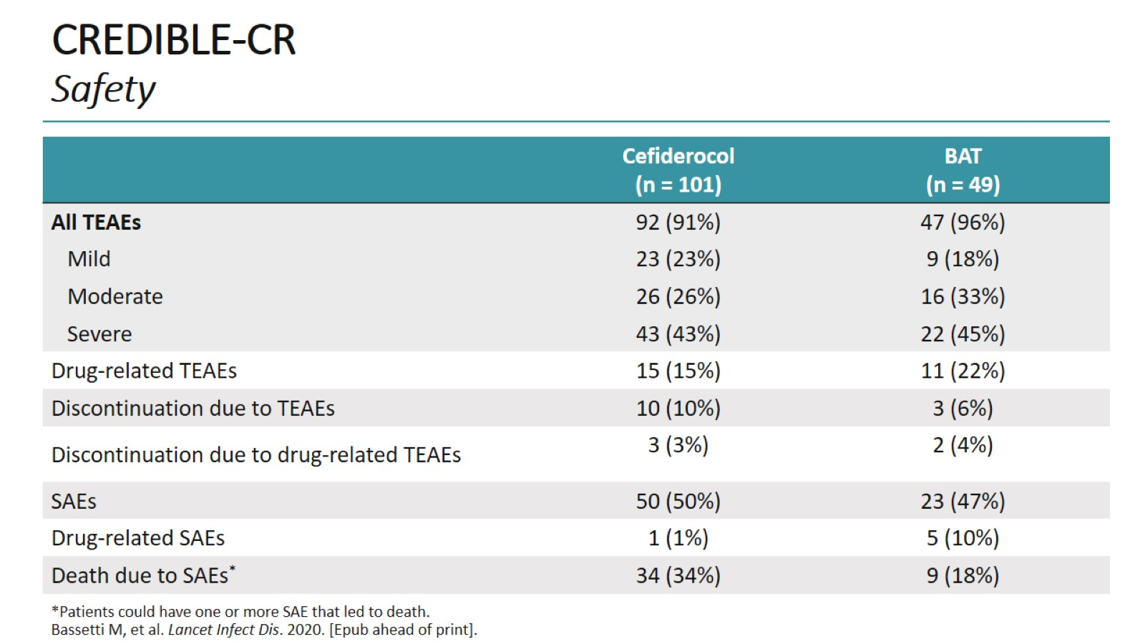
CREDIBLE-CR Safety

Slide 7
RESTORE-IMI 2 Randomized, Double-Blind, Phase 3 Study of IMI/REL vs PIP/TAZ in HABP/VABP

Slide 8
RESTORE-IMI 2 All-Cause 28-Day Mortality by Pathogen and Diagnosis

Slide 9
RESTORE-IMI 2 Study Safety

Slide 10
Newer Cephalosporin-β-Lactamase Inhibitor Combinations for Nosocomial Pneumonia

Slide 11
REPROVE: Randomized, Phase 3, Noninferiority Trial of Ceftazidime-Avibactam for Nosocomial Pneumonia

Slide 12
ASPECT-NP: Ceftolozane-Tazobactam vs Meropenem 28-Day All-Cause Mortality

Slide 13
Abbreviations

Slide 14
Abbreviations (cont)

