Slide 2
Universal Definitions Myocardial Injury and MI

Slide 3
Early cTn Kinetics in Patients After Acute Myocardial Injury Including Acute MI

Slide 4
Utility of hs-cTn Assays in Other Settings

Slide 5
Utility of hs-cTn Assays (Cont) Possibilities Beyond MI Detection

Slide 6
Characteristics of hs-cTn Reviewing the Evidence -- Detectability

Slide 7
Sex-Specific Cutoffs

Slide 8
Characteristics of hs-cTn Assays Reviewing the Evidence -- Metrics

Slide 9
Characteristics of hs-cTn Assays Reviewing the Evidence -- Analytical Considerations

Slide 10
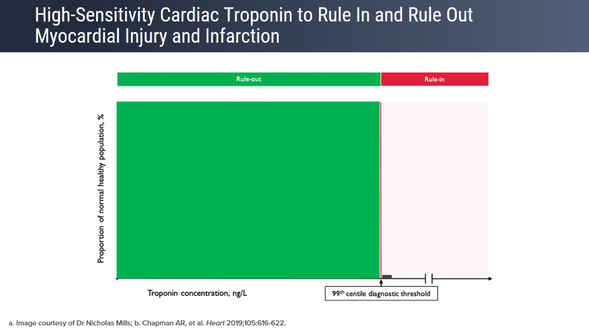
High-Sensitivity Cardiac Troponin to Rule In and Rule Out Myocardial Injury and Infarction

Slide 11
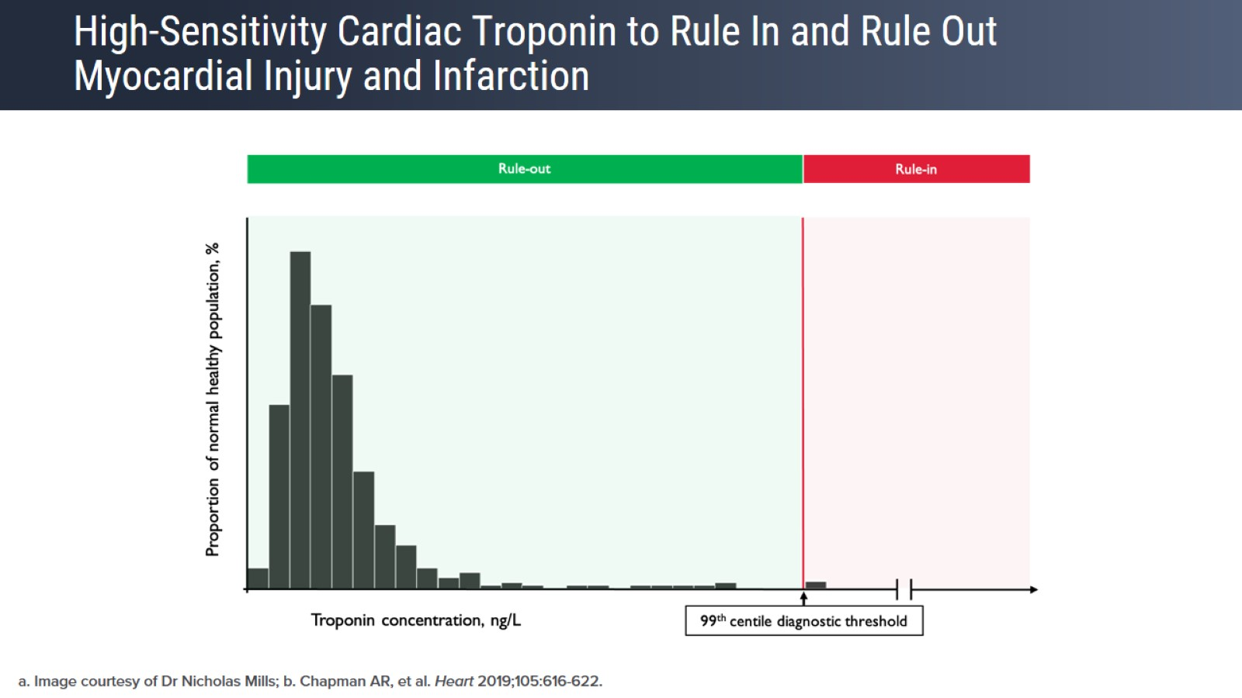
High-Sensitivity Cardiac Troponin to Rule In and Rule Out Myocardial Injury and Infarction

Slide 12
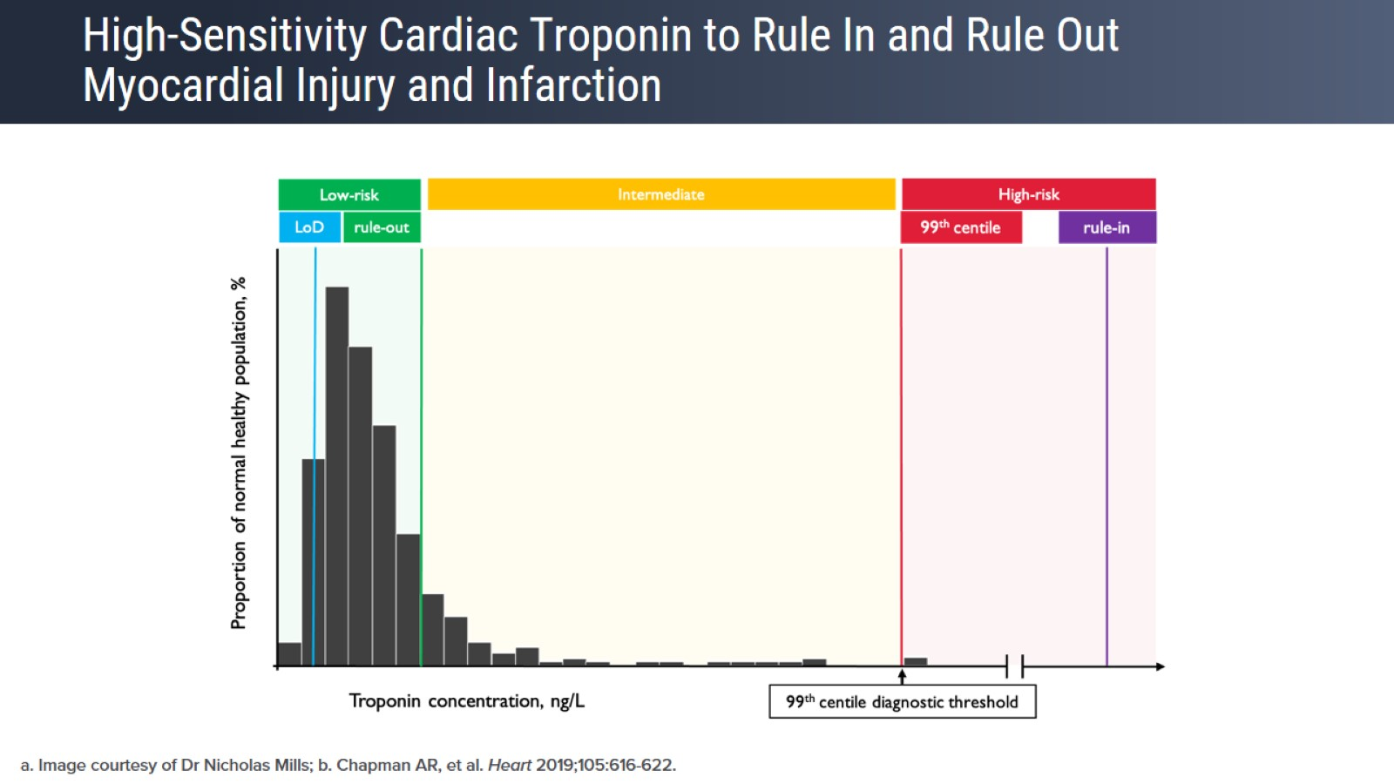
High-Sensitivity Cardiac Troponin to Rule In and Rule Out Myocardial Injury and Infarction

Slide 13
Pathways That Use Multiple Thresholds

Slide 14
Pathways That Use Separate Rule-Out and Diagnostic Thresholds

Slide 15
Safety and Effectiveness of Accelerated Diagnostic Pathways

Slide 16
Safety and Effectiveness of Accelerated Diagnostic Pathways

Slide 17
Safety and Effectiveness of Accelerated Diagnostic Pathways

Slide 18
Safety and Effectiveness of Accelerated Diagnostic Pathways

Slide 19
How Assay Use Impacts Patient Outcomes

Slide 20
Negative Predictive Value of a hs-cTnl Value by Patient Group

Slide 21
Hs-cTnT Changes in Patients With Non-STEMI

Slide 22
Practical Consideration in Implementing Accelerated Diagnostic Pathways

Slide 23
Practical Consideration in Implementing Accelerated Diagnostic Pathways

Slide 24
Key Takeaways

Slide 25
Abbreviations

