Slide 1
Recommendations for Defining Moderate-to-Severe AD and Determining Disease Severity

Slide 2
Effect of Stress on AD

Slide 3
DLQI Survey

Slide 4
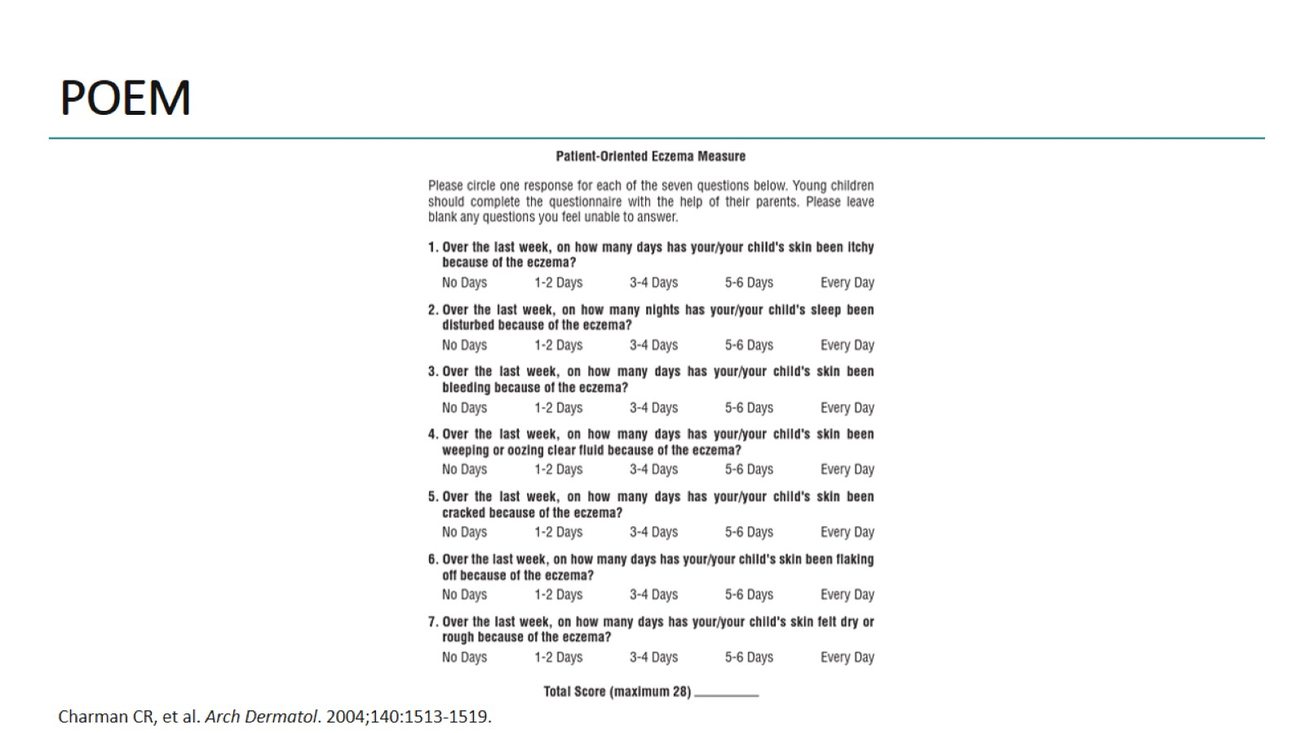
POEM

Slide 5
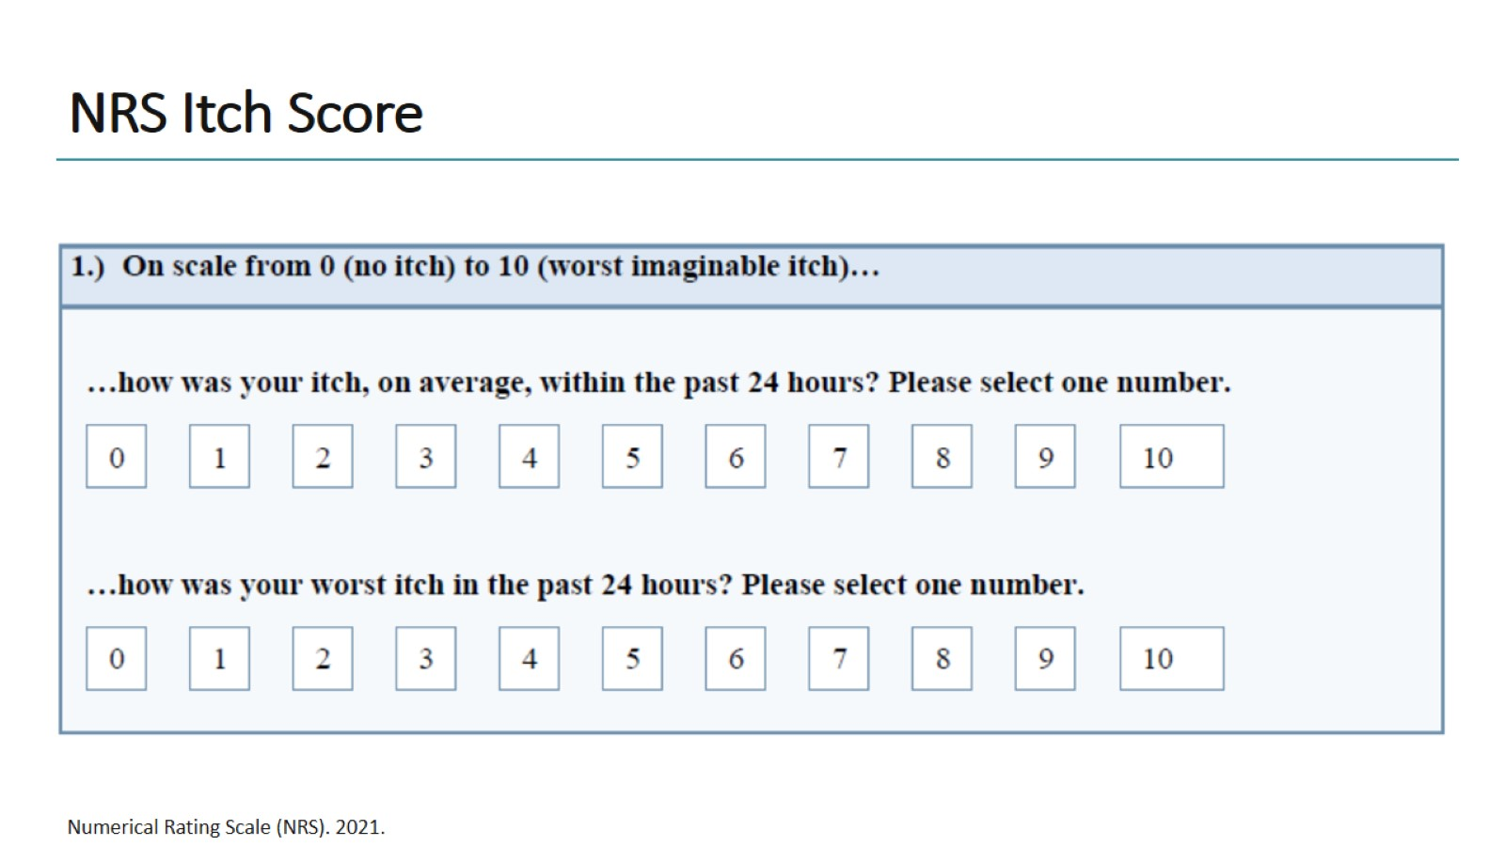
NRS Itch Score

Slide 6
Abbreviations

