Slide 2
Introduction to Systemic Mastocytosis (SM)

Slide 3
Introduction to Systemic Mastocytosis (SM)

Slide 4
Introduction to Systemic Mastocytosis (SM)

Slide 5
Signs and Symptoms of MC Activation

Slide 6
Signs and Symptoms of MC Activation

Slide 7
Signs and Symptoms of MC Activation

Slide 8
Signs and Symptoms of MC Activation

Slide 9
Signs and Symptoms of MC Activation

Slide 10
Frequency of Symptoms in SM

Slide 11
Impact of SM on QOL

Slide 14
WHO Diagnostic Criteria for SM

Slide 15
WHO Diagnostic Criteria for SM

Slide 16
WHO Diagnostic Criteria for SM

Slide 17
WHO Diagnostic Criteria for SM

Slide 18
WHO Classification of SM

Slide 19
WHO Classification of SM

Slide 22
Critical Pathological Findings Aspirate

Slide 23
Critical Pathological Findings Aspirate

Slide 24
Critical Pathological Findings Biopsy

Slide 25
Critical Pathological Findings Biopsy

Slide 26
Critical Pathological Findings Biopsy

Slide 27
Critical Pathological Findings Biopsy

Slide 28
Critical Pathological Findings Biopsy

Slide 29
Critical Pathological Findings Biopsy

Slide 30
Critical Pathological Findings Immunohistochemistry

Slide 31
Critical Pathological Findings Immunohistochemistry

Slide 32
Critical Pathological Findings Immunohistochemistry

Slide 33
Molecular Profiling

Slide 34
Blood Parameters

Slide 35
SM With an Associated Hematologic Neoplasm

Slide 38
Case Study 1

Slide 39
Case Study 1 Bone Marrow Analysis

Slide 40
Case Study 1 Bone Marrow Analysis

Slide 41
Case Study 1 Diagnosis

Slide 42
Case Study 2

Slide 43
Case Study 2 Bone Marrow Analysis

Slide 44
Case Study 2 Bone Marrow Analysis

Slide 45
Case Study 2 Diagnosis

Slide 48
WHO Classification of SM

Slide 49
Risk Stratification

Slide 50
Treatment Algorithm for Advanced SM

Slide 51
Treatment Algorithm for Advanced SM

Slide 52
Treatment Algorithm for Advanced SM

Slide 53
Treatment Algorithm for Advanced SM

Slide 54
Treatment Algorithm for Advanced SM

Slide 55
Treatment Algorithm for Advanced SM

Slide 56
Response Criteria for Advanced SM: Valent Response Criteria

Slide 57
Response Criteria for Advanced SM: International Working Group Response Criteria (Adopted by FDA & EMA)

Slide 58
Response Criteria for Advanced SM: International Working Group Response Criteria (Adopted by FDA & EMA)

Slide 59
Response Criteria for Advanced SM: Pure Pathological Response

Slide 60
Response Criteria for Advanced SM: Pure Pathological Response

Slide 63
Midostaurin

Slide 64
Midostaurin: Phase 2 Trial Efficacy

Slide 65
Midostaurin: Phase 2 Trial Efficacy

Slide 66
Midostaurin: Phase 2 Trial Efficacy

Slide 67
Midostaurin: Phase 2 Trial Safety (ITT Population)

Slide 68
Midostaurin: Phase 2 Trial Safety (ITT Population)

Slide 69
Avapritinib

Slide 70
Avapritinib: PATHFINDER Efficacy

Slide 71
Avapritinib: PATHFINDER Efficacy

Slide 72
Avapritinib: PATHFINDER Safety

Slide 73
Avapritinib: PATHFINDER Safety

Slide 74
Other Agents Used in the Treatment of SM

Slide 77
Case Study 1

Slide 78
Case Study 1

Slide 79
Case Study 1

Slide 80
Case Study 1

Slide 81
Case Study 1

Slide 82
Case Study 1

Slide 83
Case Study 1

Slide 84
Case Study 1

Slide 85
Case Study 2

Slide 86
Case Study 2

Slide 87
Case Study 2

Slide 88
Case Study 2

Slide 89
Case Study 2

Slide 90
Case Study 2

Slide 91
Case Study 2

Slide 92
Case Study 2

Slide 93
Baseline C1D1

Slide 94
C3D1 Assessment

Slide 95
Case Study 2

Slide 96
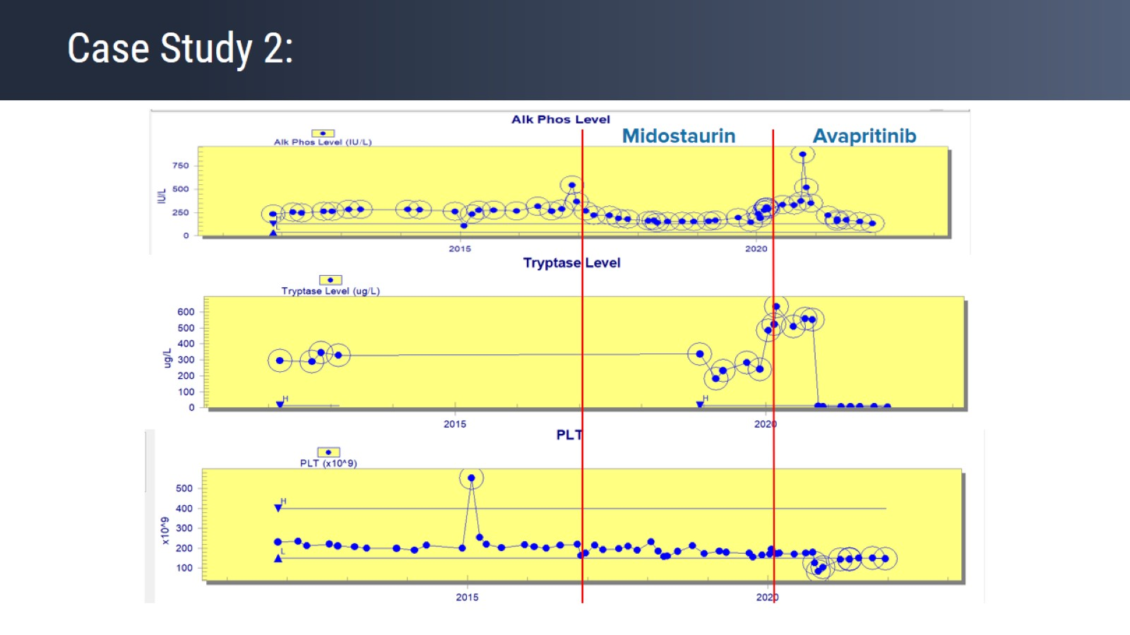
Case Study 2:

