Slide 2
Introduction

Slide 3
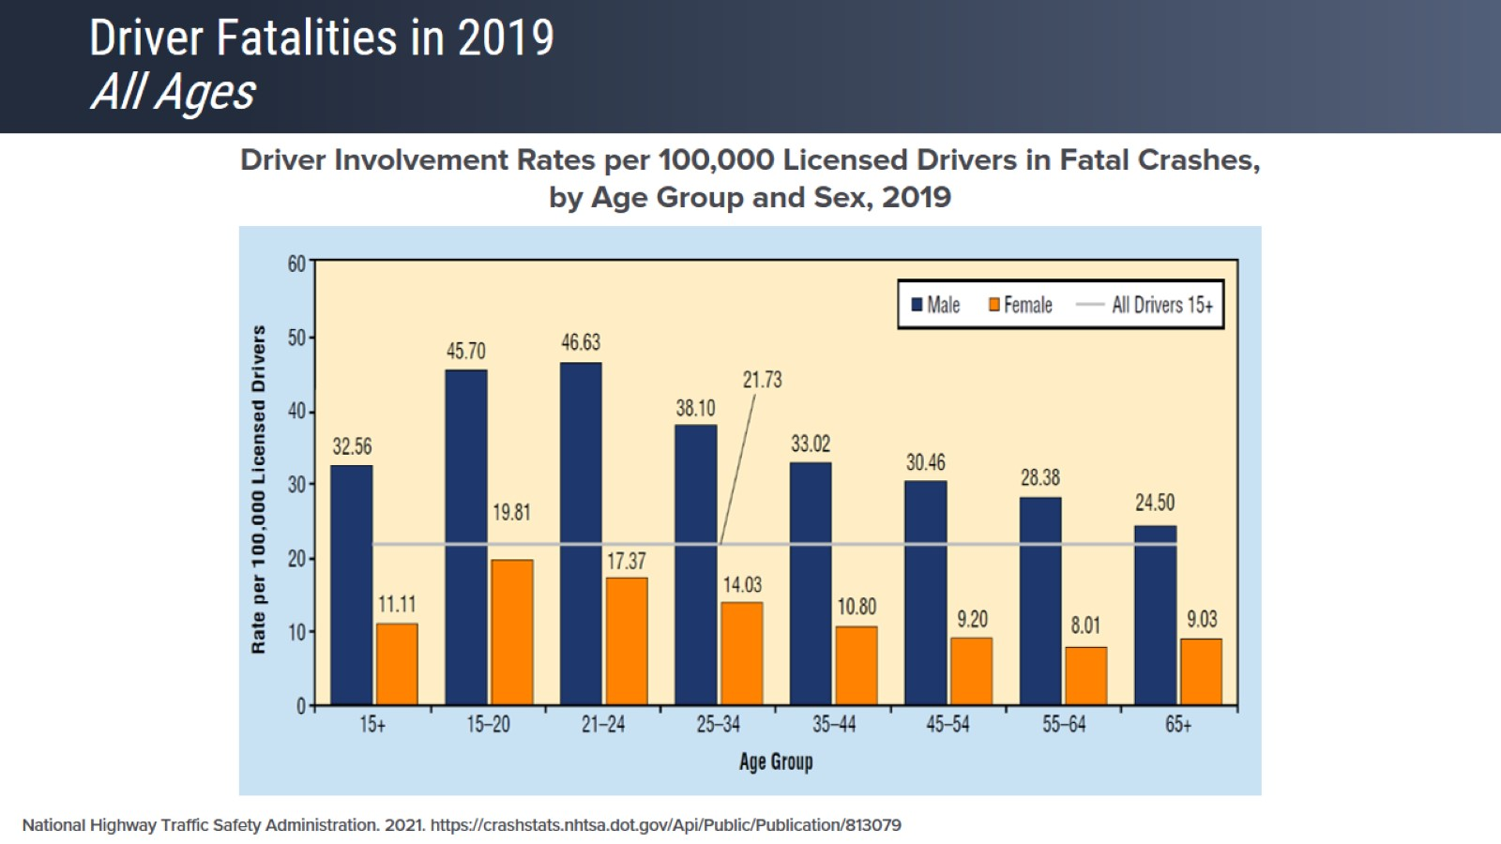
Driver Fatalities in 2019 All Ages

Slide 4
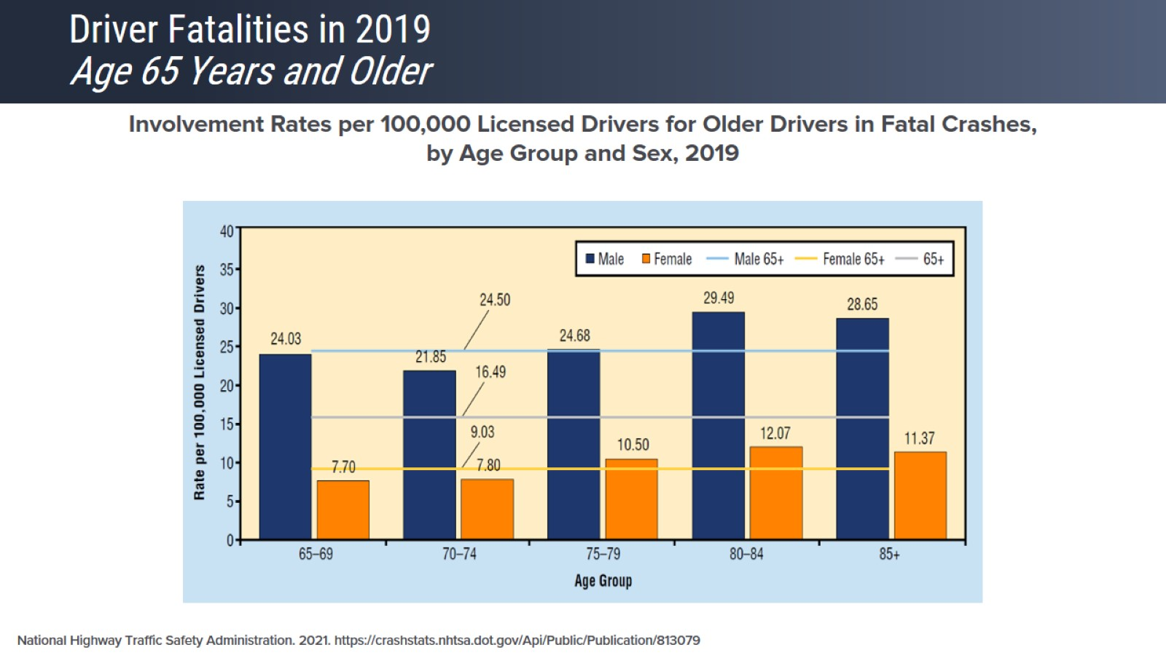
Driver Fatalities in 2019 Age 65 Years and Older

Slide 5
Driving Limitations

Slide 6
Limitations Occurring in Older Drivers

Slide 7
Older Driver At-Fault Crash Risk

Slide 8
Medical Limitations and Their Effects

Slide 9
Cognitive Limitations

Slide 10
Disorders Associated With Cognitive Impairment

Slide 11
Disorders Associated With Cognitive Impairment

Slide 12
Physical Limitations

Slide 13
Disorders Associated With Physical Limitations

Slide 14
Visual Limitations

Slide 15
Disorders Associated With Visual Limitations

Slide 16
Medications Associated With Impaired Driving

Slide 17
Medication-Impairing Effects

Slide 18
Deficits

Slide 19
Categorizing Deficits Temporary vs Permanent Conditions

Slide 20
Categorizing Deficits Temporary vs Permanent Conditions

Slide 21
Temporary vs Permanent Deficits

Slide 22
Temporary vs Permanent Deficits

Slide 23
Warning Signs At Risk for Unsafe Driving

Slide 24
Screening and Assessment

Slide 25
Role of Screening

Slide 26
Screening and Assessment

Slide 27
Self-Assessments

Slide 28
Driver Rehabilitation Program

Slide 29
Driver Rehabilitation Recommendations

Slide 30
Driving Status

Slide 31
Levels of Driving

Slide 32
Driving Cessation Discussion

Slide 33
Mobility Plan

Slide 34
Take Home Points

