Slide 2
Program Agenda

Slide 4
Question

Slide 5
Antiviral Medications Recommended for Treatment and Chemoprophylaxis of Influenza

Slide 6
Question

Slide 7
Antiviral Treatment in Primary Care Patients Presenting With ILI United States 2009-2016

Slide 8
Antiviral Treatment in Primary Care Patients Presenting With ILI According to Age

Slide 9
Antiviral Treatment in High-Risk Outpatients With an Acute Respiratory Illness United States, 2011-2016

Slide 10
Underuse of Antiviral Therapy for Influenza

Slide 11
Question

Slide 12
Reasons for Underuse of Antiviral Medications for Influenza

Slide 13
Question

Slide 14
Priority Groups for Antiviral Treatment of Influenza

Slide 15
Antiviral Treatment Recommendation for Non-High-Risk Outpatients

Slide 16
Optimal Timing of Antiviral Therapy in Critically Ill Patients in ICU With Influenza

Slide 17
Timing of NAI Therapy After Hospital Admission and Hospital Lengths of Stay

Slide 18
Question

Slide 19
Influenza Antiviral Treatment Recommendations

Slide 20
Influenza Antiviral Treatment Recommendations

Slide 21
Influenza Antiviral Treatment Recommendations

Slide 22
Antiviral Treatment Duration

Slide 23
Question

Slide 24
Antiviral Treatment Benefits

Slide 25
Antiviral Treatment Benefits

Slide 26
Question

Slide 27
Chemoprophylaxis General Recommendations

Slide 28
Chemoprophylaxis General Recommendations

Slide 29
Chemoprophylaxis General Recommendations

Slide 30
Pre-Exposure Chemoprophylaxis in Community Settings In Certain Situations

Slide 31
Post-Exposure Chemoprophylaxis in Community Settings In Certain Situations

Slide 32
Chemoprophylaxis in Community Settings Clinical Notes

Slide 33
Chemoprophylaxis in Community Settings Summary

Slide 35
Question

Slide 36
Overall Burden of Influenza: 2020-2021 Season

Slide 37
Question

Slide 38
Populations at High Risk for Influenza-Related Complications

Slide 39
Populations at High Risk Elderly and Very Young

Slide 40
Weekly US Influenza Surveillance Report

Slide 41
Populations at High Risk With Underlying Chronic Health Conditions

Slide 42
Populations at High Risk Special Situations

Slide 43
Burden of Influenza in High-Risk Groups

Slide 44
Question

Slide 45
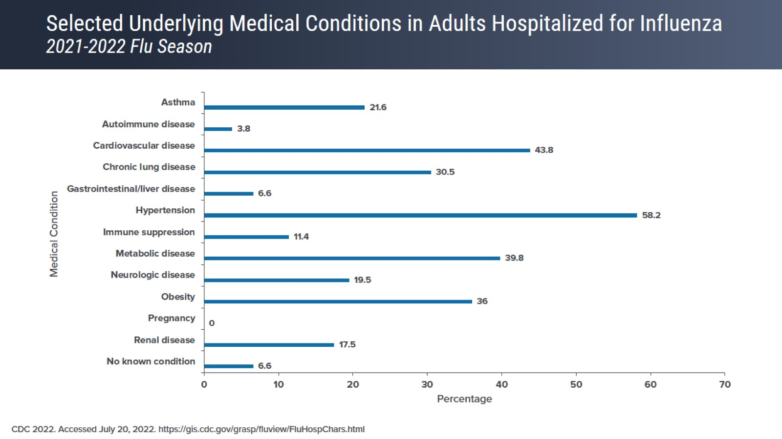
Selected Underlying Medical Conditions in Adults Hospitalized for Influenza 2021-2022 Flu Season

Slide 46
Potential Effects of Influenza Infection on Adults With Chronic Health Conditions

Slide 47
Influenza Exacerbates Chronic Health Conditions

Slide 48
Question

Slide 49
Recommendations for Influenza Vaccination

Slide 50
Benefits of Influenza Vaccination for Adults With Chronic Health Conditions

Slide 51
Influenza Vaccination Coverage in Adults ≥ 18 Years 2010-2021 Influenza Season

Slide 52
Association Between COVID-19 Vaccination and Influenza Vaccination Rates

Slide 53
Priority Groups for Antiviral Treatment of Influenza

Slide 54
Question

Slide 55
Timing of Antiviral Therapy for Treatment of Influenza

Slide 56
Question

Slide 57
Treating Influenza Via Telehealth

Slide 58
Question

Slide 59
General Recommendations for Chemoprophylaxis

Slide 60
General Recommendations for Chemoprophylaxis

Slide 62
Question

Slide 63
Burden of Influenza in the Pediatric Population

Slide 64
Influenza-Associated Pediatric Hospitalizations 2019-2020 Season

Slide 65
Influenza-Associated Pediatric Hospitalizations By Age

Slide 66
Influenza-Associated Pediatric Deaths

Slide 67
Question

Slide 68
Influenza-Related Complications in Children

Slide 69
Children at Greatest Risk of Serious Influenza-Related Complications

Slide 70
Pediatric Influenza Deaths During 2019-2020

Slide 71
Question

Slide 72
Vaccination Is the Best Protection Against Influenza

Slide 73
Benefits of Influenza Vaccination in Children Data From the 2019-2020 Influenza Season

Slide 74
Benefits of Influenza Vaccination in Children Data From the 2010-2014 Influenza Seasons

Slide 75
Question

Slide 76
Types of Influenza Vaccines

Slide 77
Question

Slide 78
Coadministration of Influenza Vaccine With Other Pediatric Vaccines

Slide 79
Question

Slide 80
Influenza Vaccination Coverage in the Pediatric Population 2010-2021 Seasons

Slide 81
Question

Slide 82
Strategies for Improving Vaccination Coverage

Slide 83
Decrease in Preventive Visits Due to COVID-19 Pandemic

Slide 84
Involving the Healthcare Team

Slide 85
Consistent Messaging About Vaccination

Slide 86
Vaccination at Non-Clinic Settings

Slide 87
Question

Slide 88
Priority Groups for Antiviral Treatment of Influenza

Slide 89
Question

Slide 90
Antiviral Medications Recommended for Treatment and Chemoprophylaxis of Influenza

Slide 91
General Recommendation for Chemoprophylaxis

Slide 92
Summary

