Slide 3
Introduction

Slide 4
Technological Approaches to Durability in nAMD

Slide 5
Gene Therapy for nAMD RGX-314

Slide 6
Subretinal RGX-314 for nAMD NCT03066258

Slide 7
Suprachoroidal RGX-314 for nAMD NCT04514653

Slide 8
Gene Therapy for nAMD ADVM-022

Slide 9
Intravitreal ADVM-022 OPTIC Phase 1 Study Design

Slide 10
Intravitreal ADVM-022 OPTIC Phase 1 Study Outcomes

Slide 11
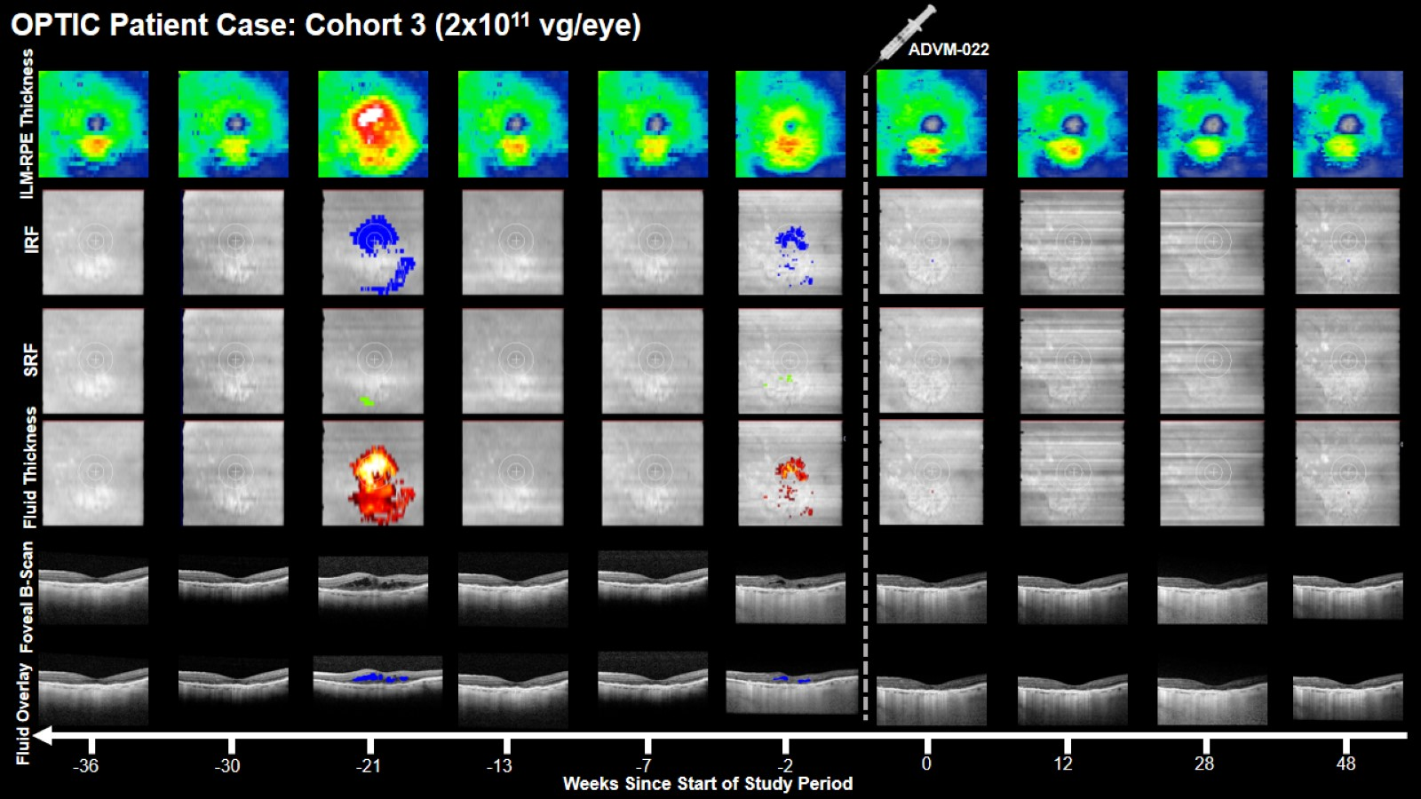

Slide 12
Expert Perspectives Gene Therapy for nAMD

Slide 13
Implants for Anti-VEGF Delivery Port Delivery System

Slide 14
ARCHWAY Phase 3 Trial in nAMD 2-Year Data (End of Study)

Slide 15
ARCHWAY Phase 3 Trial in nAMD 2-Year Data (End of Study)

Slide 16
ARCHWAY Phase 3 Trial in nAMD CST Through Week 96

Slide 17
ARCHWAY Phase 3 Trial in nAMD Distribution of CST Fluctuations > 50 µm Over 96 Weeks

Slide 18
ARCHWAY Phase 3 Trial in nAMD Distribution of CST Fluctuations > 50 µm Over 96 Weeks

Slide 19
ARCHWAY Phase 3 Trial in nAMD Similar IRF/SRF Dynamics in the Center 1 mm

Slide 20
PORTAL Extension 3-Year Data Stable Retinal Anatomy Through Week 144 in Both Arms

Slide 21
PORTAL Extension 3-Year Data Most PDS Recipients Do Not Require Supplemental Anti-VEGF

Slide 22
PORTAL Extension 3-Year Data Ocular AEs of Special Interest

Slide 23
PORTAL Extension 3-Year Data Patient Preference in Those Switching From Intravitreal Injections

Slide 24
Implications for Clinical Practice Patient Selection - Learning From the US Experience

Slide 25
Implications for Clinical Practice Patient Selection - Learning From the US Experience

Slide 26
Implications for Clinical Practice Patient Selection - Identifying Poor Candidates

Slide 27
Implications for Clinical Practice Patient Selection - Previous Treatment

Slide 28
Implications for Clinical Practice Patient Selection

Slide 29
Implications for Clinical Practice Refill-Exchange

Slide 30
Implications for Clinical Practice Surgical Complications

Slide 31
Meticulously Follow the FDA-Approved Instructions for Use

Slide 32
Implications for Clinical Practice Surgical Complications (cont)

Slide 33
Good Surgical Technique Closing

Slide 34
Pitfalls Poor Closing Can Lead to Implant Exposure

Slide 35
Implications for Clinical Practice Surgical Complications (cont)

Slide 36
Implications for Clinical Practice Follow-Up

Slide 37
Conclusions

