Slide 1
MRI in Breast Cancer Assessment of Response to Neoadjuvant Therapy

Slide 4
Neoadjuvant Therapy Enables Risk-Adapted Approach

Slide 5
I-SPY2 Event-Free Survival by pCR and Non-pCR Phase 2

Slide 6
Current Risk-Adapted Therapy Post-Neoadjuvant Therapy Followed by Surgery

Slide 7
Use of Neoadjuvant Setting to Personalize Therapy

Slide 8
KATHERINE Trial Phase 3

Slide 9
DESTINY-Breast05 (NSABP B-60) Trial Phase 3

Slide 10
Using the Neoadjuvant Setting to Omit Anthracyclines

Slide 11
TRYPHAENA Trial Phase 2

Slide 12
NCCN Guidelines Agree: Anthracyclines No Longer Preferred

Slide 13
Using the Neoadjuvant Setting to Reduce the Amount of Chemotherapy

Slide 14
WSG-ADAPT HER2-Positive/HR-Negative Trial Phase 2

Slide 15
WSG-ADAPT HER2-Positive/HR-Negative Trial Phase 2

Slide 16
CompassHER2-RD Phase 3 Trial (Alliance A011801)

Slide 17
Using Imaging to Guide Response-Adapted Therapy and Timing of Surgery

Slide 18
Immunotherapy in TNBC: KEYNOTE-522

Slide 19
Pathologic Residual Cancer Burden Is Prognostic for Event-Free Survival

Slide 20
KEYNOTE-522 Stage II/III TNBC Prevalence of RCB Categories in All Patients

Slide 21
Is There a Benefit From CIT Beyond Achieving a pCR?

Slide 22
Non-Anthracycline Neoadjuvant Regimen for TNBC

Slide 23
Using Imaging to Guide Response-Adapted Therapy and Timing of Surgery

Slide 24
Molecular Response Predictive Subtyping

Slide 25
Prevalence of TNBC Response Predictive Subtypes in I-SPY2^{[a]}

Slide 26
TNBC pCR Rates and Response Predictive Subtypes

Slide 27
TNBC pCR Rates and Response Predictive Subtypes

Slide 28
Summary: Assessment of Response to Neoadjuvant Therapy

Slide 31
Outline

Slide 32
Benefits NAT

Slide 33
Schematic of NAC

Slide 34
Breast MRI: Based on Contrast Enhancement Only

Slide 35
If We Only Assess Enhancement MRI Can Overestimate Response

Slide 36
If We Only Assess Enhancement MRI Can Overestimate Response

Slide 37
Pattern of Response

Slide 38
Residual Cancer Burden (RCB) Score

Slide 39
MRI Phenotype Correlates to Likelihood of pCR

Slide 40
Meta Analysis: Molecular Subtype Matters

Slide 41
Response Evaluation Criteria In Solid Tumors 1.1 Guidelines

Slide 42
I-SPY Trial ACRIN 6657 MC Trial Before-, During-, Post-NAT

Slide 43
NAT Axilla MRI

Slide 44
MRI Techniques Beyond Contrast to Improve Accuracy

Slide 45
Diffusion Weighted Imaging DWI -- Nonenhanced

Slide 46
ACRIN 6698

Slide 47
Radiomics

Slide 48
Standardized Framework of Radiomics Analysis

Slide 49
Radiomics for Assessing Tumor Heterogeneity

Slide 50
Radiomics of MRI for the Prediction of the pCR to Neoadjuvant Chemotherapy in Breast Cancer Patients

Slide 51
How Well Does Radiomics Do?

Slide 52
How Well Does Radiomics Do?

Slide 53
Radiomics Improves Performance

Slide 54
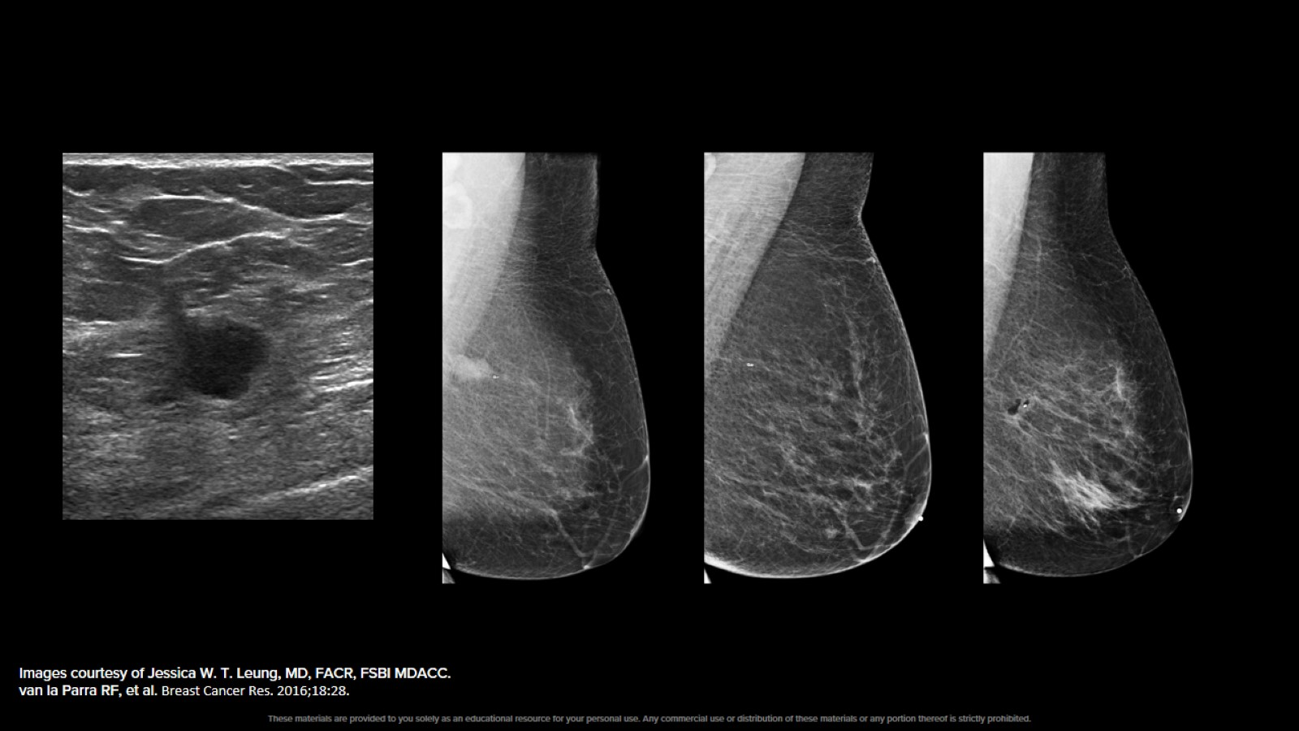

Slide 55
Other Trials: Ongoing/Planned

Slide 56
Prelim and Results of Trials Exploring BCT Without Surgery

Slide 57
Summary

