Slide 2
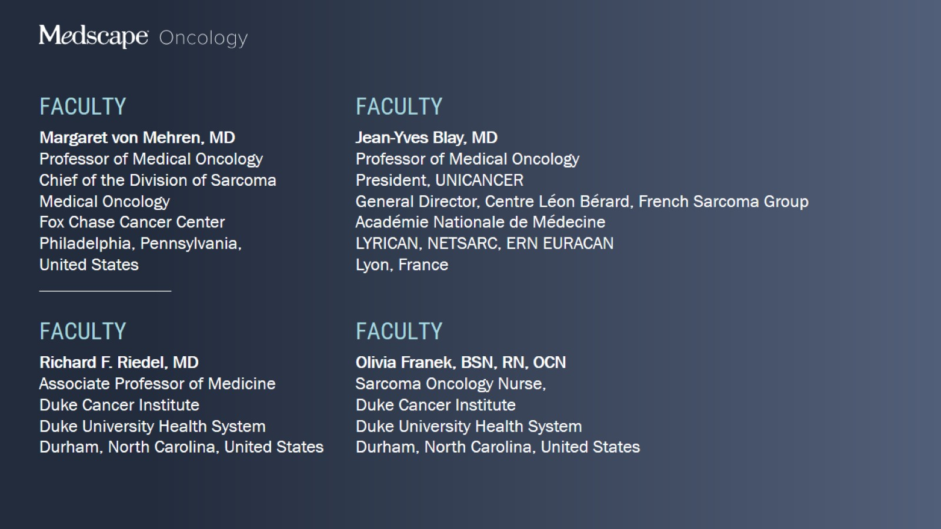

Slide 3
Challenges Faced by Patients During Their Treatment Journey With GIST

Slide 4
Importance of Being Aware of Challenges Faced by Patients

Slide 5
Establishing a Partnership From Diagnosis Onward

Slide 6
Key Considerations at the Beginning of the GIST Patient Journey

Slide 7
Key Considerations at the Beginning of the GIST Patient Journey

Slide 8
Key Considerations at the Beginning of the GIST Patient Journey

Slide 9
Key Considerations at the Beginning of the GIST Patient Journey

Slide 10
Key Considerations at the Beginning of the GIST Patient Journey

Slide 11
Key Considerations at the Beginning of the GIST Patient Journey

Slide 12
Key Considerations at the Beginning of the GIST Patient Journey

Slide 13
Key Considerations at the Beginning of the GIST Patient Journey

Slide 14
Key Considerations at the Beginning of the GIST Patient Journey

Slide 15
A Patient's Medical Journey Through GIST

Slide 16
A Patient's Social and Emotional Journey Through GIST

Slide 17
Active Listening Is Key to Addressing Quality-of-Life Issues

Slide 18
Impact of AEs on Treatment Adherence

Slide 19
Importance of a Team Approach in the GIST Treatment Journey

Slide 20
Concluding Remarks

Slide 22
Driver Mutations of Molecular GIST Subtypes

Slide 23
Driver Mutations of Molecular GIST Subtypes

Slide 24
Driver Mutations of Molecular GIST Subtypes

Slide 25
Driver Mutations of Molecular GIST Subtypes

Slide 26
Drug Sensitivities of Key GIST Driver Mutations

Slide 27
10-y Follow-Up of Adjuvant Imatinib in High-Risk GIST Survival Outcome

Slide 28
Sunitinib, Regorafenib, and Ripretinib Second-, Third-, and Fourth-Line Agents

Slide 29
Impact of Mutational Status on Long-Term Outcomes With First-Line Imatinib in Advanced GIST

Slide 30
Impact of Mutational Status on Long-Term Outcomes With First-Line Imatinib in Advanced GIST

Slide 31
Prediction of Outcome and Mutation From H&E Slides in GIST Using Deep Learning

Slide 32
Deep Learning Outperforms Miettinen System in Predicting RFS

Slide 33
Relapse Prediction Improved Using Deep Miettinen

Slide 34
Highly Accurate Mutation Prediction With Deep Learning

Slide 35
Identification of Histological Features Predictive of Mutational Profiles With Deep Learning

Slide 36
Selinexor With or Without Imatinib in Advanced GIST SeliGIST/GEIS-41 Study Design

Slide 37
Selinexor With or Without Imatinib in Advanced GIST SeliGIST/GEIS-41 Safety

Slide 38
Selinexor With or Without Imatinib in Advanced GIST SeliGIST/GEIS-41 Efficacy

Slide 39
Selinexor With or Without Imatinib in Advanced GIST SeliGIST/GEIS-41 Efficacy

Slide 40
Selinexor With or Without Imatinib in Advanced GIST SeliGIST/GEIS-41 Efficacy

Slide 41
Selinexor With or Without Imatinib in Advanced GIST SeliGIST/GEIS-41 Efficacy

Slide 42
Selinexor With or Without Imatinib in Advanced GIST SeliGIST/GEIS-41 Efficacy

Slide 43
Ripretinib vs Sunitinib in Advanced GIST After Imatinib INTRIGUE Study Design

Slide 44
Ripretinib vs Sunitinib in Advanced GIST After Imatinib INTRIGUE PFS in the ITT Population

Slide 45
Ripretinib vs Sunitinib in Advanced GIST After Imatinib INTRIGUE PFS by Stratification Factors

Slide 46
Ripretinib vs Sunitinib in Advanced GIST After Imatinib INTRIGUE Grade 3-4 Adverse Events

Slide 47
Ripretinib vs Sunitinib in Advanced GIST After Imatinib INTRIGUE Patient-Reported Skin Toxic Effects

Slide 48
Ripretinib vs Sunitinib in Advanced GIST After Imatinib EORTC QLQ-C30

Slide 49
Concluding Remarks

Slide 51
Prediction of Outcome and Mutation From H&E Slides in GIST Using Deep Learning

Slide 52
Prediction of Outcome and Mutation From H&E Slides in GIST Using Deep Learning

Slide 53
Increasing Importance of Molecular Characterization of GIST

Slide 54
Ripretinib vs Sunitinib in Advanced GIST After Imatinib INTRIGUE PFS in the ITT Population

Slide 55
Ripretinib vs Sunitinib in Advanced GIST After Imatinib INTRIGUE PFS by Stratification Factors

Slide 56
Ripretinib vs Sunitinib in Advanced GIST After Imatinib INTRIGUE PFS by Stratification Factors

Slide 57
Ripretinib vs Sunitinib in Advanced GIST After Imatinib EORTC QLQ-C30

Slide 58
Impact of Latest INTRUIGE Data on Clinical Practice Expert Discussion

Slide 59
Impact of Latest INTRUIGE Data on Clinical Practice Expert Discussion

Slide 60
Impact of Latest INTRUIGE Data on Clinical Practice Expert Discussion

Slide 61
Impact of Latest INTRUIGE Data on Clinical Practice Expert Discussion

Slide 62
Impact of Latest INTRUIGE Data on Clinical Practice Expert Discussion

Slide 63
Optimal Treatment Approach and Sequencing Expert Discussion

Slide 64
Optimal Treatment Approach and Sequencing Expert Discussion

Slide 65
Optimal Treatment Approach and Sequencing Expert Discussion

Slide 66
Optimal Treatment Approach and Sequencing Expert Discussion

Slide 67
Optimal Treatment Approach and Sequencing Expert Discussion

Slide 68
Optimal Treatment Approach and Sequencing Expert Discussion

Slide 69
Optimal Treatment Approach and Sequencing Expert Discussion

Slide 70
Management of Newly Diagnosed GIST NCCN Guidelines

Slide 71
Management of Newly-Diagnosed GIST NCCN Guidelines

Slide 72
Management of Advanced/Metastatic GIST ESMO-EUROCAN Guidelines

Slide 73
Management of Advanced/Metastatic GIST ESMO-EUROCAN Guidelines

Slide 74
Moving Toward Personalized Management of GIST

Slide 76
Timeline of Approved TKIs for the Treatment of Advanced Metastatic GIST

Slide 77
AEs Experienced by ≥ 10% of Patients Receiving Imatinib

Slide 78
Most Common AEs With Sunitinib and Regorafenib

Slide 79
AEs Experienced by ≥ 10% of Patients Receiving Ripretinib

Slide 80
AEs Experienced by ≥ 20% of Patients Receiving Avapritinib

Slide 81
AEs Experienced by ≥ 20% of Patients Receiving Avapritinib

Slide 83
Quality-of-Life Impact of Fourth-Line Ripretinib vs Placebo INVICTUS

Slide 84
Quality-of-Life Impact of Second-Line Ripretinib vs Sunitinib INTRIGUE

Slide 86
Important AE Considerations With TKIs in GIST Expert Discussion

Slide 87
Important AE Considerations With TKIs in GIST Expert Discussion

Slide 88
Important AE Considerations With TKIs in GIST Expert Discussion

Slide 89
Important AE Considerations With TKIs in GIST Expert Discussion

Slide 90
Important AE Considerations With TKIs in GIST Expert Discussion

Slide 91
Important AE Considerations With TKIs in GIST Expert Discussion

Slide 93
Management of Hand-Foot Syndrome Expert Discussion

Slide 94
Management of Hand-Foot Syndrome Expert Discussion

Slide 95
Management of AEs With Ripretinib Expert Discussion

Slide 96
Management of AEs With Ripretinib Expert Discussion

Slide 97
Management of Cognitive Impairment With Avapritinib Expert Discussion

Slide 99
Common Concerns Expressed by Patients at Clinic Appointments Expert Insight

Slide 100
Discussing Treatment Options With Patients Expert Insight

Slide 101
Discussing Treatment Options With Patients Expert Insight

Slide 102
Typical First Conversations With Patients Expert Insight

Slide 103
Typical First Conversations With Patients Expert Insight

Slide 104
Recommendations for Assessing a Patient's Understanding Expert Insight

Slide 105
Recommendations for Assessing a Patient's Understanding Expert Insight

Slide 106
Recommendations for Assessing a Patient's Understanding Expert Insight

Slide 107
Importance of the Interprofessional Team

Slide 108
Treatment of Patients Struggling With Side Effects Expert Insight

Slide 109
Treatment of Patients Struggling With Side Effects Expert Insight

Slide 110
Treatment of Patients Struggling With Side Effects Expert Insight

