Slide 2
Program Overview

Slide 3
Chikungunya Pathophysiology

Slide 4
Chikungunya Disease Burden

Slide 5
Chikungunya Disease Burden (cont)

Slide 6
Chikungunya Is Spreading Beyond Traditional Endemic Areas

Slide 7
Chikungunya Is Spreading Beyond Traditional Endemic Areas

Slide 8
Epidemiology of Chikungunya

Slide 9
Epidemiology of Chikungunya

Slide 10
Climate Change and Chikungunya Transmission

Slide 11
Climate Change and Chikungunya Transmission

Slide 12
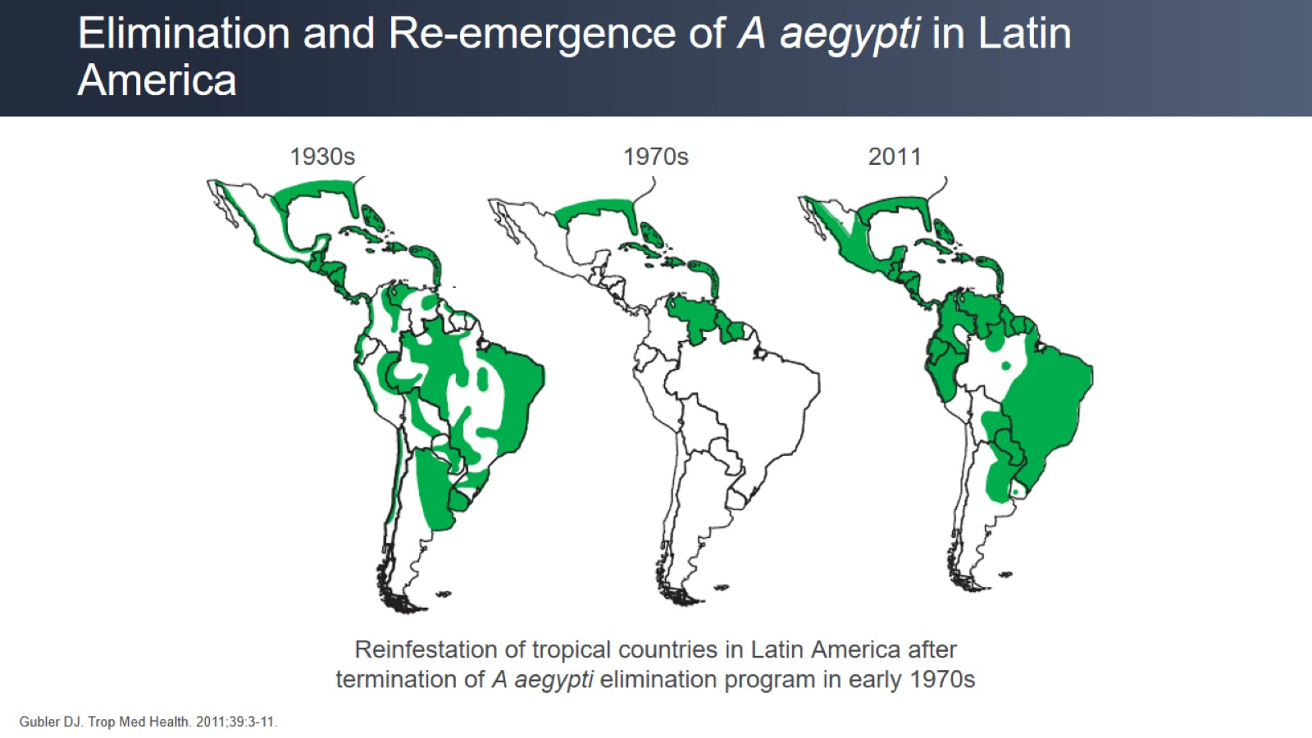
Elimination and Re-emergence of A aegypti in Latin America

Slide 13
Chikungunya Outbreaks

Slide 14
Chikungunya Outbreaks 1952 to 2004

Slide 15
Spread of Chikungunya Since 2004

Slide 16
Spread of Chikungunya Since 2014

Slide 17
Key Messages on Outbreaks

Slide 18
Key Messages on Outbreaks

Slide 19
Who Is at Risk for Chikungunya?

Slide 20
Who Is at Risk for Chikungunya?

Slide 21
Awareness of Chikungunya

Slide 22
Patient Case 1

Slide 23
Patient Case 1

Slide 24
Patient Case 2

Slide 25
Patient Case 2

Slide 26
Patient Case 2

Slide 27
Patient Case 3

Slide 28
Patient Case 3

Slide 29
Patient Case 3

Slide 30
Patient Case 2

Slide 31
Key Messages on Diagnosing Chikungunya

Slide 32
Key Messages on Diagnosing Chikungunya

Slide 33
Key Messages on Diagnosing Chikungunya

Slide 34
Prevention of Chikungunya in Travelers

Slide 35
Prevention of Chikungunya in Travelers

Slide 36
Conclusion

