Slide 1

Novel CGRP Treatments:
A Recipe for Success in Migraine Management
Supported through independent educational grants from AbbVie Inc., Biohaven Pharmaceuticals, Inc., Lundbeck, and Teva Pharmaceuticals.
Stephanie J. Nahas, MD, MSEd, FAHS, FAAN
Associate Professor of Neurology
Department of Neurology
Director, Headache Medicine Fellowship Program
Jefferson Headache Center
Thomas Jefferson University, Philadelphia, PA
stephanie.nahas@jefferson.edu
@stephaniejnahas
Shirley Kessel
Executive Director, Miles for Migraine
milesformigraine.org
shirley@milesformigraine.org
@shirleyskessel

Slide 2
Disclosures
Stephanie J. Nahas, MD, MSEd, FAHS, FAAN: Advisory Board – Allergan/AbbVie; Speaker – Allergan/AbbVie, Amgen/Novartis, Eli Lilly, Teva; Consultant – Alder/Lundbeck, Allergan/AbbVie, Amgen/Novartis, Biohaven, Eli Lilly, Teva; Support (Clinical Trial Site PI) – Teva
Shirley Kessel: Consultant – Alder/Lundbeck, Allergan/AbbVie
PI = principal investigator.

Slide 3
Learning Objectives
Describe the prevalence and key causes of suboptimal migraine management despite available treatment options
Evaluate the mechanisms of action, most recent efficacy and safety data, and administration considerations associated with current and emerging therapies for the treatment and prevention of migraine
Assess patient response to current therapy and integrate novel migraine therapies as appropriate into patient-centered care strategies

Slide 4
Why Care?
Headache, especially migraine, is common, disabling, and costly
Healthcare access remains a problem, but it shouldn’t be
More than 38 million Americans with migraine (and about 14% of the global population); women 3x more than men
3rd most prevalent disease in the world
#1 cause of years lived with disability among Americans aged 15-49
Healthcare and lost productivity costs amount to about $36 BILLION annually in the US
The patient isn’t the only one suffering
Most patients never even see the doctor (time, cost, stigma)
Many who do are misdiagnosed
Under a quarter of patients get appropriate treatment
Maybe 1/5 of them stick with treatment after a year
Even when diagnosed/treated, patients often feel dissatisfied/dismissed
All this despite clear diagnosis and treatment guidelines
Safiri S, et al. Pain. 2022;163(2):e293-e309. Burch RC, et al. Headache. 2022;62(1):111-112.

Slide 5

Missing the Moments of Life
Migraine since birth
Misdiagnosed
No advanced degree
Left career behind
Canceled plans
2 of 3 daughters inherited

Slide 6
Headache Is Underdiagnosed
Includes 24% who
consulted about headache
Undiagnosed
Percentage of Patients with Headache
Diagnosed
Lipton RB, et al. Headache. 1998;38(2):87-96.

Slide 7
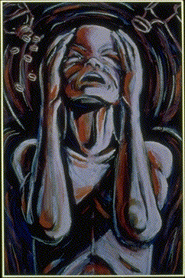
Take a History!
Where is the pain?
Dull, throbbing, shooting, burning?
Effect of physical exertion?
Nausea or vomiting?
Sensitive to light, sound, odors?
Neck pain? Muscle tension?
Autonomic features?
Physical changes?
Neurologic symptoms?
Past headache history?

Slide 8



3-Question Screener: ID Migraine
“PIN” the migraine diagnosis
Photophobia
Does light bother you
when you have a headache?
Impairment
Has headache limited activity (≥1 day) in the last 3 months?
Nausea
Are you sick to your stomach when you have a headache?
“Yes” to 2 or 3 questions = 93% have migraine
Lipton RB, et al. Neurology. 2003;61(3):375-382.

Slide 9


The Importance of Acute Treatment
Providing correct, adequate, acute treatment of migraine is important
Effective acute treatment provides rapid relief of pain, associated symptoms, and disability related to migraine attacks with minimal adverse effects
Ineffective acute treatment can lead to medication overuse and MOH, transformation to chronic migraine, and worse
long-term outcomes
MOH = medication overuse headache.
Mallick-Searle T, et al. J Am Assoc Nurse Pract. 2020;33(6):419-428. Vandenbussche N, et al. J Headache Pain. 2018;19(1):50. Agostoni EC, et al. J Headache Pain. 2019;20(1):92.
Notes:
Timecode: 00:52
Chapter Title: Acute Treatment of Migraine

Slide 10
Stratified Care for Acute Treatment
Level of disability
due to migraine
(Consider non-oral route)
Ergot/triptan/ditan ± Gepant ± NSAID ± dopamine antagonist
Severe
Moderate
Ergot/triptan/ditan ± NSAID
Mild
NSAID/acetaminophen
Rx acute drugs remain underutilized!
NSAID = non-steroidal anti-inflammatory drug.
Lipton RB, et al. JAMA. 2000;284(20):2599-2605. Lipton RB, et al. Headache. 2018;58(9):1408-1426.
Notes:
Timecode: 00:52
Chapter Title: Acute Treatment of Migraine

Slide 11
Consider Preventive Medication When:
1. Migraine significantly interferes with daily routine, despite acute treatment
2. Frequency attacks (>1/week) with risk of CDH or MOH
3. Acute medications ineffective, contraindicated, troublesome AEs, or overused
4. Patient preference
5. Presence of certain migraine variants
Hemiplegic migraine Migraine with brainstem aura
Migraine with prolonged aura Migrainous infarction
CDH = chronic daily headache; AEs = adverse events.

Slide 12
Migraine Prevention Is Underutilized
39.2% of those with migraine may be eligible for prevention
Persons
with
Migraine
9.8% receive prevention
Prevention
Candidates
Nahas SJ, et al. Presented at: American Headache Society (AHS) Annual Meeting; June 3-6, 2021; Orlando, FL. Lipton RB, et al. Presented at: AHS Annual Meeting; June 23-26, 2005; Philadelphia, PA.
Notes:
Taking these two groups together, the AMPP study showed that about 40% of migraine patients are candidates for preventive treatment.
Only 13% of all migraine sufferers currently receive preventive therapy.
Results showed that migraine prevention is underutilized (only 1 in 5 migraine sufferers use preventive therapy).
The final consensus of the committee is that preventive therapy should at least be considered in those patients whose lives are disrupted, even with a lower frequency of migraine—for example, 2 migraines per month—or if their acute treatment has not been sufficient. Using those criteria, among the total migraine cases in the United States, the study identified 3.8 million cases in which preventive therapy should be considered and 7.7 million cases for which preventive treatment should be offered.
Reference:
Lipton RB, Diamond M, Freitag FG, Bigal M, Stewart WF, Reed ML. Migraine prevention patterns in
A community sample: results from the American Migraine Prevalence and Prevention (AMPP) study.
Poster presented at: American Headache Society 47th Annual Scientific Meeting; June 23-26, 2005;
Philadelphia, Pa.

Slide 13
Principles of Preventive Treatment
Choice based on efficacy, AE profile, coexistent conditions, and diagnosis
Communicate realistic expectations
Start at low dose and gradually increase until efficacy achieved, side effects develop, or ceiling dose reached
Benefit develops slowly (months); often not fully effective until overuse eliminated
Notes:
Taking these two groups together, the AMPP study showed that about 40% of migraine patients are candidates for preventive treatment.
Only 13% of all migraine sufferers currently receive preventive therapy.
Results showed that migraine prevention is underutilized (only 1 in 5 migraine sufferers use preventive therapy).
The final consensus of the committee is that preventive therapy should at least be considered in those patients whose lives are disrupted, even with a lower frequency of migraine—for example, 2 migraines per month—or if their acute treatment has not been sufficient. Using those criteria, among the total migraine cases in the United States, the study identified 3.8 million cases in which preventive therapy should be considered and 7.7 million cases for which preventive treatment should be offered.
Reference:
Lipton RB, Diamond M, Freitag FG, Bigal M, Stewart WF, Reed ML. Migraine prevention patterns in
A community sample: results from the American Migraine Prevalence and Prevention (AMPP) study.
Poster presented at: American Headache Society 47th Annual Scientific Meeting; June 23-26, 2005;
Philadelphia, Pa.

Slide 14
Principles of Preventive Treatment
If first choice fails, choose second from another therapeutic class
Monotherapy preferred, but combination therapy often necessary
Avoid pregnancy
Evaluate therapy
  Use calendar
  Slowly taper to lowest effective dose (and stop?) if migraine is well-controlled
Notes:
Taking these two groups together, the AMPP study showed that about 40% of migraine patients are candidates for preventive treatment.
Only 13% of all migraine sufferers currently receive preventive therapy.
Results showed that migraine prevention is underutilized (only 1 in 5 migraine sufferers use preventive therapy).
The final consensus of the committee is that preventive therapy should at least be considered in those patients whose lives are disrupted, even with a lower frequency of migraine—for example, 2 migraines per month—or if their acute treatment has not been sufficient. Using those criteria, among the total migraine cases in the United States, the study identified 3.8 million cases in which preventive therapy should be considered and 7.7 million cases for which preventive treatment should be offered.
Reference:
Lipton RB, Diamond M, Freitag FG, Bigal M, Stewart WF, Reed ML. Migraine prevention patterns in
A community sample: results from the American Migraine Prevalence and Prevention (AMPP) study.
Poster presented at: American Headache Society 47th Annual Scientific Meeting; June 23-26, 2005;
Philadelphia, Pa.

Slide 15

SOS!
Became chronic
Help! What do I do now?
2 car accidents
3 kids, 1 in a “cave”
No parent support
Make advocacy part of the treatment plan

Slide 16
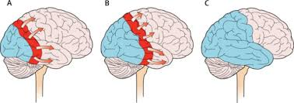
CGRP = calcitonin
gene-related peptide.
Goadsby PJ, et al. Neurol Clin. 2019;37(4):651-671.

Slide 17
Goadsby PJ, et al. Neurol Clin. 2019;37(4):651-671.

Slide 18
AHS Consensus for New Acute Tx
A. Prescribed/recommended by a licensed clinician
B. Patient is at least 18 years of age
C. Diagnosis of ICHD-3 migraine with aura, migraine without aura, or chronic migraine
D. Either of the following
  Contraindications to or inability to tolerate triptans
  Inadequate response to 2 or more oral triptans, as determined by EITHER of the following
    Validated acute treatment patient-reported outcome questionnaire (mTOQ, Migraine-ACT, PPMQ-R, FIS, PGIC)
    Clinical attestation
ICHD-3 = International Classification of Headache Disorders, 3rd ed; mTOQ = Migraine Treatment Optimization Questionnaire; ACT = Assessment of Current Therapy; PPMQ-R = Patient Perception of Migraine Questionnaire-Revised; FIS = Functional Impairment Scale; PGIC = Patient Global Impression of Change.
Ailani J, et al. Headache. 2021;61(7):1021-1039.

Slide 19
National Headache Foundation
2022 Position Statement on Acute Treatments for Migraine
  A modified step-care model for acute migraine treatment that optimizes time to pain-free and functional status
  Try 2 generic drugs
    First, a generic triptan
    Then any other generic drug, including another triptan or NSAID
  After a patient has “tried and been failed by” 2 such drugs, another suitable therapy can be selected based on the individual patient’s needs and situation, including FDA-approved acute agents such as lasmiditan or a gepant
FDA = US Food and Drug Administration.
National Headache Foundation (NHF). January 19, 2022. Accessed August 18, 2022.
https://headaches.org/national-headache-foundation-position-statement-on-the-treatment-of-migraine/#:~:text=For%20preventive%20care%2C%20NHF%20believes,established%20lower%20adverse%20event%20profiles.

Slide 20
National Headache Foundation
2022 Position Statement on Acute Treatments for Migraine
  A patient is considered to have “tried and been failed by” a drug for acute migraine if at least 1 of the following applies
    Patient is not migraine pain-free and functional within 2 hours of treatment after the majority of attacks OR the patient has a recurrence of migraine symptoms within 24 hours after treatment
    The patient cannot tolerate the drug due to its AEs (eg, tightness in the throat and/or chest on triptans)
    The patient has a documented history of the drug having proved either lacking efficacy or being intolerable due to AEs
    Patient has a comorbidity and/or other contraindications that preclude clinician from prescribing drug (eg, uncontrolled hypertension, CAD, RCVS for triptans or gastric ulcer disease, renal insufficiency for NSAIDs)
CAD = coronary artery disease; RCVS = reversible cerebral vasoconstriction syndrome.
NHF. January 19, 2022. Accessed August 18, 2022.
https://headaches.org/national-headache-foundation-position-statement-on-the-treatment-of-migraine/#:~:text=For%20preventive%20care%2C%20NHF%20believes,established%20lower%20adverse%20event%20profiles.

Slide 21
AHS Consensus for New Preventive Tx
A. Prescribed/recommended by a licensed clinician
B. Patient is at least 18 years of age
C. Diagnosis of ICHD-3 migraine with aura, migraine without aura, or chronic migraine
Inability to tolerate (due to side effects) or inadequate response to an 8-week trial at a dose established to be potentially effective of 2 or more of the following
  Topiramate
  Divalproex sodium/valproate sodium
  Beta-blocker: Metoprolol, propranolol, timolol, atenolol, nadolol
  Tricyclic antidepressant: Amitriptyline, nortriptyline
  Serotonin-norepinephrine reuptake inhibitor: Venlafaxine, duloxetine
  Other Level A or B treatments
At least moderate disability (MIDAS ≥11 or HIT-6 >50)*
OR inability to tolerate or inadequate response to a minimum of 2 quarterly injections (6 months) of onabotulinumtoxinA**
*Only for episodic migraine with 4-7 migraine days/month
**Only for chronic migraine (8+ migraine days/month and 15+ headache days/month)
For those with 8+ migraine days/month, disability is assumed to be at least moderate
MIDAS = Migraine Disability Assessment; HIT = Headache Impact Test.
Ailani J, et al. Headache. 2021;61(7):1021-1039.

Slide 22
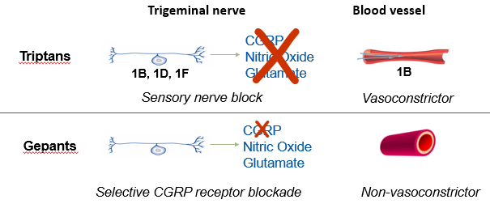
Gepants: Small-Molecule Oral CGRP Receptor Antagonists
Gepants support the notion that vasoconstriction may not be necessary for the successful treatment of migraine
No vasoconstriction
Unlike triptans, gepants do not cause vasoconstriction
No vascular contraindications
No warnings or precautions for use in people with vascular disease
No CV SAEs in clinical trials
There were no reports of CV SAEs associated with gepants in clinical trials
CV = cardiovascular; SAEs = serious AEs.
Tepper D. Headache. 2020;60(5):1037-1039. FDA. Accessed August 18, 2022. https://www.accessdata.fda.gov/drugsatfda_docs/label/2019/211765s000lbl.pdf; https://www.accessdata.fda.gov/drugsatfda_docs/label/2021/212728s006lbl.pdf; https://www.accessdata.fda.gov/drugsatfda_docs/label/2021/215206Orig1s000lbl.pdf.
Notes:
Timecode: 05:18
Abbreviations
References

Slide 23
Rimegepant: Improved Quality of Life
Migraine 2-14 days/month vs 4-14 days/month
Group 1: Rimegepant PRN; Group 2: Every other day + PRN
Improvement in MSQv2 domains over time in both groups
Improvement more pronounced in those with higher MMDs and those taking rimegepant every other day + PRN
MSQ = Migraine-Specific Quality of Life; MMDs = monthly migraine days.
Johnston KM, et al. Adv Ther. 2021;38(10):5209-5220.
Notes:
Johnston, K.M., et al. Mapping Migraine-Specific Quality of Life to Health State Utilities in Patients Receiving Rimegepant. Adv Ther 2021; 38:5209–5220

Slide 24
UNIVERSE Study – Real-World Effectiveness of Ubrogepant in Patients with Treatment Failure
  Observational cross-sectional study
  US adult users of Migraine Buddy (N=302)
  Self-report use of ubrogepant for ≥4 prior migraine headaches
  29-question survey assessed treatment patterns, outcomes, satisfaction with ubrogepant
  Results: 87.4% switched to ubrogepant due to lack of efficacy with prior treatment
    >75% satisfied with pain relief at 2 hours, 4 hours, and 48 hours post-dose
    Patient satisfaction with the ability to think clearly and return to normal function after treatment
  Reduced use of prior or concurrent medications
    Opioids (-28%)
    Barbiturates (-25%)
    Ergots (-15%)
    Triptans (-55%)
    NSAIDs (-38%)
Shewale AR, et al. Neurology. 2022;98(18 Suppl):P12-2.001.

Slide 25
Gepants for Prevention
Rimegepant FDA-approved for prevention of episodic migraine (average 9-10 days/month)
  75 mg ODT every other day
  At month 3, -4.3 days less with treatment vs -3.5 days less/month with placebo (P=0.0099)
  AEs: Nausea (3%), nasopharyngitis (4%)
Atogepant for prevention of episodic migraine (average 7-8 days/month)
  10 mg vs 30 mg vs 60 mg vs placebo daily
  At month 3, -3.7 to -4.2 days less/month with treatment vs -2.5 days less/month with placebo (P<0.001)
  AEs: Constipation (~7-8%), nausea (~6%), URI (2-4%)
ODT = orally dissolving tablet; URI = upper respiratory infection.
FDA. Accessed August 18, 2022. https://www.accessdata.fda.gov/drugsatfda_docs/label/2021/212728s006lbl.pdf; https://www.accessdata.fda.gov/drugsatfda_docs/label/2021/215206Orig1s000lbl.pdf.

Slide 26
Rimegepant: Phase 2/3 Trial
  Adults with 4 to 18 moderate to severe migraine days/month
  After a 4-week observation period, patients were randomly assigned to rimegepant 75 mg or placebo every other day for 12 weeks
  Primary endpoint: Change in the mean number of MMDs at week 9 to 12 of the treatment phase
Croop R, et al. Lancet. 2021;397(10268):51-60.

Slide 27
Rimegepant: Phase 2/3 Study Results
Croop R, et al. Lancet. 2021;397(10268):51-60.

Slide 28
Rimegepant: Phase 2/3 Study Results
Croop R, et al. Lancet. 2021;397(10268):51-60.

Slide 29
Rimegepant: Phase 2/3 Study AEs
AEs in ≤2% | Rimegepant, No. (%) | Placebo, No. (%)
Nasopharyngitis | 13 (4) | 9 (2)
Nausea | 10 (3) | 3 (1)
UTI | 9 (2) | 8 (2)
URTI | 8 (2) | 10 (3)
UTI = urinary tract infection; URTI = upper respiratory tract infection.
Croop R, et al. Lancet. 2021;397(10268):51-60.

Slide 30
Atogepant: Phase 3 ADVANCE Trial
  Met primary endpoint: Reduction in MMDs at 12 weeks
  Met secondary endpoint: 50% reduction in MMDs at 12 weeks
  Most common AEs: Constipation, nausea, URTI
Placebo
(n=223)
Treatment once daily for
12 weeks
Primary endpoint:
Change in mean MMDs
over 12 weeks
Secondary endpoint:
% of patients with ≥50% reduction in 3-month average of MMDs
N=910 adults with episodic migraine
(4-14 migraine days/month)
in the mITT population
Atogepant 10 mg
(n=222)
Atogepant 30 mg
(n=230)
Atogepant 60 mg
(n=235)
mITT = modified intention-to-treat.
Ailani J, et al. N Engl J Med. 2021;385(8):695-706.

Slide 31
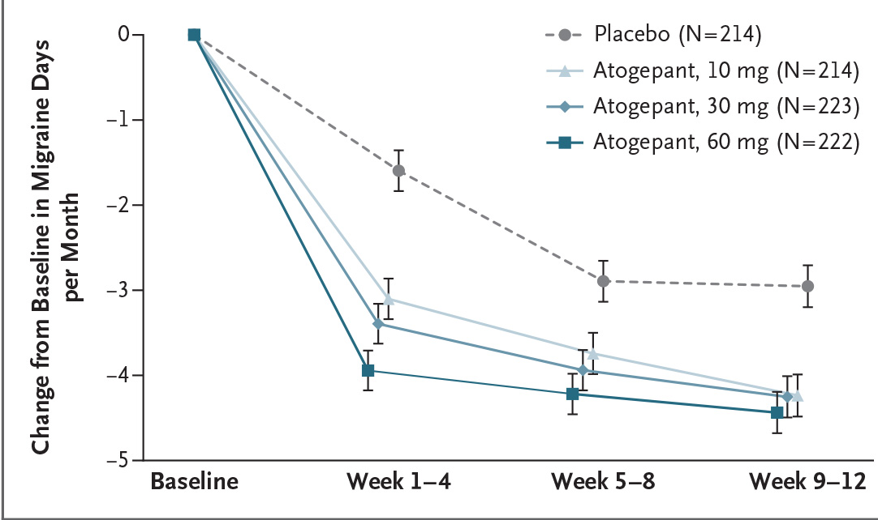
ADVANCE Results
Significant reductions in mean MMDs across the 12-week treatment period
were observed across all atogepant treatment groups vs placebo
Atogepant
Time Course of Efficacy (mITT Population)
*Indicates statistically significant vs placebo; adjusted P<0.0001; SE, 0.21 for all treatment groups.
LSM = least squares mean; SE = standard error.
Ailani J, et al. N Engl J Med. 2021;385(8):695-706.
Notes:
15:01

Slide 32
Open-Label Study of Once-Daily Atogepant 60 mg
52-week, open-label extension trial assessing the efficacy of
once-daily atogepant 60 mg (ClinicalTrials.gov identifier NCT03700320)
Primary efficacy measure for atogepant arm*:
Mean change in MMDs from baseline to week 49-52:
-5.19 (95% CI: -5.50, -4.87)
Atogepant 60 mg once daily
(n=546)
Adults with 4-14
migraine days in the 28-day baseline period (N=744)
SOC preventive treatment
(n=198)
Treatment period, 52 weeks
Randomization (5:2)
End of treatment
*The control group was included to contextualize safety data from the atogepant-treated participants.
SOC = standard of care; CI = confidence interval.
ClinicalTrials.gov. Accessed August 18, 2022. https://clinicaltrials.gov/ct2/show/NCT03700320.
Ashina M, et al. Presented at: AHS Annual Meeting; June 3-6, 2021; Orlando, FL.
Notes:
Timecode: 16:11
Abbreviations
References

Slide 33
Open-Label Study of Once-Daily Atogepant 60 mg
Ashina M, et al. Presented at: AHS Annual Meeting; June 3-6, 2021; Orlando, FL.

Slide 34
Open-Label Study of Once-Daily Atogepant 60 mg:
AEs in Participants Treated with Atogepant
  AEs reported by 67% of participants treated with atogepant
    18% considered by the investigator to be atogepant-related
    Discontinuation because of AEs: 5.7%
  Most commonly reported AEs (≥5% of participants)
    URTI (10.3%)
    Constipation (7.2%)
    Nausea (6.3%)
    UTI (5.2%)
Ashina M, et al. Presented at: AHS Annual Meeting; June 3-6, 2021; Orlando, FL.

Slide 35
CGRP Antibody Antagonists
Agent | Dosing | Development Notes
ALD403 Eptinezumab (FDA-approved Feb 2020) | IV quarterly | Humanized (rabbit) IgG1 N-glycosylation site mutation Eliminates ADCC/CDC Manufactured using yeast (Pichia)
AA334 Erenumab (FDA-approved May 2018) | SC monthly | Human IgG2 No Fc framework modification Recognizes functional CLR/RAMP1 receptor complex
LY2951742 Galcanezumab (FDA-approved Sep 2018) | SC monthly | Humanized IgG4 desialylated
LBR-101 TEV48125 Fremanezumab (FDA-approved Sep 2018) | SC monthly or quarterly | Humanized (murine) IgG2a kappa C_{H} Has 2-point mutations Reduces FcγR binding (toxicity)
ADCC = antibody-dependent cell-mediated cytotoxicity; CDC = complement-dependent cytotoxicity.
FDA. Accessed August 18, 2022. https://www.accessdata.fda.gov/scripts/cder/daf/.

Slide 36
Anti-CGRP Monoclonal Antibodies for Episodic Migraine Prevention: Responder Rates from Phase 3 Trials
≥50% Reduction in Monthly Migraine Days
a
a
a
a
a
a
≥50% Responders
Erenumab
70/140 mg
Erenumab
70 mg
ªStatistically significant difference vs placebo.
Goadsby PJ, et al. N Engl J Med. 2017;377(22):2123-2132. Dodick DW, et al. Cephalagia. 2018;38(6):1026-1037. Dodick DW, et al. JAMA. 2018;319(19):1999-2008. Stauffer VL, et al. JAMA Neurol. 2018;75(9):1080-1088. Skljarevski V, et al. Cephalalgia. 2018;38(8):1442-1454. Saper R, et al. Presented at: American Academy of Neurology (AAN) Annual Meeting; April 21-27, 2018; Los Angeles, CA. S20.001. Thanks to Deb Friedman and peerVue.

Slide 37
Anti-CGRP Monoclonal Antibodies for Chronic Migraine Prevention: Responder Rates from Pivotal Trials
≥50% Reduction in Monthly Migraine or Headache Days
a
a
a
a
≥50% Responders
Erenumab
70/140 mg
Eptinezumab
100/300 mg
ªStatistically significant difference vs placebo.
Tepper S, et al. Lancet Neurol. 2017;16(6):425-434. Silberstein SD, et al. N Engl J Med. 2017;377(22):2113-2122. Detke HC, et al. Neurology. 2018;91(24):e2211-e2221. Kudrow DB, et al. Presented at: AAN Annual Meeting; April 21-27, 2018; Los Angeles, CA. P4.470.
Thanks to Deb Friedman and peerVue.

Slide 38
Long-Term Safety and Efficacy: CGRP mAbs
Study | Participants | Outcomes
Erenumab: 64-week LIBERTY study | EM; 2-4 prior treatment failures | Efficacy: Increase in 50% responder rate from week 9-12 to week 61-64 Safety: Consistent with previous clinical trials Most common AEs: Nasopharyngitis influenza, injection site pain; constipation: 2.5%
Fremanezumab: 52-week study | EM or CM | Efficacy: Sustained improvements in MMDs (monthly and quarterly dosing) Most common AEs: Injection-site induration, pain, erythema Withdrawal due to tolerability: 4%
Galcanezumab: 12-month study | EM or CM | Efficacy: Reduction in number of monthly migraine headache days TEAEs ≥10% of patients: Injection site pain and reaction, nasopharyngitis, URTI, back pain, sinusitis
Eptinezumab: 106-week PREVAIL study | CM | Most common TEAEs: Nasopharyngitis, URTI, sinusitis, influenza, bronchitis Improvements in patient-reported outcomes: Up to week 104
mAbs = monoclonal antibodies; EM = episodic migraine; CM = chronic migraine; TEAEs = treatment-emergent AEs.
Goadsby PJ, et al. Neurology. 2021;96(22):e2724-e2735. Goadsby PJ, et al. Neurology. 2020;95(18):e2487-e2499. Camporeale A, et al. BMC Neurol. 2018;18(1):188. Kudrow D, et al. BMC Neurol. 2021;21(1):126.
Notes:
Goadsby PJ, et al. Long-term efficacy and safety of erenumab: results from 64 weeks of the LIBERTY study. Neurology. 2021;96:e2724- e2735.
Goadsby PJ, et al. Long-term safety, tolerability, and efficacy of fremanezumab in migraine: A randomized study. Neurology. 2020;95:e2487-e2499.
Camporeale A, Kudrow D, Sides R, et al. A phase 3, long-term, open-label safety study of Galcanezumab in patients with migraine. BMC Neurol. 2018;18:188.
Kudrow D, Cady RK, Allan B, et al. Long-term safety and tolerability of eptinezumab in patients with chronic migraine: a 2-year, open-label, phase 3 trial. BMC Neurol. 2021;21:126.

Slide 39
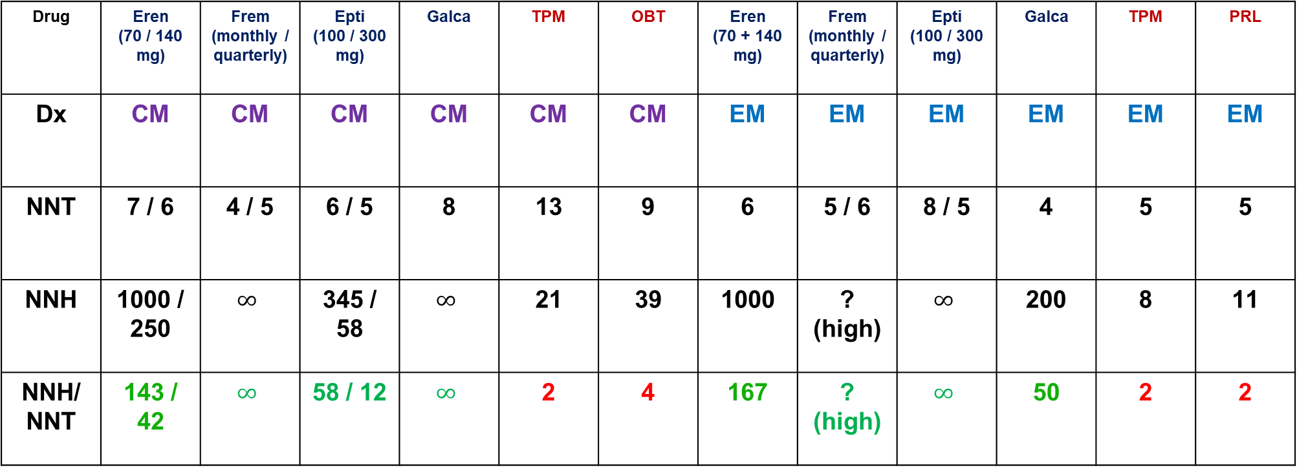
Number Needed to Treat vs Harm
Data from Migraine Prevention RCTs
Drug | Eren (70 / 140 mg) | Frem (monthly / quarterly) | Epti (100 / 300 mg) | Galca | TPM | OBT | Eren (70 + 140 mg) | Frem (monthly / quarterly) | Epti (100 / 300 mg) | Galca | TPM | PRL
Dx | CM | CM | CM | CM | CM | CM | EM | EM | EM | EM | EM | EM
NNT | 7 / 6 | 4 / 5 | 6 / 5 | 8 | 13 | 9 | 6 | 5 / 6 | 8 / 5 | 4 | 5 | 5
NNH | 1000 / 250 | $$∞$$ | 345 / 58 | $$∞$$ | 21 | 39 | 1000 | ? (high) | $$∞$$ | 200 | 8 | 11
NNH/ NNT | 143 / 42 | $$∞$$ | 58 / 12 | $$∞$$ | 2 | 4 | 167 | ? (high) | $$∞$$ | 50 | 2 | 2
RCTs = randomized controlled trials; Eren = erenumab; Frem = fremaneumab; Galca = galcanezumab; Epti = eptinezumab; TPM = topiramate; OBT = onabotulinumtoxinA; PRL = propranolol.
Slide modified, courtesy of Matthew Robbins, MD, FAHS. Adapted from Vo P, et al. Cephalalgia. 2019;39(5):608-616.

Slide 40
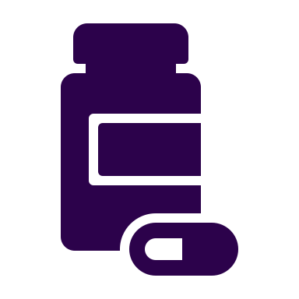
Walked to the mailbox
If at first the drug/device
does not succeed…
So much to offer!
Education, support, FUN!

Slide 41





Expert Opinions:
Considerations for Gepant Preventive Therapy
Patients with episodic migraine and poor treatment response to oral generic preventives
Patients who have frequent treatment needs (no evidence of rebound with gepants)
Patients at risk for MOH with current acute treatment
Patients on CGRP mAb who experience wearing-off
Patients on CGRP mAb considering pregnancy (gepants can be stopped without tapering, short half-life)
Mullin K, et al. Presented at: AHS Annual Meeting; June 3-6, 2021; Orlando, FL. Croop R, et al. Lancet. 2021;397(10268):51-60. Ailani J, et al. N Engl J Med. 2021;385(8):695-706. FDA. Accessed August 18, 2022. https://www.accessdata.fda.gov/drugsatfda_docs/label/2021/215206Orig1s000lbl.pdf; https://www.accessdata.fda.gov/drugsatfda_docs/label/2021/212728s006lbl.pdf; https://www.accessdata.fda.gov/drugsatfda_docs/label/2021/761077s009lbl.pdf.
Notes:
References

Slide 42
Pearls: Preventives and Comorbidities
42
Migraine + hypertension
Propranolol*, nadolol, metoprolol, candesartan
Migraine + depression/anxiety
Amitriptyline, nortriptyline, venlafaxine
Migraine + insomnia
Amitriptyline, nortriptyline
Women of
child-bearing age
AVOID valproic acid* and topiramate* (teratogenic)
Obesity
Topiramate* (associated with weight loss)
Insufficient relief
from 1 preventive
Try another preventive agent
Treatment failure
≥2 orals
Erenumab*, fremanezumab*, galcanezumab*, eptinezumab*, onabotulinumtoxinA*
*FDA-approved.
Pringsheim T, et al. Can J Neurol Sci. 2012;39(2 Suppl 2):S1-S59. Becker WJ, et al. Can Fam Physician. 2015;61(8):670-679. AHS. Headache. 2019;59(1):1-18.
Notes:
Emphasize: A common reason for a migraine preventive to fail is the lack of achieving the target dose.

Slide 43
62-Year-Old Man with Migraine
Frequency varies from 4-10 HA days/month
Significantly impaired from attacks about 2 days/month
Has been told not to use triptans since MI at age 58
Treated for HTN, HLD, DM II (all stable)
Prior preventive treatment failures
  Topiramate (initially effective, then lost effectiveness)
  Propranolol (not tolerated, fatigue and hypotension)
  Amitriptyline (not tolerated, constipation and weight gain)
HA = headache; MI = myocardial infarction; HTN = hypertension; HLD = hyperlipidemia; DM II = diabetes mellitus type 2.

Slide 44
62-Year-Old Man with Migraine
Acute ideas
Preventive ideas
Fast-acting NSAID (injection, nasal,
oral solution)
Gepant or lasmiditan
Combination approach
Device: Any
Candesartan (already treated for HTN, so need to consider that)
Simvastatin + vitamin D
Gepant or mAb
Device: Any

Slide 45
47-Year-Old Woman with Migraine
Frequency has been stable at 1-3 HA days/month until recently
Change in work schedule/demands, increased stress in personal life, frequency rising to 6-10 HA days/month
In past, chronic migraine with medication overuse headache
Treated with sertraline for anxiety and depression and candesartan for hypertension
Afraid of overusing or running out of her acute medication (rimegepant), adding to her anxiety
Multiple prior preventive treatment failures

Slide 46
47-Year-Old Woman with Migraine
Acute ideas
Preventive ideas
Re-introduce any
non-gepant
Lasmiditan
Combination approach
Device: Any
Rimegepant or atogepant
mAb
Venlafaxine
Device: Any

Slide 47

Comorbidities – Please Ask Us!
Anxiety/depression
+
Fibromyalgia =
Shame and stigma

Slide 48
Summary
Migraine is common, burdensome, underdiagnosed, and fraught with treatment gaps
We’re learning more about headache pathophysiology continually, with significant treatment implications
Antagonizing CGRP is a targeted approach to migraine, both for acute treatment and prevention
A tailored, patient-centered approach tends to yield the best outcomes

