Slide 1
Personalized Fertility Care

Slide 4
Agenda

Slide 6
There Are Multiple Reasons Someone May Seek Fertility Assistance

Slide 7
There Are Multiple Reasons Someone May Seek Fertility Assistance

Slide 8
Fertility Facts

Slide 9
Natural Conception Rates

Slide 10
Natural Conception Rates

Slide 11
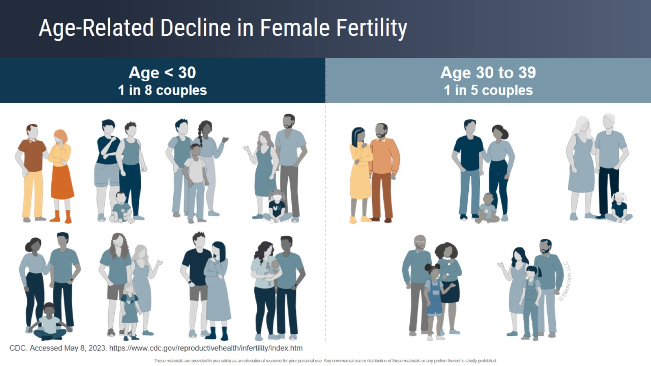
Age-Related Decline in Female Fertility

Slide 12
Earlier Evaluation (Prior to 1 Year)

Slide 13
Female Infertility Tests

Slide 14
Male Infertility Tests

Slide 15
Ovulatory Dysfunction

Slide 16
Probability of Conception

Slide 17
Anti-Müllerian Hormone

Slide 18
Lack of Access Due to Insurance Coverage

Slide 19
Women Seeking Help to Become Pregnant Tend to Be Age 35+, White, Higher Income, and Privately Insured

Slide 20
Disparities in Access to Infertility Care

Slide 21
Disparities in Access to Effective Treatment for Infertility in the United States: An Ethics Committee Opinion

Slide 22
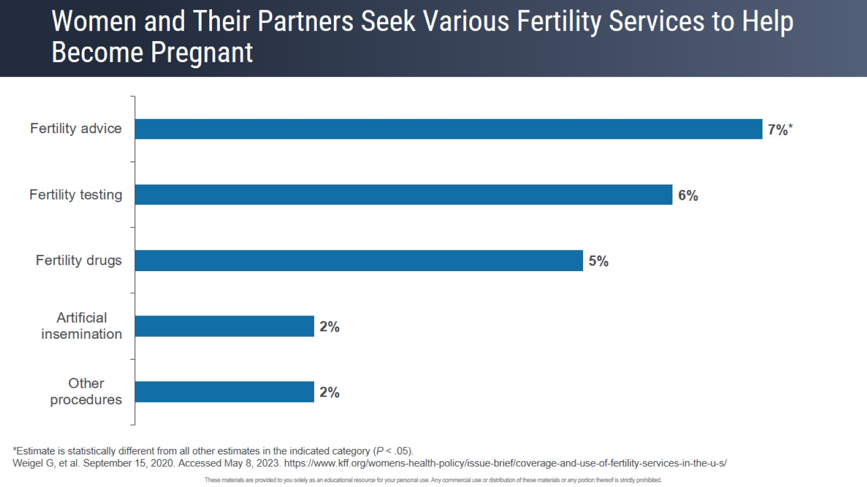
Women and Their Partners Seek Various Fertility Services to Help Become Pregnant

Slide 23
Summary

Slide 24
Patient Video

Slide 26
Definition of Infertility

Slide 27
Recommended Timing of Infertility Evaluation

Slide 28
Rationale for Duration of Time Prior to Evaluation

Slide 29
Natural Conception Rates

Slide 30
Female Age and Fertility

Slide 31
Recommended Workup

Slide 32
Ovarian Reserve Testing

Slide 33
Uterine and Tubal Assessment

Slide 34
Male Evaluation

Slide 35
Benefits of Earlier Evaluation

Slide 36
Costs and Risks of Earlier Evaluation

Slide 37
Individualizing Timing of Fertility Evaluation

Slide 38
Summary

Slide 40
Tools and Methods for Triaging Patients

Slide 41
Tools and Methods for Triaging Patients (cont)

Slide 42
Ovarian Reserve Testing: Getting Ahead of the Biological Clock

Slide 43
Testing Entire Menstrual Cycles to Forecast Fertility

Slide 44
What Happens in a Normal Menstrual Cycle

Slide 45
Daily Salivary Estradiol in Normally Cycling Women

Slide 46
Urinary Hormone Patterns in 30 Normally Cycling Women in Relation to Serum

Slide 47
Salivary Progesterone in Women of Varying Ages

Slide 48
Decreasing Luteal Phase Progesterone With Reproductive Aging

Slide 49
Erratic Hormone Patterns in Perimenopause

Slide 50
Caveats With Urine and Salivary Steroid Hormone Measurements

Slide 51
Detection of Ovulation

Slide 52
What to Look for in an Algorithm

Slide 53
What Is the Value of Self-Testing of Sex Steroids Across the Menstrual Cycle?

Slide 54
What Daily Sex Steroid Measurements Cannot Do

Slide 55
Is Luteal Phase Deficiency Even a Thing?

Slide 56
Summary

Slide 58
Challenges in Assessing Ovulation Cycles and Hormones

Slide 59
Current Options

Slide 60
Current Challenges of Estrogen/Progesterone Testing

Slide 61
Additional Possibilities for Estrogen/Progesterone Testing

Slide 62
Concluding Remarks

