Slide 2
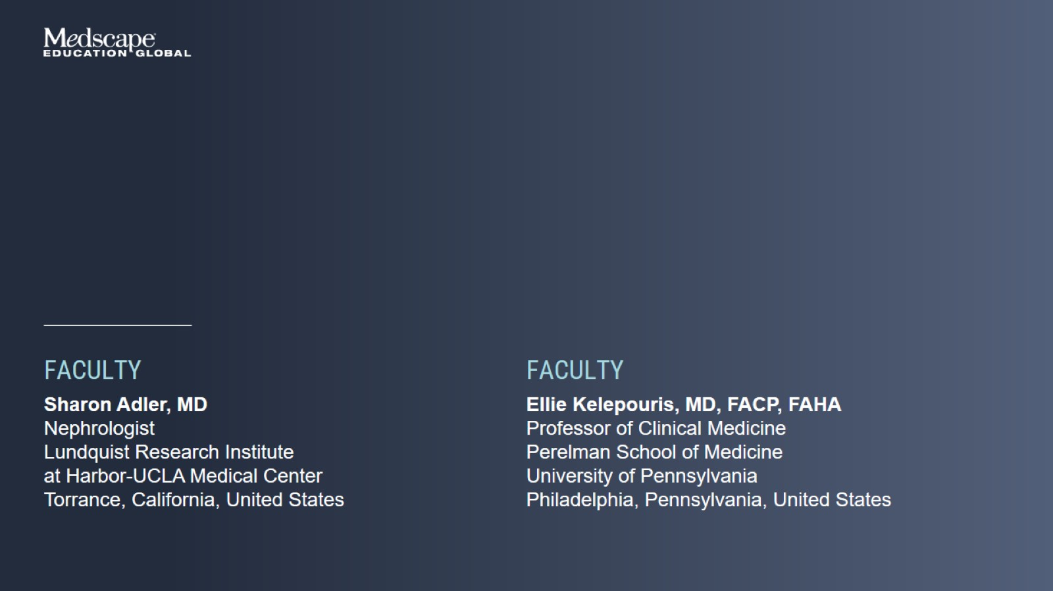

Slide 3
Background on IgA Nephropathy

Slide 4
The 4-Hit Hypothesis

Slide 5
IgAN Epidemiology

Slide 6
IgAN Clinical Presentations

Slide 7
International IgAN Prediction Tool at Biopsy Determining Prognosis

Slide 8
Implications of Proteinuria in the Prognosis of IgAN

Slide 9
Importance of Reduction of Proteinuria in IgAN

Slide 10
Initial Assessment and Management of the Patient With IgAN

Slide 11
Supportive Care in IgAN

Slide 12
Treatment Continuum of IgAN

Slide 13
IgAN-Specific Therapies with Accelerated FDA Approval

Slide 14
Goals of Therapy

Slide 15
IgAN Challenges With Immunosuppressive Treatments

Slide 16
Clinical Trial Enrollment for High Risk Patients

Slide 17
The Voice of the Patient NKF-IGA Nephropathy Foundation of America

Slide 18
Approved or Emerging Therapies Based on Improved Understanding of IgAN Pathogenesis

Slide 19
Understanding the Pathogenesis of IgAN Endothelin Pathway

Slide 20
IgAN Clinical Trials Investigational Agents Targeting the Endothelin Pathway

Slide 21
Understanding the Pathogenesis of IgAN B-Cell Pathway

Slide 22
IgAN Clinical Trials Investigational Agents Targeting the B-Cell Pathway

Slide 23
Complement Activation in Glomerular Disease

Slide 24
Complement Activation in Glomerular Disease

Slide 25
Complement Pathways in IgAN Pathogenesis Involvement of Lectin and Alternative Pathways

Slide 26
IgAN Clinical Trials Investigational Agents Targeting the Complement Pathway

Slide 27
IgAN Clinical Trials Investigational Agents Targeting the Complement Pathway (cont)

Slide 28
Conclusion

