Slide 3
Introduction

Slide 4
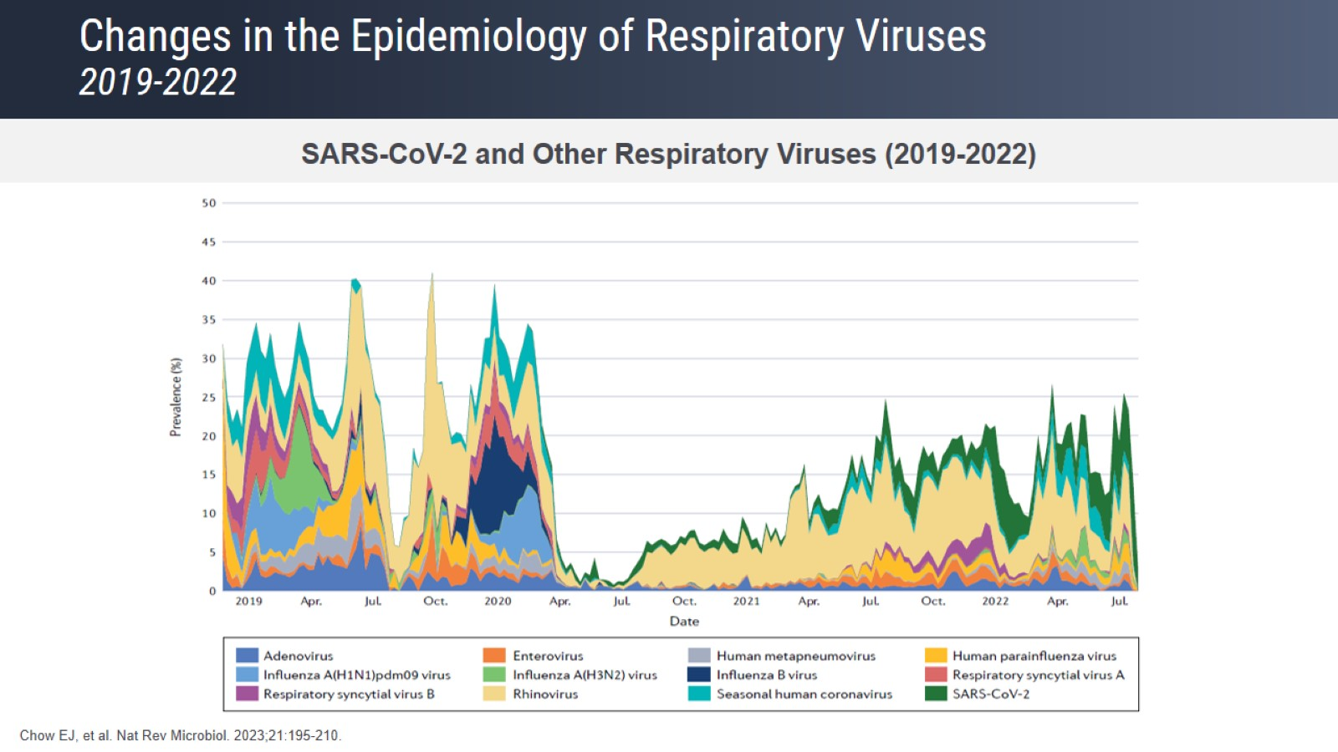
Changes in the Epidemiology of Respiratory Viruses 2019-2022

Slide 5
URIs: Urgent Care Experience – Trends Over The Past 12 Months Expert Insights

Slide 6
Utilization of Urgent Care Expert Insights

Slide 7
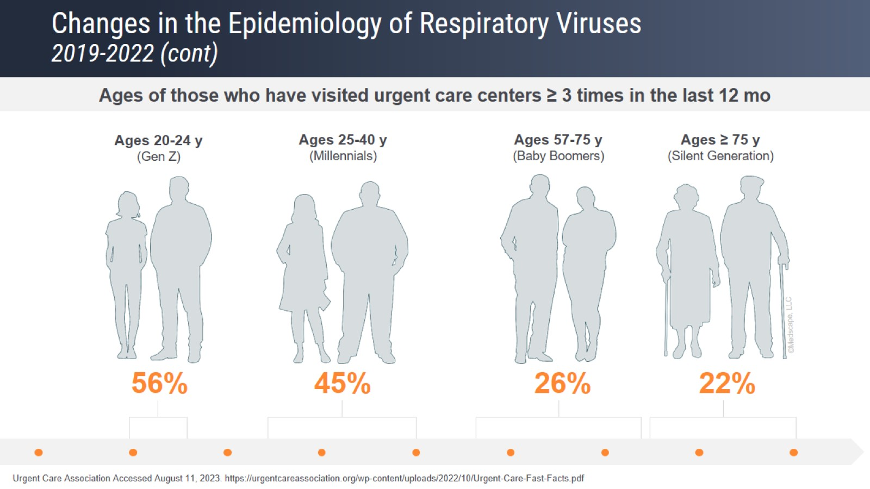
Changes in the Epidemiology of Respiratory Viruses 2019-2022 (cont)

Slide 8
Role of Urgent Care in Diagnosing and Managing URIs Expert Insights

Slide 9
Multiplex Upper Respiratory Panels

Slide 10
Multiplex Respiratory Panels What Do They Detect?

Slide 11
Novel Bacterial and Viral Biomarker POC Test FebriDx

Slide 12
Diagnostic Accuracy of a Novel Infection Biomarker POC Test FebriDx (cont)

Slide 13
How RDTs Can Be Applied in Urgent Care Expert Insights

Slide 14
Impact of RIDT on Clinician Decision-Making in Urgent Care

Slide 15
Impact of RIDT on Clinician Decision-Making in Urgent Care (cont)

Slide 16
Diagnostic Stewardship in Urgent Care Expert Insights

Slide 17
What Types of RDTs Are Best Suited for Urgent Care? Expert Insights

Slide 18
Importance of Other HCPs and Good Communication Expert Insights

Slide 19
Concluding Remarks

