Slide 1
Congenital Cytomegalovirus

Slide 4
Congenital CMV

Slide 5
Missed Opportunities in Congenital CMV

Slide 6
Congenital CMV: Underappreciated Public Health Urgency

Slide 7
Putting the Burden of Congenital CMV in Perspective

Slide 8
Who Diagnoses Congenital CMV in Newborn?

Slide 9
PCP/Newborn Hospitalist Responses to Congenital CMV Knowledge

Slide 10
Case Study 1: The Overlooked Case

Slide 11
Case Study 1: The Overlooked Case (cont)

Slide 12
Questions to Clinicians Should Ask

Slide 13
Case Study 2: Missed Prenatal Diagnosis

Slide 14
Case Study 2: Missed Newborn Diagnosis

Slide 15
Case Study 2: Universal Screening Diagnoses

Slide 16
Consequences of Undiagnosed Congenital CMV

Slide 17
Deciphering the Diagnosis

Slide 18
CMV Establishes Lifelong Infection

Slide 19
CMV Is Transmitted From Person to Person Through Bodily Fluids

Slide 20
Unraveling the Mystery of Congenital CMV: Clinical Clues

Slide 21
Diagnosing CMV: Physical Exam and Routine Testing

Slide 22
Diagnosing CMV

Slide 23
Confirming Congenital CMV Diagnoses

Slide 24
Testing for Congenital CMV in Neonates

Slide 25
Process for Testing DBS for CMV

Slide 26
Diagnosis After Three Weeks of Life

Slide 27
Symptomatic vs Asymptomatic Congenital CMV

Slide 28
Symptomatic Congenital CMV Disease

Slide 29
"Asymptomatic" Congenital CMV Disease

Slide 30
Potential Neurodevelopmental Sequelae

Slide 31
What Do You Say to Parents When Baby Has Congenital CMV?

Slide 32
Testing Positive for Congenital CMV: Conversations With Patients

Slide 33
Burden of Congenital CMV on Families

Slide 34
What to Tell Your Patients About Their Newborn Testing Positive for Congenital CMV

Slide 35
Patient Education

Slide 36
Patient Education

Slide 37
Patient Education

Slide 38
Parenting a Child With Congenital Cytomegalovirus Infection

Slide 39
Typical Family Experience – Diagnosis

Slide 40
Family Experience: It's a Journey

Slide 41
Resources for Families

Slide 42
Next Steps After Congenital CMV Diagnosis

Slide 43
Lessons From the Field

Slide 44
Prevalence of Congenital CMV and Racial Disparities

Slide 45
CMV Seroprevalence Rates and Prevalence of Congenital CMV Infection

Slide 46
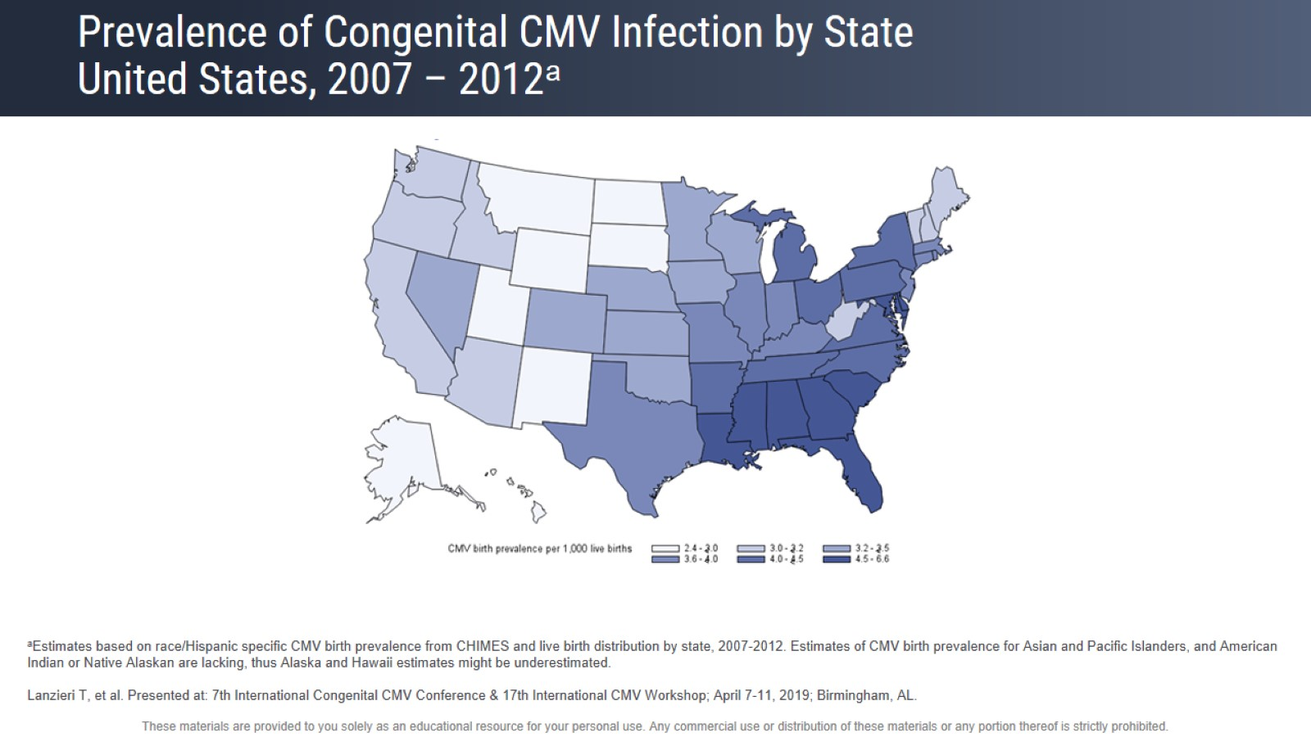
Prevalence of Congenital CMV Infection by State United States, 2007 – 2012

Slide 47
CMV Acquisition Rates Are Population-Dependent

Slide 48
Risk Factors for CMV Seropositivity

Slide 49
CMV Seroprevalence Increases With Age in the United States

Slide 50
CMV Seroprevalence in US Women of Childbearing Age

Slide 51
Congenital CMV Prevalence Varies by Race/Ethnicity and SES

Slide 52
CMV Seroprevalence Varies by Socioeconomic Status in Canada and United States

Slide 53
Key Takeaways and Implications for Health Equity

Slide 54
Key Takeaways and Implications for Health Equity

Slide 55
Challenges in Diagnosing Congenital CMV

Slide 56
Inconsistent Testing Practices: Missed Diagnoses

Slide 57
Results of Retrospective EHR Study on Missed cCMV

Slide 58
Current Screening Approaches

Slide 59
Approaches to Diagnosis and Screening for Congenital CMV

Slide 60
Hearing-Targeted Congenital CMV Screening

Slide 61
Hearing-Targeted Screening Misses Many Infants With cCMV

Slide 62
How Can We Detect Congenital CMV in a More Timely Fashion? Hearing-Targeted vs Universal Screening

Slide 63
Hearing Targeted vs Universal Congenital CMV Screening Controversies

Slide 64
Universal Screening for CMV?

Slide 66
Woman Want to Know About Congenital CMV

Slide 67
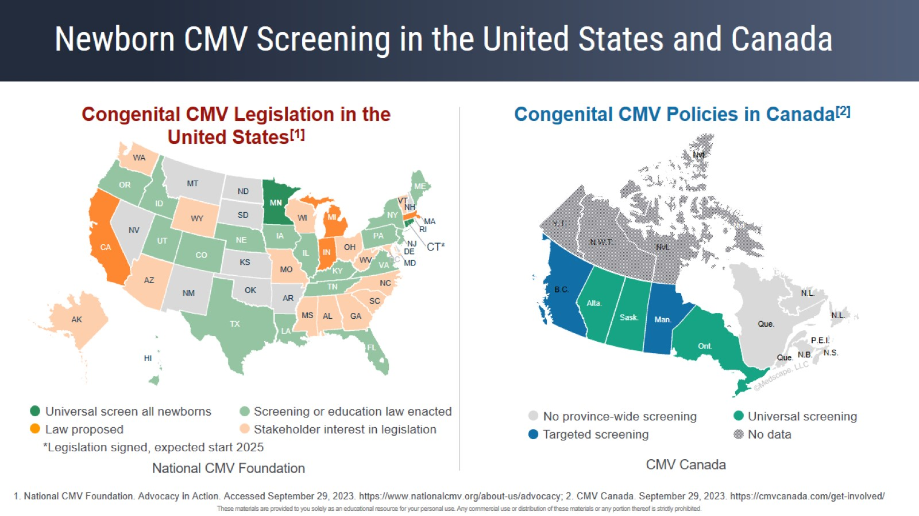
Newborn CMV Screening in the United States and Canada

Slide 68
Minnesota Case Study: Vivian Act

Slide 69
Vivian Act: A Visit to the State Capitol

Slide 70
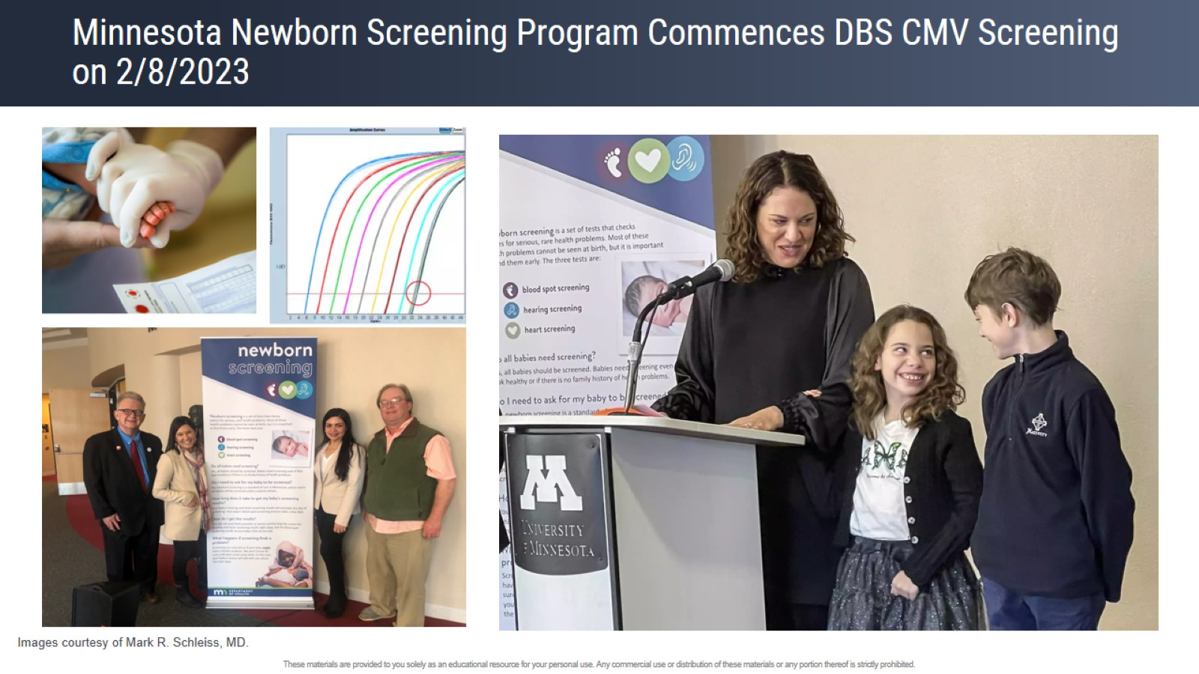
Minnesota Newborn Screening Program Commences DBS CMV Screening on 2/8/2023

Slide 71
UTAH Case Study – Expanded Targeted Screening

Slide 72
UTAH Case Study – Summary of Indications for cCMV Testing and Tests

Slide 73
UTAH Case Study – Characteristics of cCMV-Positive Patients

Slide 74
Panel Discussion

Slide 75
Question to Ms Devereaux and Dr Pesch

Slide 76
Missed Clinical Clues and Parenting a Child With cCMV

Slide 77
Question to Dr Schleiss

Slide 78
Cytomegalovirus Structure

Slide 79
Congenital CMV Prevention in Pregnancy by Vaccine

Slide 80
CMV Vaccines in Clinical Development Clinical Phase

Slide 81
Most Recent Congenital CMV Vaccine Clinical Trials in the United States

Slide 82
Question to Ms Devereaux

Slide 83
Awareness of Congenital CMV in United States Is Increasing

Slide 84
Counseling About CMV Before and During Pregnancy Can Impact Behavior

Slide 85
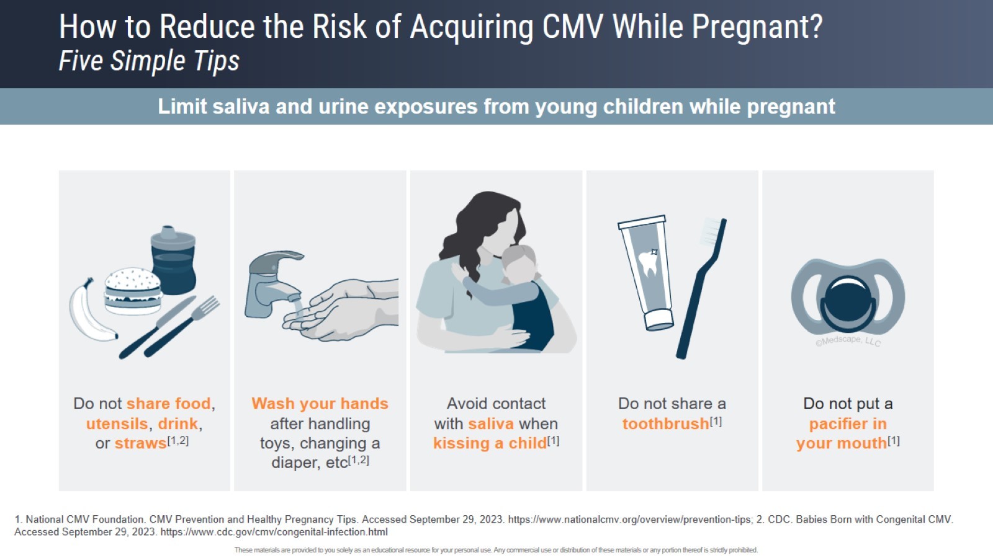
How to Reduce the Risk of Acquiring CMV While Pregnant? Five Simple Tips

Slide 86
CMV Awareness Among Healthcare Providers

Slide 88
The Role of Antiviral Treatment in Congenital CMV

Slide 89
Treatment of Congenital CMV

Slide 90
Concluding Remarks

