Slide 1
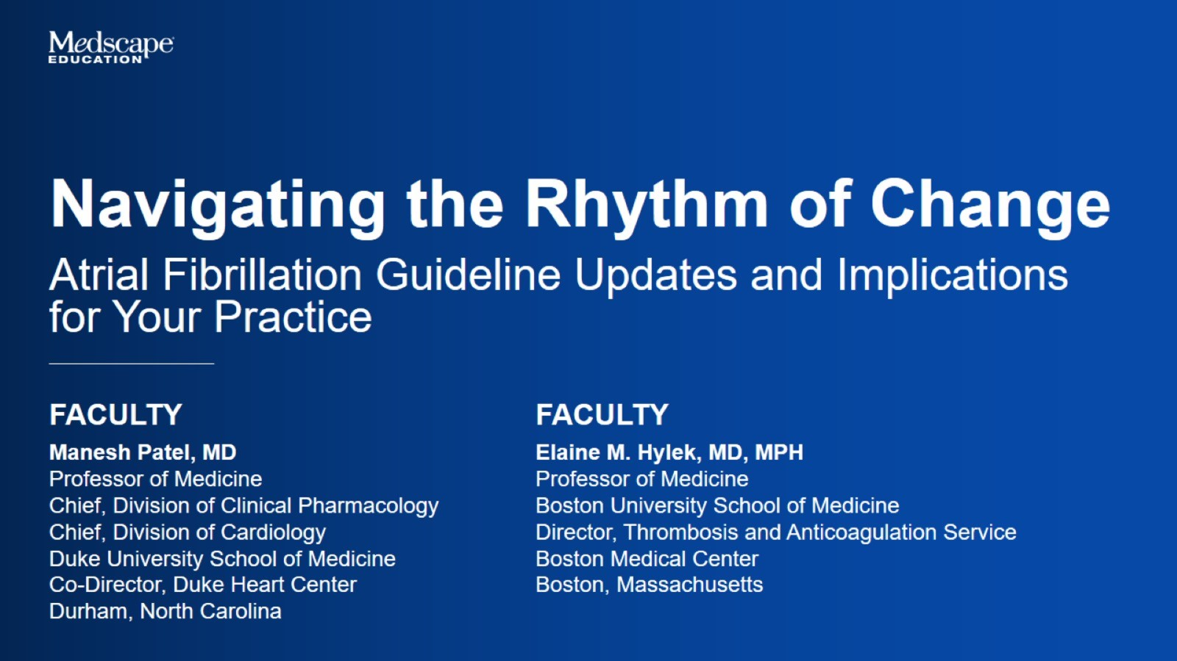

Slide 2
Atrial Fibrillation Is Common in Clinical Practice

Slide 3
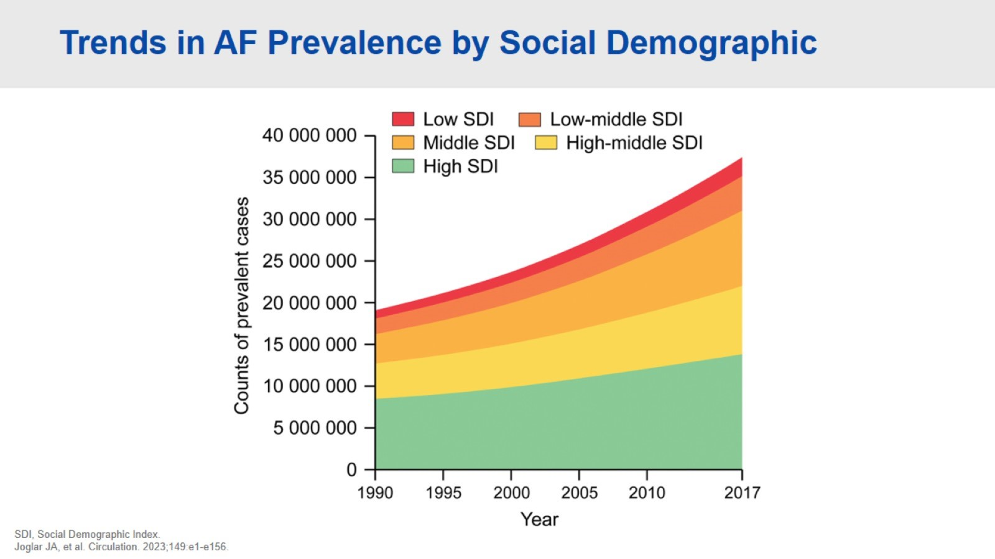
Trends in AF Prevalence by Social Demographic

Slide 4
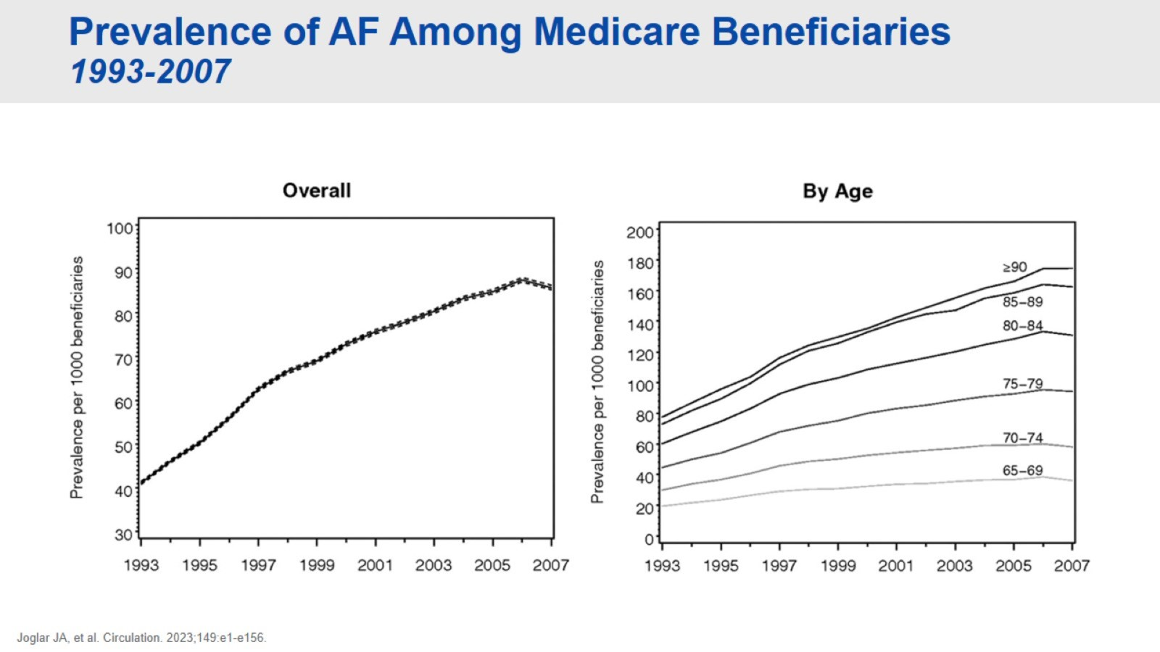
Prevalence of AF Among Medicare Beneficiaries 1993-2007

Slide 5
AF-Related Outcomes

Slide 6
Case 1 58-Year-Old Female

Slide 7
Case 1 58-Year-Old Female

Slide 8
Expert Guidance on Smartwatch Arrhythmia Detection

Slide 9
2023 ACC/AHA/ACCP/HRS Guidelines Atrial Fibrillation Diagnosis and Management

Slide 10
Pillars of AF Management 2023 ACC/AHA/ACCP/HRS Guidelines for AF

Slide 11
Addressing AF in Your Practice

Slide 12
Case 1 Conclusion 58-Year-Old Female

Slide 13
Case 2 81-Year-Old Male

Slide 14
Case 2 81-Year-Old Male

Slide 15
Case 2 Key Questions

Slide 16
Considerations When Prescribing Anticoagulation

Slide 17
Should This Patient Receive Reduced Dosing of DOAC?

Slide 18
Should This Patient Receive Reduced Dosing of DOAC?

Slide 19
2023 ACC/AHA/ACCP/HRS Recommendations for Antithrombotic Therapy

Slide 20
DOACs Significantly Reduce Hemorrhagic Stroke and All-Cause Mortality vs Warfarin

Slide 21
Addressing Stroke Risk

Slide 22
How Do You Reduce Bleeding?

Slide 23
Tips for Your Patients to Avoid Falling/Bleeding Expert Perspectives

Slide 24
Tips for Clinicians When Treating With Anticoagulant Expert Perspectives

Slide 25
Treatment Algorithm for Drug Therapy for Maintenance of Sinus Rhythm

Slide 26
Patient and Clinical Considerations for Choosing Between Rhythm Control and Rate Control

Slide 27
Case 2 Conclusion 81-Year-Old Male

Slide 28
Concluding Remarks

Slide 32
CAD and PAD

Slide 33
Disparities in Care/Outcomes for Racial/Ethnic Minority Patients With or at Risk of CAD/PAD

Slide 34
CAD: Worse Outcomes in Black Than in White Patients

Slide 35
Racial Disparities in PAD Prevalence

Slide 36
Disparities in Care/Outcomes for Racial/Ethnic Minority Americans With or at Risk of CAD/PAD

Slide 37
CAD/PAD Risk Factors

Slide 38
Factors Contributing to Racial Disparities in Health Care

Slide 39
PAD Awareness Scores in Barbershop Screening Program Impact of Patient Education

Slide 40
PAD Awareness Scores in Barbershop Screening Program Impact of Education Level

Slide 41
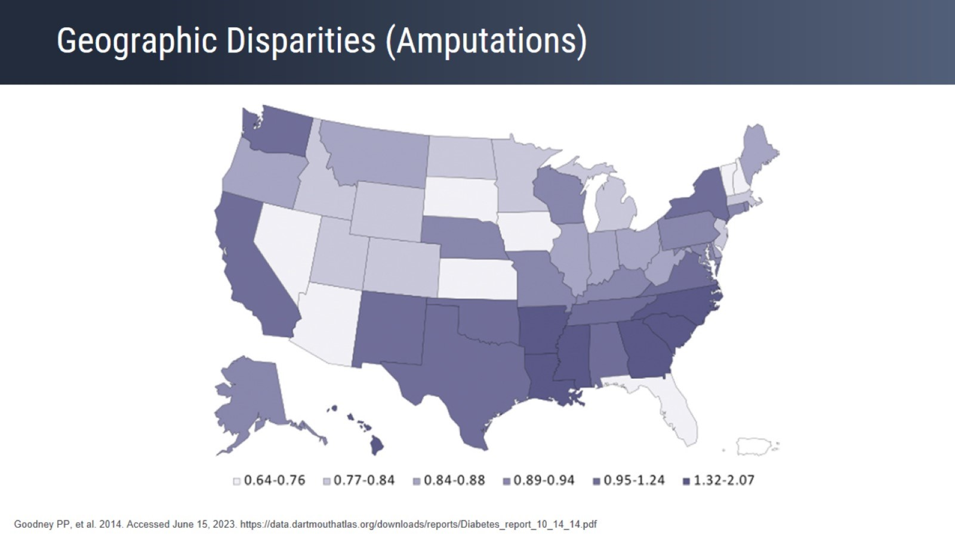
Geographic Disparities (Amputations)

Slide 42
SDOH Contribute to Health Disparities and Inequities

Slide 43
Racial/Ethnic Disparities in CHD Management

Slide 44
Racial/Ethnic Disparities in CHD Management

Slide 45
GOULD Registry Analysis Impact of New Guidelines

Slide 46
SDOH Have Tremendous Effects on an Individual’s Health

Slide 47
CV Survival Decreases With Increasing Numbers of SDOH

Slide 48
2019 ACC/AHA Guideline on the Primary Prevention of CVD

Slide 49
Team-Based Care

Slide 50
COMPASS Trial: Study Design

Slide 51
COMPASS Trial: Efficacy

Slide 52
COMPASS Trial: Safety

Slide 53
VOYAGER PAD Trial: Study Design

Slide 54
Data From VOYAGER-PAD: Antithrombotic Therapy in Patients Undergoing Lower Extremity Revascularization

Slide 55
COMPASS: Outcomes in Patients With PAD

Slide 56
MALE in PAD

Slide 57
COMPASS Trial: Outcomes in High-Risk Patients

Slide 58
Clinical Decision-Making for Patients With PAD

Slide 59
DPI in Patients Undergoing Surgical or Endovascular Revascularization Data From VOYAGER-PAD

Slide 60
Antiplatelet Therapy in Patients Undergoing Revascularization

Slide 61
Antiplatelet Therapy in Patients Undergoing Revascularization 2017 ESC/ESVS PAD Guidelines

Slide 62
Antiplatelet Therapy in Patients Undergoing Revascularization (cont)

Slide 63
Duration of P2Y12 in Patients With CAD Treated With DAPT

Slide 64
DAPT and Duration of P2Y12 After PCI and CABG

Slide 65
VOYAGER PAD

Slide 66
Model of Paths Through Which HCP-Implicit Bias May Contribute to Health Disparities

Slide 67
Practical Approaches to Tailor Antithrombotic Strategies With DPI

Slide 68
Team-Based Care The Interdisciplinary Team Working Together

Slide 69
Benefits of Shared Decision-Making Patient Focus

Slide 70
Take-Away Thoughts

Slide 71
Conclusion

Slide 75
Overview

Slide 76
Prevalence of CAD in Adults by Race US National Center for Health Statistics

Slide 77
One-Year CV Event Rates in Outpatients With Atherosclerosis

Slide 78
Managing Patients With Atherosclerotic Vascular Disease

Slide 79
Managing Patients With Atherosclerotic Vascular Disease

Slide 80
Managing Patients With Atherosclerotic Vascular Disease

Slide 81
Managing Patients With Atherosclerotic Vascular Disease

Slide 82
Managing Patients With Atherosclerotic Vascular Disease

Slide 83
Role of Revascularization

Slide 84
Targets for Antithrombotic Therapy

Slide 85
THEMIS-PCI Ticagrelor + Aspirin in High-Risk Patients With CAD

Slide 86
PEGASUS-TIMI 54 Ticagrelor + Aspirin in Patients With Prior MI, With and Without PAD

Slide 87
COMPASS Trial Primary Outcome: Composite of CV Death, Stroke, or MI

Slide 88
COMPASS Trial Major Vascular Events* by Diabetes Status

Slide 89
VOYAGER PAD Trial

Slide 90
VOYAGER PAD Trial

Slide 91
BEST-CLI Trial Surgery or Endovascular Therapy for CLTI

Slide 92
Shift in Antithrombotic Therapy Strategies in CAD/PAD Expert Perspective

Slide 93
Shift in Antithrombotic Therapy Strategies in CAD/PAD Expert Perspective

Slide 94
Guidelines for Antithrombotic Therapy in CAD/PAD ACC/AHA 2016, DAPT-CAD

Slide 95
Guidelines for Antithrombotic Therapy in CAD/PAD AHA/ACC 2016, PAD

Slide 96
Guidelines for Antithrombotic Therapy in CAD/PAD ESC 2019, Chronic Coronary Syndromes

Slide 97
Guidelines for Antithrombotic Therapy in CAD/PAD ADA 2022

Slide 98
Patient Case 1

Slide 99
COMPASS Trial Net Clinical Benefit (NCB) in High-Risk Groups

Slide 100
COMPASS Trial Event Rates of NCB in High-Risk Groups

Slide 101
COMPASS Trial Event Rates of NCB in High-Risk Groups

Slide 102
COMPASS Trial Event Rates of NCB in High-Risk Groups

Slide 103
COMPASS Trial Event Rates of NCB in High-Risk Groups

Slide 104
COMPASS Trial Event Rates of NCB in High-Risk Groups

Slide 105
COMPASS Trial Event Rates of NCB in High-Risk Groups

Slide 106
Patient Case 1

Slide 107
Expert Commentary on Patient Case 1

Slide 108
Patient Case 2

Slide 109
Expert Commentary on Patient Case 2

Slide 110
Rivaroxaban Dosing for CAD/PAD vs Atrial Fibrillation

Slide 111
Rivaroxaban Dosing for CAD/PAD vs Atrial Fibrillation

Slide 112
Closing Comments

Slide 116
VTE in Hospitalized Medical Patients

Slide 117
VTE Risk in Medically Ill Patients

Slide 118
Periods of VTE Risk in Medically Ill Patients

Slide 119
Periods of VTE Risk in Medically Ill Patients

Slide 120
VTE Risk Extends Beyond Hospitalization in Medical Ill Patients

Slide 122
Risk Factors for VTE in Medically Ill Patients

Slide 123
VTE Is a Major Issue in Hospitalized Patients

Slide 124
VTE Is a Major Issue in Hospitalized Patients

Slide 125
VTE Is a Major Issue in Hospitalized Patients

Slide 126
VTE Is a Multifactorial Condition

Slide 127
VTE Is a Multifactorial Condition

Slide 128
VTE Is a Multifactorial Condition

Slide 129
VTE Is a Multifactorial Condition

Slide 130
Common Risk Factors for VTE

Slide 131
Common Risk Factors for VTE

Slide 132
Common Risk Factors for VTE

Slide 133
Common Risk Factors for VTE

Slide 134
Common Risk Factors for VTE

Slide 135
There Are Common Risk Factors Between VTE And Bleeding

Slide 136
Hospitalization Is an Important Risk Factor

Slide 137
Hospitalization Is an Important Risk Factor

Slide 138
Risk Is Not Confined to the Hospitalization Period

Slide 139
At the End

Slide 141
Practical Strategies to Apply VTE Risk Assessment in Hospitalized, Medically Ill Patients to Determine Need for Thromboprophylaxis

Slide 142
Validated VTE Risk Assessment Models

Slide 143
Validated VTE Risk Assessment Models

Slide 144
Validated VTE Risk Assessment Models

Slide 145
Validated VTE Risk Assessment Models (cont)

Slide 146
Validated VTE Risk Assessment Models (cont)

Slide 147
Individualized (Patient Level) Risk-Adapted Thromboprophylaxis

Slide 148
Individualized (Patient Level) Risk-Adapted Thromboprophylaxis

Slide 149
Individualized (Patient Level) Risk-Adapted Thromboprophylaxis

Slide 150
Individualized (Patient Level) Risk-Adapted Thromboprophylaxis

Slide 151
Electronic Alerts to Prevent VTE Among Hospitalized Patients

Slide 152
Electronic Alerts to Prevent VTE Among Hospitalized Patients

Slide 153
Electronic Alerts to Prevent VTE Among Hospitalized Patients (cont)

Slide 154
IMPROVE-DD Study Flow Chart: Cluster Randomization

Slide 155
IMPROVE-DD Study Flow Chart: Cluster Randomization

Slide 156
IMPROVE-DD Study Flow Chart: Cluster Randomization

Slide 157
IMPROVE-DD Study Discharge VTE Risk Assessment

Slide 158
IMPROVE-DD Study Discharge VTE Risk Assessment

Slide 160
Latest Data for Use of DOACs for VTE Prevention in Medically Ill Patients

Slide 161
Appropriate Prophylaxis Reduces the Risk of VTE and Related Mortality

Slide 162
Key Therapy Recommendations

Slide 163
Individualized (Patient Level) Risk-Adapted Thromboprophylaxis in Medically Ill Patients

Slide 164
Individualized (Patient Level) Risk-Adapted Thromboprophylaxis in Medically Ill Patients

Slide 165
Meta-Analysis of EDT in Medically Ill Patients

Slide 166
Modified IMPROVE VTE Risk Score Plus Elevated D-Dimer Identifies High VTE Risk: Data From MAGELLAN

Slide 167
ISTH Major Bleeding (MAGELLAN Subpopulation-IMPROVE Subgroup, Safety)

Slide 168
Extended VTE in Medically Ill Patients Comparative Efficacy and Safety

Slide 169
FDA Approval of DOACs for VTE Prophylaxis in Medically Ill Patients

Slide 170
At the End

Slide 172
Case Challenge to Walk Through Risk Assessment, Initiation of Thromboprophylaxis, and Considerations for Monitoring and Follow-Up

Slide 173
VTE Prevention: A Case-Based Perspective

Slide 174
VTE Prevention: A Case-Based Perspective

Slide 175
VTE Prevention: A Case-Based Perspective

Slide 176
VTE Prevention: A Case-Based Perspective

Slide 177
VTE Prevention: A Case-Based Perspective

Slide 178
VTE Prevention: A Case-Based Perspective

Slide 179
At the End

Slide 180
At the End

Slide 181
At the End

Slide 183
Practical Approaches to VTE Prevention in Hospitalized, Medically Ill Patients Conclusion

Slide 184
At the End

Slide 185
At the End

Slide 186
At the End

Slide 187
At the End

Slide 188
At the End

Slide 191
Single Ventricle Heart and the Fontan Procedure

Slide 192
Various Techniques of Fontan Procedure

Slide 193
Post-Fontan Complications

Slide 194
Post-Fontan Complications (cont)

Slide 195
Prevalence of Thrombosis and Use of Thromboprophylaxis Two Cross-Sectional Studies in Pediatric Single Ventricle Patients*

Slide 196
Prevalence of Thrombosis and Use of Thromboprophylaxis Two Cross-Sectional Studies in Pediatric Single Ventricle Patients*

Slide 197
Prevalence of Thrombosis and Use of Thromboprophylaxis Two Cross-Sectional Studies in Pediatric Single Ventricle Patients*

Slide 198
Prevalence of Thrombosis and Use of Thromboprophylaxis (cont) Freedom From Thrombotic Complications Post-Fontan

Slide 199
Prevalence of Thrombosis and Use of Thromboprophylaxis (cont) Summary

Slide 200
RCT of ASA vs Warfarin Post-Fontan

Slide 201
RCT of ASA vs Warfarin Post-Fontan Secondary Analysis

Slide 202
RCT of ASA vs Warfarin Post-Fontan (cont) Secondary Analysis

Slide 203
RCT of ASA vs Warfarin Post-Fontan (cont) Secondary Analysis

Slide 204
Thromboprophylaxis Strategies for Fontan Patients Mechanisms and Concerns in Children

Slide 205
Thromboprophylaxis Strategies for Fontan Patients Mechanisms and Concerns in Children

Slide 206
Thromboprophylaxis Strategies for Fontan Patients Mechanisms and Concerns in Children

Slide 207
Thromboprophylaxis Strategies for Fontan Patients Mechanisms and Concerns in Children

Slide 208
UNIVERSE Study - Rivaroxaban vs ASA Post-Fontan 2-Part Study Design

Slide 209
UNIVERSE Study - Rivaroxaban vs ASA Post-Fontan Dosing Scheme for Rivaroxaban Oral Suspension

Slide 210
UNIVERSE Study - Rivaroxaban vs ASA Post-Fontan Efficacy

Slide 211
UNIVERSE Study - Rivaroxaban vs ASA Post-Fontan Safety

Slide 212
UNIVERSE Study - Rivaroxaban vs ASA Post-Fontan Summary

Slide 213
Considerations in the Pediatric Population

Slide 214
Challenges in Gaining Clinical Evidence

Slide 215
Post-Fontan Thromboprophylaxis Recommendations

Slide 216
New FDA Indication for Rivaroxaban

Slide 217
Coagulation and Anticoagulation in Fontan Patients

Slide 218
Coagulation and Anticoagulation in Fontan Patients

Slide 219
Implications for the Care Team

Slide 220
Multidisciplinary Fontan Clinic

Slide 221
Conclusion

Slide 225
Practical Management of VTE

Slide 226
VTE Epidemiology

Slide 227
Trends in VTE Diagnosis

Slide 228
Duration of Treatment: Framework

Slide 229
Provoking Risk Factors for VTE

Slide 230
Provoking Risk Factors for VTE

Slide 231
Find the Net Clinical Benefit of Ongoing Treatment

Slide 232
Find the Net Clinical Benefit of Ongoing Treatment

Slide 233
What Is the Threshold to Continue Treatment?

Slide 234
What Is the Threshold to Continue Treatment?

Slide 235
Extended Treatment Recommendations After Completing Primary Treatment

Slide 236
Step-Down Dosing for Long-Term Anticoagulation

Slide 237
Step-Down Dosing for Long-Term Anticoagulation Clinical Trial Data

Slide 238
Guidelines on Step-Down Dosing

Slide 239
VTE Management in Special Populations

Slide 240
VTE Management in Obesity

Slide 241
Efficacy and Safety Outcomes in VTE Treatment Clinical Studies Comparing DOACs With VKA/LMWH in Patients With Obesity

Slide 242
Expert Guidance on Anticoagulation in Obesity

Slide 243
International Society on Thrombosis and Hemostasis (ISTH) Updated Guidance Statements on VTE Management in Obesity

Slide 244
VTE Management in Kidney Failure

Slide 245
VTE Management in Kidney Failure Canadian Perspective

Slide 246
VTE Management in Kidney Failure United States Perspective

Slide 247
Effectiveness and Safety of Apixaban vs Warfarin in Patients With VTE and CKD

Slide 248
Effectiveness and Safety of Apixaban vs Warfarin in Patients With VTE and CKD (cont)

Slide 249
Cancer-Associated VTE Management

Slide 250
Cancer-Associated VTE Management Expert Perspectives

Slide 251
Extended Anticoagulant Treatment With Full- or Reduced-Dose Apixaban in Patients With Cancer-Associated VTE (API-CAT)

Slide 252
Antiphospholipid Syndrome-Associated VTE Several Trials Investigating VKA vs DOAC

Slide 253
Antiphospholipid Syndrome-Associated VTE Case

Slide 254
Antiphospholipid Syndrome-Associated VTE Management

Slide 255
Expert Commentary on APS-Associated VTE Management

Slide 256
Summary and Take-Home Points

Slide 273
VTE Prevention in the Hospital

Slide 275
Risk of VTE

Slide 276
Who Is at High Risk for VTE?

Slide 277
Incorporating the Use of Assessment Tools in the Hospital Setting

Slide 278
Which Tool to Use? Common Elements

Slide 279
IMPROVE Bleeding Risk Score Calculator

Slide 280
Systemwide Approach to VTE Risk Assessment and Prophylaxis

Slide 281
Current Treatments for Prophylaxis

Slide 282
Current Strategies Are Shifting…

Slide 283
APEX Trial: Design Betrixaban vs Enoxaparin

Slide 284
APEX Trial Primary Efficacy End Point

Slide 285
APEX Trial Fatal Bleeding and ICH

Slide 286
MAGELLAN Trial: Primary Efficacy Outcome Events

Slide 287
MARINER Trial: Study Design

Slide 288
MARINER Trial Primary Efficacy Endpoint

Slide 289
MARINER Trial Symptomatic VTE

Slide 290
MARINER Trial Bleeding

Slide 291
Risk-Benefit in Patients With Renal Insufficiency

Slide 292
Improved Safety

Slide 293
2013 IUA Guidelines

Slide 294
Clinical Perspective Moving Forward

Slide 295
Concluding Remarks

Slide 296
Concluding Remarks (cont)

Slide 297
Abbreviations

Slide 298
Abbreviations (cont)

